Slide 1
CYSTS OF THE JAWS AND
ORAL SOFT TISSUES
L23

Slide 2
Cysts are pathological fluid-filled cavities lined by epithelium.
-They are more common in the jaws than in any other bone because of the many rests of odontogenic epithelium remaining in the tissues. - Cysts formed from this epithelium (Odontogenic cysts) account for most cysts of the jaws.
Table-1 shows classifications of cysts of jaws.

Slide 4
ODONTOGENIC DEVELOPMENTAL CYSTS
DENTIGEROUS CYST:
Odontogenic cyst that surrounds the crown of an impacted tooth; caused by fluid accumulation between the reduced enamel epithelium and the enamel surface, resulting in a cyst in which the crown is located within the lumen.

Slide 5
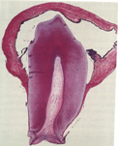
Clinical features:
-This is one of the most common types of developmental odontogenic cyst, estimated to be about 20% of all jaw cysts.
It is estimated that about 10% of impacted teeth have formed
a dentigerous cyst.
The dentigerous cyst nearly always associated
with the crown of a permanent tooth
Seldom is a deciduous tooth involved.

Slide 6
.- A dentigerous cyst may also be found enclosing a complex or compound odontoma or involving impacted supernumerary tooth.
-The most common sites of this cyst are the mandibular and maxillary third molar and maxillary canine areas, since these are the most commonly impacted.
More than twice as common in males as female between the ages of 20 and 50.
- Like other cysts, uncomplicated dentigerous cysts cause no symptoms until the swelling becomes noticeable.

Slide 7
Alternatively a dentigerous cyst may be a chance radiographic finding or found when the cause is sought for a missing tooth.
Cyst is potentially capable of becoming an aggressive lesion.
-Infection of a dentigerous cyst causes the usual symptoms of pain and accelerated swelling.
- Expansion of bone with subsequent facial asymmetry
- Extreme displacement of teeth
- Severe root resorption of adjacent teeth as well as expansion of the cortical plate due to the pressure exerted by the lesion

Slide 8
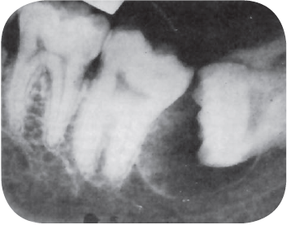

Radiographical features:
- The dentigerous cyst is usually a smooth, unilocular lesion, but occasionally multilocular appearance may occur, contains the crown of a tooth displaced from its normal position
- The slow growth of dentigerous cysts usually results in a sclerotic bony outline and a well-defined cortex.
Radiolucent area associated with the crown of impacted tooth.

Slide 9
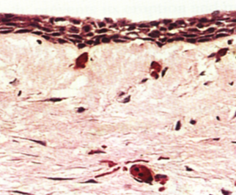
Histopathological features:
It is usually composed of a thin connective tissue wall with a thin layer (2-3 cell layer) of stratified squamous epithelium lining the lumen
Rete peg formation is generally absent except in cases that are secondarily infected.
Mucus-secreting cells in the lining are
also seen.
Dentigerous cyst lined by a thin layer of stratified squamous epithelium.

Slide 10
Connective tissue wall of dentigerous cysts contain varying numbers of islands of odontogenic epithelium.
The content of the cyst lumen is usually thin watery yellow fluid.
- Several relatively serious potential complications exist stemming from the dentigerous cyst, besides simply the possibility of recurrence following incomplete surgical removal. These include:

Slide 11
The development of an ameloblastoma either from the lining epithelium or from rests of odontogenic epithelium in the wall of the cyst
The development of epidermoid carcinoma from the same two sources of epithelium
And the development of a mucoepidermoid carcinoma, from the lining epithelium of the dentigerous cyst which contains mucus secreting cells.

Slide 12
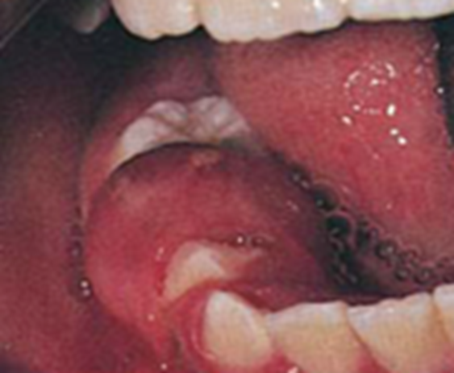
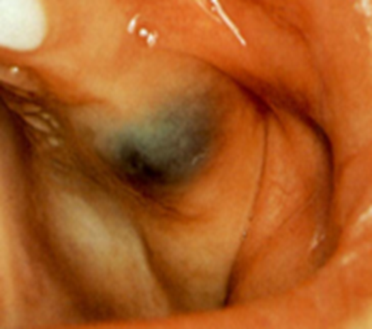
ERUPTION CYST: defined as an odontogenic cyst with the histologic features of a dentigerous cyst that surrounds a tooth crown that has erupted through bone but not soft tissue.
Clinical features: - It is usually painless unless infected.
-Found in children of different ages, and occasionally in adults if there is delayed eruption. When cystic cavity contains blood, the swelling appears deep blue; hence the term ‘eruption hematoma.

Slide 13
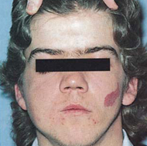
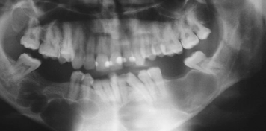

ODONTOGENIC KERATOCYST:
-There is general agreement that the origin of the odontogenic keratocyst comes from dental lamina remnants in the mandible and maxilla or, as originally believed, from the enamel organ before tooth formation.
- Multiple keratocysts behave aggressively and can recur, and can be associated with the nevoid basal cell carcinoma syndrome (Gorlin's syndrome)

Slide 14
Clinical features:
-The cyst may occur at any age with peak incidence is in the second and third decades of life.
- There is a predilection for occurrence in males.
The most common site is the third molar area.
The expansion of the jaw is much less than the radiographic extent of the cyst, hence clinical signs often fails to appear until the cyst is well advanced.

Slide 15
Keratocysts, like other jaw cysts, are symptomless until the bone is expanded or they become infected.
Among the more common features are pain, soft-tissue swelling and expansion of bone, and various neurologic manifestations such as paresthesia of the lip or teeth.

Slide 16
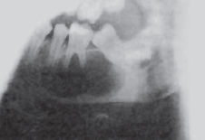
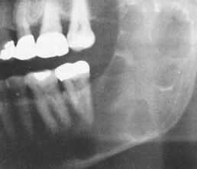

Radiographic features:
Radiographically most OKCs are unilocular, presenting a well-defined peripheral rim.
Scalloping of the border is also a frequent finding.
Multilocular radiolucent OKC is also observed

Slide 17
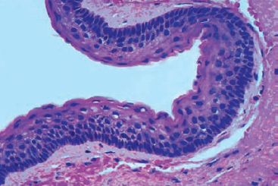
Histopathological features:
The odontogenic keratocyst wall is usually thin unless there has been superimposed inflammation.
These cysts are formed with a stratified squamous epithelium with a remarkable uniformity of thickness of the epithelium, usually ranging from 6 to 10 cells thick with prominent palisaded basal layer
Parakeratinised odontogenic keratocyst, the epithelial lining with elongated palisaded basal cells

Slide 18
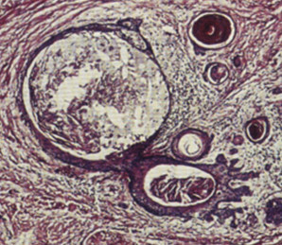
-The mitotic activity of this epithelium is frequent.
-The epithelium which is typically corrugated or wrinkled produces orthokeratin, parakeratin, or both types of keratin.
- No rete ridges are present; therefore, the epithelium often sloughs from the connective tissue.
The connective tissue wall often shows small islands of epithelium similar to the lining epithelium; some of these islands may be small cysts (daughter cyst).
Satellite cyst.

Slide 19
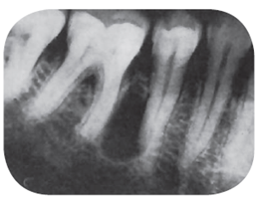
LATERAL PERIODONTAL CYST:
- These uncommon intraosseous cysts are form beside a vital tooth
occurs chiefly in adults, mostly in the mandibular bicuspid/cuspid/incisor area,
slowly growing, nonexpansile developmental odontogenic cyst derived from rests of the dental lamina, usually seen by chance in routine radiographs
They cause no symptoms unless they
erode through the bone to extend into the
gingiva.

Slide 20
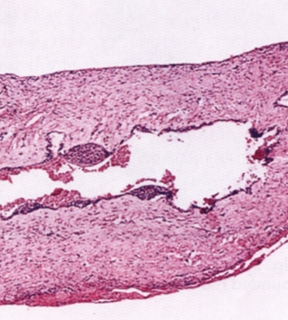
Microscopically, the lining is squamous or cuboidal epithelium, frequently only one or two cells thick, but sometimes with focal thickenings.
The cyst should be enucleated and the related tooth can be retained if healthy.

Slide 21
CALCIFYING EPITHELIAL ODONTOGENIC CYST (Gorlin’s cyst):
Develops from the reduced enamel epithelial cells or remnant of odontogenic epithelium in the dental follicle.
The calcifying odontogenic cyst is a benign neoplasm but has a malignant variant.

Slide 22
Clinically,
- Almost second decade of life, both sexes and either jaws can be affected.
The site is most often anterior to the mandibular first molar.
The cyst presents a boney hard swelling, and may become extensive causing expansion and distortion of cortical plate and displacement of teeth.

Slide 23
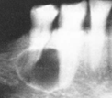
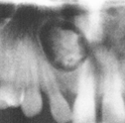
Radiographic features: The appearance is usually unilocular cystic lesion but it may be multilocular or contain areas of calcification
.Occasionally roots of adjacent teeth are eroded.
(A) radiolucent (B ) mixed.

Slide 24
Histopathological features:
Cystic cavity lined by an odontogenic keratinized epithelium with ameloblast-like basal cells.
This epithelium is sometimes thick and can contain areas resembling stellate reticulum.
-The most conspicuous feature is abnormal keratinization producing areas of swollen, eosinophilic cells devoid of nuclei . which become progressively paler, leaving only their outlines (ghost cells).
-The ghost cells typically calcify in patchy fashion.

Slide 25
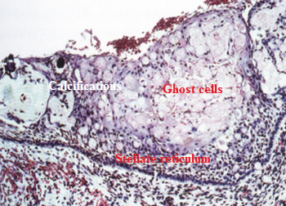
Approximately 10% of calcifying odontogenic cysts are associated with odontomas or other odontogenic tumors.
-The behavior of a calcifying odontogenic cyst is similar to that of a non-neoplastic cyst, overlying bone is only occasionally eroded and enucleation is usually effective.
Microscopic features of Gorlin’s cyst reveal thick epithelial lining contain a palisaded columnar basal cells and ghost cells.

Slide 26
NON-ODONTOGENIC
DEVELOPMENTAL CYSTS
L24

Slide 27
NASOPALATINE DUCT CYST (incisive canal cyst):
A few epithelial cells lying along the line of the nasopalatine duct sometimes persist and can give rise to nasopalatine duct cysts which form in the midline of the anterior maxilla.
Nasopalatine duct cysts are slow-growing and if allowed to grow sufficiently large, nasopalatine cysts may cause a swelling in the midline of the anterior part of the palate.

Slide 28
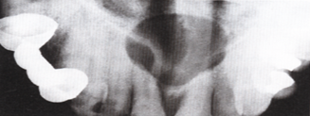
. Radiography shows a rounded radiolucent area with a well defined often sclerotic margin in the anterior part of the midline of the maxilla causing displacement of teeth.
They occasionally appear heart shaped because of radiographic superimposition of the nasal spine

Slide 29
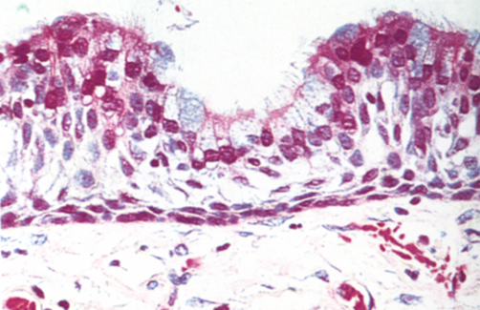
Microscopically the cyst contains epithelial lining which is either stratified squamous epithelium or ciliated columnar (respiratory) epithelium or both together with connective tissue walls.
Nasopalatine duct cysts should be enucleated.
Recurrence is unlikely

Slide 30
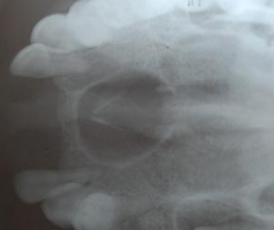
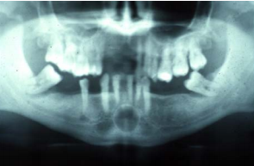
MEDIAN PALATINE AND MEDIAN MANDIBULAR CYSTS: Some authors consider its origin from epithelial inclusions trapped in the mid line during embryonic development
MEDIAN PALATINE MEDIAN MANDIBULAR CYSTS

Slide 31
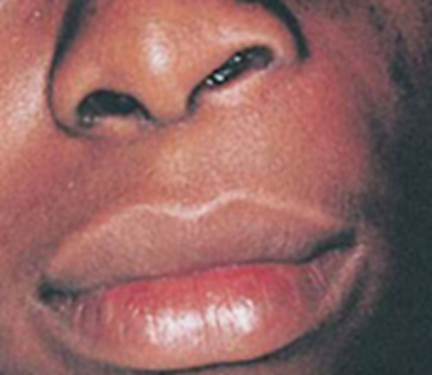
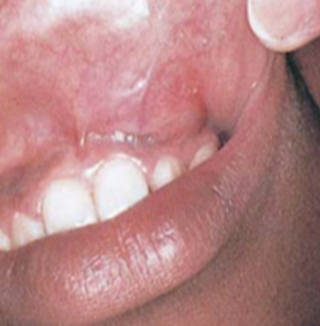
NASOLABIAL CYST:
-It forms outside the bone in the soft tissues below the ala of the nose.
-It may produce a painless swelling of the upper lip which often obliterates the nasolabial fold.
The lesion does not exhibit any radiographic changes; however some produce superficial resorption of the underlying bone.

Slide 32
GLOBULOMAXILLARY CYST:
Developmental fissural cyst that arises in the bone suture between the maxilla and premaxilla
Occur due to proliferation of sequestered epithelium along the line of fusion of embryonic processes.
Usually painless, but it may cause pain, and elevation of the lip.
In many cases appear bilateral

Slide 33
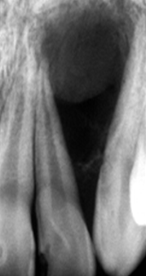
Radiograph reveals an inverted pear shaped radiolucent area between the roots of maxillary lateral incisor and canine causing divergence of the roots.

Slide 34
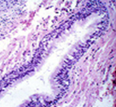
The cystic cavity lined by thin squamous or respiratory epithelium which is supported by connective tissue capsule which may contain inflammatory cells.
I

Slide 35
NON-EPITHELIAL CYSTS (pseudo cysts)
SOLITARY BONE CYST: (simple bone cyst, traumatic bone cyst, hemorrhagic bone cyst):
- It is an uncommon non epithelial lined cystic lesion.
- Trauma has been suggested as the etiology, leading to intra boney hemorrhage, and if the clot does not organized, the liquefaction occurs to the clot, and intra boney cavity formed.
.

Slide 36
Clinical features:
- Mainly diagnosed in young patients most frequently during the second decade of life .More common in males
Majority of them are located in the mandibular body between the canine and the third molar.
The lesion is asymptomatic in the majority of cases and is often accidentally discovered on routine radiological examination.
Some are associated with pain and boney swelling of the jaw. Paresthesia of the lip, expansion of cortical plate and displacement of regional teeth are common.

Slide 37
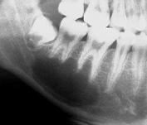
Radiographic feature: Usually appear as a unilocular radiolucent area with a scalloped superior border spreading between the roots of vital teeth .

Slide 38
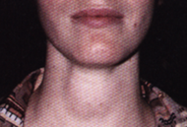
CYSTS OF SOFT TISSUES (mouth, face and neck)
THYROGLOSSAL DUCT CYST:
-This cyst is a developmental cyst arising from the embryonic remnants of the thyroglossal tract
-It develops in the midline of the neck anywhere between the base of the tongue and the thyroid gland.

Slide 39
Clinical features:
Most often occurs before age 20, but may be found in the older population as well.
Thyroglossal duct cysts most often present with a palpable asymptomatic midline neck mass at or below the level of the hyoid bone.
These cysts can occur within the tongue and cause dysphagia.
The neck mass moves with swallowing.
Some patients will have neck pain when secondary infected.

Slide 40
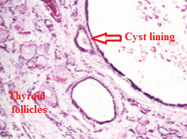
Histopathological features:
-The thyroglossal tract cyst may be lined by stratified squamous epithelium, ciliated columnar epithelium, or a mixture of any of these epithelial types.
-The connective tissue wall of the cyst will frequently contain small patches of lymphoid tissue, thyroid tissue, and mucous glands

Slide 41
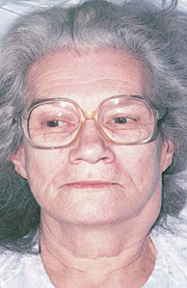
LYMPHOEPITHELIAL CYST (Branchial cleft cyst):
It is probably derived from epithelium entrapped within lymphoid tissues of the neck during embryonic development of branchial clefts. Clinical features:
- Present in the lateral aspect of the neck anterior to the sternomastoid muscle, and involve the floor of the mouth in 50% of cases.

Slide 42
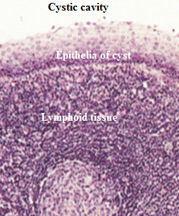
Histopathological features:
-The lesion consists of a cystic cavity lined by thin stratified squamous epithelium.
The cyst connective tissue being infiltrated by large number of lymphocytes, plasma cells and macrophages.
The lymphoid tissue sometimes typically exhibits follicle of the lymph node pattern

Slide 43
CYSTS OF SALIVARY GLANDS
MUCOCELE: The most common type of salivary soft tissue cyst is the mucocele.
-Mucoceles mainly affect the minor salivary glands, particularly of the lip.
- Preceding the formation of extravasation mucocele, saliva leaking from a damaged duct due to trauma into the superficial surrounding tissues to form a collection of fluid surrounded by compressed connective tissue without an epithelial lining.

Slide 44
- Less frequently, the duct may become obstructed by calculus or scarring, or due to the presence of atresia, so that saliva does not escape into the surrounding tissues, a retention mucocele thus forms with a lining of compressed duct epithelium.
- A small superficial mucocele should be excised with the underlying gland.

Slide 45
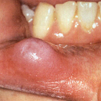
Clinical features:
-They are either superficial and appear bluish, or deep and appear as a diffuse swelling with no color changes.
-It is rarely larger than 1 cm in diameter.
Mostly affect the lower lip, although the cheek, palate and tongue are frequently affected.
In the early stages they appear as rounded fleshy swellings.
later, they are obviously cystic,
and fluctuant and the size of the
cyst increase during meal time.

Slide 46


Histopathological features:
-Mucous extravasation cyst present as a cystic cavity within a connective tissue stroma, filled with mucus and the lining epithelium is absent.
While the mucous retention cyst presents a small cystic cavity which is filled by mucus and lined by flattened epithelial cells of the salivary gland duct.
The connective tissue of these
cysts may contain inflammatory cells.

Slide 47
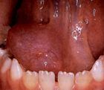
RANULA:
A salivary cyst arising from the sublingual or submandibular salivary glands, either extravasation (without epithelium) or retention cyst (with epithelium).
- Ranula is usually unilateral and 2 or 3 cm in diameter.
Occasionally they extend across the whole of the floor of the mouth
-They are soft, fluctuant and bluish if it is superficial.
-They are typically painless but may
interfere with speech or mastication.
Ranula in the floor of mouth caused either by
mucous extravasation or mucous retention.

