Slide 1
Tishk International University
Pharmacy Faculty
Pharmacy Department
Pharmaceutics II
Semisolid Dosage Form (I)
3rd Grade- Spring Semester 2023-2024
Instructor: Dr. Rozhan Arif

Slide 2
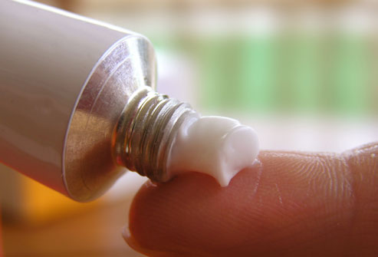
Definition
Pharmaceutical semisolid preparations may be defined as topical products intended for application on the skin or accessible mucous membranes to provide localized and sometimes systemic effects at the site of application.

Slide 3
In general, semisolid dosage forms are complex formulations having complex structural elements.
They are often composed of two phases, one of which is a continuous (external) phase and the other a dispersed (internal) phase.
The active ingredient is often dissolved in one or both phases, thus creating a three-phase system.

Slide 4
I. SKIN
In treating skin diseases, the drug in a medicated application should penetrate and be retained in the skin for a period of time.
Drug penetration into skin depends on a number of factors including
the physicochemical properties of the medicinal substance,
the characteristics of the pharmaceutical vehicle,
the condition of skin itself.

Slide 5
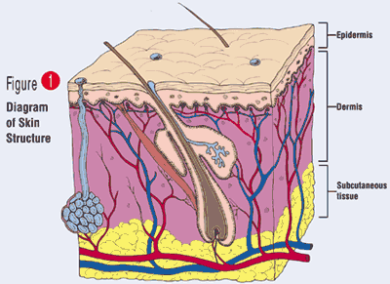
The skin is divided histologically into the
the stratum corneum (the outer layer),
the living epidermis,
the dermis.

Slide 6
Blood capillaries and nerve fibers rise from the subcutaneous fat tissue into the dermis and subcutaneous layers rise to the skin’s surface.
Sebaceous glands, sweat glands, and hair follicles originating in the dermis and subcutaneous layers rise to the skin’s surface.

Slide 7
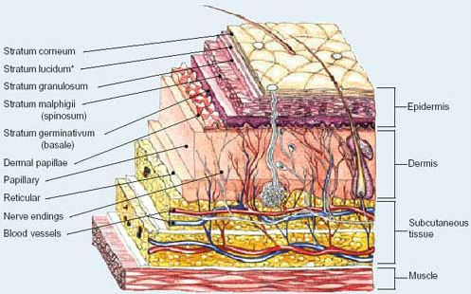

Slide 8
Sublayers of epidermis
Epidermis is divided into the following 5 sublayers or strata:
Stratum corneum
Stratum lucidum
Stratum granulosum
Stratum spinosum
Stratum germinativum (also called "stratum basale").
Blood capillaries are found beneath the epidermis, and are linked to an arteriole and a venule.

Slide 9
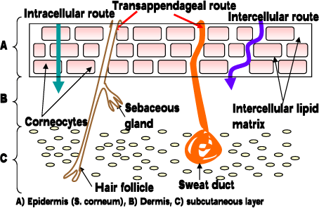
Possible Routes of Skin Penetration
Drugs can penetrate skin barrier by three routes:
-Transcellular (across cells)
-Intercellular (between cells)
-Transappendageal (via hair follicles, sweat and sebum glands)
Percutaneous drug absorption results from direct penetration through the stratum corneum, followed by passing through the epidermal tissues and into the dermis.

Slide 10
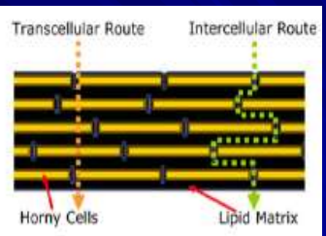
Rrepresentation of the stratum corneum membrane, illustrating two possible micro routes for permeation. (1) Intercellular (2) transcellular

Slide 11
Generally, drug absorption into the skin occurs by passive diffusion.
The rate of drug transport across the stratum corneum follows Fick's Law of Diffusion,

Slide 12
Transport of lipophilic drug molecules is facilitated by their dissolution into intercellular lipids around the cells of the stratum corneum.
• Absorption of hydrophilic molecules into skin can occur through pores or openings of the hair follicles and sebaceous glands, but the relative surface area of these openings is barely 1% of the total skin surface.
• This small surface area limits the amount of drug absorption.

Slide 13
The film covering the stratum corneum varies in composition, thickness, and continuity as a result of differences in the proportion of sebum and sweat produced and the extent of their removal through washing and sweat evaporation.
It offers little resistance to drug penetration.
Hair follicles and gland ducts can provide entry for drug molecules, but because their relative surface area is so minute compared to the total epidermis, they are minor factors in drug absorption.

Slide 14
The rate of drug movement across the skin layer depends on
the drug concentration in the vehicle,
its aqueous solubility,
the oil/water partition coefficient between the stratum corneum and the product’s vehicle.
Substances that possess both aqueous and lipid solubility characteristics are good candidates for diffusion through the stratum corneum.

Slide 15
Medicated semisolid preparation
Non-medicated semisolid preparations: are used for their physical effects as protectants and lubricants.

Slide 16
Most of the semisolid preparations are applied to the skin for topical relief of dermatologic conditions, whereas a smaller portion of these preparations are applied to mucous membranes such as rectal and buccal tissue, vaginal mucosa, urethral membrane, external ear lining, nasal mucosa, and cornea.
Whereas normal skin permeation is limited to localized effects, the mucous membranes permit more ready access to systemic circulation.

Slide 18
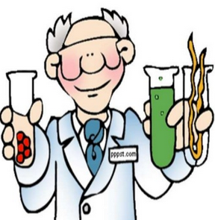
IDEAL PROPERTIES OF SEMISOLID DOSAGE FORMS:
PHYSICAL PROPERTIES:
a)Smooth texture
b)Elegant in appearance
c)Non dehydrating
d)Non gritty
e)Non greasy and non staining
f)Non hygroscopic
g)Non irritating
h)Do not alter membrane / skin functioning
i)Miscible with skin secretion
j)Have low sensitization Index

Slide 19
Advantages
The major advantages of semisolid dosage forms include
their demonstrated ability to readily incorporate a wide variety of hydrophilic and hydrophobic drugs
to reduce the undesirable effects arising from the systemic metabolism, and to minimize unnecessary fluctuations in drug concentration, which in turn will significantly enhance the efficacy of the incorporated drug.

Slide 20
Ointments
Ointments are semisolid preparation intended for external application to the skin or mucous membranes.
Ointments may be medicated or non-medicated ointments. Ointment bases, as described may be used for their physical effects as protectants, emollients or lubricants or as vehicles in the preparation of medicated ointments.

Slide 21
Ointments are greasy or fatty semisolid preparations.
• they are occlusive bases and suitable for dry lesions.
to improve the spreadability of the formulation, they may contain some excipients (cetostearyl alcohol, silicon, dimethicon).
The solubility can be increased with the addition of hydrocarbon miscible solvents like propylene glycol.
Drug release behavior can be affected from the slight variations of the constituents emollient and protective functions because of their highly occlusive nature (Increased skin hydration, increased release).
Many ointments are prepared from mixtures of hydrocarbons, such as paraffin with various grades and qualities.

Slide 22
Ingredients used in preparation of semisolids
Ingredients used for formulating semisolids include;
Active Pharmaceutical Ingredients (API),
Bases,
Antimicrobial preservative,
Chelating agents, Humectants, fragrances.

Slide 23
Ointment Base
1) Oleaginous (hydrocarbon) bases
2) Absorption bases
3) Water-removable bases (Emulsion bases )
4) water-soluble bases.

Slide 24
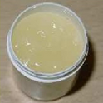
Hydrocarbon Bases
Hydrocarbon bases are also termed oleaginous base, on application to the skin, they have an emollient effect, protect against the escape of moisture, and effective as occlusive dressings, can remain on the skin for prolonged periods of time with-out drying out,
Because of their immiscibility with water are difficult to wash off. Petrolatum, white ointment, white Petrolatum, and yellow Ointment are examples of hydrocarbon base

Slide 25
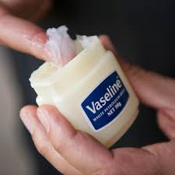
Oleaginous (hydrocarbon) bases -
These bases are:
- Immiscible with water (they are difficult to wash off)
- Not absorbed by the skin, remain on the skin for
prolonged period of time without “drying out”
- Absorb very little water from formulation or from
skin exudates.
- Inhibit water loss from the skin by forming a water
proof film (OCCLUSIVE DRESSING).
- Improving hydration, may encourage penetration of
the medication through skin.
Examples: Vaseline, hard paraffin, liquid paraffin,
white ointment
Uses: protectants, emollient, and vehicle for solid
drugs

Slide 26
Occlusive and skin hydration

Slide 27
Petroleum, USP:
Is a purified mixture of semisolid hydrocarbons obtained from petroleum. It is varying in color from yellowish to tight amber. It melts at temperatures between 38 - 60°C and may be used alone or in combination with other agents as an ointment base. Petrolatum is also known as "Yellow Petrolatum" and Petrolatum jelly a commercial product is Vaseline

Slide 28
White Petrolatum, USP:
Is a purified mixture of semisolid hydrocarbons from Petrolatum that has been wholly or nearly decolorized. It is used for the same purpose as Petrolatum, but due to its lighter color it is considered more esthetic by some pharmacists and patients. White Petrolatum is also known as "White Petroleum Jelly." A commercial product is White Vaseline.

Slide 29
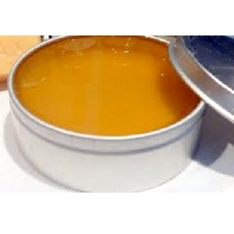
Yellow Ointment, USP
This ointment has the following formula for the preparation of 1000 g:
Yellow Wax 50 g
Petrolatum 950 g
Yellow wax is the purified wax obtained from the honeycomb of the bee. The ointment is prepared by melting the yellow wax on a water bath, adding the petrolatum until the mixture is uniform, then cooling with stirring until congealed. The ointment also has been called "Simple Ointment."
White Ointment, USP
This ointment differs from Yellow Ointment by substituting White Wax (bleached and purified Yellow Wax) and White Petrolatum in the formula.

Slide 30
Mineral oil
α mixture of liquid hydrocarbons obtained from petroleum
These are useful as levigation agents to wet and incorporate solid substances (e.g., salicylic acid, zinc oxide) into the preparation of ointments that consist of oleaginous bases as their vehicle.

