Slide 1
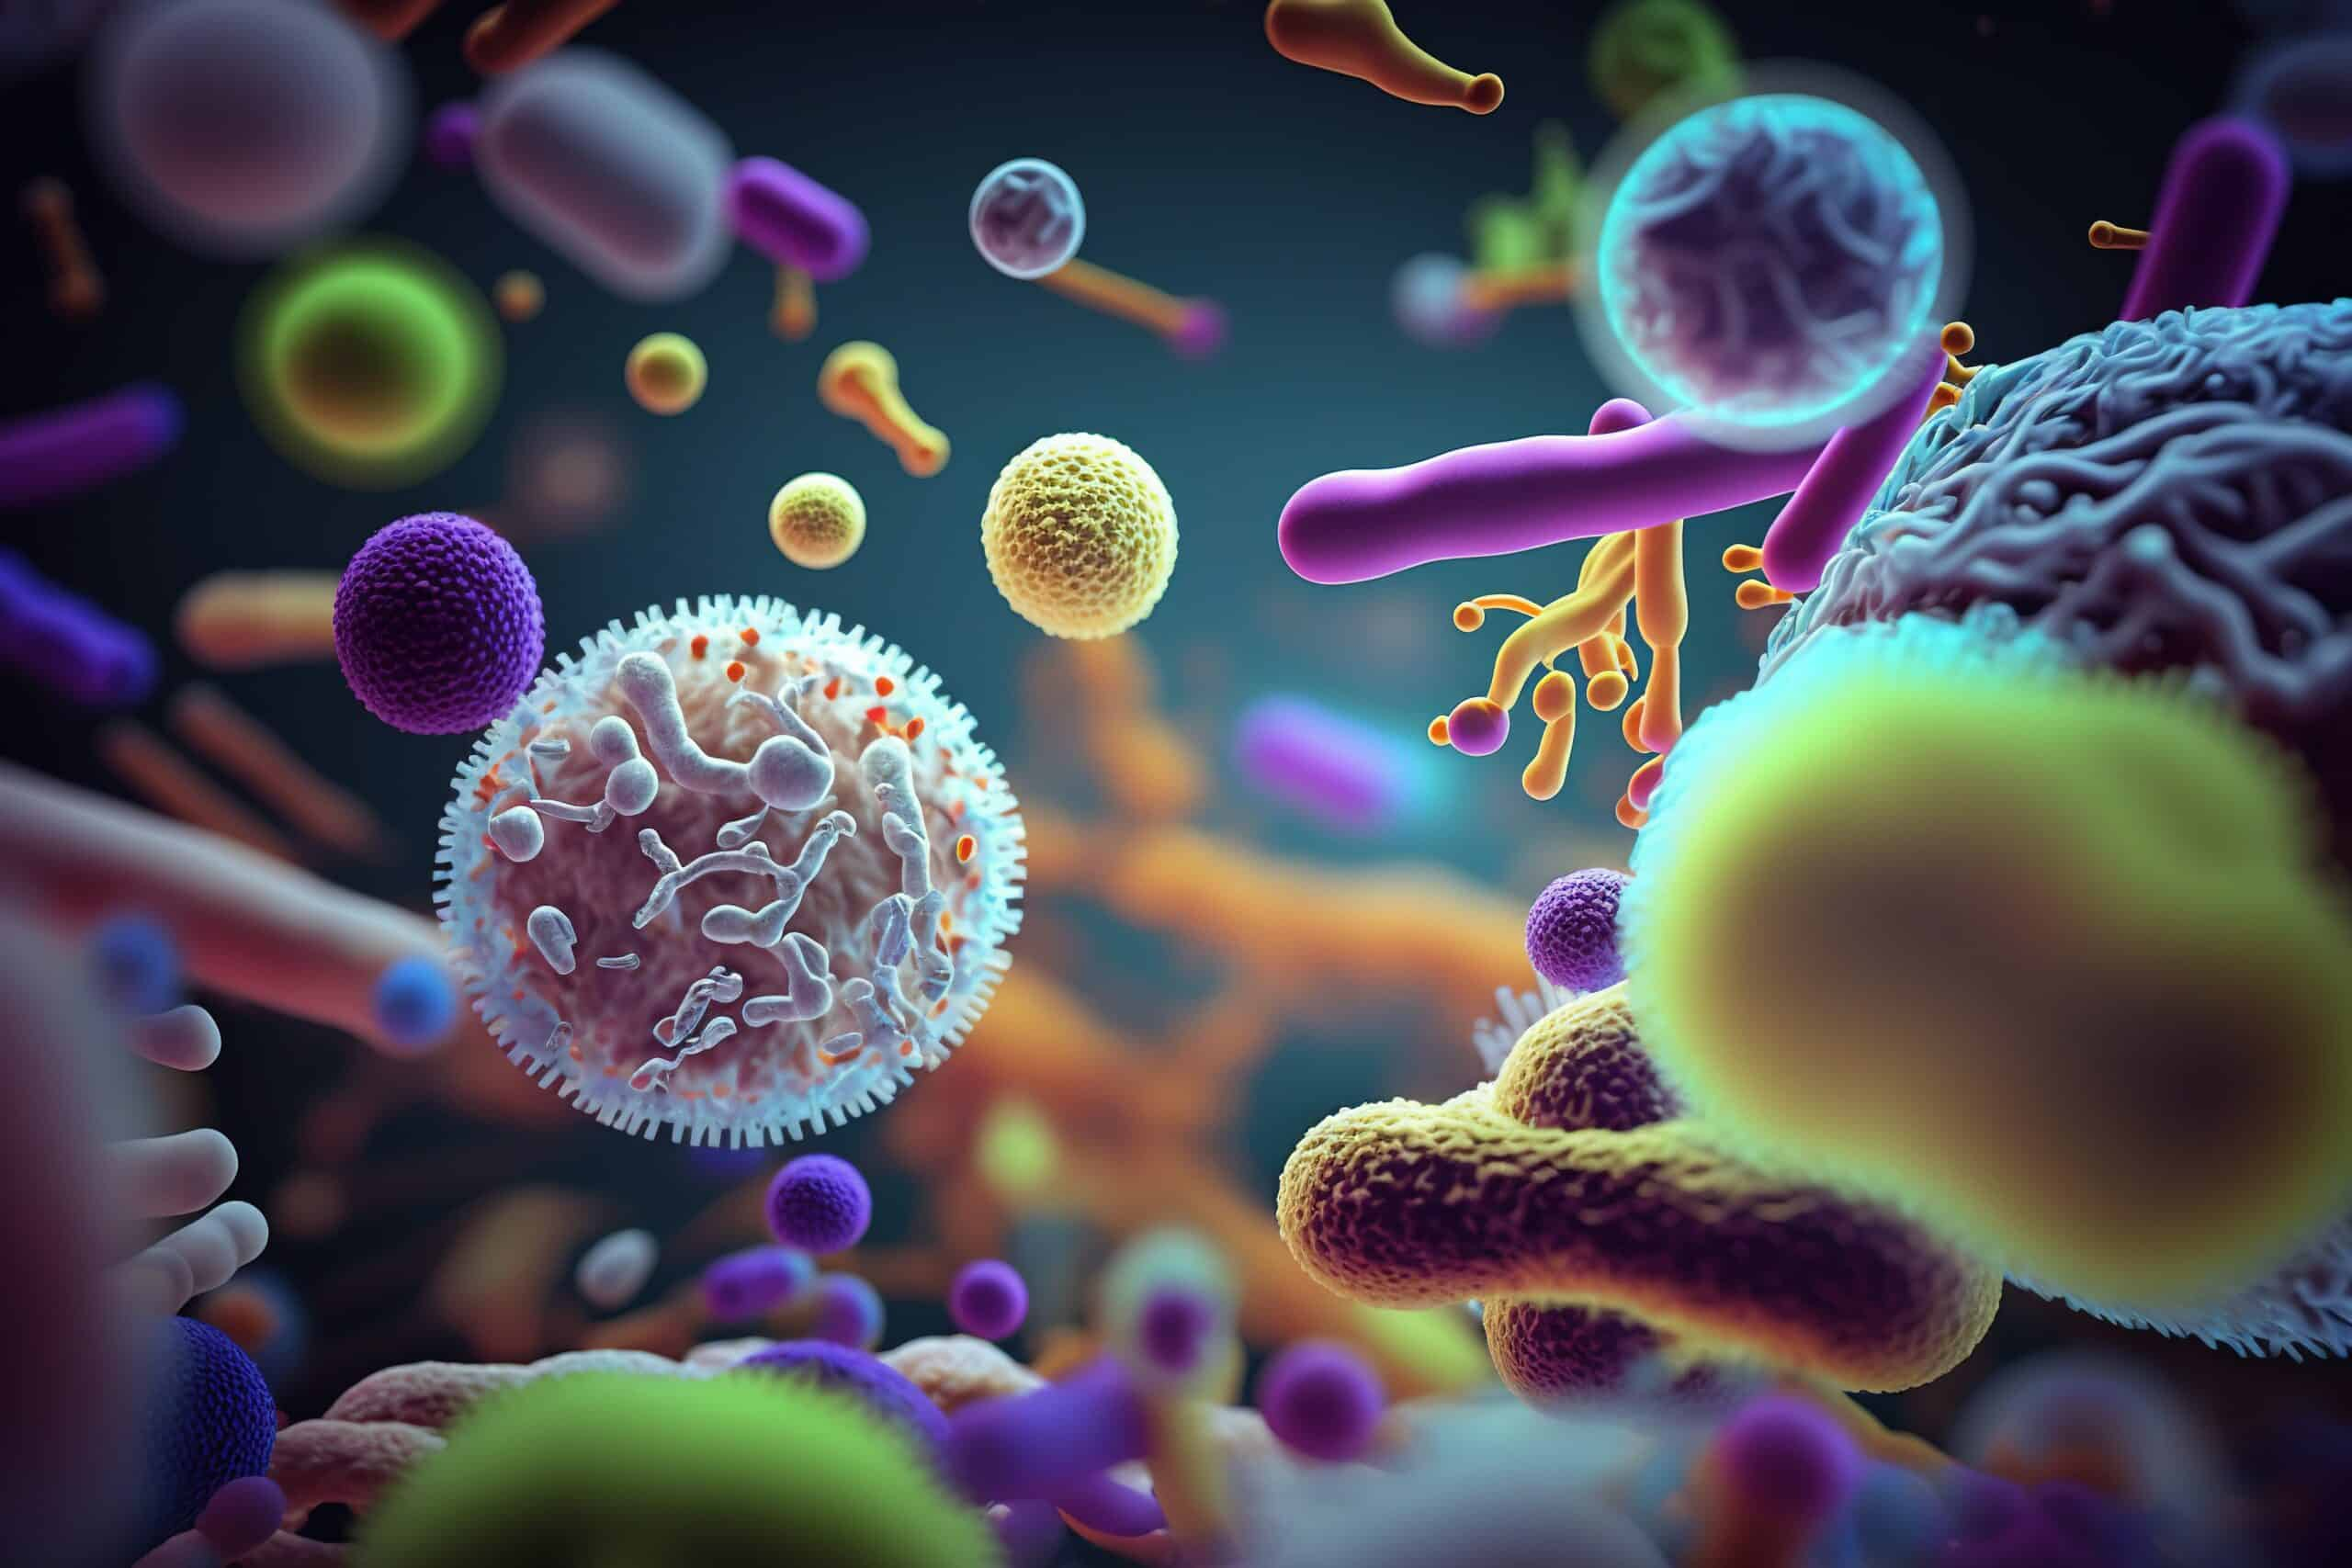
Helicobacter pylori
Ms. Heshu J. Ahmed
PhD Candidate
Medical Bacteriology 423
Spring Semester
Week Ten

Slide 2
Outline
Introduction to Helicobacter pylori
Unique Bacteriologic Features of H. pylori
Epidemiology
Pathogenesis
Clinical Manifestations
Treatment

Slide 3
Objectives
Understand the characteristics and growth requirements of Helicobacter pylori.
Identify unique bacteriologic features of Helicobacter pylori.
Learn about the epidemiology of Helicobacter pylori infection.
Explore the pathogenesis and survival mechanisms of Helicobacter pylori in the stomach.
Recognize the clinical manifestations of Helicobacter pylori infection.
Discuss the treatment options and preventive measures for Helicobacter pylori infection.

Slide 4
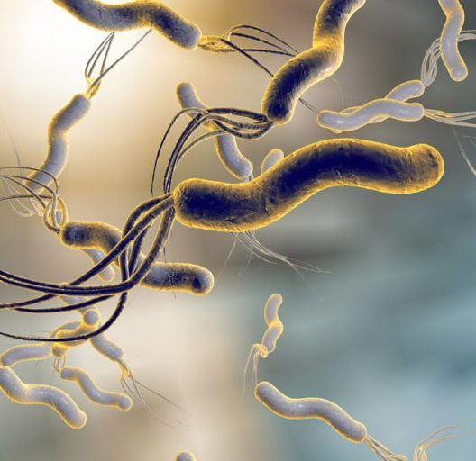
Helicobacter Pylori characteristics
Slender, curved rods with polar flagella.
Typical gram-negative cell wall structure.
Requires a microaerophilic atmosphere for growth.
Slow growth (3-5 days).
Rapidly motile due to multiple polar flagella.

Slide 5
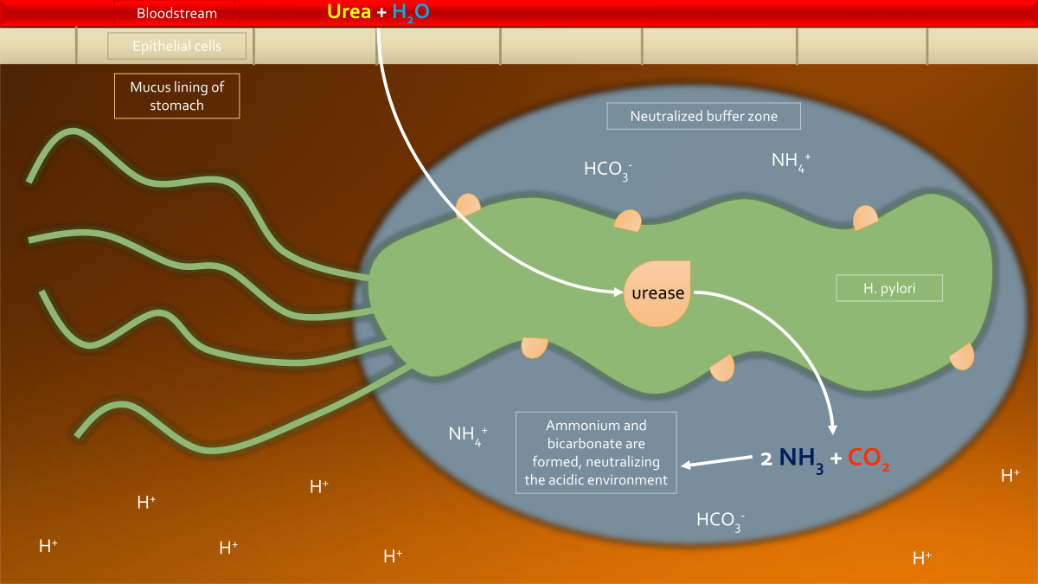
Helicobacter Pylori Unique Bacteriologic Features:
Urease:
Allows persistence in low pH environments by generating ammonia.
High production (6% of bacterial protein).
Demonstrable action within minutes in the presence of urea.

Slide 6
Epidemiology
Infection is transmitted by human fecal or gastric secretions
Gastric colonization is prevalent worldwide
Colonization persists indefinitely
Ethnic links are strong
H pylori is the sole nondrug cause of gastritis and ulcers
Adenocarcinoma and lymphoma are preceded by infection

Slide 7
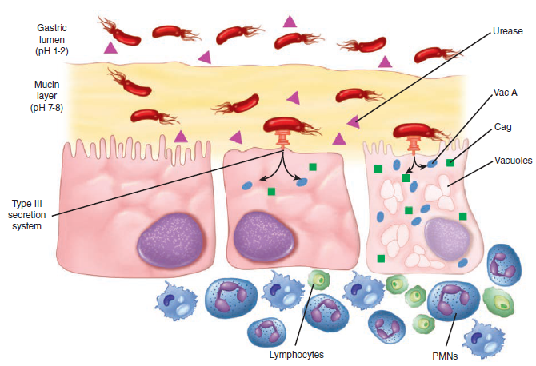
Pathogenesis
Survival Mechanisms in the Stomach:
Adherence to Gastric Mucosa:
Multiple mechanisms used for adherence.
Motility via flagella to reach less acidic area beneath gastric mucus.
Urease production creates a neutral microenvironment by producing ammonia.
Urease activity regulated by changes in gastric acidity (e.g., pH rise after meals).
Colonization and Inflammation:
Gastritis and duodenal ulcers strongly associated with colonization of the antrum area of the stomach.

Slide 8
Manifestations
Primary Infection:
Often silent or causes mild illness.
Symptoms: nausea and upper abdominal pain lasting up to 2 weeks.
Long-term Findings of Gastritis and Peptic Ulcer Disease:
Symptoms: nausea, anorexia, vomiting, epigastric pain.
Less specific symptoms: belching.
Many patients remain asymptomatic for decades.
Complications:
Ulcer perforation.
Extensive bleeding.
Peritonitis from leakage of gastric contents into the peritoneal cavity.

Slide 9
Treatment
H. pylori is susceptible to various antimicrobial agents.
Bismuth Salts:
Have antimicrobial activity (e.g., Pepto-Bismol).
Previously believed to act by coating the stomach.
Effective Treatment Regimens:
Combinations of bismuth salts and/or a proton pump inhibitor plus two antibiotics.
Clarithromycin plus either amoxicillin or metronidazole.
Metronidazole plus tetracycline.
Cure rates approaching 90%.

Slide 10
References
Sherris Medical Microbiology: An Introduction to Infectious Diseases.
Jawetz, Melnick & Adelberg's Medical Microbiology by Geo. F. Brooks, Karen C. Carroll, and Janet S. Butel
Prescott's Microbiology by Joanne Willey, Linda Sherwood, and Christopher J. Woolverton

