Slide 1
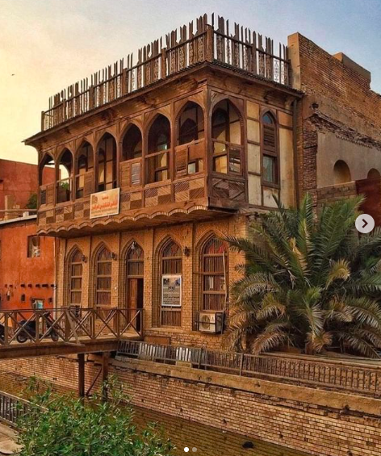
Tishk International University (TIU) Vernacular Architecture​
​
Lecturer : Darbaz Pirot​
2023-2024​
Lecture 5: IRAQI VERNACULAR ARCHITECTURE

Slide 2
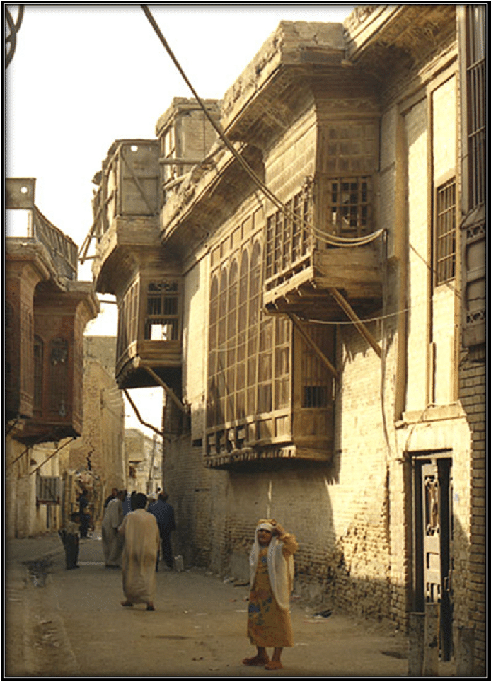
IRAQI VERNACULAR ARCHITECTURE
Vernacular architecture is the traditional way of building that's perfectly adapted with Iraqi environment. In Iraq, where the climate is mainly dry, this style of architecture is evident in several key aspects:
1.Organization of Households: How homes are laid out and structured to maximize comfort in a dry climate.
2.Shape and Size of Buildings: The overall design and dimensions of buildings are fitted to reduce heat inside and make living spaces more comfortable.
3.Functional Design: The specific design features of buildings that make them suitable for their environment, such as spaces and elements that are useful for everyday life.

Slide 3
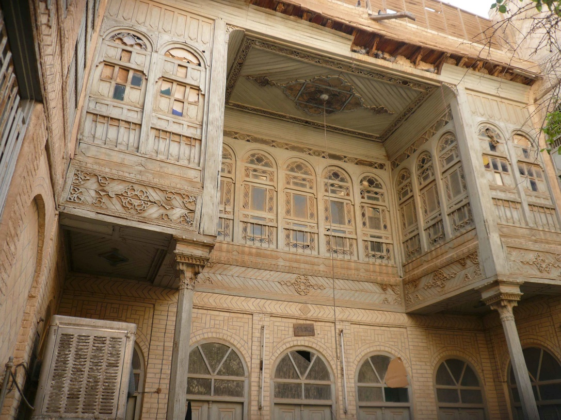
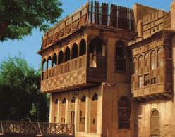
1 Vernacular Architecture and Buildings Specific
A distinctive feature of Iraqi vernacular architecture is the strategic use of shadows. This is achieved through:
Architectural Details and Building Volumes: Structures are designed to cast shadows that cool the buildings, reducing the need for artificial cooling.
Natural Elements: Incorporation of vegetation and water features not only enhances the beauty and functionality of spaces but also contributes to cooling, adding to the unique character of local architecture.
This approach not only ensures buildings are comfortable but also shapes the architectural identity of the region, making these structures iconic representatives of local culture and environmental adaptation.

Slide 4
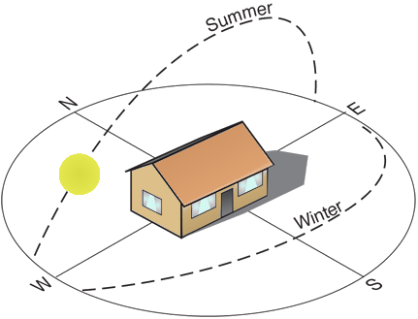
Optimal Orientation for Summer Rooms: In Iraq, rooms oriented north are ideal for summer use, staying cooler by receiving indirect sunlight, which provides light without excessive heat. These rooms are designed with specific depth and width to create shaded areas, crucial for managing intense sunlight. This orientation is fundamental in architectural planning for hot climates, making indoor-outdoor transitions more comfortable.

Slide 5
How People Adapt Their Homes for the Climate:
Daytime in Basements: During the hottest hours of the day, people often use basements. These underground spaces stay cooler because they are insulated from direct sunlight.
Nighttime on the Roof: At night, rooftops become sleeping areas. They are cooler than indoor spaces after sunset, offering relief from the day's heat.
Selective Heating: Only the rooms that are in use are heated, conserving energy and maintaining comfort without overheating the entire home.
These adaptations are practical responses to the arid climate in Iraq, illustrating how traditional architecture and lifestyle work together to enhance living conditions naturally.

Slide 6
THE TYPES OF SPACES WITHIN VERNACULAR ARCHITECTURE IN IRAQ:
Understanding Space Mechanisms in Vernacular Architecture
In Iraq's dry climate, the design of habitat spaces within homes is categorized into three types based on their function and exposure to the environment: Closed Spaces, Intermediary Spaces, and Open Spaces.
2.1.1 Closed Spaces with Thermal Roles: Functional Spaces
In traditional homes, particularly in Basrah which showcases vernacular architecture, functional spaces are critical. These spaces are : Habitable rooms(livable space), guest room, kitchens, bathrooms, storerooms, and basement

Slide 7
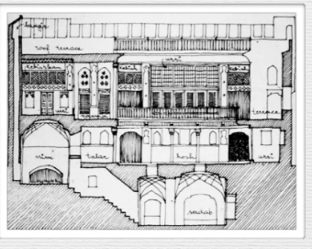
Types of Closed Spaces Include:
- Habitable Rooms: Main living areas used daily.
- Guest Room: Spaces designated for visitors, providing comfort and privacy.
- Kitchens: Designed to handle heat and smells away from living areas.
- Bathrooms: Functional spaces typically isolated from main living areas.
- Storerooms: Used for storing goods and supplies, usually kept separate from living spaces.
- Basement: A crucial cool retreat during the hottest parts of the day, often used as a functional space during peak heat hours.
These spaces are designed to maximize their usefulness while maintaining a comfortable indoor climate, demonstrating the bioclimatic approach of vernacular architecture in managing temperature and providing functional living spaces.

Slide 8
Habitable Rooms in Vernacular Architecture
Habitable rooms in vernacular Iraqi homes are designed with a strong focus on climate adaptability. These rooms are connected to the outside environment in several ways, including direct openings and transitional buffer spaces.
Key Features of Habitable Rooms:
High Ceilings: These allow warm air to rise during the summer, which is then naturally expelled due to the temperature difference between the warmer interior and the cooler outside air, or through specially designed cooler air storage areas.
Window Placement and Size: Windows are small and typically face the inner patio, minimizing direct sunlight while maximizing natural light.
Wall Orientation and Thickness:
North-facing rooms: Thicker walls for summer use, often shaded by plants.
South-facing rooms: Ground-level for winter warmth, using sunlight.
Buildings are designed for temperature control, with deep shadows and air circulation that cool in summer and retain heat in winter, ensuring comfort throughout the year.

Slide 9
B. Guest Room The guest room in traditional Iraqi homes is designed for privacy and accessibility. It is separate from the family's living areas and typically has its own entrance. This setup allows guests to come and go without disrupting the household. Windows in the guest room often face narrow, winding streets and feature decorative wooden jigsaw panels that provide privacy while allowing light and air to enter.
Features of the Guest Room:
Isolated from main living areas for privacy.
Separate entrance for easy access.
Windows with wooden panels overlooking scenic or traditional streetscapes.

Slide 10
C. Kitchens, Bathrooms, and Storerooms are strategically located for efficiency and comfort but are kept separate from main living areas.
Kitchens: are placed deep inside the home to contain heat and odors and face north to use prevailing winds for ventilation. A buffer zone links them to the yard, improving functionality and circulation.
Bathrooms and Storerooms: are isolated like kitchens, with street-facing windows to enhance ventilation without sacrificing privacy. Their design prioritizes practicality and ease of access.
These design choices show careful planning in the placement and orientation of house spaces, ensuring efficiency and contributing to overall home comfort and functionality.

Slide 11
D. Basement: In traditional Iraqi architecture, the basement plays a critical role in managing indoor climate, particularly in arid regions. This underground space utilizes the earth's natural cooling properties to maintain a lower temperature than the above-ground areas.
Key Features of the Basement:
Thermal Inertia: The basement leverages the ground’s ability to absorb and retain cool temperatures, serving as a natural air conditioning system.
Structural Design: Basements are often vaulted and may feature decorative elements. They are typically constructed from burnt brick, which enhances their durability and thermal properties.
Air Flow Connection: A unique feature is the basement's connection to the terrace via a structure called a Bagdir (wind tower), which exploits the difference in air pressure between the high terrace and the lower basement. This design creates a cool air flow that naturally ventilates the space.
The design of the basement in traditional Iraqi architecture demonstrates how local building methods effectively address the region's hot climate, making it a functional and comfortable retreat during peak heat.

Slide 12
2.1.2 Intermediary Spaces with Thermal Role
Intermediary spaces in vernacular architecture serve as transitional zones that bridge the interior (inside) and the exterior (outside) environments of a building. These spaces are crucial for adapting to the local climate by moderating temperatures and airflow, thereby creating a comfortable living environment.
A. Loggia A loggia is a type of intermediary space that is deeper than standard galleries, playing a significant role in climate control within the building.
Key Features of the Loggia:
Shade and Shelter: The loggia is designed to provide shade and reduce the impact of direct sunlight and strong winds, making it an effective buffer zone that enhances indoor comfort.
Construction: It is often enclosed with tracery made from rectangular wooden panels, which adds an aesthetic element while also filtering light and air.
Functionality: This space is typically used for hosting guests, allowing them to enjoy outdoor views and breezes in a protected setting.
By integrating such spaces, vernacular architecture cleverly manages the harsh climatic conditions, ensuring that both indoor and outdoor areas are optimally utilized and comfortable throughout the year.

Slide 13
B. Gallery
In traditional Iraqi homes, the gallery serves as a crucial intermediary space that enhances the functionality and comfort of the dwelling. Positioned around patios, it acts as an open corridor that facilitates movement and provides transitional space between the interior and the exterior.
Key Features of the Gallery:
Structure and Location: Typically, galleries are open corridors with a roof or porch that wraps around the patio. This design allows for easy movement around the house while offering protection from the elements.
Protective Role: By shielding the doors, windows, and even the external walls from direct exposure to the sun and weather, the gallery helps to maintain the structural integrity and comfort of the home.
Usage: Besides being a passageway, the gallery often becomes a place for relaxation or social interaction, offering views of the courtyard and access to fresh air.
The gallery's strategic design and placement make it an integral part of managing the harsh climatic conditions typical of hot climates, thereby enhancing the livability and sustainability of traditional structures.

Slide 14
2.1.3 Open Spaces with Thermal Role: Patio (Courtyard)
The patio, or courtyard, is a central feature of traditional Iraqi dwellings, playing a critical role in creating a comfortable microclimate within the home.
Key Features of the Patio:
Microclimate Creation: The patio serves as an open but enclosed space that helps control indoor temperature, cooling the air through natural elements like water pools, fountains, and vegetation.
Thermal Efficiency: Water pools in the patio absorb heat during the day and release it slowly at night, maintaining a consistent temperature and making the area comfortable all day and night
Design Variations: In multi-level houses, patios may be shaded with grids or lightweight tarpaulins on bars, called Rawak, to provide shade and improve airflow, enhancing temperature control.
What is a Rawak?
A Rawak is an open corridor or covered area that helps manage the local microclimate. It acts as a buffer zone, shielding from direct sunlight while promoting air movement, thereby enhancing environmental comfort around and within the house.
This thoughtful integration of the patio into the house design demonstrates how traditional Iraqi architecture utilizes natural elements and strategic design to create sustainable, livable spaces suited to the local climate.

Slide 15
B. Terrace: Terraces are vital features in houses located in arid zones, serving multiple roles that contribute to the comfort and functionality of the home.
They come in two primary types:
B1. Front Terrace: Function and Atmosphere: The front terrace is designed to reduce the temperature around the entry area and create a welcoming, enjoyable atmosphere.
Cooling Features: This space often includes shade from trees and climbing plants that naturally cool the area. Alternatively, it may be covered with a light fabric canvas to provide shade without trapping heat, enhancing the cooling effect.
B2. Roof Terrace: Design and Usage: The roof terrace is enclosed by walls ranging from 1.8 to 2.2 meters high, which provide necessary shading. This type of terrace is especially useful during the night.
Nighttime Function: The roof terrace, due to its elevated position and wall cooling, is often used as a sleeping area on hot nights, providing a cooler alternative to indoor spaces.
Both types of terraces are key in managing indoor temperatures and adding living spaces suited to local climates, improving livability in arid regions.

Slide 16
C. Iwan: The Iwan is a hallmark of traditional architecture from Mesopotamia, serving as a unique and functional intermediary space within the home.
Key Features of the Iwan:
Design and Structure: Typically, an Iwan appears as a square-shaped room that is open on one side. This open side usually faces a patio, creating a seamless connection between indoor and outdoor spaces.
Location and Orientation: It is strategically oriented towards the north, which minimizes sun exposure, making the Iwan a cool and shaded area within the house.
Enhancements: Often, the Iwan may be enhanced with architectural elements like arches or a cupola-terrace above, adding to its aesthetic and functional attributes.
Usage: This space is commonly equipped with water features such as pools or fountains, which contribute to its cooling effect. The Iwan is ideal for receiving guests, thanks to its open, airy, and inviting environment.
The Iwan’s design is not only about aesthetic appeal but also about its practical role in climate control, making it an essential element in the traditional dwellings of hot, arid regions like Iraq.

Slide 17
2.2 Architectural Elements with Thermal Role: Wind Tower (Bagdir)
What are Wind Towers? are architectural structures designed to boost natural ventilation in buildings. They act as vertical air ducts with internal channels linking the exterior to the interior spaces of a dwelling.
How Do Wind Towers Work?
Principle of Operation: The basic function of a wind tower relies on temperature and pressure differences between the inside and outside of a building, creating a "thermal depression" that pulls air through the tower.
Air Movement: During the day, the wind tower absorbs heat from passing air, with warmer air moving down along the cooler tower walls. At night, this process reverses, as cooled air inside the tower draws up warmer indoor air, facilitating continuous circulation.
Ventilation Control: The flow of air can be adjusted by opening or closing the ventilation doors within the tower, allowing for customizable climate control within the home.
Wind towers are an ingenious solution for hot climates, offering natural cooling and ventilation to improve indoor comfort without electrical air conditioning. This traditional, environmentally friendly method relies solely on natural air movements and thermal dynamics.

Slide 18
Functions of a Wind Tower (Bagdir)
Primary Functions:
Dust and Sand Filtration: The wind tower is particularly effective at reducing the volume of sand and dust brought in by prevailing winds, which is a common challenge in arid regions.
Climate Control: The Bagdir harnesses summer breezes to naturally cool interior spaces. In winter, it can be closed to retain warmth, demonstrating versatility across different seasons.
2.2.2 Ventilation Gaps
Purpose and Design:
Ventilation and Lighting: Ventilation gaps are strategically placed openings at the upper parts of houses. They are often enhanced with a grid or screen that is both functional and decorative.
Air and Light Flow: These gaps allow for the passage of air and light, helping to improve the indoor environmental quality by ensuring natural light access and adequate air circulation.
Aesthetic Element:The grids or screens in these gaps are often crafted with intricate designs, providing visual appeal while serving their practical functions.
Wind towers and ventilation gaps are key elements of traditional Iraqi architecture, designed to create comfortable living conditions naturally. These features demonstrate a sophisticated understanding of environmental adaptation in vernacular architecture.

Slide 19
2.2.3 Shanashil
What is Shanashil? Shanashil refers to an ornamental element commonly found in traditional Iraqi architecture, characterized by intricate wooden lattices or screens made from small pieces of wood assembled like a jigsaw.
Functions and Benefits:
Ventilation and Lighting: The design of shanashil allows for natural ventilation and lighting to filter into the interior spaces, maintaining a comfortable indoor environment without the use of mechanical systems.
Heat Reduction: By blocking direct sunlight, shanashil helps to reduce the amount of heat entering a building. The wooden material absorbs some heat but significantly limits heat transfer through radiation, keeping the interiors cooler.
Airflow Management: The patterns and placement of shanashil can influence the direction and flow of air within a space. By altering how air moves through an area, shanashil contributes to more effective natural cooling.
Aesthetic Appeal: Besides its functional roles, shanashil adds a decorative aspect to buildings, showcasing the richness of Iraqi architectural heritage with its detailed craftsmanship.
Shanashil exemplifies traditional design elements that enhance indoor environmental quality naturally while also enriching the visual and cultural character of architecture.

Slide 20
2.2.4 Fountains and Water Pools (Selsebil)
Role and Importance:
Integration into Architecture: Fountains and water pools are integral components of traditional Iraqi architecture. They are strategically placed within the design of a house to enhance both the aesthetics and the functionality of the living spaces.
Microclimate Creation: These water features are key in creating a favorable microclimate inside the house by cooling the surrounding air through evaporation. This natural cooling effect makes interior spaces more comfortable, especially in hot climates.
Aesthetic and Functional Harmony: Beyond their practical benefits, fountains and water pools add a visual and auditory element to homes, offering tranquility and a connection to nature, which is highly valued in many traditional cultures.
These elements demonstrate how traditional methods can be both effective and beautiful, contributing to sustainable living environments that are well-adapted to the local climate.

Slide 21
2.2.5 Doors and Windows
Design and Functionality:
Windows: In traditional Iraqi architecture, windows are usually small and high on walls, controlling light and heat entry while allowing adequate ventilation. They often have wooden frames, offering natural insulation and aesthetic appeal.
Doors: Doors in traditional Iraqi homes are typically wooden and often adorned with metal decorations. Wood enhances the doors' visual appeal and functionality, helping control airflow and maintain indoor temperature by effectively blocking external weather.
Purpose and Benefits:
Air Current Control: Both doors and windows play crucial roles in managing air circulation within the home. Their strategic placement and design ensure that air flows naturally throughout the house, helping to keep it cool in the summer and warm in the winter.
Aesthetic Integration: The decorative elements of these building features reflect the cultural importance of craftsmanship and beauty in architecture, making them not just functional but also integral to the house’s overall character.
These architectural elements are essential for creating comfortable living environments that are well-adapted to the harsh climatic conditions of the region.

Slide 22
2.2.6 Outside Decoration
Outside decorations are shaped, bulky elements on buildings. They create distinct shadows on sunlit facades, alter the direction of air flow, and provide shade.
2.3 Natural Elements with Positive Effects
This refers primarily to plants and vegetation:
High Trees with Thick Leaves (like Palm Trees)
These trees block sunlight, lower the surrounding air temperature, alter wind direction, and cool the temperature in shaded areas on the roof, walls, and terraces.
Horizontal Plants
These plants reduce the temperature at the ground surface and decrease sun radiation.
Vertical Plants
These plants form cool areas near buildings by covering them with green leaves.

Slide 23
3 Habitat-Specific Concept
3.1 Urban Texture Specific
In this urban layout, homes are compact with internal courtyards, surrounded by winding streets. The courtyards provide shade, protecting rooms from direct exposure to hot air and serving as buffer zones. Each courtyard is isolated from the street by at least one wall or building, enhancing privacy and security.
3.2 Specific Volume
House Shapes and Shadows: Houses are designed with unique shapes to maximize shadow coverage, strategically arranging rooms to optimize shade in the interior courtyard.
Shady Courtyard: The courtyard provides essential shade, acting as a buffer zone that protects the rooms from direct exposure to hot external air.
Bioclimatic Design: Features such as flat roofs, strategic courtyard placement, and the compact design of homes demonstrate bioclimatic architectural principles.
Interaction with the Exterior: The relationship between indoor and outdoor spaces emphasizes the importance of shade and natural ventilation to improve living conditions.

Slide 24
3.3 Specific Habitat Plan for Arid Climates:
Endomorphic Design ("internal-focused design“): Buildings in arid climates often feature an endomorphic design, resembling an open tree structure, with a hierarchical layout from the entrance to concentrated living areas deeper within the home.
Intermediary Spaces: Traditional houses in hot climates include service rooms, buffer zones, and transitional areas such as loggias, balconies, terraces, and basements. Rooms less used, suitable for warmer conditions, are placed on the southern side to benefit from heat and light.
Storage Conditions: Storage rooms should remain dry with minimal concern for heat and light. They are designed to maintain a constant cool temperature, utilizing spaces like basements and areas under stairs. Durable materials can be stored outside the insulated envelope.
Thermal Buffering: Intermediary spaces act as crucial thermal buffers between the hot exterior and cooler interior, moderating temperature fluctuations and enhancing thermal efficiency.
Insulation and Building Design: While thermal buffering helps, it doesn’t replace proper insulation. Elements adjoining intermediary spaces should be insulated similarly to external elements. Compact and well-insulated intermediary envelopes increase the effectiveness of thermal buffers, reducing the need for extra temperature control.
Impact on Thermal Efficiency: The integration of the house’s design, including its plan and form, significantly affects heat loss and solar gain, impacting the home's overall thermal efficiency.

Slide 25
3.4 Specific Building Materials
Local Materials: In regions where earth and sand are predominant, innovative building techniques have been developed using these readily available resources.
Construction Techniques: Arches and cupolas (dooms)are commonly built from burnt or sun-dried bricks, with wood used to fill gaps, while the construction of these elements is labor-intensive, often sealed with wood.
Finishing Materials: Enameled ceramics made from burnt clay are used for finishing, serving both aesthetic and functional purposes.
Traditional Knowledge: Drawing on traditional knowledge and centuries of experience, vernacular builders select materials and methods that provide durability and thermal protection.
Mud-Build: Mud-build is a crucial material in hot climates, favored(chosen or selected) for its ability to maintain(preserve) cool interior temperatures.

Slide 26
Conclusion
From the discussion, several key aspects emerge concerning traditional Iraqi vernacular houses:
Shadow: Shadows are a distinctive feature of Iraqi vernacular houses, created through architectural details, structural volumes, and natural elements such as vegetation and water.
Usage of Space: People adapt their living habits according to the climate—residing in basements during the peak heat hours, sleeping on the roofs at night, and heating only the rooms in use.
Spatial Hierarchy (spatial organization): The layout includes an entrance leading to the main space, the courtyard, surrounded by a rewaq (rawak)(arcade), with various rooms branching off. There are also exclusive spaces directly connected to the courtyard.
Urban Fabric: The urban fabric of these areas is notably compact, integrating these homes closely within their environment.

Slide 27
References
Al-Khalil, M. S., & Al-Janabi, H. N. (2018). The development of the courtyard house in Iraq: A sustainable lesson for the contemporary house. Journal of Engineering and Sustainable Development, 22(2), 181-192.
Al-Qaisy, A. S. (2012). The Iraqi courtyard house: A sustainable response to the environment. World Applied Sciences Journal, 19(10), 1422-1429.
Hameed, R. A. (2013). The climatic responsive planning principles of the traditional Iraqi courtyard house. Journal of Sustainable Development, 6(3), 103-110.
Mackintosh, S. (2011). The courtyards of Baghdad. Journal of Architectural Conservation, 17(2), 142-158.
Nabil, F., & Ismail, K. (2005). The Iraqi courtyard house: A catalyst for social interaction. PLEA 2005 - The 22nd Conference on Passive and Low Energy Architecture, 11, 457-462.
Younis, R. M., & Abdulwahid, S. K. (2017). The impact of climate on the planning of the traditional Iraqi house. Journal of Engineering and Sustainable Development, 21(1), 71-82.

