Slide 1

Growth hormone
Zhikal O. Khudhur
Endocrinology BIO 414
Spring Semester
Week number: 10
Date: / 2024

Slide 2

Objectives
1.
What is GH
Structure of GH
Mechanism of action
Regulation
Abnormality
Zhikal Omar Khudhur
5/28/2024
2

Slide 3
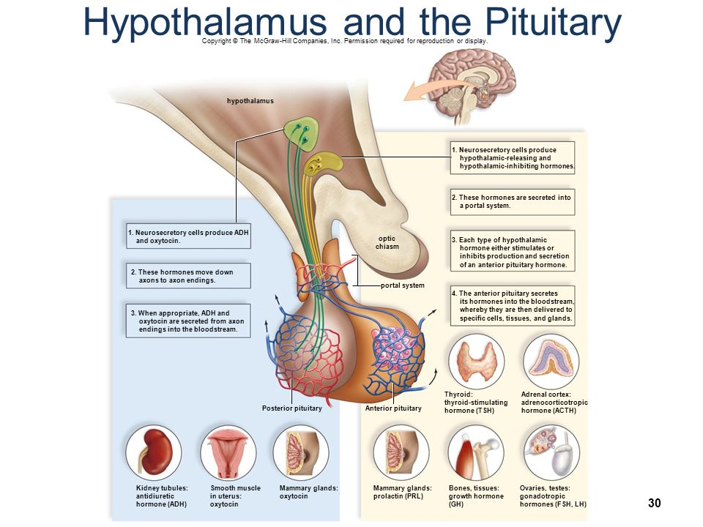

Slide 4
Introduction to growth hormone
Human growth hormone is a protein consisting of a chain of 187 amino acids. It has a molecular weight of 21,500.
Although the structural formula is known, its only source is from human pituitary glands.
It is species specific and growth hormone from other animals, except possibly the monkey, has no effect in man.
Growth hormone, also known as somatotropin,
It plays a pivotal role in stimulating growth, cell reproduction, and regeneration in humans and animals.

Slide 5
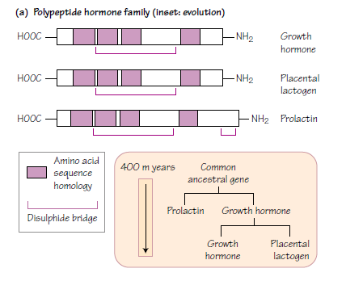
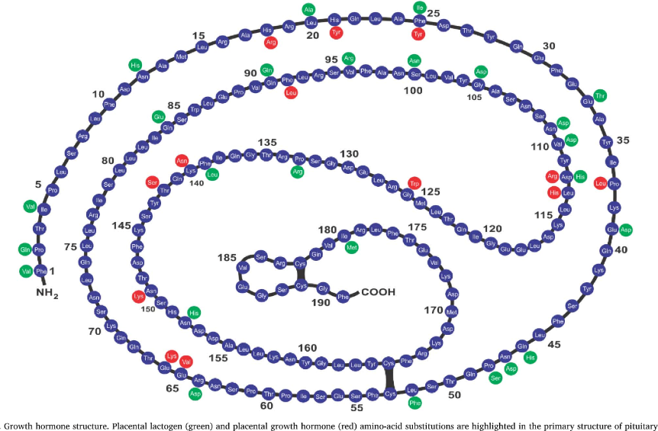
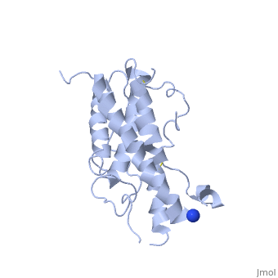
1.GROWTH HORMONE

Slide 6
Mechanism of action
When growth hormone is released into the bloodstream, transfer freely and it travels to various tissues in the body to exert its effects. Upon reaching its target cells, growth hormone binds to specific receptors located on the cell surface. These receptors are abundant in tissues crucial for growth and development, such as bone, muscle, and adipose (fat) tissue.
The binding of growth hormone to its receptors initiates a series of intracellular signaling events within the target cells. One of the main signaling pathways activated by growth hormone is the Janus kinase-signal transducer and activator of transcription (JAK-STAT) pathway. In this pathway, the binding of growth hormone to its receptor triggers the activation of Janus kinases (JAKs), which are enzymes associated with the receptor.
Activated JAKs then phosphorylate (add phosphate groups to) signal transducers and activators of transcription (STAT) proteins. These phosphorylated STAT proteins form dimers and translocate to the cell nucleus, where they act as transcription factors. In the nucleus, STAT proteins regulate the expression of specific genes involved in growth and metabolism.
One of the important genes regulated by the JAK-STAT pathway is responsible for the synthesis and secretion of insulin-like growth factor 1 (IGF-1). IGF-1 is a key mediator of growth hormone's effects on growth and development. It promotes cell proliferation, differentiation, and survival in various tissues, contributing to overall growth and tissue repair.

Slide 7
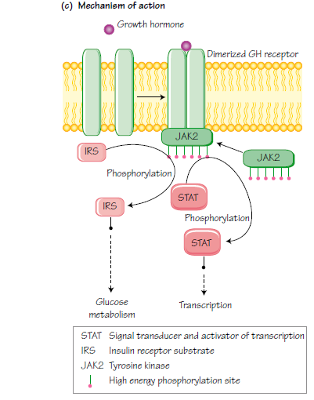
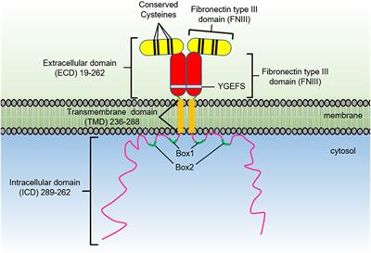
GH RECEPTOR

Slide 8
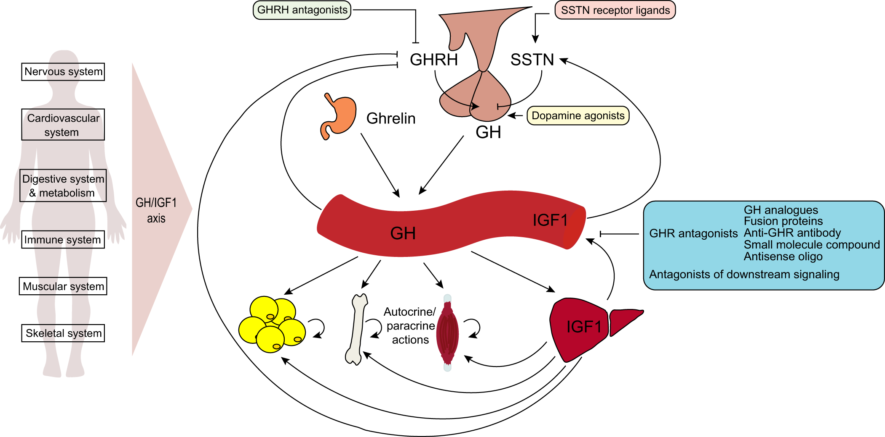
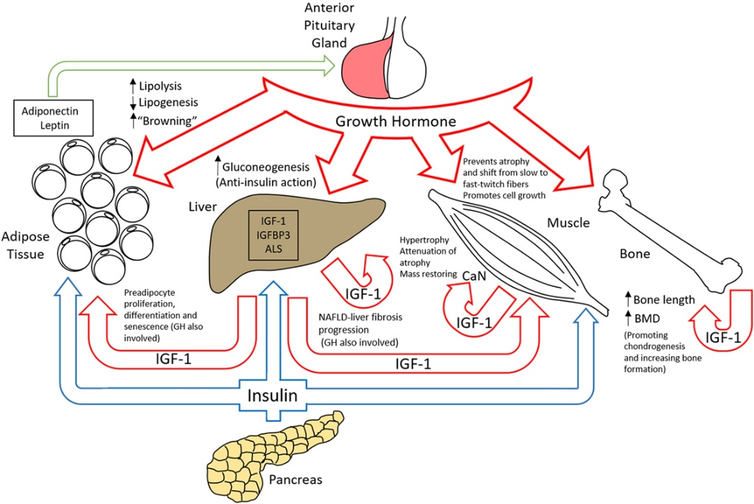

Slide 9
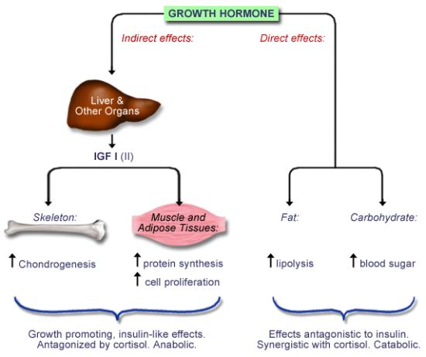

Slide 10
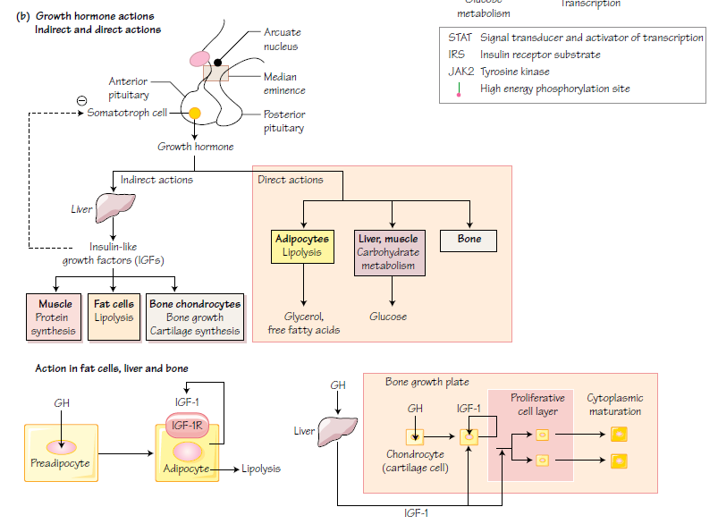

Slide 11
Growth hormone secretion is tightly regulated by various factors.
These factors include hypothalamic hormones (Growth Hormone-Releasing Hormone and Somatostatin), nutritional status, sleep patterns, and stress.
Regulation of GH secretion

Slide 12
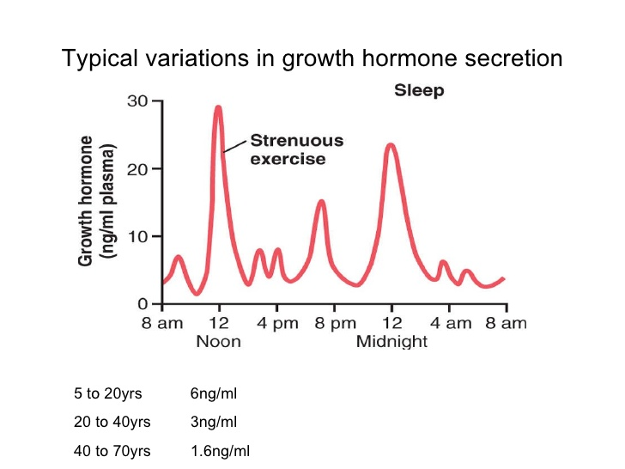

Slide 13
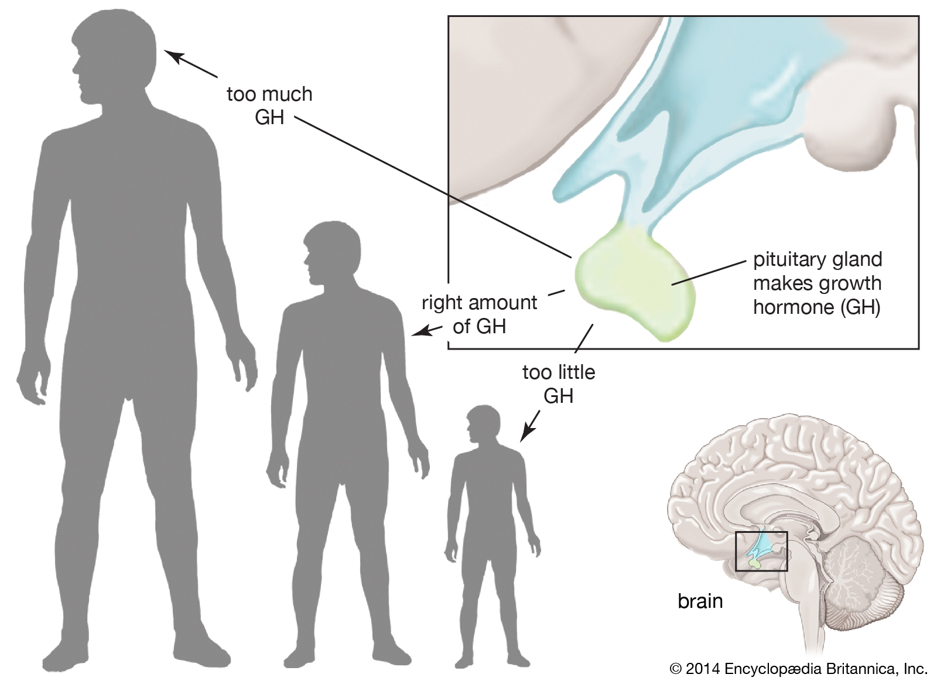
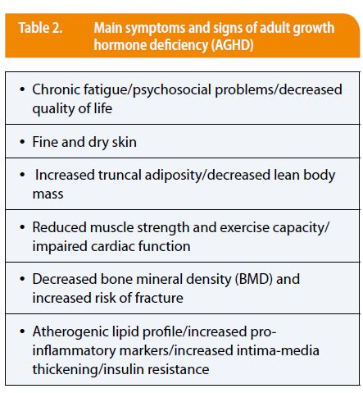

Slide 14
GH abnormality
Under-production of this hormone during the period of growth leads to retarded growth and dwarfism.
Over-production leads to excessive growth of the bones of the body and also of the muscles and viscera leading to gigantism.
Over activity later in life does not increase the stature once the epiphyses of the long bones in the limbs have fused to the shafts (at an age of 18-24 years) and then no further increase in length is possible.
Acromegaly

Slide 15
Trials with the limited amount of human growth hormone available have shown that it has its expected effect on growth, and dwarf children have increased their rate of growth markedly when under treatment with this hormone.

Slide 16
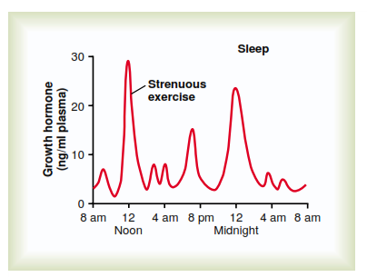
Typical variations in growth hormone secretion throughout the day, demonstrating the especially powerful effect of strenuous exercise and also the high rate of growth hormone secretion that occurs during the fist few hours of deep sleep.

Slide 17
References
Greenstein B. & Wood D. F. (2011). The endocrine system at a glance (3rd ed.). Wiley-Blackwell
Melmed S. Auchus R. J. Goldfine A. B. Koenig R. Rosen C. J. & Williams R. H. (2020). Williams textbook of endocrinology (14th ed.). Elsevier. Boron W. F. & Boulpaep E. L. (2021).
Boron & boulpaep concise medical physiology. Elsevier. Barrett K. E. Barman S. M. Yuan J. X.-J. & Brooks H. (2019).
Ganong's review of medical physiology (review questions) (26th ed.). McGraw-Hill Education LLC Molina P. E. (2018). Endocrine physiology (Fifth). McGraw-Hill Education.

Slide 18
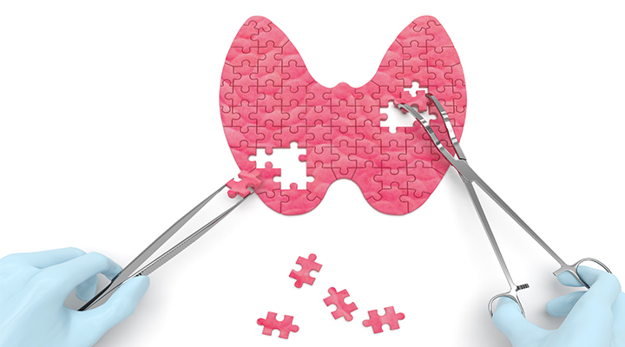
Thank you

