Slide 1
Pineal gland
Zhikal O. Khudhur
Endocrinology BIO 414
Spring Semester
Week number: 11
Date: / 2024

Slide 2
Objectives
Pineal gland
Secretion of penial gland
serotonin
melatonin
Diurnal change and biological clock
Zhikal Omar Khudhur
1/28/2024
2

Slide 3
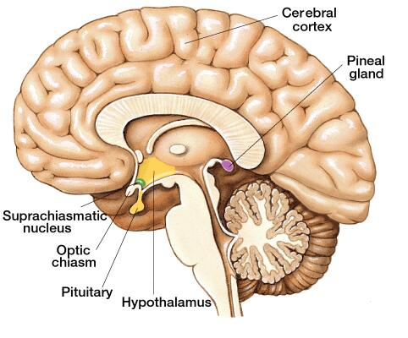
Secretions from the pineal gland…
The pineal gland is pine-cone-shaped and only about 1 cm in diameter.
Melatonin: communicates information about environmental lighting to various parts of the body. Has some effect on sleep/awake cycles and other biological events connected to them, such as a lower production of gastric secretions at night.

Slide 4
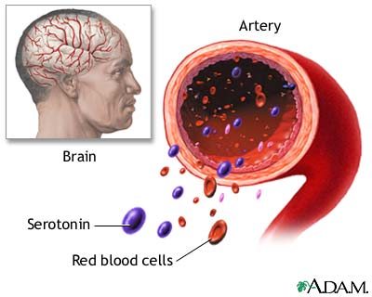
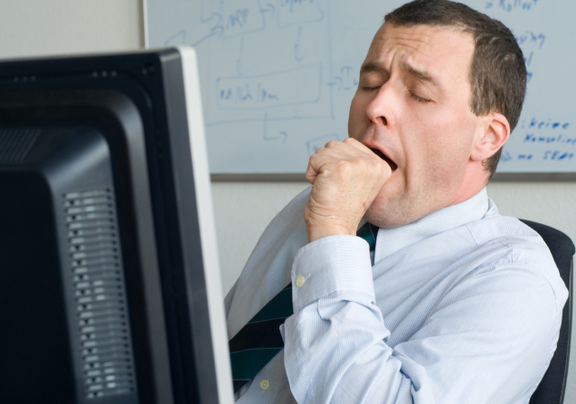
Secretions from the pineal gland…
Serotonin: a neurotransmitter that regulates intestinal movements and affects appetite, mood, sleep, anger, and metabolism.

Slide 5
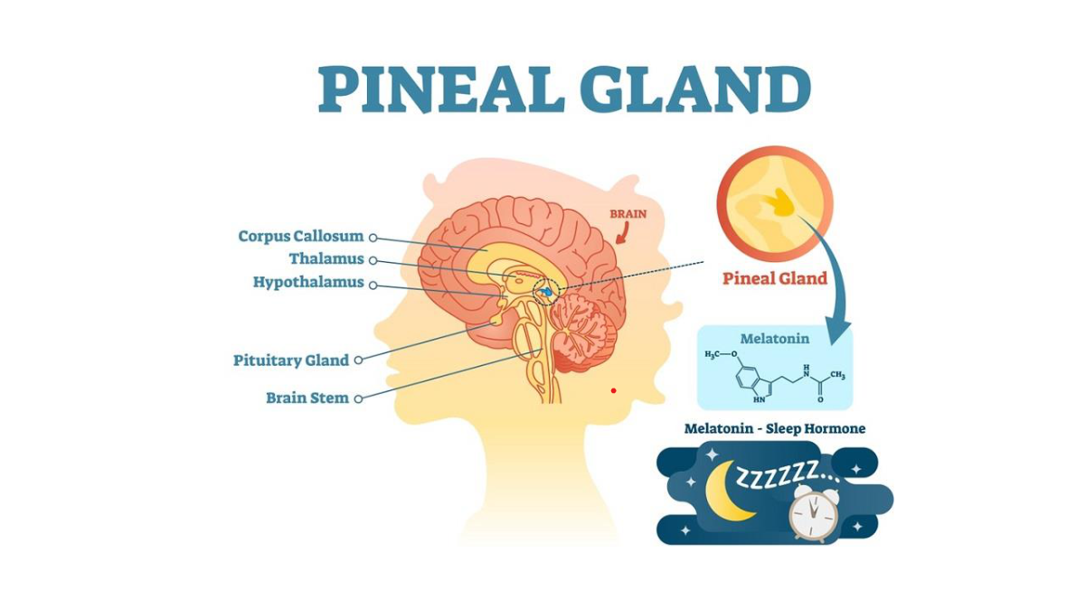

Slide 6
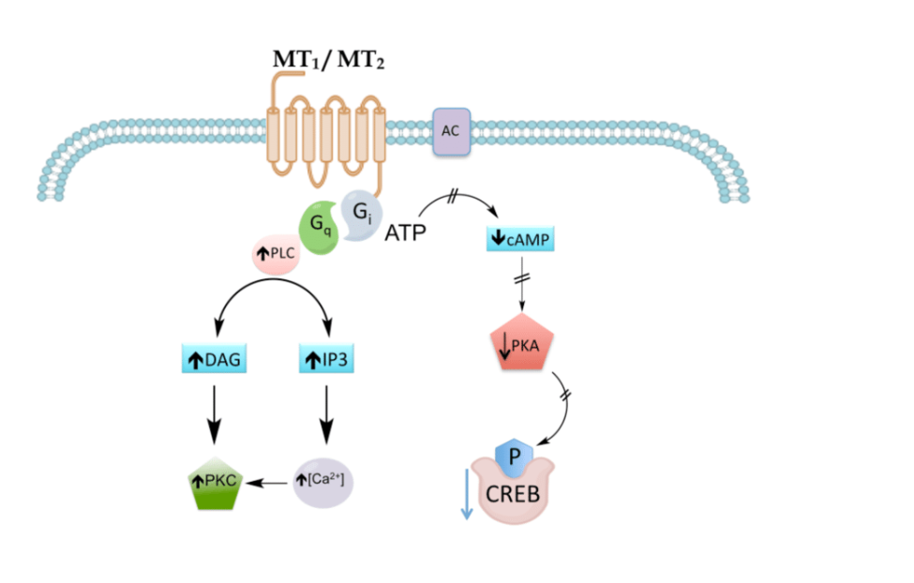

Slide 7
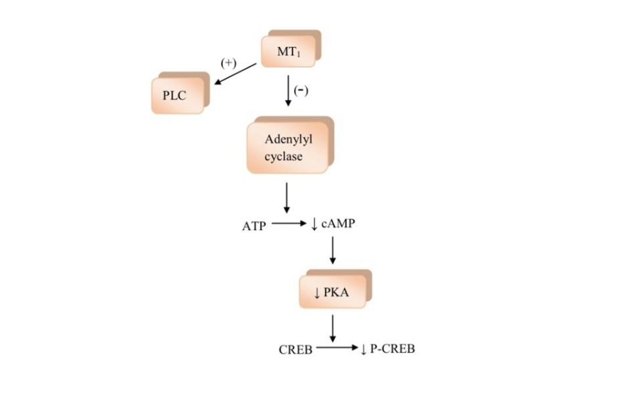

Slide 8
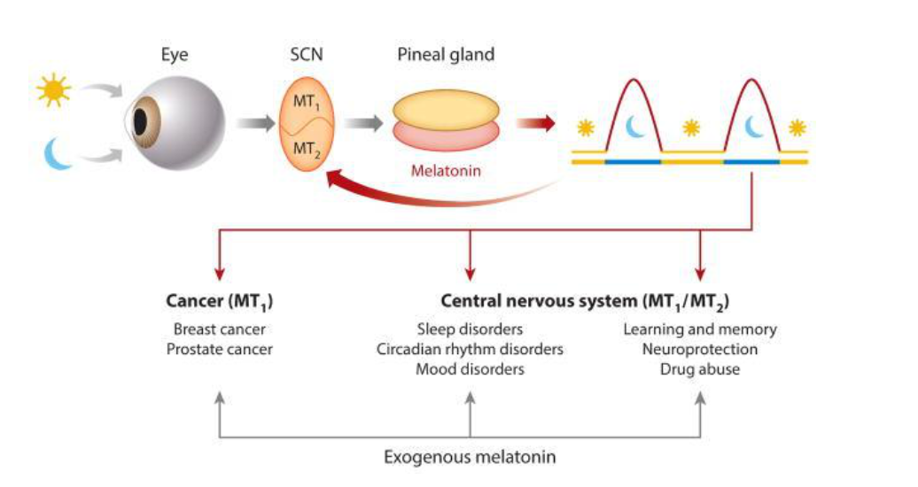

Slide 9
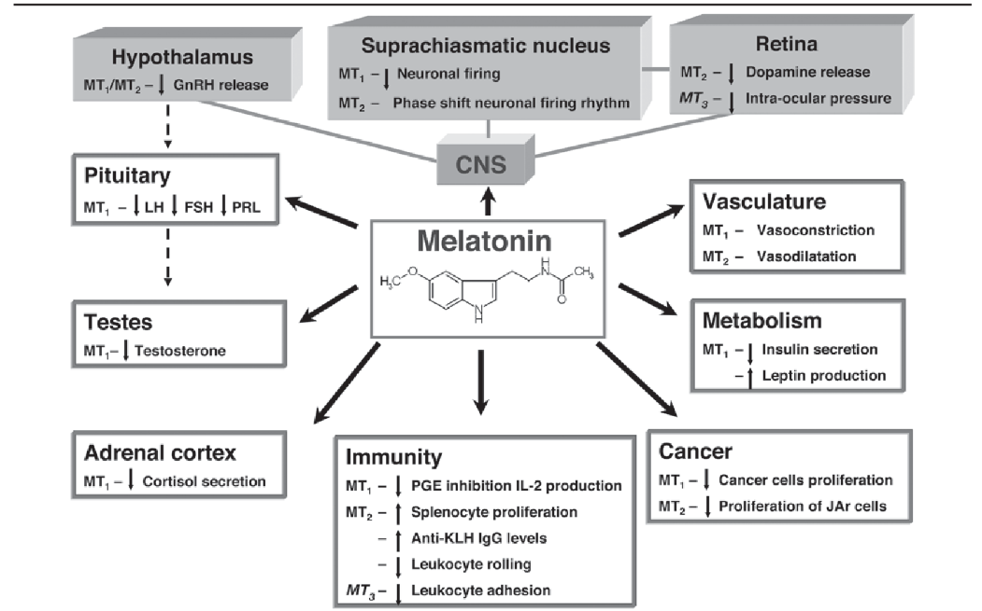

Slide 10
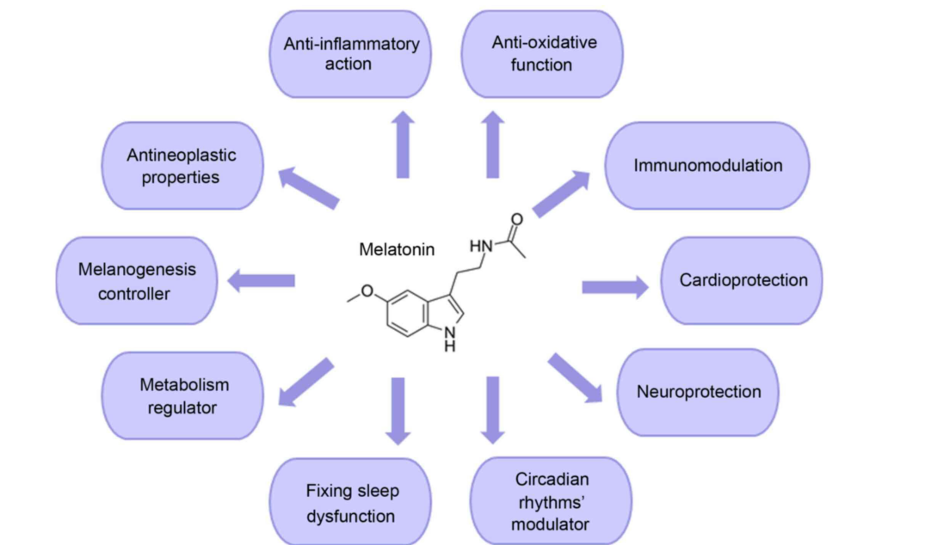

Slide 11
References
Greenstein B. & Wood D. F. (2011). The endocrine system at a glance (3rd ed.). Wiley-Blackwell
Melmed S. Auchus R. J. Goldfine A. B. Koenig R. Rosen C. J. & Williams R. H. (2020). Williams textbook of endocrinology (14th ed.). Elsevier. Boron W. F. & Boulpaep E. L. (2021).
Boron & boulpaep concise medical physiology. Elsevier. Barrett K. E. Barman S. M. Yuan J. X.-J. & Brooks H. (2019).
Ganong's review of medical physiology (review questions) (26th ed.). McGraw-Hill Education LLC Molina P. E. (2018). Endocrine physiology (Fifth). McGraw-Hill Education.

Slide 12
Thank you

