Slide 1

Transduction
Dr. Salah Tofik Balaky
Course: Molecular Biotechnology
MA Code408
Semester 8: Week 8
Date 9/05/2024

Slide 2
Transduction
Transduction is the process by which DNA is transferred from one bacterium to another by a virus. It is a process by which a bacterial phage (virus) picks up a piece of DNA from one bacterial cell and injects it into another where it is incorporated into the chromosome. In most cases, bacterial transduction takes place between members of the same species.

Slide 3
Types of transduction in bacteria
Generalized transduction.
Specialized transduction.

Slide 4
Generalized transduction
In generalized transduction, phages can carry any part of the chromosome, the phage attaches to the bacterial cell wall and injects DNA into the bacterium. Normally this directs the synthesis of new viruses.

Slide 5
Generalized transduction
Sometimes, however, bits of bacterial chromosome are accidentally incorporated into the viral DNA. When these viruses infect a new host cell, they can incorporate this genetic information from the previous bacterial host into the new bacterial host.

Slide 6
Steps of generalized transduction
A phage infects the donor cell.
Phage DNA and proteins are made, and the bacterial chromosome will break into pieces.
Occasionally during phage assembly, pieces of bacterial DNA are packaged in a phage capsid.
Then the donor cell lyses and releases phage particles containing bacterial DNA.

Slide 7
Steps ……..
A phage carrying bacterial DNA infects a new host cell, the recipient cell.
Recombination can occur, producing a recombinant cell with a genotype different from both the donor and recipient cells.

Slide 8
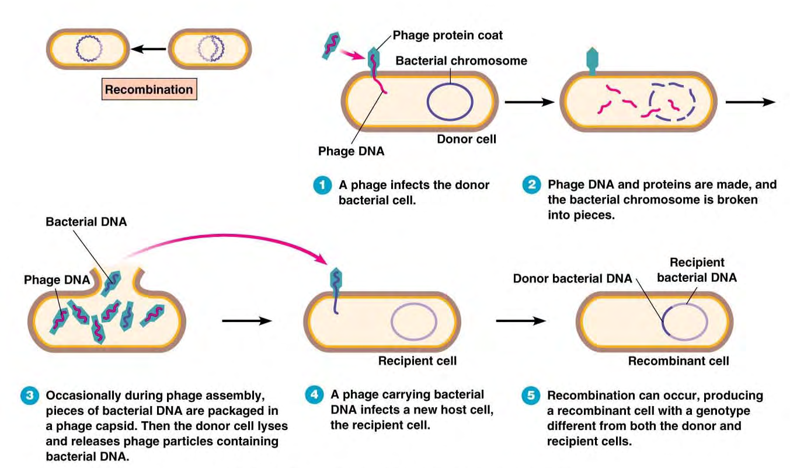
Steps of generalized transduction

Slide 9
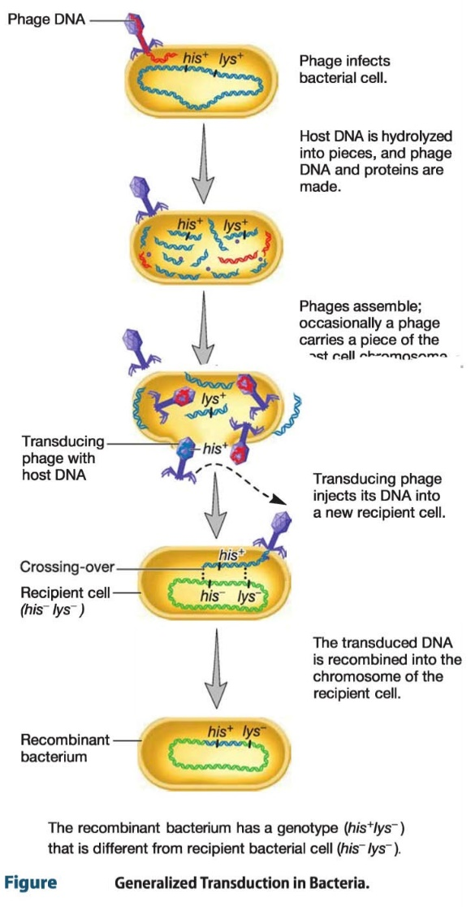
Steps of generalized
transduction

Slide 10
Characteristics of generalized transduction
Here, any bacterial gene from the donor can be transferred to the recipient.
Phages that mediate generalized transduction generally breakdown host DNA into smaller pieces.
Occasionally one of the pieces of host DNA is randomly packaged into a phage coat.
The transferred DNA fragment is the one that can fit into a phage head.

Slide 11
Specialized transduction
specialized transducing phages carry only restricted parts of the bacterial chromosome.In this case, only certain donor genes can be transferred by each viral strain. Different phages may transfer different genes. Specialized transduction is mediated by lysogenic (temperate) phages. The genes that get transferred depend on where the prophage has inserted in the chromosome.

Slide 12
Specialized Transduction
During excision of the prophage, some of the host DNA may be excised with the phage DNA. Only host DNA on either side prophage can be transferred (specialized transduction). After replication, each of the released phages can transfer the same donor genes into a recipient.

Slide 13
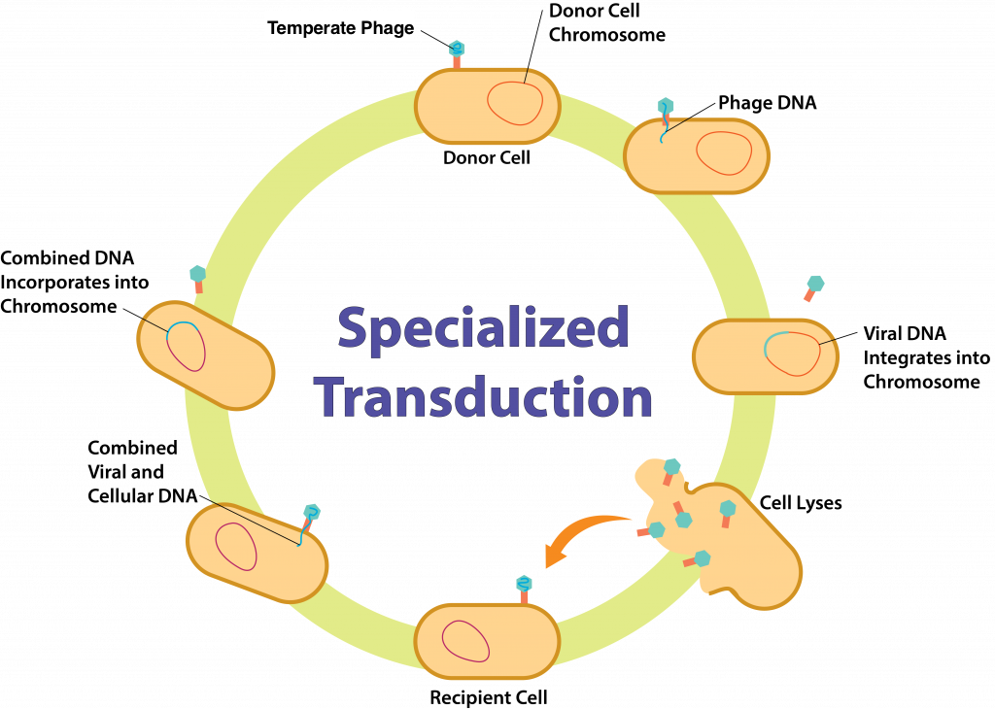
Specialized Transduction

Slide 14
Examples of specialized transduction
Lambda phage and the lac operon in E. coli.
Staphylococcus aureus and antibiotic resistance.

Slide 15
Lambda phage and the lac operon in E. coli:
In Escherichia coli bacteria, the lambda phage is a well-studied temperate bacteriophage. When the lambda phage integrates its DNA into the E. coli genome, it can sometimes pick up adjacent bacterial genes along with its own DNA. One such example involves the lac operon in E. coli, which contains genes involved in the metabolism of lactose.

Slide 16
Staphylococcus aureus and antibiotic resistance
Specialized transduction can also play a role in the transfer of antibiotic resistance genes between bacteria. For example, in S. aureus, bacteriophages can carry genes for antibiotic resistance along with their own DNA. During specialized transduction, if a phage carrying antibiotic resistance genes excises these genes along with its own DNA and transfers them to another S. aureus bacterium, the recipient bacterium becomes resistant to the antibiotic carried by those genes.

Slide 17
Antibiotic resistance in S. aureus
Antibiotic resistance in S. aureus, particularly MRSA, presents a significant challenge in healthcare settings. Bacteriophages that infect S. aureus can carry genes for antibiotic resistance, such as genes encoding resistance to beta-lactam antibiotics like penicillin.

Slide 18
Next lecture
Conjugation

Slide 19
Questions and comments?

