Slide 1

Production of Antibiotics
Dr. Salah Tofik Balaky
Miss Amna
Course: Molecular Biotechnology
MA Code408
Semester 8: Week 9
Date 7/ 5/ 2024

Slide 2
Production of Antibiotics
Antibiotics may be wholly produced by fermentation. Nowadays, however, they are increasingly produced by semi-synthetic processes, in which a product obtained by fermentation is modified by the chemical introduction of side chains. Some wholly chemically synthesized compounds are also used for the chemotherapy of infectious diseases e.g. sulfonamides and quinolones. Thousands of antibiotics are known; and every year dozens are discovered. However, only a small proportion of known antibiotics is used clinically, because the rest are too toxic.

Slide 3
Main groups of antibiotics according to their mode of action
Inhibitors of cell wall synthesis.
Inhibitors of cell membrane function.
Inhibitors of protein synthesis.
Inhibitors of nucleic acid synthesis.
Inhibitors of other metabolic processes.

Slide 4
Beta-Lactam antibiotics such as Penicillins
The Beta-lactam antibiotics include the well-established and clinically important penicillins and cephalosphorins as well as some relatively newer members: cephamycins, nocardicins, thienamycins, and clavulanic acid.

Slide 5
Strain of organism used in penicillin production
In the early days of penicillin production, when the surface culture method was used, a variant of the original culture of Penicillium notatum discovered by Sir Alexander Fleming was employed. When however the production shifted to submerged cultivation, a strain of Penicillium chrysogenum, was introduced. In submerged culture it gave a penicillin yield of two to three times more than given by Penicillium notatum.

Slide 6
Penicillin
Present-day penicillin producing P. chrysogenum strains are far more highly productive than their parents. They were produced through natural selection, and mutation using UV irradiation and X-irradiation.

Slide 7
Fermentation for penicillin production
The inoculum is usually built up from lyophilized spores or a frozen culture and developed through vessels of increasing size to a final 5-10% of the fermentation tank. The fermentors vary from 38,000 to 380,000 liters in capacity and in modern establishments are worked by computerized automation, which monitor various parameters including oxygen content, Beta-lactam content, pH, etc.

Slide 8
Main media used for the production of penicillin
The medium for penicillin production now usually has as carbohydrate source glucose, beet molasses or lactose. The nitrogen is supplied by corn steep liquor. Cotton seed, peanut, linseed or soybean meals have been used as alternate nitrogen sources.

Slide 9
Environmental condition
The temperature is maintained at about 25°C, but in recent times it has been found that yields were higher if adjusted according to the growth phase. Thus, 30-32°C was found suitable for the trophophase and 24°C for the idiophase. Aeration and agitation are vigorous in order to keep the components of the medium in suspension and to maintain yield in the highly aerobic fungus.

Slide 10
Phases of penicillin production
The first phase (trophophase): during which rapid growth occurs, lasts for about 30 hours during which mycelia are produced.
The second phase (idiophase) lasts for five to seven days; growth is reduced and penicillin is produced.
In the third phase, carbon and nitrogen sources are depleted, antibiotic production ceases, the mycelia lyse releasing ammonia and the pH rises.

Slide 11
Extraction of penicillin after fermentation
At the end of the fermentation the broth is transferred to a settling tank. Penicillin is highly reactive and is easily destroyed by alkali conditions (pH 7.5-8.0) or by enzymes. It is therefore cooled rapidly to 5-10°C. A reduction of the pH to 6 with mineral acids sometimes accompanied by cooling helps also to preserve the antibiotic. The produced penicillin will then be isolated and purified.

Slide 12
Methods for converting penicillin to a stable form
It can be reacted with a calcium carbonate to give the calcium salt.
It may be reacted with sodium or potassium buffers to give the salts.
It may be precipitated with an organic base such as triethylamine.

Slide 13
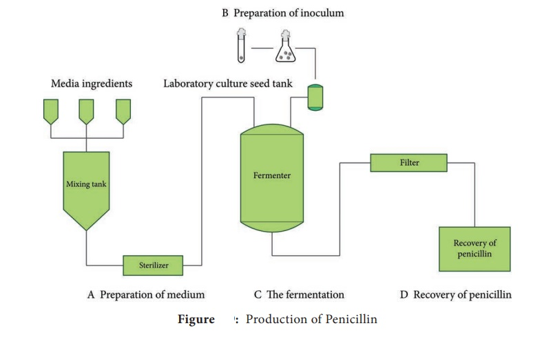
Penicillin production steps

Slide 14
Next lab
Production of Vaccines

