Slide 1

Conjugation
Dr. Salah Tofik Balaky
Course: Molecular Biotechnology
MA Code408
Semester 8: Week 9
Date 9/05/2024

Slide 2
Conjugation
Conjugation requires contact between living cells of opposite mating types. The donor cell, called an F⁺ cell (corresponding to maleness), has extra DNA pieces called F (or fertility) factors. These are a type of plasmid, a free genetic element in the cell. When F⁺ and F– (corresponding to femaleness) cells are mixed, the F⁺ cells attach by sex pili to F– cells.

Slide 3
Conjugation main characteristics
1.Conjugation process requires cell-to-cell contact and mediated by fertility plasmids.
2. The fertile cell forms a sex pilus to connect the recipient and the plasmid DNA replicate.
3. Genes from Donor cells F⁺ move into F^{-.}
4. Fertility plasmid will be transferred from the donor cell to the recipient cell, both cells will separate.

Slide 4
Different types of bacterial conjugation
F-type conjugation.
P-type conjugation.
Type IV secretion systems (T4SSs).

Slide 5
F-type conjugation
This type of conjugation is mediated by the F plasmid and is the most well-studied. It involves the transfer of genetic material from the donor bacterium to the recipient bacterium through the formation of a conjugative pilus.

Slide 6
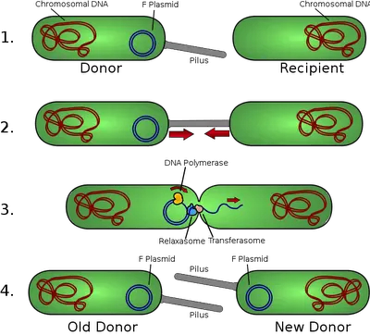
F-type conjugation

Slide 7
P-type conjugation
This type of conjugation is mediated by the P plasmid and is less well-studied compared to F-type conjugation. It also involves the transfer of genetic material from the donor bacterium to the recipient bacterium through the formation of a conjugative pilus. The P plasmid is also a self-replicating plasmid that can carry antibiotic resistance genes and other traits beneficial to the recipient bacterium.

Slide 8
Differences between F and P conjugation Types
The specific plasmids involved (F plasmid vs. P plasmid).
The genetic diversity of the conjugation genes.
The impact of capsule traits on conjugation efficiency.
The F-type conjugative pili appear to be more frequently associated with plasmids carrying both antibiotic resistance and virulence factors.

Slide 9
Type IV secretion systems (T4SSs).
These are complex systems that are involved in the transfer of genetic material from the donor bacterium to the recipient bacterium. T4SSs are encoded on the plasmids themselves and are responsible for the transfer of antimicrobial resistance genes. They are commonly used by bacteria to acquire exogenous DNA, particularly plasmids, containing antimicrobial resistance genes.

Slide 10
Type IV secretion systems (T4SSs)
T4SSs are used by bacteria for different functions, the two most common being conjugation and effector protein translocation. These processes play important roles in spread of antibiotic resistance and infection by bacterial pathogens. During conjugation single-stranded DNA is translocated into recipient cells by a contact-dependent process. Neisseria gonorrhoeae is the only bacterium known to use a T4SS to secrete single-stranded DNA into the extracellular milieu.

Slide 11
Significance of conjugation
Each of these types of bacterial conjugation plays a significant role in the spread of antibiotic resistance genes and the evolution of bacterial populations. Understanding the mechanisms and regulation of these processes is essential for the development of effective strategies to combat the spread of antibiotic resistance and to prevent the emergence of new bacterial pathogens.

Slide 12
Questions and comments?

