Slide 1
Communication Skills Mastering the Art of Interaction
By Rizwan Tahir

Slide 2
Table of Contents
What is Effective Communication?
Uses of Effective Communication
The 7 Cs of Communication
Principles of Communication
What is Miscommunication?
Digital Communication

Slide 3
What is Communication?
Communication is the process by which individuals exchange information through a common system of symbols, signs, or behavior.
Essential for building relationships, achieving goals, and functioning effectively in everyday life.

Slide 4
Uses of Effective Communication
Effective communication helps to understand a person or situation in a better way.
• It enables us to solve the differences, build trust and respect in the organization.
• Sometimes our message is misunderstood or we misunderstand the received message, effective communication helps us to resolve problems with both's point of view.
• Effective communication helps us to connect well with kids, spouse, boss, colleagues, etc.
• It helps us in decision making.

Slide 5
Types of Communication
Verbal Communication: The use of words to convey messages (e.g., face-to-face, telephone, presentations).
Non-verbal Communication: Conveying messages without words (e.g., body language, facial expressions, tone of voice).
Written Communication: Any communication that involves writing or typing (e.g., emails, letters, reports).
Visual Communication: Delivering information visually (e.g., graphs, charts, logos).

Slide 6
The 7 Cs of Effective Communication
1. Completeness
2. Conciseness
3. Consideration
4. Clarity
5. Concreteness
6. Courtesy
7. Correctness

Slide 7
1. Completeness
•The information conveyed in the message should be complete for the communication to be effective.
•The sender must take into consideration the receiver's mind set and convey the message accordingly.
•Complete communication enhances the reputation of the organization.
•Complete information always gives additional information wherever required, it leaves no question in the minds of the receiver.
•Complete information helps in better decision making as it serves all the desired and crucial information.

Slide 8
2. Conciseness
•Conciseness means communicating what you want to convey in least possible words.
•Conciseness is a necessity for effective communication.
•Concise communication provides short and essential message in limited words.
•Concise message is more appealing and comprehensive to the audience.
•Concise messages are non repetitive in nature.

Slide 9
3. Consideration
Effective communication must take audience into consideration by knowing the viewpoints, background, mindset, educational level, etc.
•Consideration implies 'stepping into the shoes of others'.
•Consideration ensures that the self respect of the audience is maintained, and their emotions are not harmed.
•Consider the needs and requirements of the audience to achieve effective communication.

Slide 10
4. Clarity
• Clarity implies emphasizing on a specific goal or objective at a time, rather than trying to move away from track.
•Clarity helps to understand the message easily.
•Complete clarity of thoughts and ideas enhances the meaning of message.
•Clarity comes with the use of exact, appropriate and concrete words.

Slide 11
5. Concretness
•Concrete communication implies being particular and clear rather being fuzzy and general.
•Concrete communication shows good level of confidence.
•Concrete information helps to strengthen the reputation of the organization.
•Concrete information cannot be misinterpreted.

Slide 12
6. Courtesy
•Courtesy means being polite, kind, judicious, enthusiastic and convincing.
•Courtesy reflects the nature and character of the sender of the message.
•It is the same as give respect and then expect the same.
•Courtesy is not at all bias in nature.

Slide 13
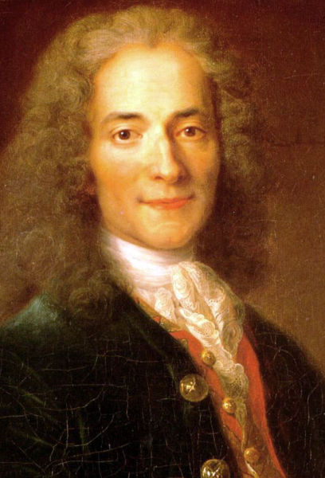
7. Correctness
“Everything you say should be true, but not everything true should be said.”
This Photo by Unknown Author is licensed under CC BY-SA-NC

Slide 14
7. Correctness
•Correctness in the communication implies that the correct information is conveyed through message.
•Correct communication boosts up the confidence level of the sender.
•Correct information has greater impact on the audience.

Slide 15
Communication Game

Slide 16
Barriers to Effective Communication
Physical Barriers: Distractions in the environment that impede the message.
Psychological Barriers: Biases, assumptions, and attitudes that distort communication.
Language Barriers: Differences in language or jargon leading to misunderstandings.
Emotional Barriers: Letting emotions affect how you communicate and interpret messages.

Slide 17
Quotes on Communication
"Speak a good word or remain silent" - Prophet Muhammad
“A wise man speaks because he has something to say; a fool speaks because he has to say something.” Plato
“If it takes a lot of words to say what you have in mind, give it more thought.” Dennis Roth.
“All the great speakers were bad speakers at first.” Ralph Waldo Emerson.

Slide 18
Quotes on Communication
If you want me to speak for an hour, I am ready today. If you want me to speak for just a few minutes, it will take me a few weeks to prepare.” Mark Twain.
“The tongue is very small and light but it can take you to the greatest heights and it can put you in the lowest depths.” Imam Gazali

Slide 19
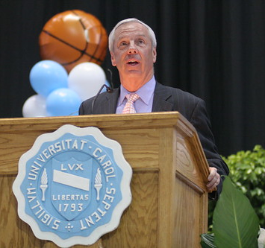
Power of Words
“Words start wars and end them, create love and choke it, bring us to laughter and joy and tears. Words cause men and women to willingly risk their lives, their fortunes and their sacred honor. Our world, as we know it, revolves on the power of words.”
This Photo by Unknown Author is licensed under CC BY-NC-ND

Slide 20
Miscommunication
Miscommunication occurs for a variety of reasons, often stemming from the complex nature of communication itself, which involves not just the exchange of information but also the interpretation and understanding of that information.

Slide 21
Miscommunication
Lack of Clarity
Assumptions and Preconceptions
Cultural Differences

Slide 22
Miscommunication
Emotional State
Language Barriers
Cognitive Biases

Slide 23
Practical Steps for Students
1. Practice Active Listening
Focus Fully on the Speaker: Avoid distractions and give your full attention to the person speaking.
Show That You're Listening: Use non-verbal cues such as nodding, maintaining eye contact, and leaning slightly forward.
Reflect and Ask Questions: Paraphrase what was said to confirm understanding and ask clarifying questions.

Slide 24
Practical Steps for Students Continue
2. Engage in Public Speaking
Join a Club or Group: Participate in activities like debate clubs, public speaking societies, or drama groups to gain speaking experience.
Practice Regularly: Use opportunities in class or group projects to present and speak in front of others.
Seek Feedback: After speaking or presenting, ask for constructive feedback from peers or teachers.

Slide 25
Practical Steps for Students Continue
3. Improve Non-verbal Communication
Be Mindful of Body Language: Practice open and positive body language to convey confidence and receptiveness.
Understand the Role of Tone: Experiment with tone and pace to learn how they affect the delivery of your message.
Practice Facial Expressions: Be aware of your facial expressions and how they can communicate feelings and reactions.

Slide 26
Practical Steps for Students Continue
4. Engage in Conversations
Start Conversations: Don’t be afraid to initiate discussions with classmates, teachers, and others.
Join Discussion Groups: Participate in or form study groups where you can discuss academic materials and diverse topics.

Slide 27
Digital Communication
Principles of Effective Digital Communication
Clarity: Importance of being clear and concise due to the nature of digital formats.
Tone: How to maintain a professional and appropriate tone, understanding the lack of non-verbal cues.
Responsiveness: The expectation for timely responses in many digital platforms.

Slide 28
Digital Communication
Email Etiquette
Subject Lines: Crafting informative and concise subject lines.
Structure: Importance of greeting, body, and closing; using paragraphs for clarity.
Attachments and Links: Guidelines for including and referencing attachments or links.

Slide 29
Digital Communication
Social Media Communication
Personal vs. Professional: Navigating the differences between personal and professional use.
Engagement: Tips for engaging with an audience, including the use of hashtags, images, and interactive content.
Privacy and Security: Basic privacy settings and practices to protect information.

Slide 30
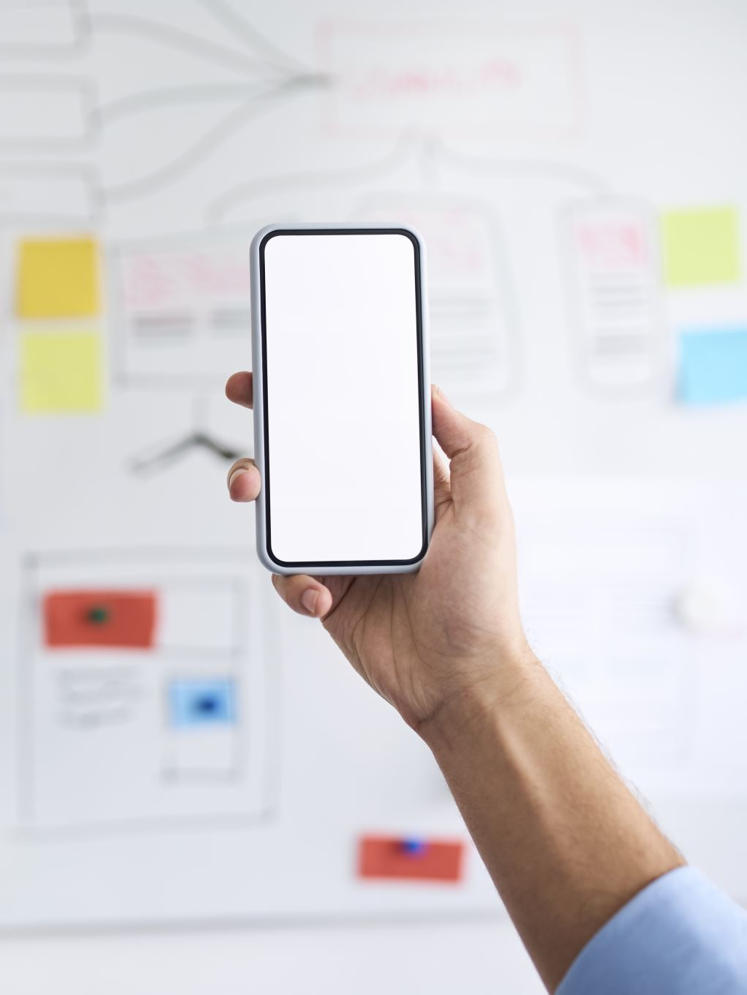
Digital Communication
Video Conferencing Etiquette
Preparation: Technical setup, background, and personal appearance.
During the Call: Muting when not speaking, using video effectively, and managing participation.
Follow-up: Summarizing decisions or actions post-meeting.

Slide 31
Thank you

