Slide 1
Interpersonal Dynamics & Character Building
2023-2024 Academic Year
Spring Semester
IDCB
BY
Ridhwan Tahir

Slide 2
IDCB Course Objectives
IDCB aims to support students in their process of self–development, and character-building.
IDCB helps learners assign relevant meaning to the outside world.
IDCB helps students to equip themselves with the skills that they need to establish a balance between themselves and the outside world in the framework of the Sustainable Development Goals (SDG) initiated by the United Nations (UN).

Slide 3
IDCB Course Contents
Trustworthiness
Communication Skills
Quality Education & Fight against Ignorance
Problem Solving
Peace, Justice, & Fairness
Culture of Co-existence
Collaboration and Partnership
Love & Compassion
Prosperity & Elimination of Poverty
Love of Homeland & Patriotism
Cleanliness & Personal Hygiene
Positive Attitude
Etiquette (Student Lecturer Relationships)
Time Management

Slide 4
WHY?
IDCB
A significant positive impact on learning and academic success
Effective study habits
Building confidence

Slide 5
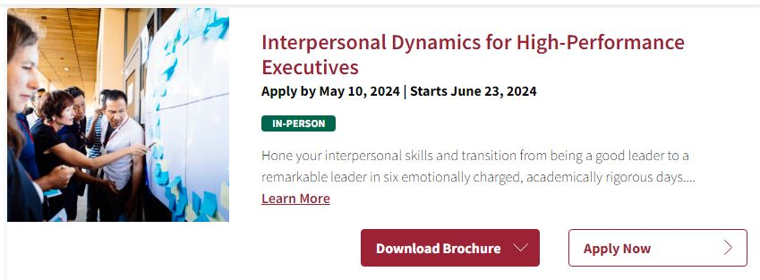
WHY?

Slide 6
WHY?

Slide 7
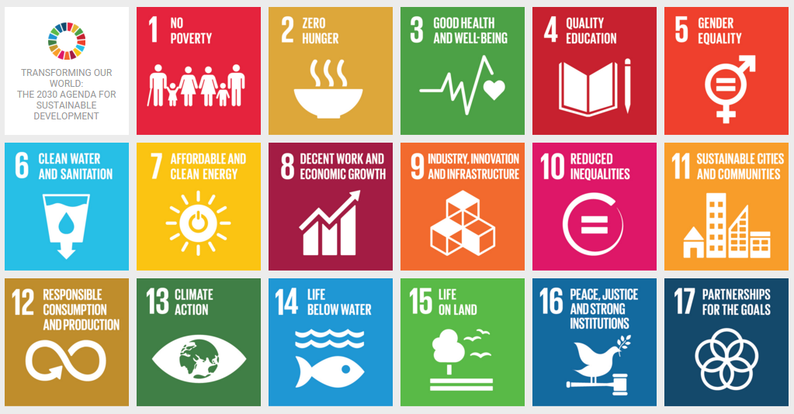
WHY?

Slide 8
IDCB Rubric
 | Percentage (%)
Homework/Field Trips | 10
Participation | 10
Social Responsibility Project Proposal/Poster Presentation | 20
Participation in a Community Project | 40
Reflection Paper on the Community Project | 20
TOTAL | 100

Slide 9
Community Projects
1 | Book Fair | 11 | Packing food for the needy in Ramazan
2 | Breast Self-Examination Community Project | 12 | Developing and designing a Library Catering to Children Affected by Cancer (Nanakaly Hospital)
3 | Interactive Orphanage Website | 13 | Nanakaly Child Cancer Project
4 | The development of a "Sadaqah" Fundraising Platform | 14 | Clean and Green: Together for a Brighter Future
5 | Orphanage Home | 15 | Elderly Home in Erbil
6 | Clean & Love Kurdistan | 16 | Erbil Autism Center
7 | Extravagance (Israf) Project | 17 | Fight Against Addictions (Drug, Smoking, Technology) Project/ Bad habits
8 | Deaf Hiwa Institute | 18 | Erbil Orphanage Home (Boys & Girls)
9 | Seeing Abilities not Disabilities; Promoting Disability Awarness | 19 | School Dental Care Project
10 | Tree Planting Project | 20 | Motivation for Physics Learning in High Schools in Erbil

Slide 10
Community Projects
21 | Opening courses for Orphanage house | 31 | Erbil Juvenile Prison
22 | Light a candle for those left behind | 32 | Erbil Nursery Home
23 | Anesthesia | 33 | Erbil Nursery Home (Erbil Infirmary House Dental Care Project)
24 | Art workshop for Orphanage | 34 | General Health Education on Disease Prevention Community Project
25 | Awat Institute for Educational Brain | 35 | Health secreening of general population
26 | back to school project | 36 | ICT (Information & Communication Technology) Course to Public School Teachers
27 | Blood Donation | 37 | Martyrs Kids Project
28 | Climate change awareness | 38 | Mercy Corner Project
29 | Darashakran Refugee Camp schools | 39 | Metabolic Syndrome as a FOE!
30 | Draw your future | 40 | Occupational Health safety community project

Slide 11
Community Projects
41 | Organize a drug-free campaign | 51 | Teach (calculus, Art, language, etc.) to underprivileged children and mentor them to become more educated.
42 | Organizing a team to read short stories to a children's hospital and give the short stories as a gift. | 52 | Train girls and children for self-defense
43 | Public awareness of how social media could be used by kids or teenagers and spend time with their family rather than using social media. | 53 | translated book for child
44 | Raising Dental Awareness Project | 54 | Tutoring Project for Wezari Students
45 | School health environment community project | 55 | Volunteer Teachers Project for Refugee Camp.
46 | Security of food production community project | 56 | Water Sanitation Process community project
47 | Shopping for Erbil Orphanage Children on Eid | 57 | Thalassemia Institude
48 | Social Media Awareness and how could be used by Highschool Students | 58 | Youth mappers
49 | Soft-Skills Workshops to Traffic Policemen | 59 | Unity in Education: Community Support for Our School
50 | Stay against Paint over graffiti.

Slide 12
Reflection Paper Content (Min. 1000 words)
What was the project about?
Who was the supervisor of the project and how many people paricipated in it?
What has inspired you to get involved in this project?
How did you plan the project?
What was your role in the project?
How were you feeling before the project was executed?
How did the project pass?
What difficulties did you encounter during the project?
How were you feeling after the project was executed?

Slide 13
IDCB
Best of Luck

