Slide 1
By Ridhwan Tahir
Tishk International University

Slide 2
Collaboration and Teamworking outline
Principles of collaboration and teamworking
Techniques of collaboration and teamworking
Benefits of collaboration and teamworking
“ Many hands make light work” However, “ Too many cooks spoil the broth“ How do you explain these two opposing ideas?
Four basic problems and their solutions in teamworking and collaboration
Cultural diversity and collaboration and teamworking

Slide 5
Collaboration and teamworking

Slide 6
Industry 4.0

Slide 7
COLLABORTION AND Teamworking

Slide 8
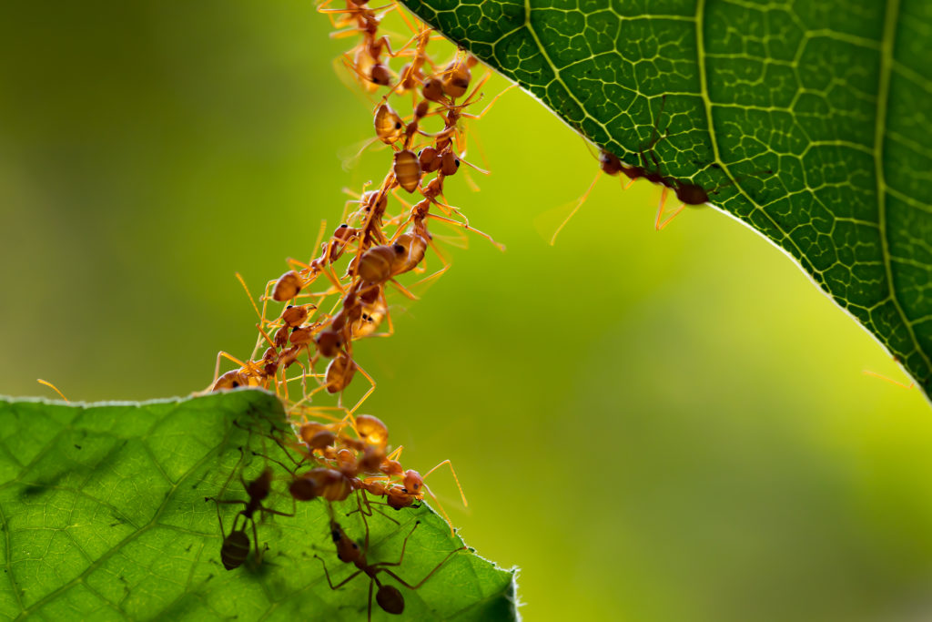
Teamworking & COLLABORATION
A team is a group of people working together to achieve a common goal.
Teamworking is the ability to cooperate and communicate effectively with others to achieve a common goal.
Robbins (2001) defines a team as a group whose individual efforts result in a performance that is greater than the sum of those individual parts.

Slide 9
COLLABORATION AND TeamworkING
1 + 1 + 1 = 3
1 1 1 = 111

Slide 10
Principles of COLLABORATION AND Teamworking

Slide 11
Be prepared to compromise

Slide 12
Avoid dominating or imposing your ideas

Slide 13
Principles of Teamworking

Slide 14
Principles of Teamworking
Be prepared to compromise.
Avoid dominating or imposing your own views.
Exploit team members’ strength to achieve the team’s goal.

Slide 15
COLLABORATION AND TEAMWORKING TECHNIQUES

Slide 16
Clear & smart goals (MISSION AND VISION)

Slide 17
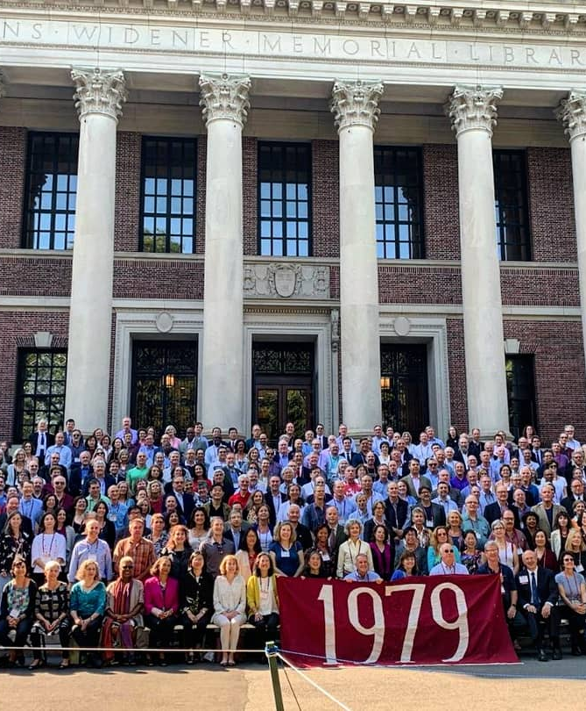
In 1979, Interviewers asked how many students in Harvard MBA programs set goals.
84% set no goals.
13% set goals but they were not committed on paper.
3% set goals that were committed on paper and had plans to accomplish them.

Slide 18
In 1989, they interviewed the same individuals again.
Those 13% who set some goals but they hadn’t written them down on paper were making thrice as much as the 84% who never set a goal.
The 3% who had committed goals written on paper had actually been making more money than the 97% put together.

Slide 20
Clarity in sharing responsibilities according to members’ skills

Slide 23
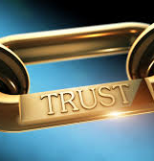
Why is trust important?
We need to feel physically and emotionally safe.

Slide 24
Collective work and commitment

Slide 25
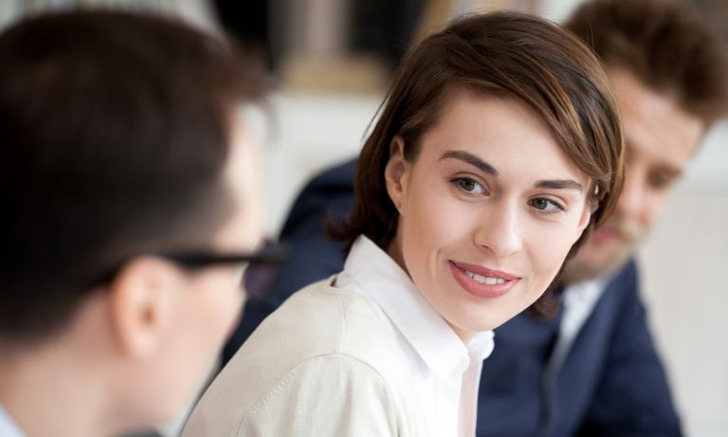
COMMUNICATION

Slide 29
APPRECIATE INDIVIDUAL DIFFERENCES

Slide 30
COLLABORATION AND Teamworking techniques
Clear goals
Clarity in sharing responsibilities according to members’ skills
Building trust among team members
Collective working and commitment
Clear and correct communication
Be kind and helpful
Appreciate individual differences

Slide 31
Collaboration time

Slide 32
Teamwork activity
Write down the “teamworking techniques” in the same order as in the slide.
You have only 15 seconds
What are you waiting for??????

Slide 33
Team working video

Slide 34
Story time use one of the themes to reflect your perspective on collaboration and teamworking
a clock
1
our body
2
the universe
3

Slide 36
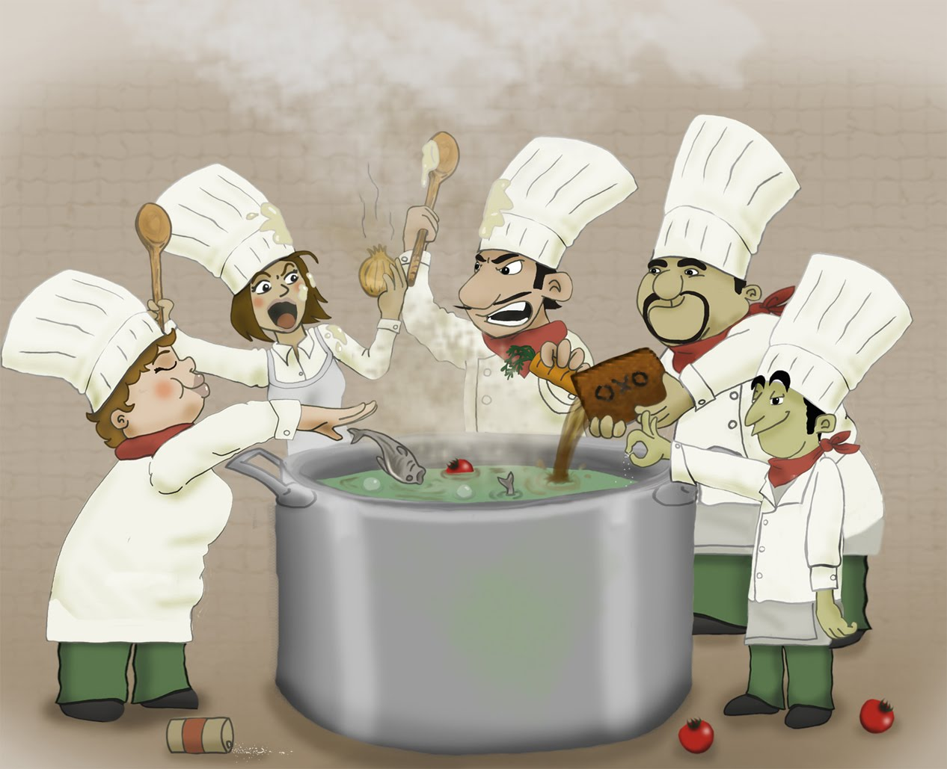
….then why………….
Too many cooks spoil the broth.

Slide 37
Problems of teamwork
There are three types of problems
The ones you can fix with some work,
The ones you can fix with a lot of work,
The ones you can not fix.

Slide 38
The problems you can fix with some work Organizational or structural problem
Goals are not clear,
Responsibilities are not clear,
People with the wrong talents are on the team,
The challenge is too big for the team,
There is little or no communication.

Slide 39
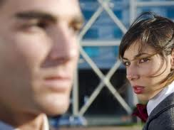
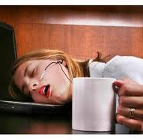
The problems you can fix with a lot of work Personal issues
People don’t like each other,
There is mistrust,
Someone is slacking off.

Slide 40
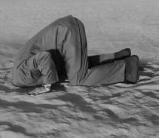
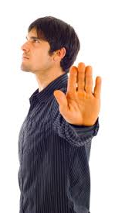
The problems you cannot fix Deeper Personal problems
One or more members of the team does not want to solve the problem.
Even they may not see that there is a problem.
They refuse to change.
They are ready to fight .

Slide 41
Problems and solutions of teamwork
Problems
Solutions
Self-centeredness
Half-heartedness
Uncooperative
Stubbornness
Selflessness
Dedication
Collaboration
Flexibility and tolerance

Slide 42
Thank you for your participation and patience!

