Slide 1
Positive Attitude
Interpersonal Dynamics and Character Building (IDCB) 23 March 2024
Rizwan Tahir

Slide 2
Positive attitude, sustainable development which of the goals does it cover?

Slide 3
What is the meaning of a positive attitude?

Slide 11
What is the benefit of a positive attitude?

Slide 12
The benefit of a Positive Attitude

Slide 14
Let give me an example of a positive and negative attitude

Slide 17
How can we develop a positive Attitude?

Slide 22
Real-Life Examples of a positive attitude

Slide 23
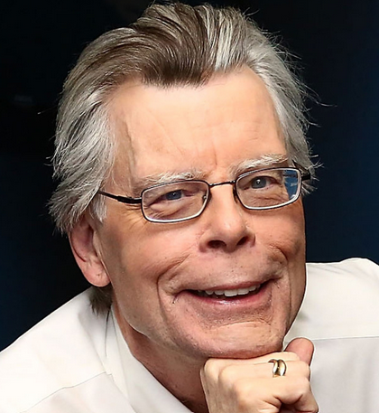
Stephen King
King was broke and struggling when he was first trying to write down. He lived during a trailer together with his wife—also a writer—and they both worked multiple jobs to support their family while pursuing their craft. They were so poor that they had to borrow clothes for their wedding and had no phone because it had been too expensive.
King received numerous rejection letters for his works that he developed a system for collecting them. In one of his books named On Writing, he recalls that By the time he used to be 14. The nail in his wall would not support the load of the rejection slips impaled upon it.
So, He replaced the nail with a spike and kept on writing. This is what we call a positive attitude. Now that he gained success afterward. He received 60 rejections before selling his first story, “The Glass Floor,” for $35. Even his new best-selling book, Carrie, wasn’t successful initially. After receiving so many rejections, he, at last, sold Carrie for a meager advance to Doubleday Publishing. Only 13000 copies were sold of the hardback —not great. But, Soon after, Signet Books signed on for the paperback rights for $400,000, of which half that is, $200,000 went to King.

Slide 24
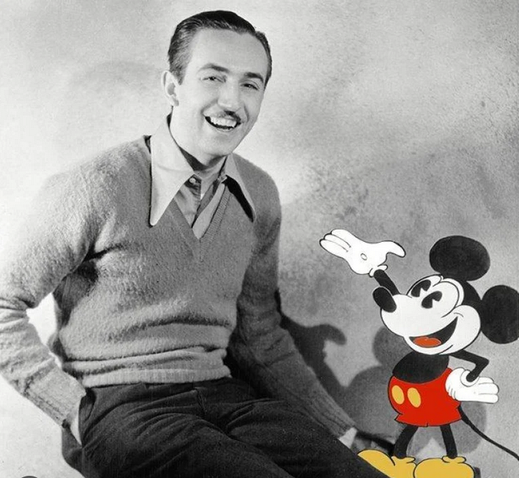
Walt Disney
Back in 1919, an aspiring young cartoonist was fired from his job at a Kansas City newspaper. His editor told him he wasn’t creative enough and would check out work elsewhere. Had the cartoonist listened to his boss and given in to negative thinking, we wouldn’t have the work of Walt Disney. Disney may have considered quitting or going after a special line of labor, but he persisted. He believed he had what it took to succeed and listened to the voice inside himself urging him to stay trying. He turned to the facility of positive thinking and made himself a Real-life example, which encouraged him to travel after success rather than succumbing to his fear of failure. You’ll adopt this mindset and knowledge of all the advantages of positive thinking in your own life.

Slide 25
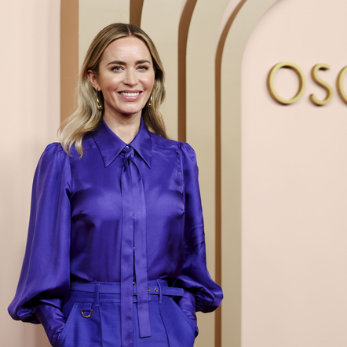
Emily Blunt
Emily had a life that hardly anyone could believe in. Before she was landing leading roles on the stage and big screen and getting nominated for Golden Globes, she could barely carry a conversation together with her classmates: Between ages 7 and 14, Emily had a serious stutter. As she told W magazine, that she was a sensible kid and hatons to mention, but she just couldn’t say it. It might just haunt her. She could not even sit and ask someone. But that all changed when one among her junior high school teachers encouraged her to try out for the school play—a totally unappealing feat given the very fact that she had such a tough time communicating. But the teacher kept gently pressing and suggested she try accents and character voices to assist in getting the words out—and it worked. By the top of her teens, Blunt had overcome her stutter and went on to achieve the successful career she has now. Alike her, there are millions of untold stories of people who tackled hardships and achieved something which once they were just dreaming of. As you noticed in the Positive Thinking Real Life Examples. It just takes a little belief in yourself and your dreams before you finally reach your goal. So, if you ever think you have a hard life and you are trapped. Stop Thinking and start believing. One day you will have all you dream of.

Slide 26
How do we know if the outcome of an event is positive or negative for us?

Slide 27
Positive attitude, sustainable development which of the goals does it cover?

Slide 28
Activity
The Attitude Inventory: Take out a piece of notebook paper and answer the following questions one at a time:

Slide 29
Write down the name of someone you think typically has a good attitude. Why do they or what about them makes you think that?
Write down the name of someone you think typically has a lousy or bad attitude. How do you know they have a bad attitude?
When you think of a person with a bad attitude, what things or who does that person usually point to as the reason they are in a bad mood?
Do you think you can have a bad attitude one day and a good one the next? Why or why not? What influences that?
Do you have to have a bad attitude if things aren't going your way or do you think it’s possible to have a good attitude even when bad stuff is happening? Tell me why.
Are there things in your life you’d like to change to help you have a more positive attitude?
If negative stuff is happening to you, are there things you can do to keep your outlook positive? Name a few of them.

Slide 30
“Wherever you go, no matter the weather, always bring your own sunshine.” – Anthony J. D’Angelo
See you next class

