Slide 1
Interpersonal Dynamics and Character Building
PROBLEM-SOLVING
Rizwan Tahir

Slide 2
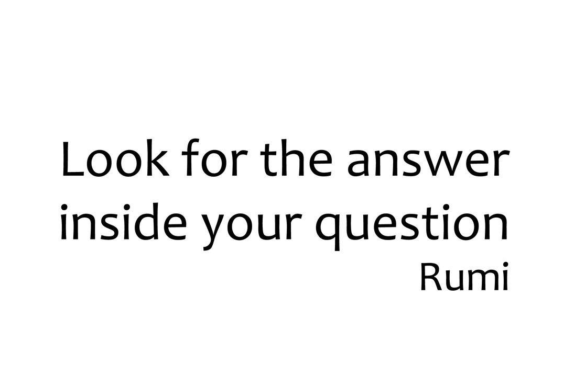

Slide 3
What are the answers inside these questions?
I’m always LATE for my classes, what should I do?
I don’t DRINK enough WATER, what can the reason be?
I spent TOO MUCH MONEY, how can I manage this?

Slide 5
What do you think a problem is?
A matter or situation regarded as uncomfortable or harmful and needing to be dealt with and overcome.
https://www.menti.com/alfgotzr8egi

Slide 6
Puzzle

Slide 7
What are the common problems of the world nowadays?
Are there enough ways to solve those global problems? How?

Slide 8
Problems Introduce Us to Ourselves
﻿﻿﻿5. The Quickest Way to Gain Leadership: Problem Solving
Problems are what you deal with every day. Expecting anything other than that is being unrealistic. So if you’re a leader, don’t be surprised when problems arise and it’s your responsibility to solve them.

Slide 9
A Case Study
You are a student in the faculty of Engineering. You have 6 courses in a semester and each one of them has too many lectures to be studied. You started the semester by procrastinating your studies for one week. Then you continued and you reached the exam with no studied course.
What is the first step you should take to overcome this situation?
Which technique do you use to manage your time during the exam period?
Will you quit or continue? Why?

Slide 10
ACTIVITY ☺
Work with your group,
Read the case study and discuss among yourselves,
Find an applicable solution for it,
Note down the problem with its solutions on the mind map in front of you.
20 minutes
Team work

Slide 11
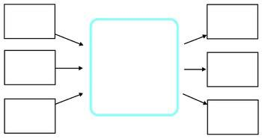
Mind Maps

Slide 12
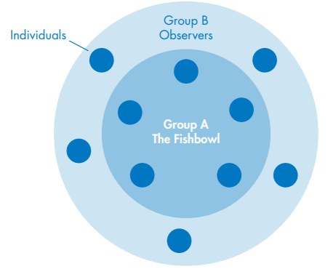
Discussion
THANK YOU
Insert the Subtitle of Your Presentation

Slide 13
How much I can go?
01
Belongs to what you need to do alone by yourself,
How much time do I have?
02
Belongs to your time management while trying to solve any problem,
Where can I go?
03
The 4 Q.s to Solve a Problem
Belongs to any point that you can go for solving your problem,
Who should I talk to?
04
Belongs to the people who may be able to help you with solving your problem.

Slide 14
Zoom Out
Focus In
Disconnect

Slide 15
Think Outside the Box !
When you face a problem, try to look at the problem as a guest not as an enemy, so that you can sit with it,
There are NO problems in this world without solution,
Give yourself enough TIME and SPACE to feel the problem and THINK of any steps for solution,
Do not forget that, YOU ARE NOT YOUR PROBLEM, and your whole life is not equal to that one problem,
DO not take problems PERSONALLY, sometimes people may project their insecurities to you.

Slide 16
So, surely with
hardship
comes ease.
CONCLUSION

Slide 17
TASK ☺
Write down a problem with its details and find one to three solutions for it. Mention the timing of the solution. You may breakdown the problem according to the (4 Q.s technique).
Deadline: after 10 days

