Slide 1
General INTRODUCTION pharmacology and clinical pharmacology
Asst. Prof. Dr. Jaafaru Sani Mohammed
Clinical Pharmacology, MA 411
Summer Semester
Week 1-1
14/08/2024

Slide 2
Semester activities
First Quiz – 10%
Second Quiz – 10%
Assignment – 5%
Daily class activities – 5%

Slide 3
Outline
General Introduction of the course.
Topics to be covered in the course.
Familiarization of terminologies.

Slide 4
Objectives
At the end of the lesson, the students should be able to:
Understand what Clinical pharmacology is all about.
Familiarized themselves with some common terminologies
Ask and respond to questions pertaining to the lesson

Slide 5
Topics to cover for the semester
General Introduction
Nature of drug
Drug discovery and development
Mechanisms of drug action
Pharmacokinetics
Pharmacodynamics
Pharmacogenomics
Pharmacotherapy
Antipsychotic drugs
Antidepressant drugs
Antiepileptic drugs
Drugs for Parkinson’s disease
Narcotic analgesics
Drugs for gout disease
Drugs for rheumatoid arthritis
Antihypertensive drugs

Slide 6
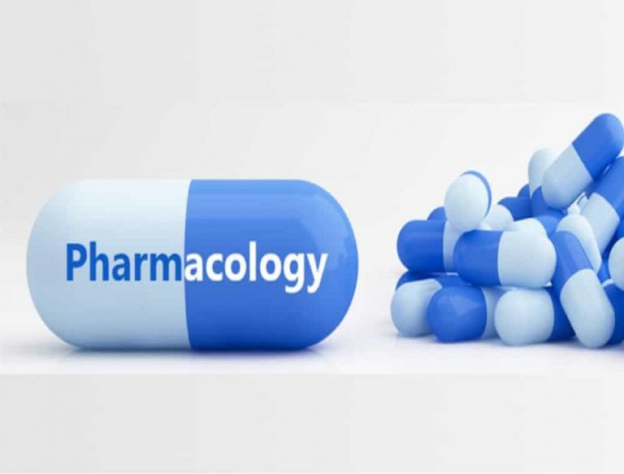
General Introduction and Terminologies
Pharmacology is the scientific study of the effects of drugs and chemicals on living organisms.
A drug can be broadly defined as any chemical substance, natural or synthetic, which affects a biological system.
Clinical pharmacology studies the effect of drugs on humans.

Slide 7
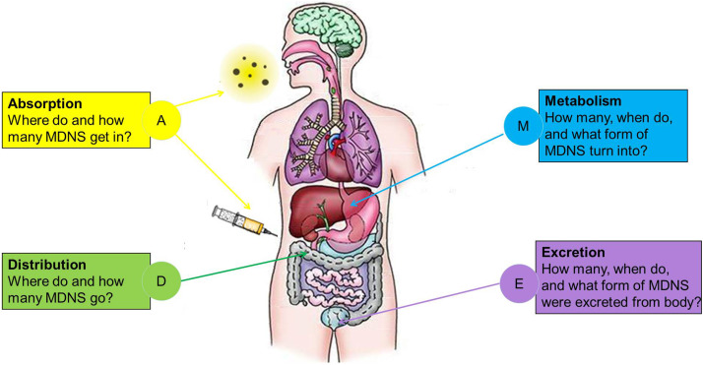
Pharmacokinetics (PK):
The study of how the body interacts with administered substances (drugs) for the entire duration of exposure

Slide 8
Pharmacodynamics (PD):
The study of a drug's molecular, biochemical, and physiologic effects or actions

Slide 9
Pharmacogenomics (PGx):
Is a field of research that studies how a person's genes affect how he or she responds to medications.

Slide 10
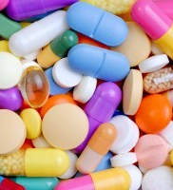
Pharmacotherapy (PT):
The treatment of health conditions by using pharmaceutical products (drugs) as medication

