Slide 1
Nature of drugs and its action
Asst. Prof. Dr. Jaafaru Sani Mohammed
Clinical Pharmacology, MA 411
Summer Semester
Week 1-2
14/08/2024

Slide 2
Semester activities
First Quiz – 10%
Second Quiz – 10%
Assignment – 5%
Daily class activities – 5%

Slide 3
Outlines
Introduction of the topic
Nature and size of drugs.
Major mechanisms of drug action.

Slide 4
Objectives
At the end of the lesson, the students should be able to:
The definition and meaning of some terminology in clinical pharmacology.
The nature of drugs in terms of shapes and sizes that influence their reactivity with receptors.
The importance of definite reactivity of drugs based on their physical nature

Slide 5
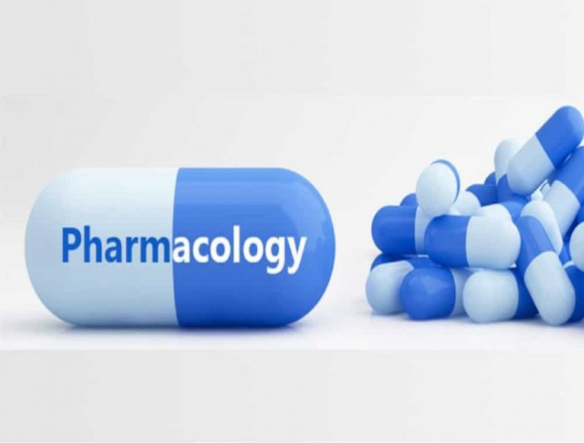
Introduction
Pharmacology is the scientific study of the effects of drugs and chemicals on living organisms.
A drug can be broadly defined as any chemical substance, natural or synthetic, which affects a biological system.
Clinical pharmacology studies the effect of drugs on humans.

Slide 6
Nature of drugs
A In most cases, the drug molecule interacts as an agonist or antagonist with a specific target molecule (receptor) that plays a regulatory role biologically.

Slide 7
Cont.
Antagonist drugs may interact directly with other drugs, whereas a few drugs interact almost exclusively with water molecules.

Slide 8
Physical nature of drug
A drug must have the appropriate size, charge, shape, and atomic composition to interact chemically.
A drug is administered at a location distant from its intended site of action (to be transported).

Slide 9
Cont.
A drug should act for an appropriate duration (be inactivated or excreted).
Drugs may be solid, liquid, or gaseous (determines the best route).

Slide 10
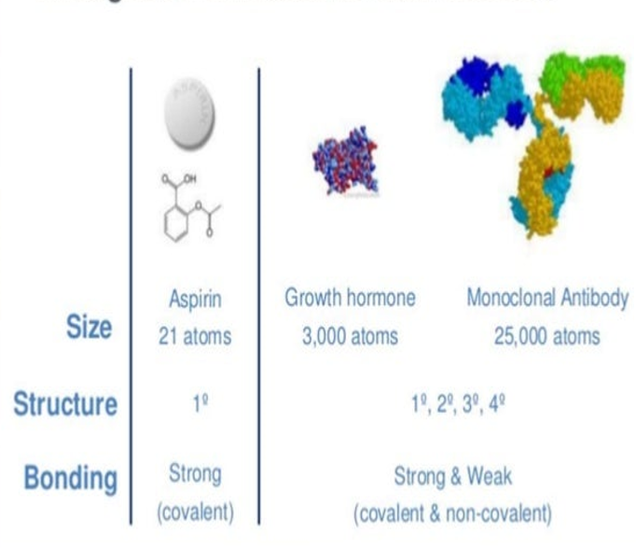
Size of drug
The molecular size of drugs varies from very small to very large but most of them MW between 100 and 1000.
To achieve a unique selective binding, a drug must be sufficient in shape, charge, and other properties (at least 100 MW).

Slide 11
Cont.
Drugs much larger than MW 1000 do not diffuse readily between compartments of the body.
Large drugs (usually proteins) must often be administered directly into the compartment where they have their effect.

Slide 12
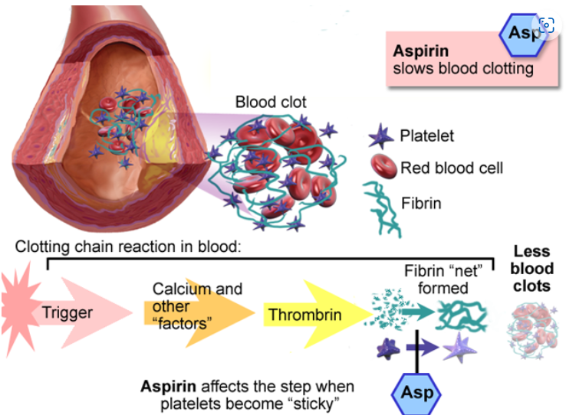
Drug Reactivity & Receptor Bonds
Drugs interact with receptors by means of chemical forces (covalent, electrostatic, and hydrophobic).

Slide 13
Cont.
Thus, the covalent bond formed between the acetyl group of acetylsalicylic acid (aspirin) and cyclooxygenase in platelets, is not readily broken.

Slide 14
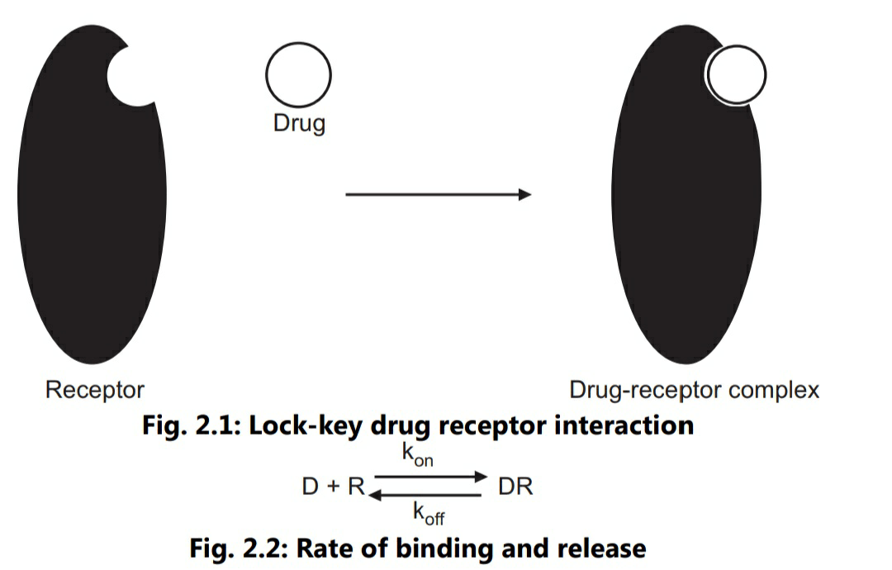
Drug shape
The shape of a drug molecule must be appropriate enough to permit binding to its receptor site.

Slide 15
Cont.
Optimally, the drug’s shape is complementary to that of the receptor site in the same way that a key is complementary to a lock.

Slide 16
Summary
Pharmacology is referred to as the study of substances that interact with living systems through chemical processes.
Drug molecule interacts as an agonist or antagonist with a specific target molecule that regulates biological function.

Slide 17
Cont.
Size, charge, shape, and atomic composition entail the about drug’s interaction with other molecules chemically.
Covalent, electrostatic, and hydrophobic forces are the major chemical bonds for drug interaction with its molecules.

