Slide 1
Drug Principles and mechanisms of Actions
Asst. Prof. Dr. Jaafaru Sani Mohammed
Clinical Pharmacology (MA 411)
Summer Semester
Week 2-1
22/08/2024

Slide 2
Outlines
Introduction
Principle of drug action and underlying elements.
Summary
Take home messages

Slide 3
Objectives
At the end of the lesson, the students should be able to understand:
The basic principles of drug action.
Types of mechanisms through which drugs act.
Differences between classic and modern mechanisms of drug actions.

Slide 4
Introduction
Drug action is regarded as biochemical reactions through which the drug produces its effects on the target site.
The first requirement for drug action is drug delivery to the site of action.
Drugs are delivered to their site of action through the body’s circulatory system.

Slide 5
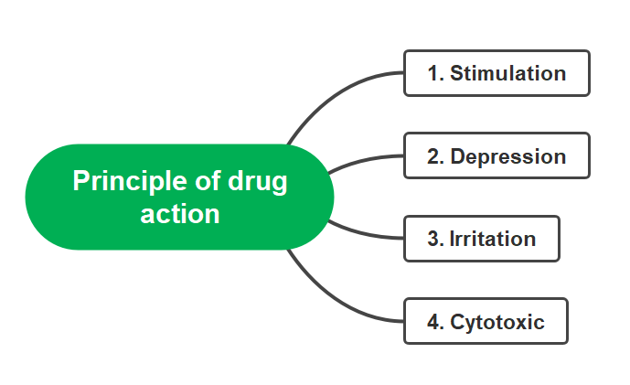
Principles of drug action
The principle states that newly administered drug (except genetic-based drugs) does not trigger a new action on the target site or on any cell, tissue, organ, or organ system.
The administered drug, however, changes the pace or speed of ongoing activity.
The principles of drug action include Stimulation, Depression, Irritation, Replacement, and Cytotoxic action.
Principles elements of
drug action

Slide 6
Stimulation
Administered drug selectively enhances the activity of the specialized cell. E.g.
Adrenaline selectively enhances the activity of the heart.
Pilocarpine enhances the activity of salivary glands.
Excess stimulation turns to depression (Picrotoxin- CNS stimulant- Convulsion- coma- death). The

Slide 7
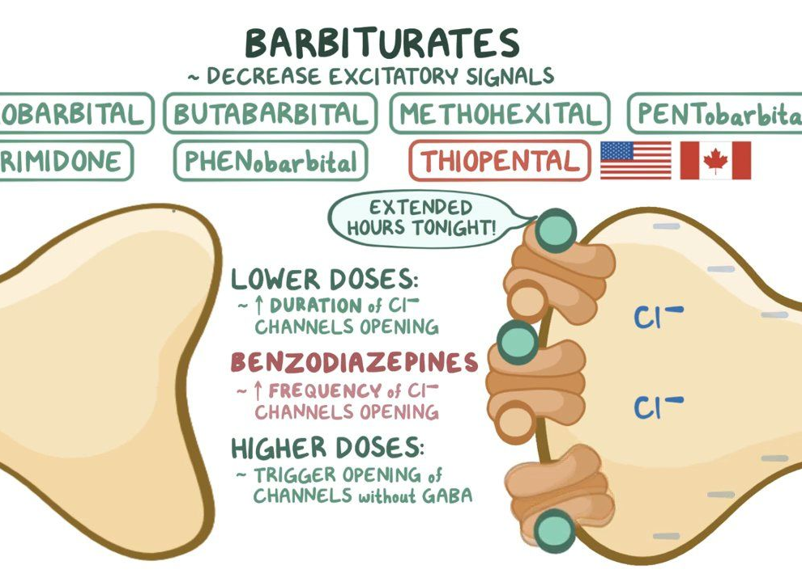
Depression
Depression is the opposite of Stimulation.
When a drug is administered it selectively decreases the activity of the specialized cell. E.g.
Quinidine depresses the heart cells.
Barbiturates depress the CNS cells and produce sedative and hypnotic effects.

Slide 8
Irritation
Irritation is an unwanted noxious effect, undesirable to the human body.
The non-selective and noxious effect occurs on non-specialized cells such as epithelial cells and connective tissue.
Irritation may be mild or sometimes severe. E.g.
Production of bitterness that increases salivary and gastric secretions.
However, Counter-irritants produce increased blood flow to the site.

Slide 9
Replacement
Replacement signified utilization of other substitutes in place of the actual molecules.
This refers to the use of natural substances such as metabolites and hormones in the deficiency state of the actual drug. E.g.:
Use of L-dopa in place of dopamine during Parkinsonism.
Use of synthetic insulin in diabetes mellitus.
Iron supplement in iron deficient anemia.

Slide 10
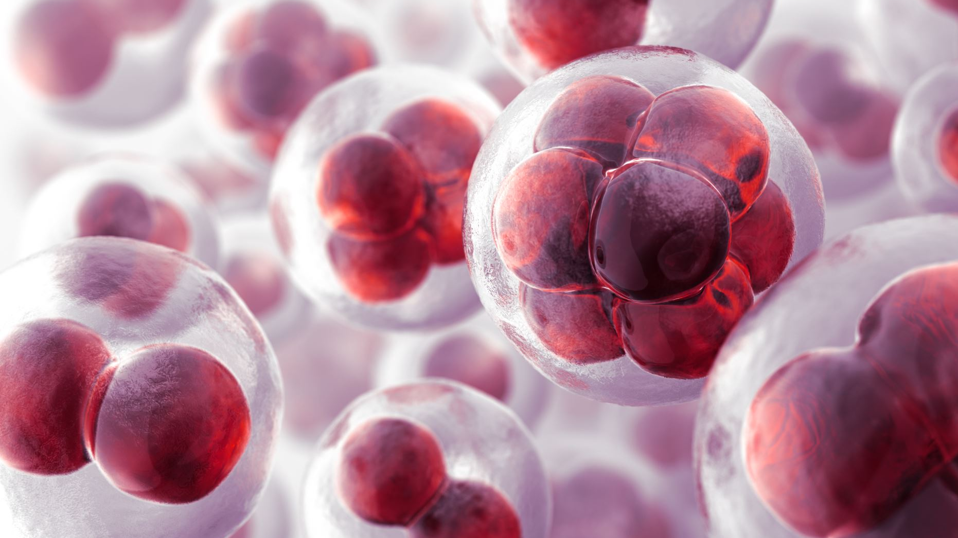
Cytotoxic action
Cytotoxic action refers to the process of producing harmful effect(s) by a drug against only the affected cell(s), not the normal cell.
This is seen in cancer therapy, where the drug shows its significant effect on the cancerous cell only and most other cells are unaffected or have minimal effect.

Slide 11
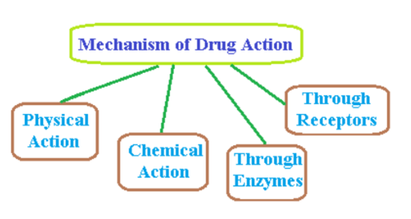
Drug mechanism of action
Broadly, mechanism of drug action can be categorized as the

Slide 12
Physical action
Physical is determined by the physical property of the drug.
Mechanism of action of Bulk Laxatives such as polysaccharides.
It forms a hardy mass in the intestine by absorbing water around it and blocking the lumen which creates pressure with consequent smooth peristalsis

Slide 13
Chemical action

Slide 14
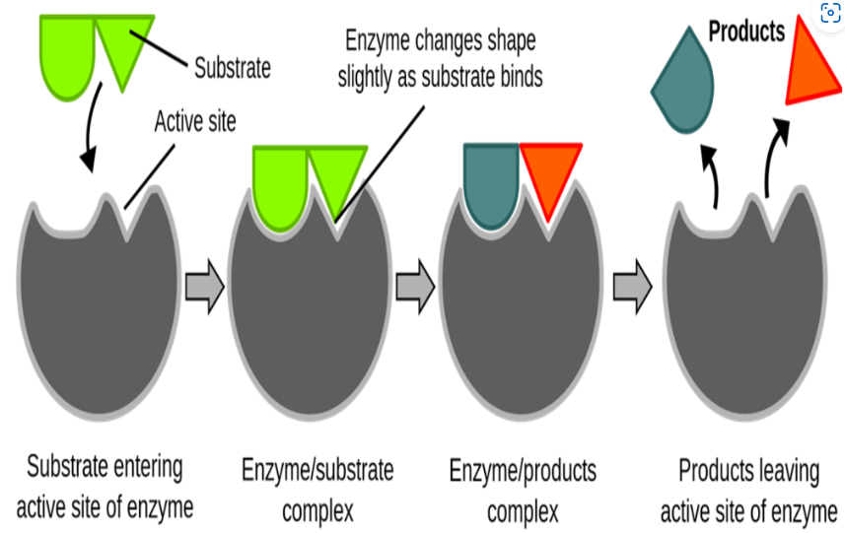
Enzymatic reaction
Enzymes are proteins that speed up of chemical reactions without taking part and can be recovered.
All reactions in living system are carried out with the help is enzymes.
Drugs form complexes with enzymes and influence the rate of enzymatic activity.

Slide 15
Sub-Types
Enzyme stimulation
Stimulation of enzyme increases the affinity of the substrate to an enzyme.
Many endogenous mediators and modulators get stimulated by enzymes.
Pyridoxine increases decarboxylase activity.
Adrenalin stimulates Adenylyl cyclase.

Slide 16
Cont.
Enzyme inhibition:
Inhibition of enzymes is a more common mechanism of drug action as compared to enzyme stimulation.
Sub-type
Non-Specific Inhibition: As the name implies alcohols as drugs denature the tertiary/quaternary structure of the enzyme, thus affecting its function negatively.
Specific inhibition: As the name implies, the drug affects a specific enzyme and denatures it. Thus, affecting its function negatively.

Slide 17
Division of specific inhibition
Competitive type
Competitive inhibition: The drug competes with the normal substrate and binds to the catalytic site. E.g. Neostigmine competes with Ach to cholinesterase.
Non-competitive inhibition: The inhibitor reacts with the enzyme on the allosteric site to prevent substrate binding on the catalytic site.

Slide 19
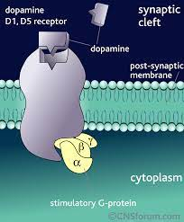
Through Receptors
Receptors are macromolecules that provide a specific site for drug binding to elicit biological action.
Outer surface, transverse, or Inner surface.
Generally, receptors provide binding sites for substances or chemical molecules to carry out further functions.

Slide 20
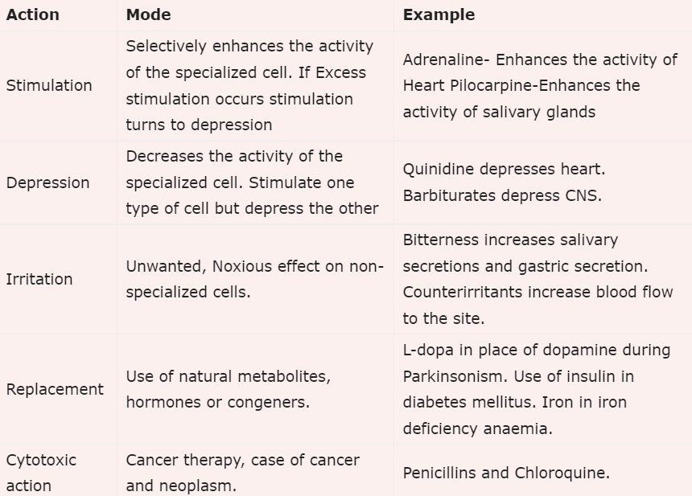
Summary of Drug’s Principle of Action

Slide 21
Summary
Stimulation, Depression, Irritation, Replacement, and Cytotoxic action are the principles of drug action.
The physical and chemically mediated actions are classical forms of drug action. However, they are upgraded to a universal standard.
The enzyme and receptor-mediated drugs are preferred for their better and more efficient actions
Majority of drugs act through the receptor-mediated response.

Slide 22
Take home message
State the principle of drug action and mention the underlying elements of the principle.
Mention one internal molecule/drug that acts as a stimulant in the body.
What is the function of Barbiturates on nerve cells in the body?
Cytotoxic drugs are drugs that affect all cells in the body. True/False
Enumerate the major mechanisms of drug action.
Enumerate the possible locations of drug-receptor molecules on the cell membrane.

