Slide 1
Pharmacokinetics (drug absorption)
Asst. Prof. Dr. Jaafaru Sani Mohammed
Clinical Pharmacology (MA 411)
Summer Semester
Week 2-2
22/08/2024

Slide 2
Outlines
Objectives
Introduction
Properties of membrane
Absorption from GIT
Absorption from lung
Absorption from skin
Absorption from parenteral routes
Bioavailability of drugs
Summary

Slide 3
Objectives
At the end of the lesson, the students should be able to understand:
Crucial role of drug absorption in pharmacokinetics
The role of biological membranes in drug absorption.
The importance of routes of drug administration in connection to drug absorption.
The factors affecting bioavailability of drugs.

Slide 4
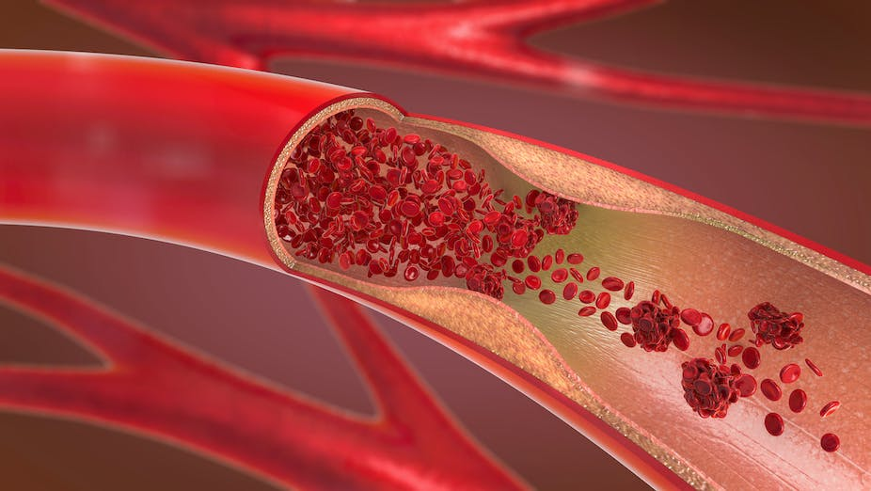
Introduction
All administered drugs go to bloodstream and get distributed unless they are to act topically.
To be effective, the drug must leave the vascular space and enter the intercellular or intracellular spaces or both.
The rate at which a drug reaches its site of action depends on the rate of absorption and distribution.
Absorption is the passage of the drug from its site of administration into the blood, while distribution is the delivery of the drug to the tissues.

Slide 5
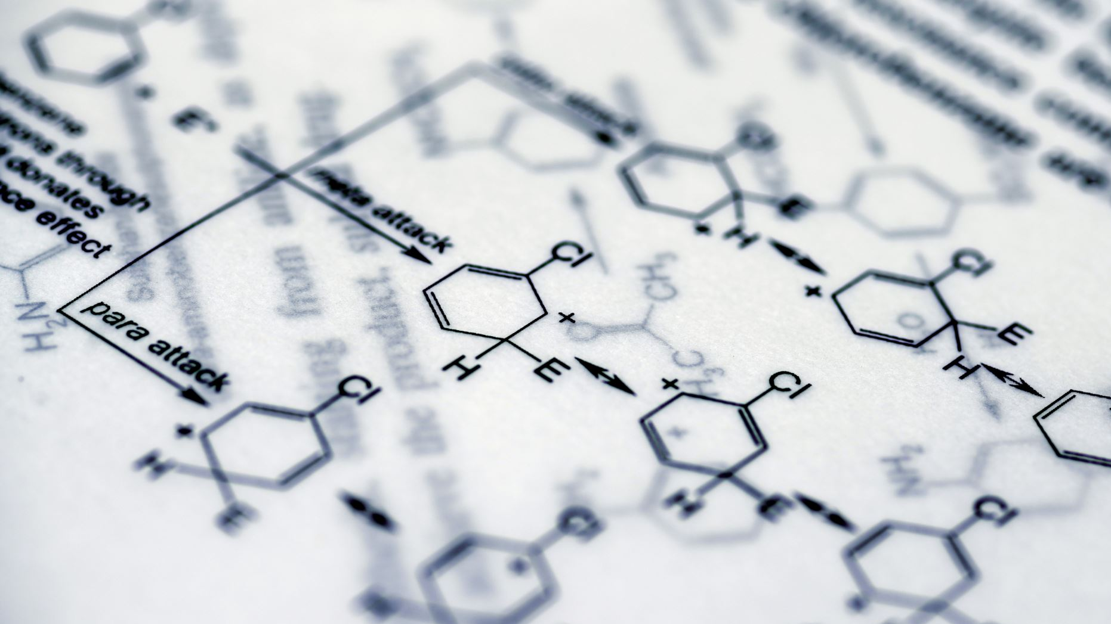
Introduction
To reach its site of action, a drug must cross a number of biological barriers and membranes, predominantly lipid.
Competing processes, such as binding to plasma proteins, tissue storage, metabolism, and excretion, determine the amount of drug finally available for interaction with specific receptors.
The mere presence of a drug in the blood, however, does not lead to a pharmacological response.

Slide 6
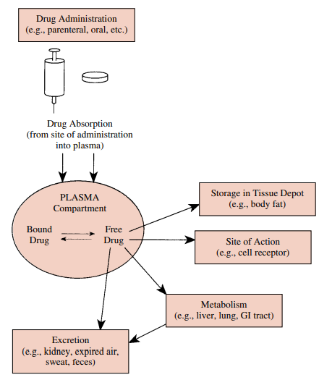

Slide 7
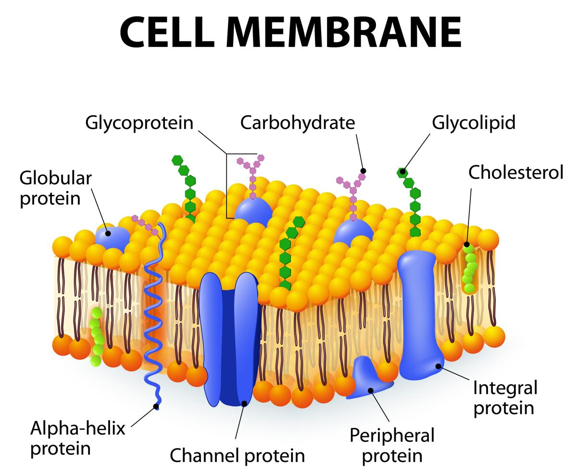
Properties of Biological Membranes That Influence Drug Passage
Most foreign compounds penetrate cells by diffusing through lipid membranes.
While few substances with low molecular weight and charges can diffuse freely.
Physicochemical Properties of Drugs and the Influence of pH determine their absorption.

Slide 8
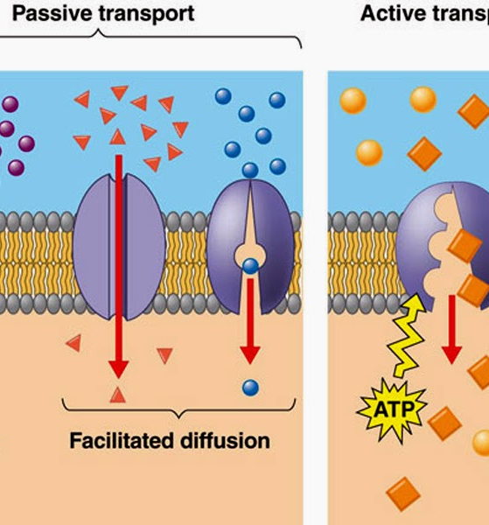
Solute Transport Across CM
All routes of drug administration require transported into the systemic circulation, except for intravenous administration.
A drug is said to be absorbed only when it has entered the blood or lymph capillaries.
The transport of drugs across membranes entails following processes:
passive diffusion, filtration, bulk flow, active transport, facilitated transport, ion pair transport, endocytosis, and exocytosis.

Slide 9
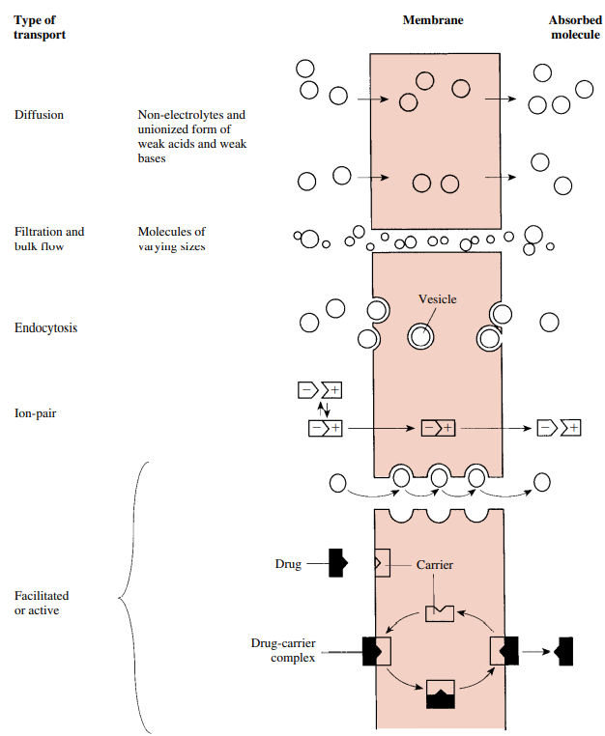
Solute Transport Across Membranes

Slide 10
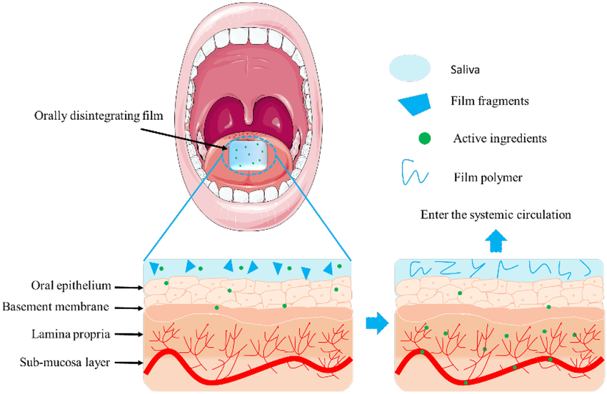
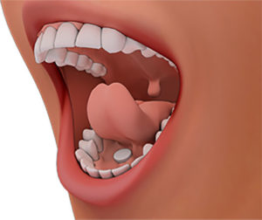
Absorption from the Alimentary Tract
Oral Cavity and Sublingual Absorption:
Drugs absorbed from the oral cavity enter the general circulation directly. Diffusion process is very rapid for un-ionized drugs.
The oral mucosa is highly vascularized and its epithelial lining is quite thin.
Drug absorption from the oral cavity is limited due to the slow dissolution rate.
These difficulties may be overcome if the drug is placed under the tongue (sublingual administration) or between the cheek and gum (buccal cavity)

Slide 11
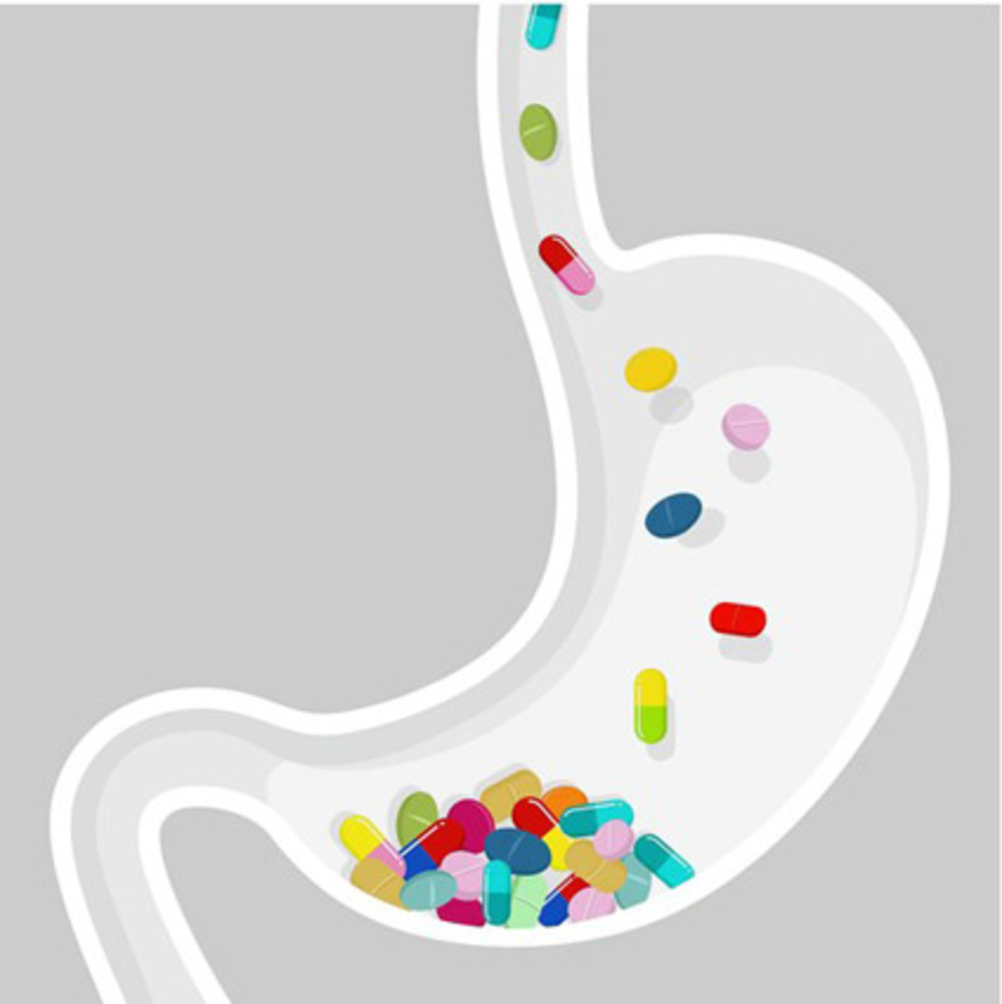
Absorption from the Stomach
The rich blood supply and the contact of stomach contents with epithelial lining of the gastric mucosa provide a potential site for drug absorption.
Many variables can alter stomach emptying time making the extent of gastric absorption vary from patient to patient.
The low pH of the gastric contents (pH 1–2) may have consequences for absorption because it can affect the degree of drug ionization.

Slide 12
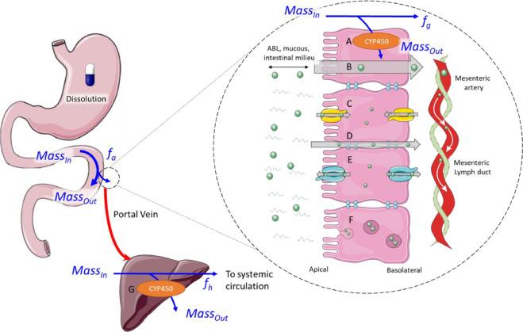
Absorption from the Small Intestine
The epithelial lining of the small intestine consists of many villi and microvilli and has a complex supply of blood vessels into which drugs are absorbed.
The small intestine, with its large surface area and high blood perfusion rate, has a greater capacity for absorption than does the stomach.
Most drug absorption occurs in the proximal jejunum, & the predominant process for most drug absorption is through diffusion.
Thus, the pKa of the drug and the pH of the intestinal fluid (pH 5) strongly influence the rate of drug absorption.

Slide 13
Absorption from the Large Intestine
The large intestine has a considerably smaller absorptive surface area than the small intestine.
Little absorption occurs from LI site, since the relatively solid nature of the intestinal contents impedes diffusion of the drug.
The most distal portion of the large intestine, the rectum, can be used directly as a site of drug administration.
Although the surface area available for absorption is not large, absorption can still occur, owing to the extensive vascularity of the rectal mucosa.
Drugs absorbed from the rectum largely escape the biotransformation to which orally administered drugs are subject.

Slide 14
Absorption from the Lung
The lungs serve as a major site of administration for a number of agents given for both local and systemic effects.
Such drugs can be inhaled as gases (volatile anesthetics) or as aerosols (suspended liquid droplets or solid particles).
Absorption of agents from the lung is facilitated by the large surface area of the pulmonary alveolar membranes.
Pulmonary absorption of volatile anesthetics across the alveolar-capillary barrier is very rapid because of the relatively high lipid–water partition coefficients.

Slide 15
Absorption of Drugs through the Skin
Most drugs that have been incorporated into creams or ointments are applied to the skin for their local effect.
The diffusion rate of drug through the skin is largely determined by the compound’s lipid–water partition coefficient.
Even highly lipid-soluble compounds will be absorbed much more slowly through the skin than from other sites.
If penetration of the skin by lipid-insoluble compounds does occur, it is probably accomplished by diffusion through the hair follicles, sweat glands, or sebaceous glands

Slide 16
Absorption from Parenteral routes
Intramuscular and Subcutaneous (IM & SC):
IM and SC injections - most common parenteral drug administration.
Drug absorption generally is more rapid via IM than SC.
Drug absorption from IM and SC sites depends on the quantity and composition of the connective tissue and the capillary density in the area.
Advantages of the IM and SC routes include increased reliability and precision in the drug blood level & reasonable rapid drug absorption and action.

Slide 17
Cont.
Intravenous (IV) Administration:
IV drug administration ensures immediate pharmacological response.
Problems of absorption are circumvented because the entire quantity of the drug enters the vasculature directly (useful for poorly absorbed drugs.
The rate of injection should be slow enough to prevent excessively high local drug concentrations & termination of undesired effects.
A serious disadvantage of IV drug administration becomes clearly apparent when an overdose is inadvertently given.

Slide 18
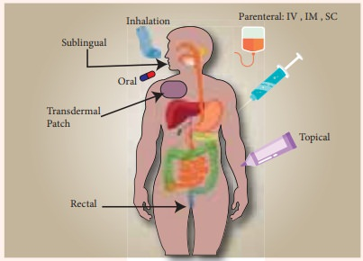

Slide 19
Bioavailability (BA) of Drug
BA refers to the extent and rate at which the active moiety (drug or metabolite) enters systemic circulation.
BA of a drug is largely determined by the properties of the dosage form, which depend partly on its design and manufacture.
Differences in BA among formulations of a given drug can have clinical significance; thus, knowing whether drug formulations are equivalent is essential.

Slide 20
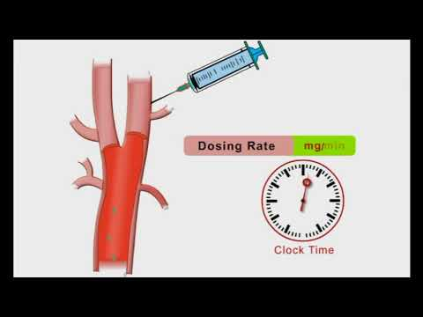
Cont.
Types of bioavailability are as follows:
Absolute Bioavailability?
Relative Bioavailability?
ABA: When the route of administration is IV, the BA achieved will be 100%. And If the reference standard is an IV dose, it is referred to as absolute BA.
RBA: It is the BA of the drug when obtained and it is compared with a reference standard. If the reference standard is not via IV, it is referred to as RBA.

Slide 21
Cont.
Factors affecting Drugs Bioavailability
Physiochemical ppts:
State of the drug (solution, suspension, or solid form)
Particle Size (small size have higher surface area)
pKa value and state of ionization (non-ionized drugs are better)
Partition coefficient PC (Increase in PC increases drug bioavailability)
Partition Coefficient is referred to as the ratio of solubility of the drug in a non-aqueous solvent to the ratio of drug in an aqueous solvent]
Route of administration (Parenteral route “100% Bioavailable”)
Plasma protein binding (when binds to the drug, BA increases) compare to free drugs

Slide 22
Cont.
Dosage form (Solution>Suspension>Powder>Tablets>Capsules)
Dissolution Rate (The higher the DR the higher the BA of a drug)
Biological Factors:
GIT flora (the drug administered via oral route has decreased BA)
Disease Status (severe reoccurring disease decreases BA of a drug)

Slide 23
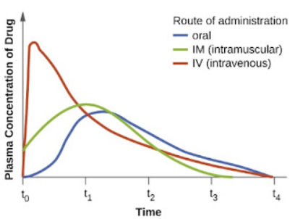

Slide 24
Summary
Proper absorption of drugs is key to the manifestation of their pharmacological action.
The route of drug administration determines the rate of absorption of drugs.
All drugs get to the bloodstream for distribution and absorption to cells for metabolism and pharmacological action.
The large intestine has a lower absorption rate than the small intestine.
Intravenous administration of drugs remains the most effective for certain drugs, followed by IM & SC.

