Slide 1
Pharmacokinetics (drug METABOLISM)
Asst. Prof. Dr. Jaafaru Sani Mohammed
Clinical Pharmacology (MA 411)
Fall Semester
Week 3-2
29/08/2024

Slide 2
Outlines
Objectives
Introduction
Types of metabolic reactions
Site of drug metabolism
Determinants of Drug Metabolism
Factors affecting drug metabolism Summary

Slide 3
Objectives
At the end of the lesson, the students should be able to understand:
The general concept and importance of drug metabolism.
The important pharmacological terminologies used in the lecture.
The types of reactions (phase I and Phase II) involved in drug metabolism.
The general factors that affect the metabolism of drugs in the body.
The mechanisms involved in biotransformation of drugs in the body

Slide 4
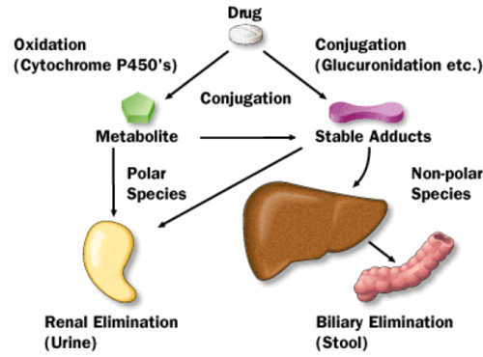
Introduction
Drug metabolism, also known as the Biotransformation process, is an important mechanism by which the body terminates the action of many drugs or activates prodrugs.
Most drugs are relatively lipid soluble as given, a characteristic needed for absorption across membranes.
The same property would result in very slow removal from the body because the unchanged molecule would also be readily reabsorbed from the urine in the renal tubule.
The body hastens excretion by transforming many drugs to less lipid soluble, less readily reabsorbed forms.

Slide 5
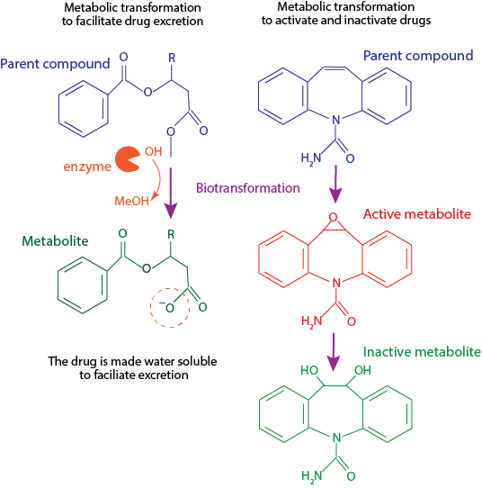

Slide 6
Cont.
All organisms are exposed to foreign chemical compounds (xenobiotics) in the air, water, and food.
To ensure elimination of drugs and to terminate the action of many endogenous substances, evolution has provided metabolic pathways that alter the activities of such compounds and their susceptibility to excretion.

Slide 7
Phase I reactions | Reactions that convert the parent drug to a more polar (water-soluble) or more reactive product by unmasking or inserting a polar functional group such as —OH, —SH, or —NH₂.
Phase II reactions | Reactions that increase water solubility by conjugation of the drug molecule with a polar moiety such as glucuronate, acetate, or sulfate.
CYP isozymes | Cytochrome P450 enzyme species (eg, CYP2D6 and CYP3A4) are responsible for much of drug metabolism.
Enzyme Induction | Stimulation of drug-metabolizing capacity; usually manifested in the liver by increased synthesis of smooth endoplasmic reticulum (which contains high concentrations of phase I enzymes).
P-glycoprotein, MDR-1 | An ATP-dependent transport molecule found in many epithelial and cancer cells. The transporter expels drug molecules from the cytoplasm into the extracellular space. In epithelial cells, expulsion is via the external or luminal face.

Slide 8
Types of Metabolic reactions
Phase I Reaction
Phase I reactions include oxidation (by the cytochrome P450 enzymes), reduction, deamination, and hydrolysis.
Phase I enzymes are found in high concentrations in the smooth endoplasmic reticulum of the liver.
They are not highly selective in their substrates, so a relatively small number of P450 isoforms are able to metabolize thousands of drugs.
Most of the oxidation reactions in phase I are conducted by CYP450s family.

Slide 9
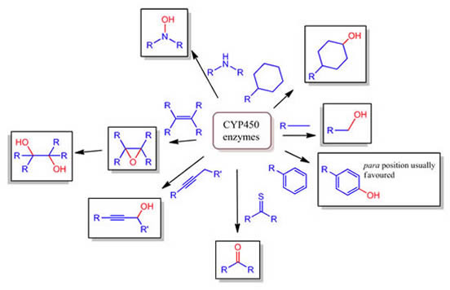

Slide 10
Cont.
B. Phase II Reactions
Phase II reactions are synthetic reactions that involve addition (conjugation) of subgroups to —OH, —NH₂, and —SH functions on the drug molecule.
The subgroups that are added include glucuronate, acetate, glutathione, glycine, sulfate, and methyl groups.
Most of these groups are relatively polar and make the product less lipid-soluble than the original drug molecule.
Like phase I enzymes, phase II enzymes are not very selective. Drugs that are metabolized by both routes may undergo phase II metabolism before or after phase I.

Slide 12
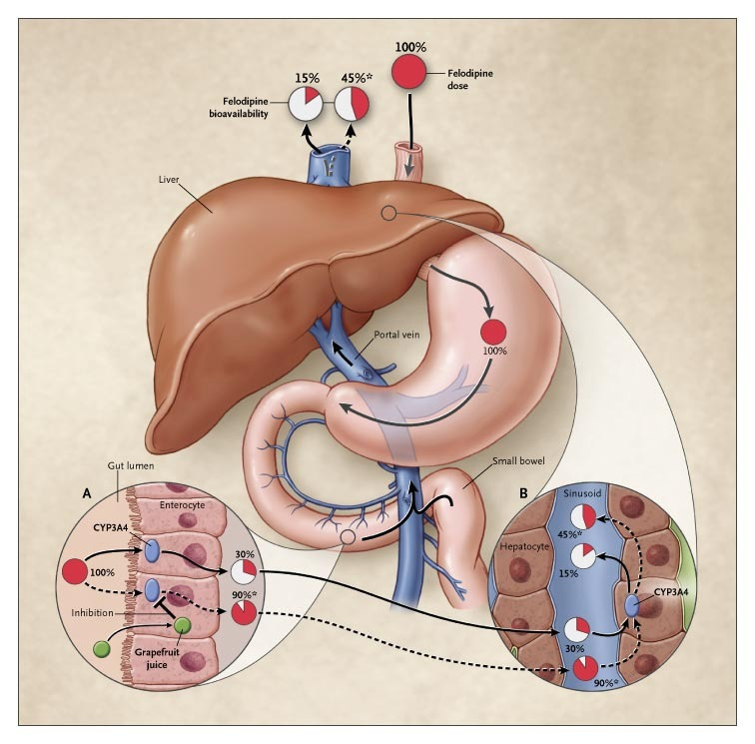
Site of drug metabolism
The most important organ for drug metabolism is the liver.
The kidneys play an important role in the metabolism of some drugs.
A few drugs (eg, esters) are metabolized in many tissues (eg, liver, blood, intestinal wall) because of the wide distribution of their enzymes.

Slide 13
Site of drug metabolism

Slide 14
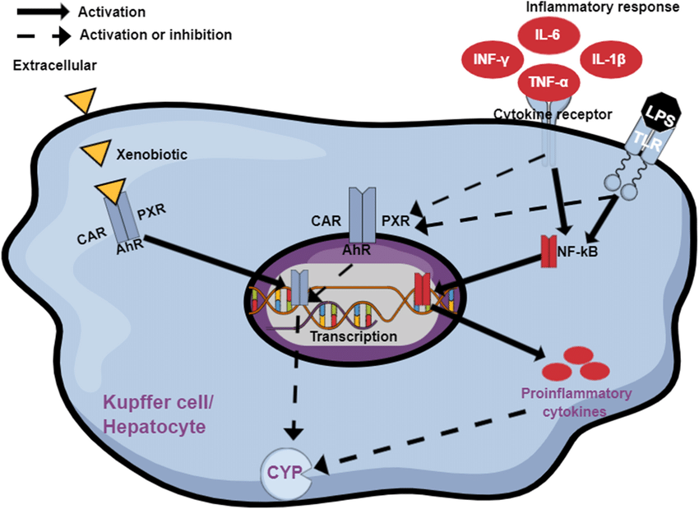
Determinants of Drug Metabolism
The rate of biotransformation of a drug may vary markedly among different individuals.
Some of this variation is due to genetic factors, a variety of drugs may induce or inhibit drug-metabolizing enzymes to a larger extent.
Smoking is a common cause of enzyme induction in the liver and lung and may increase the metabolism of some drugs.
For a few drugs, age or disease-related differences in drug metabolism are significant. In humans, gender is important for only a few drugs. (First-pass metabolism of ethanol is greater in men than in women.)

Slide 15
Major Factors affecting Drug Metabolism
A. Genetic Factors
Several drug-metabolizing systems have long been known to differ among families or populations in genetically determined ways.
Because recent advances in genomic techniques are making it possible to screen for a huge variety of polymorphisms.
It is expected that pharmacogenomics will become an important part of patient evaluation in the near future.
The development would influence both drug choice and drug dosage

Slide 16
Cont.
B. Effects of Other Drugs
Coadministration of certain agents may alter the disposition of many drugs (Drug-Drug interaction).
This could be done through the following mechanisms:
Enzyme induction:
Induction (increased rate of drug metabolism) results from increased synthesis of CYP450 enzymes in the liver as well as the cofactor, heme.
Several cytoplasmic drug receptors have been identified that result in activation of the genes for P450 isoforms.

Slide 17
Cont.
Drugs and other xenobiotics that increase enzyme activity are known as inducers.
Several days are usually required to reach maximum induction; a similar amount of time is required to regress after withdrawal of the inducer.
The most common strong inducers of drug metabolism are carbamazepine, phenobarbital, phenytoin, and rifampin.

Slide 18
Cont.
2. Enzyme inhibition
The inhibitors of drug metabolism involved in serious drug interactions are furanocoumarins (in grapefruit juice), azole (antifungals), and ritonavir (HIV protease inhibitor).
Suicide inhibitors are drugs that are metabolized to products that irreversibly inhibit the metabolizing enzyme, they include ethinyl estradiol, norethindrone, spironolactone, etc.
Metabolism may also be decreased by pharmacodynamic factors such as a reduction in blood flow to the metabolizing organ.

Slide 19
Cont.
3. Inhibitors of intestinal P-glycoprotein
P-glycoprotein (P-gp), is an important modulator of intestinal drug transport.
Its functions are to expel drugs from the intestinal mucosa into the lumen, thus contributing to pre-systemic (first pass) elimination.
They are found in the BBB and in drug-resistant cancer cells. Their inhibitors include mibefradil (a calcium channel blocker), & furanocoumarin.
The Important drugs that are normally expelled by P-gp include digoxin, cyclosporine and saquinavir.

Slide 20
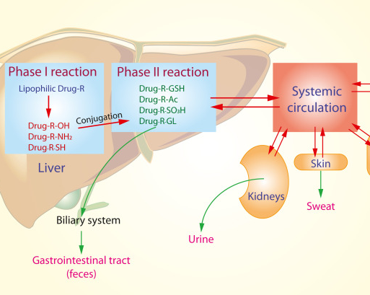
Summary

Slide 21
Drug metabolism vs drug elimination | Termination of drug action requires either removal of the drug from the body (excretion) or modification of the drug molecule (metabolism) so that it no longer has an effect. Both methods constitute drug elimination, and both are very important in the clinical use of drugs. Almost all drugs (or their metabolites) are eventually excreted, but for many, excretion occurs only after they have been metabolized to inactive products.
Induction and inhibition of drug metabolism | A large number of drugs alter their own metabolism and the metabolism of other drugs either by inducing the synthesis of larger amounts of the metabolizing enzymes (usually P450 enzymes in the liver) or by inhibiting those enzymes. Some drugs both inhibit (acutely) and induce (with chronic administration) drug metabolism.
Toxic metabolism | Some substances are metabolized to toxic molecules by drug-metabolizing enzymes. Important examples include methyl alcohol, ethylene glycol, and, at high doses or in the presence of liver disease, acetaminophen.

Slide 22
References
Huang, S. M., Lertora, J. J., & Atkinson Jr, A. J. (Eds.). (2012). Principles of clinical pharmacology. Academic Press.
Becker, D. E. (2013). Basic and clinical pharmacology of glucocorticosteroids. Anesthesia progress, 60(1), 25-32.
BERTRAM G KATZUNG, K. A. T. Z. U. N. G. (2021). Basic & clinical pharmacology. EGC.
Hedaya, M. A. (2012). Basic pharmacokinetics. CRC Press.
Atkinson Jr, A. J. (2022). Introduction to clinical pharmacology. In Atkinson's Principles of Clinical Pharmacology (pp. 1-10). Academic Press.

