Slide 1
Isolation of genomic and plasmid dna from bacteria
Dr. Salah Tofik Balaky
Miss Amna
Course: Molecular Biotechnology
MA Code408
Summer school: Week 1
Date 18/ 8/ 2024

Slide 2
Isolation of Genomic DNA from E. coli
The isolation and purification of DNA from cells is one of the most common prerequisites in many techniques of Molecular Biotechnology applications.

Slide 3
Principle of DNA isolation
Many different techniques are available for isolating genomic DNA from bacterial cells; however, all follow the common steps od DNA isolation from bacterial cells.
1. lysis of cell.
2. Removal of proteins, carbohydrates, RNA etc.

Slide 4
Cell lyses
Cell walls and membrane disruptions usually are accomplished with an appropriate combination of enzymes to digest the cell wall (usually lysozyme) and detergents. to disrupt membranes. Most common ionic detergent used in this step is Sodium Dodecyl Sulphate (SDS).

Slide 5
Removing RNA and proteins
RNA is usually degraded by the addition of DNase free RNase. The resulting oligoribonucleotides are separated from the high-molecular weight DNA on the basis of their higher solubility in nonpolar solvents (usually alcohol/water). Proteins are subjected to chemical denaturation and/or enzymatic degradation by addition of proteinase-K. The most common technique of protein removal involves denaturation and extraction into organic phase viz. phenol and chloroform

Slide 6
Reagents Required for DNA isolation from E. coli and Their Role
1. Luria–Bertani Broth to grow E. coli.
2. Tris EDTA Buffer, As a major constituent of Tris EDTA (TE) buffer, Tris acts as a common pH buffer to control pH, while EDTA chelates cations like Mg2+. Thus, TE buffer is helpful to solubilise DNA and protect it from degradation.
3. Sodium Dodecyl Sulphate (SDS), SDS is a strong anionic detergent that can solubilise the membrane proteins and lipids. This will help the cell membranes to break down and expose the chromosomes to release DNA.

Slide 7
Reagents Required for DNA isolation from E. coli and Their Role
4. Proteinase-K, which has 2 main functions:
A/ It degrades most types of protein impurities to get a quality DNA product.
B/ It is responsible for the inactivation of nucleases, thus preventing damage of isolated DNA.
5. NaCl Solution. NaCl provides Na+ ions that block negative charge of phosphates of DNA. Negatively charged phosphate in DNA causes molecules to repel each other. The Na+ ions form an ionic bond with the negatively charged phosphates; thus, neutralise the negative charges and allowing the DNA molecules to come together.
6. Cetyl Trimethyl Ammonium Bromide ((CTAB) is a detergent that helps lyse the cell membrane.

Slide 8
Reagents Required for DNA isolation from E. coli and Their Role
7. Phenol: Chloroform: Isoamyl Alcohol: This is a method of liquid–liquid extraction. It separates mixtures of molecules based on differential solubility of the individual molecules in two different immiscible liquids.
8. Isopropanol: DNA is highly insoluble in isopropanol, and hence, isopropanol dissolves in water to form a solution that causes the DNA in the solution to aggregate and precipitate.

Slide 9
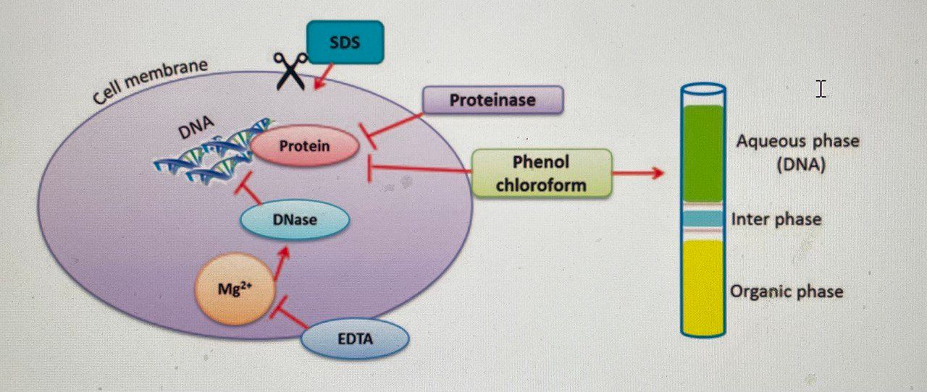
A schematic presentation of genomic DNA isolation from bacterial cell

Slide 10
Procedure
1. Grow a 5 ml bacterial culture and centrifuge (6000 rpm for 10 min) 1.5 ml of culture for 2 min a compact pellet is formed.
2. Discard the supernatant and resuspend the pellet in 567 µl TE buffer.
3. Add 30 µl of 10% SDS and 3 µl of 20 mg/ ml proteinase-K, mix thoroughly, and incubate for 1 h at 37°C.
4. Add 100 µl of 5 M NaCl and mix thoroughly. If NaCl concentration is <0.5 M, the nucleic acid may also precipitate.
5. Add 80 µl of NaCl solution and mix thoroughly.
6. Add 1 volume (0.7–0.8 ml) of 24:1 chloroform/isoamyl alcohol, mix thoroughly, and centrifuge at 6000 rpm for 4–5 min. Transfer supernatant to a fresh tube.
7. To the supernatant, add 1 volume of 25:24:1 phenol/chloroform/isoamyl alcohol, extract thoroughly, and centrifuge at 6000 rpm for 5 min. Transfer supernatant to a fresh tube.
8. To the supernatant, add 0.6 volume isopropanol and mix gently until a stringy white DNA precipitation. Centrifuge at 10,000 rpm for 10 min briefly at room temperature, discard supernatant, and add 100 µl of 70% ethanol to pellet.
9. Centrifuge this mixture for 5 min at room temperature, and dry the pellet by complete evaporation of ethanol.
10. Resuspend this dry pellet in 50 µl TE buffer to yield DNA. Typical yield is 5–20 µg DNA/ml starting culture (108–109 cells/ml).

Slide 11
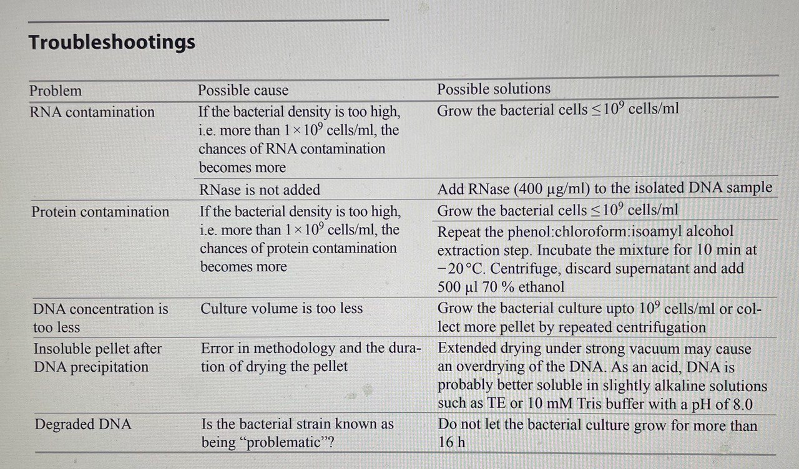
Principle of

Slide 12
Isolation of Plasmid DNA from bacteria
Plasmids used in genetic engineering are called as vectors, which are commonly used to multiply or express a particular gene. Plasmids can be introduced to bacterial cell by transformation, as bacteria divide rapidly they can be used as factories to generate DNA fragments in large numbers. Plasmids are the DNA molecules that are distinct from chromosome of bacterial cell and are capable of inherited stably without linking to the bacterial chromosome.

Slide 13
Principle
Plasmids need to be isolated from the bacteria to purify a specific sequence to use as vectors in molecular cloning. There are various methods and commercial kits available nowadays for the
isolation of pure and desired conformation of plasmid DNA, irrespective of their copy numbers, i.e. high or low.

Slide 14
Principle
As plasmid DNA is highly sensitive to mechanical stress, shearing forces such as vigorous mixing or vortexing should be avoided after cell lysis. In this context, all the mixing steps should
be carried out by careful inversion of the tubes several times rather than vortexing.

Slide 15
Main challenges in plasmid DNA isolation
The trickiest stage of plasmid isolation is the lysis of bacteria, as both incomplete lysis and total dissolution of the cell may result in reduced yield of plasmid DNA. As simple lysis of the cell generates huge amount of genomic DNA from bacteria of high-molecular weight, they can be separated from the plasmid DNA by high-speed centrifugation along with other cell debris.

Slide 16
Methods
The most popular method of isolating plasmid DNA is the use of Birnboim and Doly. This technique takes the advantage of the narrow range of pH difference (12.0–12.5), which denatures linear DNA but not covalently closed circular DNA. Thus, on lysozyme digestion cell wall of bacteria weakens and the cellular macromolecules come out of the cell due to the treatment of SDS and sodium hydroxide.

Slide 17
Methods
Chromosomal DNA remains in high-molecular weight form but becomes denatured. When neutralised with acidic medium, the chromosomal DNA renatures and aggregates to form an insoluble network. Additionally, high concentration of sodium acetate precipitates protein-SDS complexes and high-molecular weight RNA. As the pH of the alkaline denaturation is carefully controlled, the covalently closed circular form of plasmid DNA molecules still remain in their native form in the solution while other contaminating macromolecules coprecipitate. Thus, the precipitate can be removed by centrifugation to concentrate plasmid by ethanol precipitation. If necessary, plasmids can be purified further by gel filtration.

Slide 18
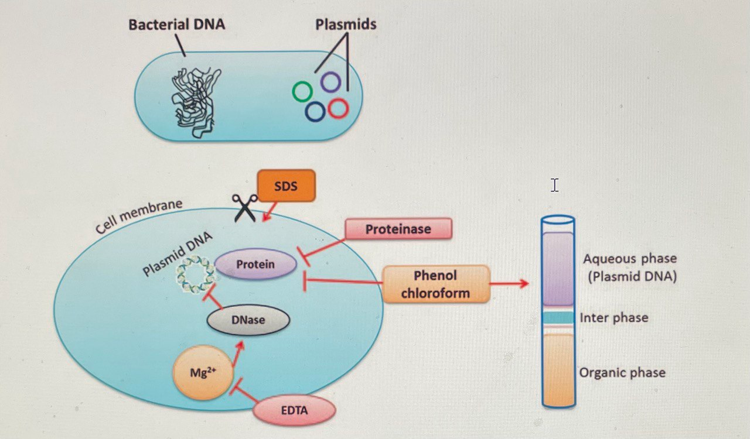
Materials and their role in plasmid DNA isolation

Slide 19
Reagents Required and Their Role
1. Luria–Bertani Broth.
2. Tris EDTA Buffer.
3. Glucose: During isolation of plasmid DNA, glucose is added in the lysis buffer to increase the osmotic
pressure outside the cells. Glucose maintains osmolarity and prevents the buffer from bursting the cells. Additionally, glucose is used to make the solution isotonic.
4. Ethylenedinitrilo Tetra-acetic Acid

Slide 20
Reagents Required and Their Role
5. Sodium Hydroxide: Sodium hydroxide is used to separate bacterial chromosomal DNA from plasmid DNA (circular).
6. Potassium Acetate: Potassium acetate is used to selectively precipitate the chromosomal DNA and other cellular debris away from the desired ds plasmid DNA.
7. Glacial Acetic Acid: It neutralises the alkaline conditions in the solution that have been developed by addition of NaOH to solution, which helps in the rapid renaturation of the plasmid DNA.

Slide 21
Procedure
1. Inoculate a single bacterial colony into 5 ml of LB broth medium and incubate the tube at 37 °C for 24 h with 180 rpm shaking.
2. Collect the bacterial cell pellet from the grown culture by centrifugation at 6000 rpm for 5 min at room temperature.
3. Discard the supernatant and resuspend the cell pellets with 600 µl of autoclaved TE buffer, again centrifuge at 6000 rpm for 5 min at room temperature and collect the cell.
4. Resuspend the cell pellet with 1 ml of icecold Solution I. Pipette up and down to completely resuspend the cell pellet.
5. Add 200 µl of Solution II to the suspension. Mix thoroughly by repeated gentle inversion. Avoid vortexing.
6. Add 1.5 ml ice-cold Solution III to the cell lysate. Do not vortex.
7. Look for the development of a white precipitate.
8. Centrifuge at 12,000 rpm for 30 min at 4°C.
9. Transfer the supernatant to a fresh tube.
10. Add 2.5 volume of isopropanol to precipitate the plasmid DNA. Mix thoroughly by repeated inversion without vortexing.
11. Centrifuge at 12,000 rpm for 30 min at 4°C.
12. Discard the supernatant to collect the pellet.
13. Rinse the pellet with ice-cold 70% ethanol followed by air drying for approximately 10 min to evaporate ethanol.
14. Add 50 µl of TE buffer to dissolve the pellet.
15. Add 2 µl of RNase (10 mg/ml) and incubate for 20 min at room temperature to remove RNA contamination.
16. Store the tube at −20°C till further use.

Slide 22
Next Lecture
RNA Extraction Methods

