Slide 1

PCR and RT-PCR in
Molecular Biotechnology
Dr. Salah Tofik Balaky
Miss Amna
Course: Molecular Biotechnology
MA Code408
Summer school: Week 3
Date 25/ 8/ 2024

Slide 2
Amplification of 16S rRNA Gene
The aim is to amplify 16S rRNA gene from bacterial genomic DNA by PCR. PCR is the exponentially progressing synthesis of the defined target DNA sequences in vitro. The molecular basis of identification of bacterial species deals with the amplification and sequencing of 16S rRNA gene followed by their comparison with the existing database. Comparison of rRNA gene sequences for bacterial identification has been extensively used for identification of many microorganisms.

Slide 3
PCR
PCR is called as chain because the products of the first reaction become the substrate of the following one and so on. PCR relies
on thermal cycling that consists of repeated heating and cooling of the reaction for denaturation of DNA followed by enzymatic replication of it.

Slide 4
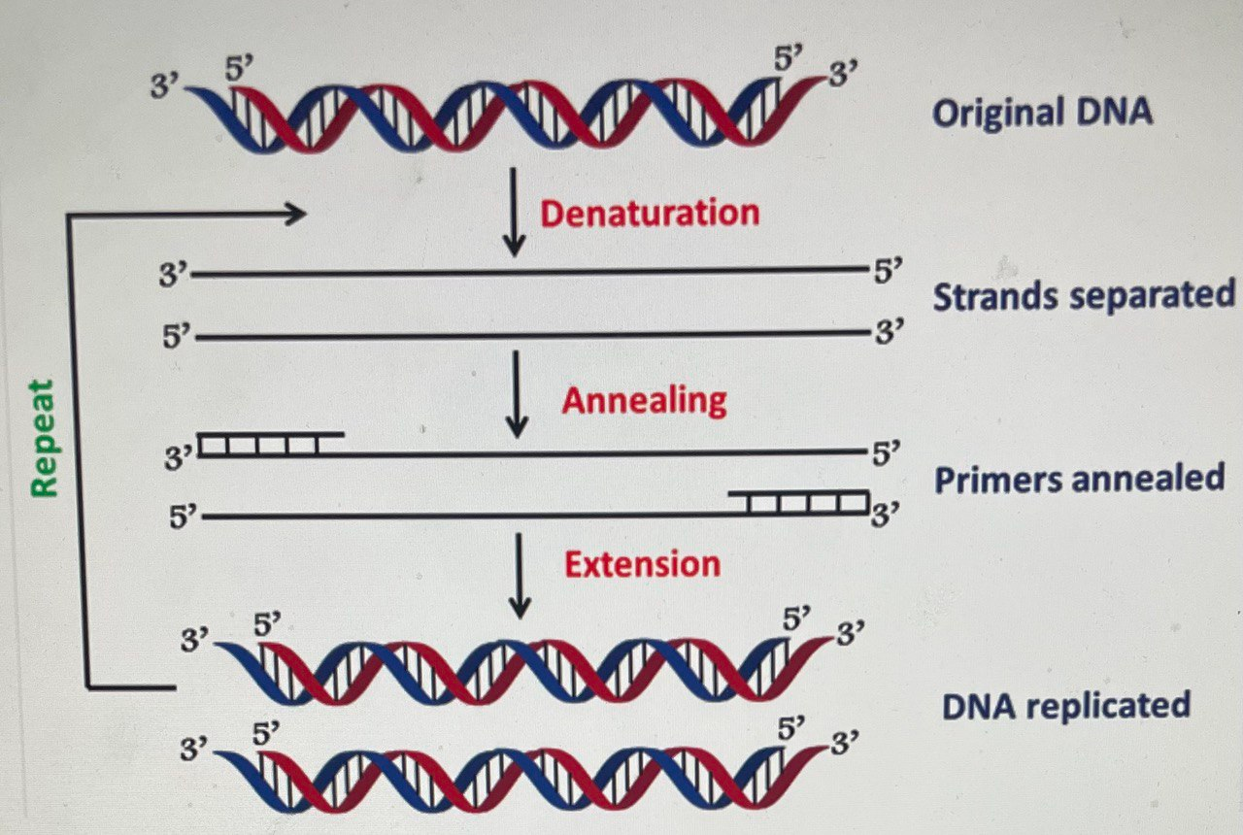
Generation of huge copy numbers of the desired gene fragment by polymerase chain reaction

Slide 5
PCR applications
There are many widespread applications of PCR in Molecular Biotechnology such as medical applications, infectious disease applications, forensic applications and gene cloning.
DNA cloning and DNA fingerprinting for forensic applications are some of the effective practical approaches of using PCR.

Slide 6
16S ribosomal RNA is a component of the 30S small subunit of prokaryotic ribosome having a length of 1.542 kb.

Slide 7
The reason behind the use of 16S rRNA gene amplification for identification purpose include:
1. Occurrence of the gene in all organisms performing the same function.
2. The gene sequence is conserved sufficiently containing conserved, variable and hypervariable regions.
3. 1500 bp of size, which is relatively easy to sequence and large enough to contain sufficient information for identification and analysis of phylogeny.

Slide 8
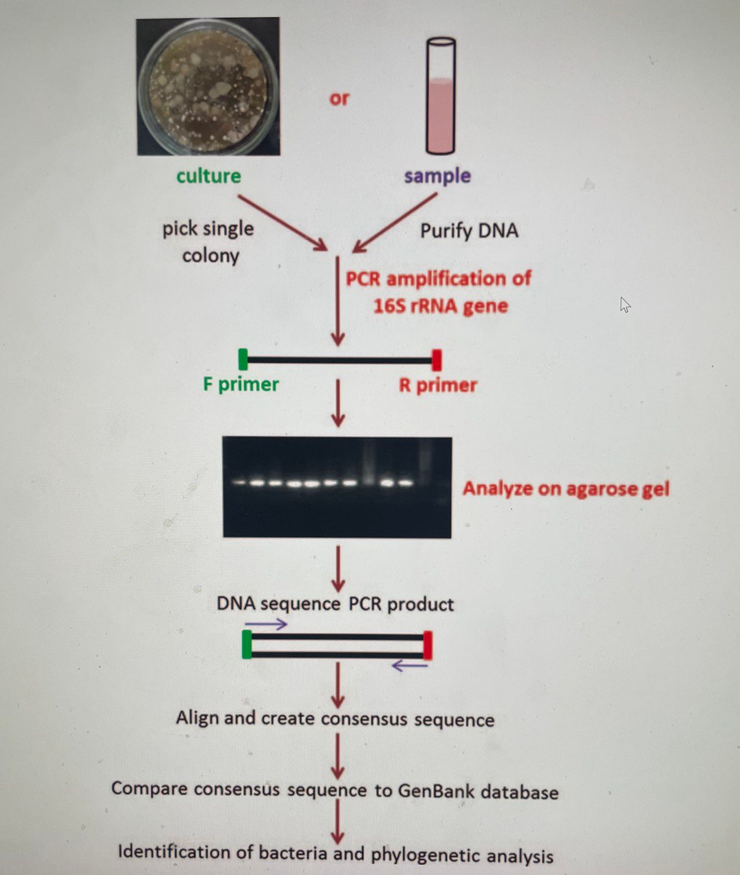
PCR amplification and sequencing of 16S rRNA gene for identification of bacterial species

Slide 9
Taq DNA polymerase
PCR can be regarded as the in vitro DNA synthesis that requires the same precursor molecules as in case of DNA replication in vivo. The DNA polymerase has been replaced by a thermo-stable polymerase called as Taq DNA polymerase that can withstand a temperature of >90 °C with an optimum activity of 72 °C.

Slide 10
Reagents required and their role
1. DNA Template: Template contains the target DNA region that needs to be amplified.
2. Primers: The set of primers to be used
16S Forward primer 27F -5- AGAGTTTGATCMTGGCTCAG-3
16S Reverse primer 1492R - 5 - ACGGCTACCTTGTTACGA-3
3. Taq Polymerase: Taq polymerase is a thermo-stable DNA polymerase isolated from the thermophilic bacterium Thermus aquaticus.
4. dNTP (Deoxynucleotide Triphosphate): The dNTPs are the building blocks of new DNA strand. In most of the cases, they come as a mixture of four deoxynucleotides (dATP, dTTP, dGTP and dCTP).
5. Buffer Solution and MgCl2: Every enzyme needs certain conditions in terms of their pH, ionic strength, cofactors etc.

Slide 11
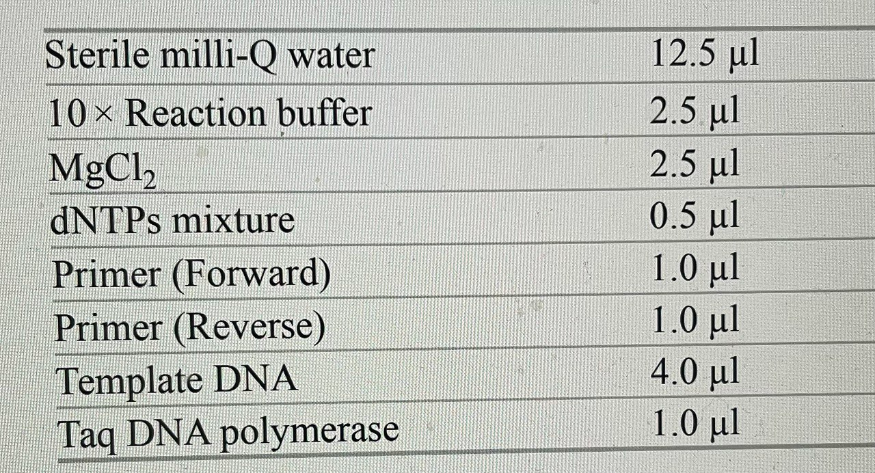
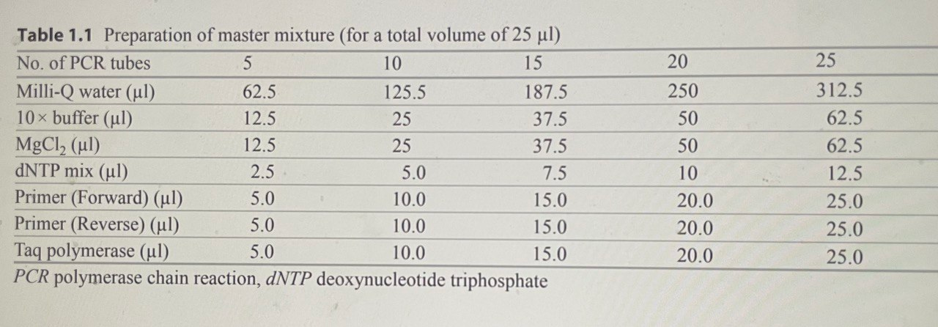
Procedure
1. Mix DNA template, primers, dNTPs and Taq polymerase in a 0.2 ml thin-walled microcentrifuge tube.

Slide 12
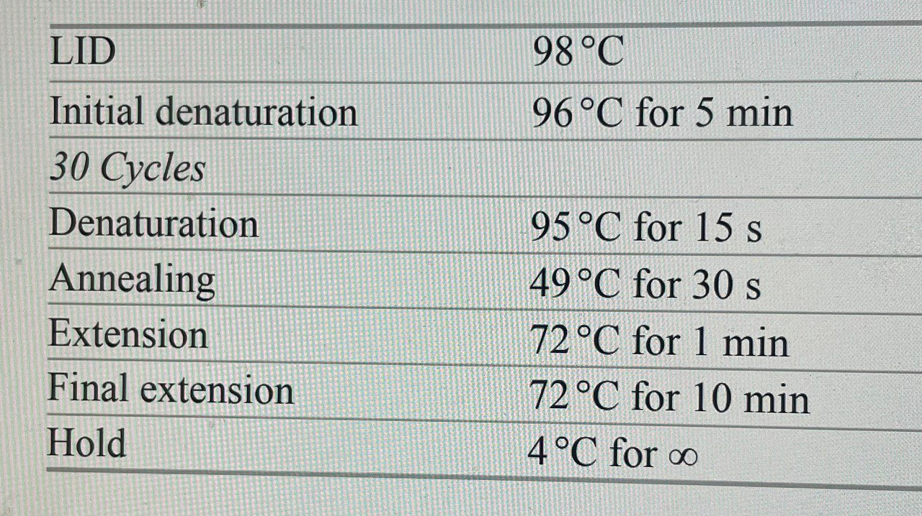
Procedure
Carry out the amplification with the following programme:
At the end of the PCR cycles, take out the PCR products and run the samples by agarose gel electrophoresis in 1% agarose gel with ethidium bromide and visualise under UV light.

Slide 13
Next lab
Recombinant DNA Technology

