Slide 1
GENE EXPRESSION
Dr. Salah Tofik Balaky
Course: Molecular Biotechnology
MA Code408
Summer school: Week 2
Date 21/8/2024

Slide 2
Gene Expression
The process of gene expression is sometimes called the ‘’central dogma’’ of molecular biology, which states that information in DNA is copied into RNA to be translated into protein. DNA carries the information for the synthesis of RNA and proteins in regions called genes.

Slide 3
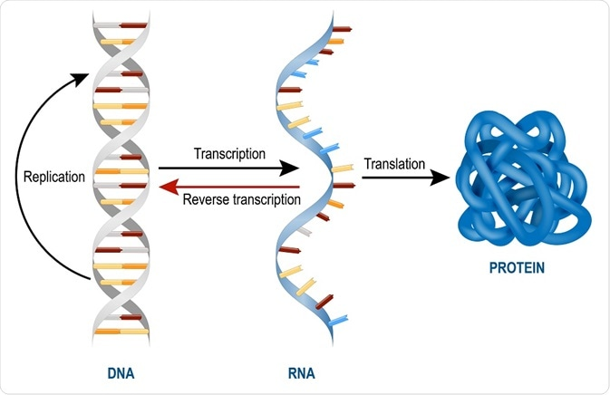
Gene Expression

Slide 4
Gene Expression
DNA --------------> RNA --------------> Protein
Transcription & Translation
Transcription is the synthesis of complementary strand of RNA from DNA template
Translation is the synthesis of protein from information on mRNA template

Slide 5
Transcription
Transcription follows the same basepairing rules as DNA replication: T, G, C, and A in the DNA pair with A, C, G, and U, respectively, in the RNA product. The enzyme that directs transcription is called RNA polymerase.

Slide 6
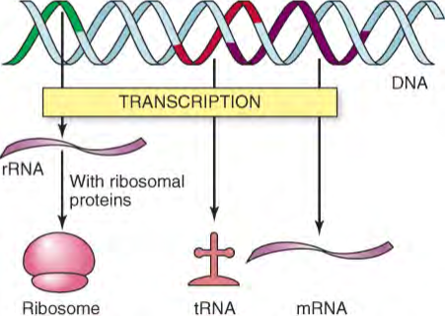
Transcription

Slide 7
Transcription
In transcription mRNA is synthesized under the direction of DNA by the enzyme RNA polymerase. An E. coli cell can have as many as 7,000 RNA polymerase molecules; only 2,000 to 5,000 polymerases may be active at any one time. The reaction is quite similar to that catalyzed by DNA polymerase. ATP, GTP, CTP, and UTP are used to produce an RNA copy of the DNA sequence.

Slide 8
RNA Polymerase
The α, β, and β′ subunits are essential parts of the RNA polymerase, and the ω subunit helps in its assembly. A sixth subunit, the σ factor, is required only for initiation and cycles off the enzyme after initiation of transcription. Without the σ factor, the RNA polymerase is called the core enzyme; with σ, it is called the holoenzyme.

Slide 9
Promoter and Terminator
The Promoter and Terminator are directions for RNA polymerase to indicate the location of the gene to be transcribed.
The ORF is the “coding” region of the gene: it begins at the start codon and contains in order all the codons for all the amino acids in the resulting protein.

Slide 10
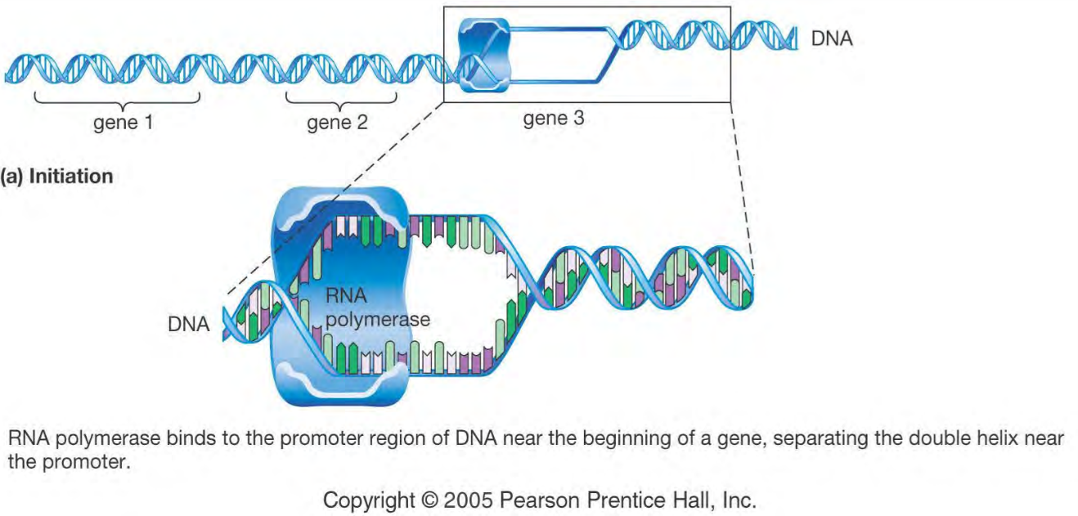
Initiation
The polymerase binds tightly to the promoter and starts building the RNA chain. The substrates, or building blocks, are the four ribonucleoside triphosphates: ATP, GTP, CTP, and UTP. The first substrate is usually a purine nucleotide. After the first nucleotide is in place, the polymerase joins a second nucleotide to the first, forming the initial phosphodiester bond in the RNA chain. Several nucleotides may be joined before the polymerase leaves the promoter and elongation begins.
Text

Slide 11
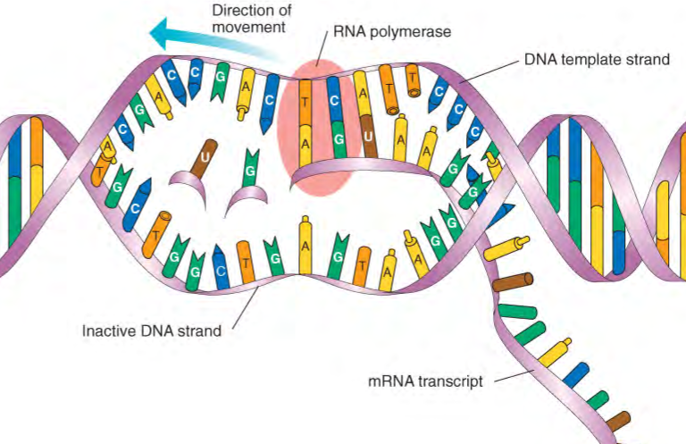
Transcription

Slide 12
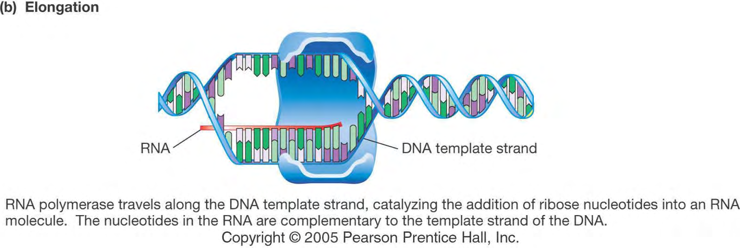
Elongation
Only 1 DNA strand is used as a template
RNA polymerase travels along the DNA template strand, catalyzing the addition of ribose nucleotides.
The nucleotides in the RNA are the complementary to the template strand of the DNA.

Slide 13
3) Termination
Triggered by specific DNA sequences in the gene DNA completely rewinds into a double helix

Slide 14
Translation
Protein synthesis is called translation because it translates the language of nucleic acids into the language of proteins.
All organisms use the same codons to specify the genetic code for the particular amino acids
64 possible codons but only 20 amino acids
61 codons code for amino acids = sense codons
3 nonsense codons serve as the STOP signal to terminate protein synthesis.

Slide 15
Translation
For each sense codon there is a tRNA with a complementary antisense codon: this tRNA carries the amino acid specified by the codon.
There are no tRNA molecules with anticodons to the 3 nonsense codons (stop codons): UAA, UAG, UGA, and thus no amino acids.
The start codon is AUG and codes for the amino acid methionine.

Slide 16
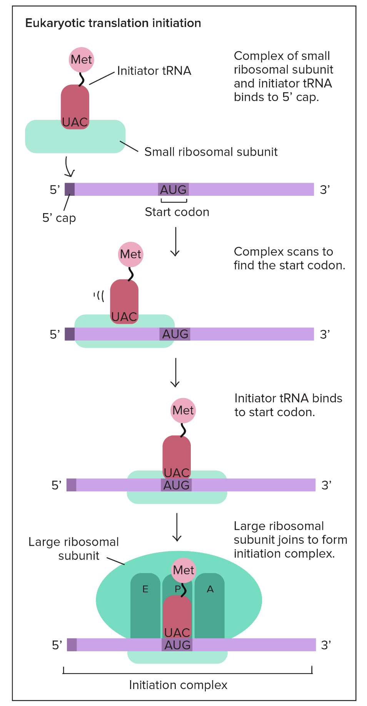
1) Initiation
Components needed to begin translation come together.

Slide 17
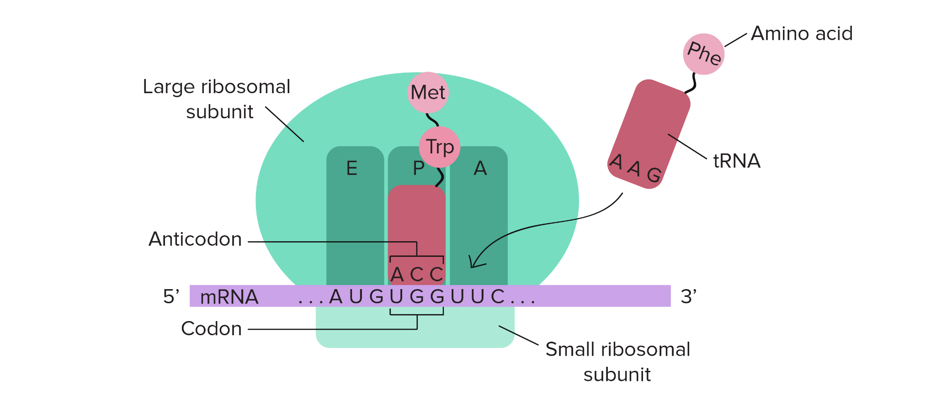
A tRNA carrying the first amino acid is paired with the start codon on the mRNA, and the second tRNAapproaches.

Slide 18
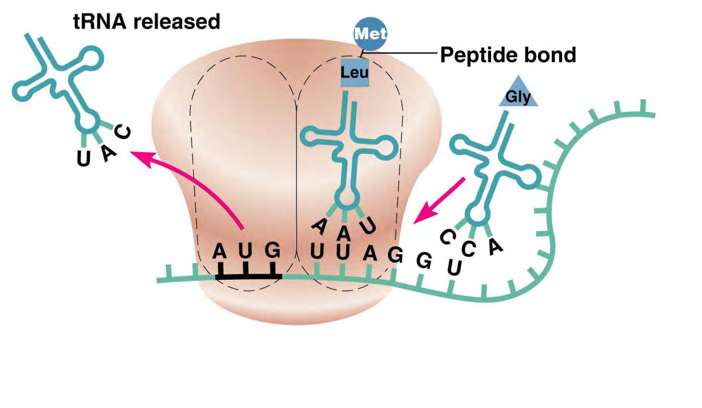
2) Elongation The second tRNA carrying second codon of mRNA and the second amino acid binds to the ribosome (A site) next to the first amino acid on ribosome (P site). The first amino acid then joins to the second by a peptide bond, and the first tRNA is released

Slide 19
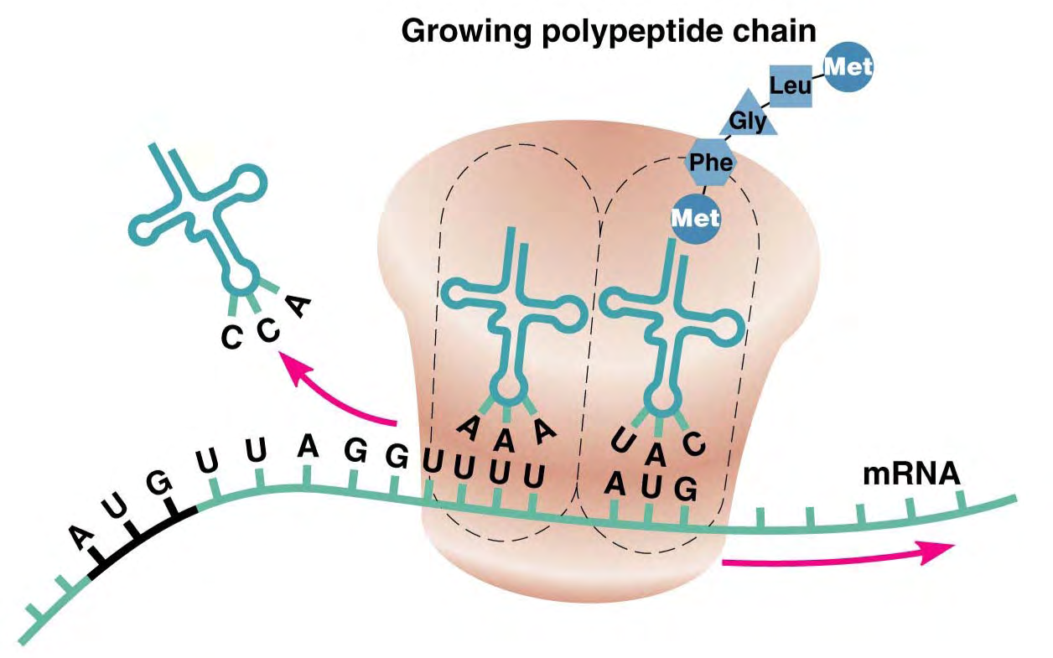
Elongation
The ribosome moves along the mRNA until the second tRNA is in the P site, and the process continue. The ribosome continues to move along the mRNA, and new amino acids are added to the polypeptide.

Slide 20
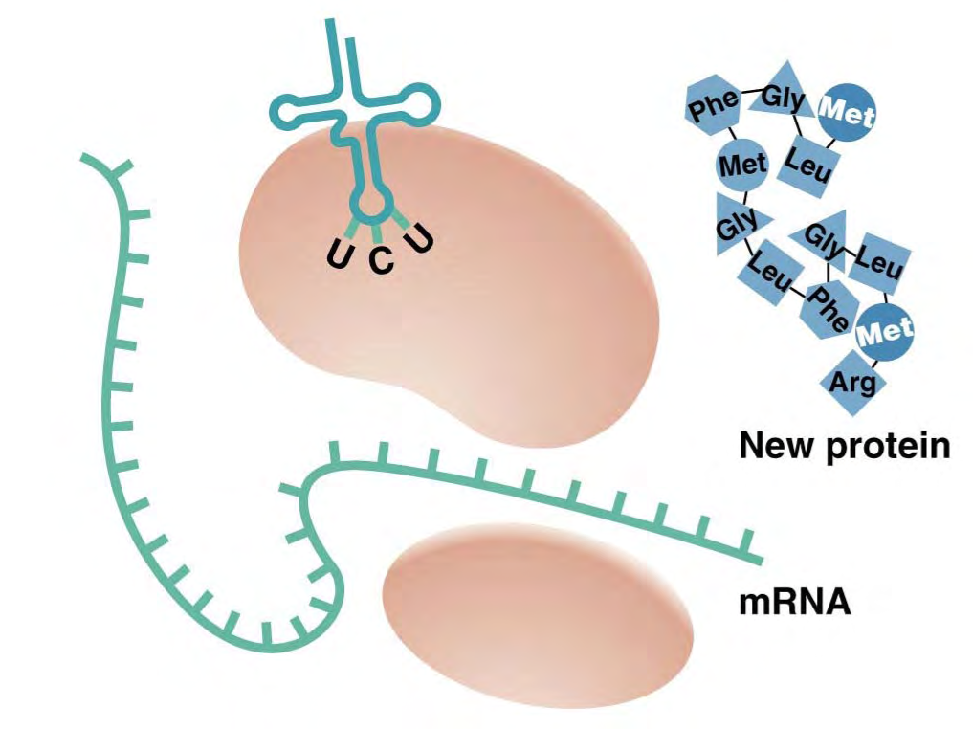
3) Termination
When the ribosome reaches a stop codon, the polypeptide is released. Finally, the last tRNA is released, and the ribosome comes a part. The released polypeptide forms a new protein.

Slide 21
Next Lecture
Regulation of gene Expression in bacteria

Slide 22
Questions and comments?

