Slide 1
Regulation of gene Expression in bacteria
Dr. Salah Tofik Balaky
Course: Molecular Biotechnology
MA Code408
Summer school: Week 2
Date 22/8/2024

Slide 2
Regulation of gene expression
The process by which the expression of genes is turned on and off at different times and under different conditions is called the regulation of gene expression.

Slide 3
Repression and Activation
Regulatory proteins can bind to their control region and prevent transcription, This is known as repression. Regulatory proteins can promote RNA polymerase binding to the promoter. This effect is known as activation.

Slide 4
Gene regulation by inducers
An inducer is a substance whose presence results in the formation, or increase in the amount, of an enzyme. Such enzymes are called inducible enzymes; this genetically controlled response is termed enzyme induction. Transcription activator proteins accelerate the rate of RNA synthesis from promoter sites. Lactase production in response to lactose is an example.

Slide 5
Gene regulation by repressors
Genetic regulation that decreases enzyme synthesis is enzyme repression. Proteins that mediate this are repressors. Repression occurs if cells are exposed to an overabundance of a particular endproduct of a metabolic pathway. One example is the repressor of the tryptophan biosynthesis operon TrpR.

Slide 6
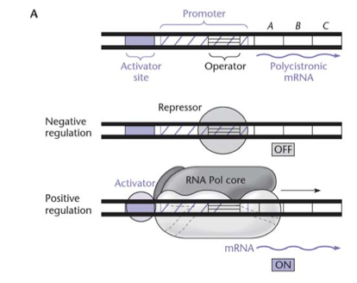
Gene regulation by inducers & repressors

Slide 7
Operon & Regulon
An operon is a group of genes physically linked on the chromosome and under the control of the same promoter. In an operon, the linked genes give rise to a single mRNA that is translated into the different gene products. This type of mRNA is called a polycistronic mRNA. A regulon is a group of genes all needed for the same process but physically located in different parts of the chromosome and containing their own promoter.

Slide 8
Operon consists of:
Promoter: Where RNA polymerase initiates transcription.
Operator: Serves as stop/go signal for transcription.
Genes: all the ORFs for all the enzymes in the pathway; each has its own start and stop codon.
Terminator: region of DNA where RNA polymerase ends transcription

Slide 9
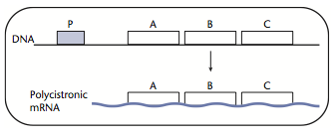
PolycistronicmRNA
Polycistronic mRNAs are translated into more than one protein. In this example, gene A, gene B, and gene C are encoded on one mRNA.

Slide 10
Operon model of gene expression
Protein synthesis in bacteria is controlled by a system called the operon model. For example, three enzymes are involved in uptake and utilization of the sugar lactose in E. coli. The genes for these enzymes and operator site are close together on the bacterial chromosome. The operator and promoter sites plus the structural genes are the operon.

Slide 11
lac Operon
The metabolism of the sugar, lactose, requires at least two proteins in E. coli. The lactose permease, encoded by the lacY gene, transports lactose into the cell. The enzyme b-galactosidase, encoded by the lacZ gene, catalyzes the cleavage of lactose resulting in the monosaccharides, galactose and glucose in a process called catabolic.

Slide 12
lac Operon

Slide 13
When lactose is present
When lactose is present inside the cell, it is converted to allolactose and binds to the LacI, repressor protein. This will prevent its interaction with the lac O operator site. The operator then induces the structural genes (lacZ, lacY, and lacA) to produce enzymes to utilize lactose.

Slide 14
Next Lecture
Molecular Typing of Bacteria

Slide 15
Questions and comments?

