Slide 1
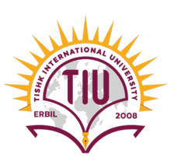
Mutations and Mutagenesis
Dr. Salah Tofik Balaky
Course: Molecular Biotechnology
MA Code408
Semester 8: Week 2
Date 21/8/2024

Slide 2
Mutation
Mutation refers to any change in the sequence of Nucleotides in DNA, which leads to changes in the genotype and phenotype of an organism. Mutations can either be beneficial or harmful.

Slide 3
Mechanisms of mutation
1. Substitution of a nucleotide.
2. Deletion or addition of a nucleotide.

Slide 4
Mutation
Mutations can be induced or spontaneous, result either fromerrors in DNA replication or from the damaging effects of mutagens, such as biological, chemicals and radiation.
Mutations occur due to deletion, insertion or substitution of one or more nucleotides.
When a purine nucleotide is replaced by a purine nucleotide it is known as transition, and when a purine is replaced by a pyrimidine, it is known as transversion.

Slide 5
Spontaneous Mutation
Spontaneous mutations occur naturally in the genome. They generally occur due to error during replication, mitosis, meiosis, etc. Mutations may also occur due to mobile genetic elements or transposons.

Slide 6
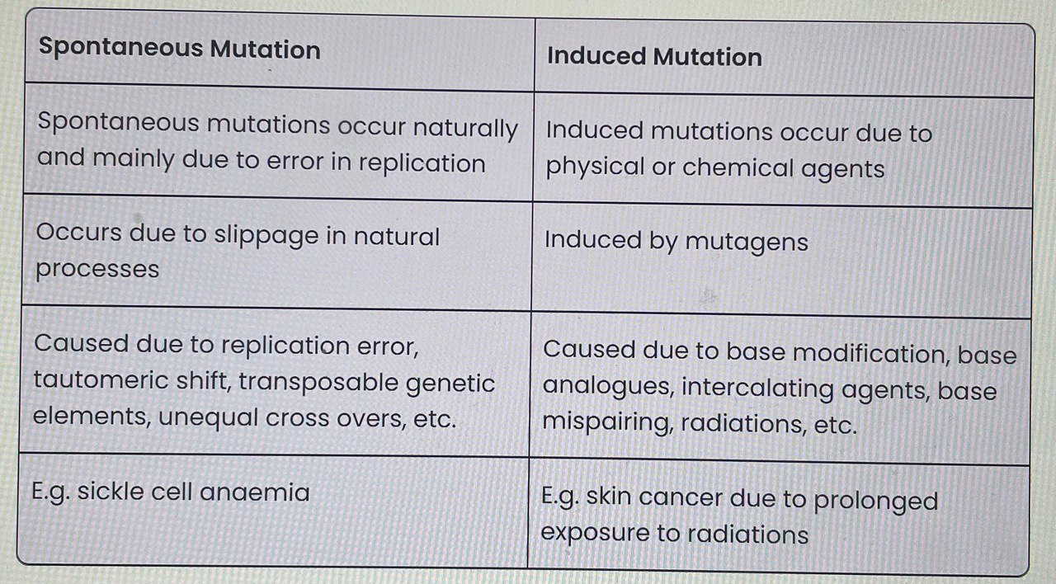
Difference between Spontaneous and Induced Mutation

Slide 7
Mutations types
Mutations where only one nucleotides is exchanged are termed point mutations; other types of mutations include chromosome mutations or rearrangements when larger sequence sections are deleted or inserted, doubled, inverted. If such mutations occur within a transcription unit, they are referred to as gene mutations.

Slide 8
Deamination
In the human body, deamination of nucleotides also spontaneously
arises with a rate of 100 deaminations per day and per cell. Cytidine
is converted to uracil by deamination. If, following replication, U pairs with A instead of with G, as the original C had done, then the resulting CG pair is completely replaced with a TA pair

Slide 9
Depurination
The purine residues G and A can be removed spontaneously from DNA by hydrolysis. Depurination is considered as one of the most common spontaneous mutations and usually leads to transversions, but also to the deletion of individual bases; over 5000–10 000 purine bases are depurinated daily in every human cell.

Slide 10
Dimerization
Under UV radiation (e.g., from extensive sunbathing) neighboring T and C residues can be activated, which then form dimers (dimerization)

Slide 11
Oxidation
The oxidation of G to 8-oxoguanosine by reactive oxygen species (ROS) can also induce point mutations.

Slide 12
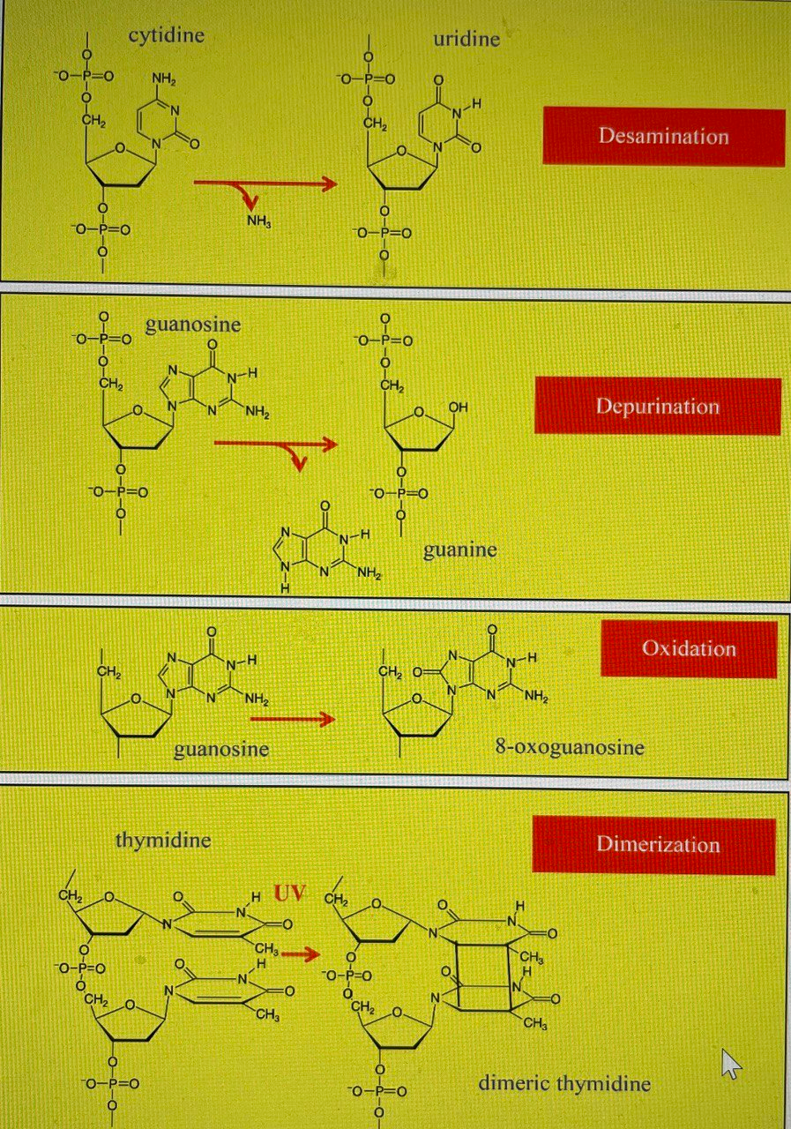
Major mutation mechanisms.

Slide 13
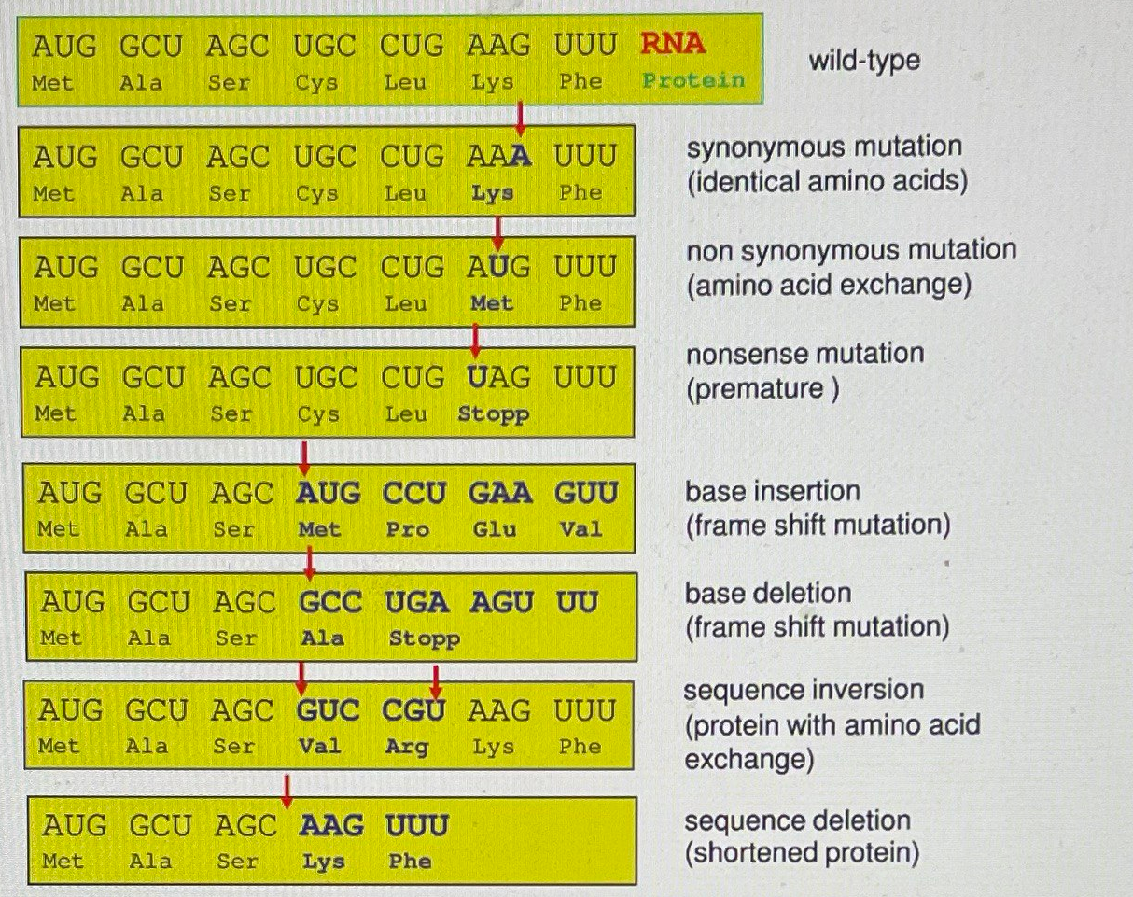
Consequences of gene mutations

Slide 14
Significance of mutation
Discovery of a mutation in a gene can help in identifying the function of that gene.
Mutations can be induced at a desired region to create a suitable mutant, especially to produce vaccines.
Spontaneous mutations can result in emergence of antibiotic resistance in bacteria.

Slide 15
Mutagens
Mutagens are substances that alter or change the genetic material of an organism, hence they are termed genotoxic. In most cases, the mutagens can incite carcinogenic responses or impair the functions of certain genes, thereby causing various medical conditions. However, the effects of most mutagens cannot be substantiated from a scientific perspective. For instance, a mutagen that shows a possible carcinogenic effect on one organism may not hold true for another organism.

Slide 16
Mutagens and Induced Mutation
Induced mutations do not occur spontaneously. They are induced through various chemical and physical agents known as mutagens. Mutagens greatly enhance the frequency of mutation.
Induced mutagens can be chemical, physical or biological mutagens.

Slide 17
Biological mutagens (Transposons and viruses).
Transposons are DNA units that carry out the DNA fragment’s self-directed relocation and multiplication. The functionality of the genes is disrupted when transposons are inserted into chromosomal DNA. The insertion of viral DNA into the genome may lead to the disruption of genetic function.

Slide 18
Chemical Mutagens
Chemical mutagen is a chemical agent that causes mutations. Many chemicals that occur naturally in the environment have mutagenic properties and these have been supplemented in recent years with other chemical mutagens that result from human industrial activity.

Slide 19
Chemical mutagen mechanisms
Some act as base analogs and are mistakenly used as substrates when new DNA is synthesized
Some react directly with DNA, causing structural changes that lead to miscopying of the DNA.
3. Some mutagens act indirectly on DNA by synthesize chemicals that have a direct mutagenic effect.

Slide 20
Types of physical mutagens
1. UV radiation induces dimerization of adjacent pyrimidine bases, which results in a deletion mutation.
2. Ionizing radiation has various effects on DNA depending on the type of radiation and its intensity.
3. Heat stimulates the water-induced cleavage of the β-N-glycosidic bond that attaches the base to the sugar component of the nucleotide.

Slide 21
Next lecture
Gene Expression

Slide 22
Questions and comments?

