Slide 1
HISTOPATHOLOGICAL FEATURES OF ENAMEL CARIES L3
Early lesion (white opaque spot):
-The essential nature of the carious attack on enamel is permeation of acid into its substance.
- The calcium apatite crystals are relatively impermeable but part of the organic matrix of enamel, have relatively high water content and are permeable to acid.
Permeating the organic matrix enabling them to attack the surface of the apatite crystals which become progressively smaller.
These initial changes are not due to bacterial invasion, but due to bacterial acids causing varying degrees of demineralization.

Slide 2
The lesion in the proximal surface is conical in shape with its apex towards the dentine, and a series of four zones of differing translucency can be discerned. Working back from the deepest, advancing edge of the lesion:
*Translucent zone: It is the results from formation of pores due to earliest and deepest demineralization. The volume of the pores in this zone is 1% of the enamel volume.
*The dark zone: It is superficial to the translucent zone. Polarized light microscopy shows that the volume of the pores in this zone has increased to 2-4% of the enamel volume.

Slide 3
*Body of the lesion: Forms the bulk of the lesion and extends from just beneath the surface zone to the dark zone. Polarized light examination shows that the pore volume is 5% at the periphery but increases to at least 25% in the center.
*Surface zone: It shows more heavily mineralized than the deeper zones. The surface zone appears to form partly by remineralization.
- The remineralizing salts may come either from those concentrated in the plaque or from precipitation of calcium and phosphate ions diffusing outwards as the deeper zones are demineralized .

Slide 4
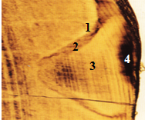
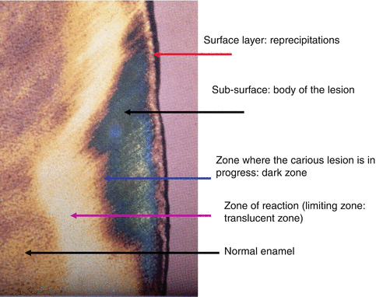
Ground section of early enamel caries showing the four zones.

Slide 5
Cavity formation :
As the lesion progresses and cavitation develops, demineralization comes to dominate the process; therefore, enamel crystallites are progressively dissolved until disintegration becomes visible microscopically.
Defects eventually become large enough to allow bacteria to enter.
Once bacteria have penetrated the enamel they reach the amelodentinal junction and spread laterally to undermine the enamel and the enamel loses the support of the dentine and is therefore greatly weakened..

Slide 6
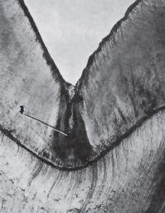
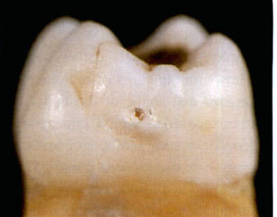
Clinically this is frequently evident when there is no more than a pinhole lesion in an occlusal pit, but cutting away the surrounding enamel shows it to be widely undermined.
As undermining of the enamel continues, it starts to collapse under the stress of mastication and to fragment around the edge of the lesion. By this stage, bacterial damage to the dentine is extensive.
A
B
(A) Early cavitation in enamel caries allowing plaque bacteria into enamel. (B) Pit and fissure caries, pyramidal in shape and follows the directions of enamel rods.

Slide 7
HISTOPATHOLOGICAL FEATURES OF DENTINE CARIES
Early dentinal changes:
. Initial penetration of the dentine by caries cause dentinal sclerosis.
. Calcification of dentinal tubules cause sealing off from further penetration by micro-organisms.
. Once the bacteria have spread along the amelodentinal junction, it attacks the dentine over a wide area. The lesion is therefore conical with its apex towards the pulp, and consists of five zones:

Slide 8
The lesion is therefore conical with its apex towards the pulp, and consists of five zones:
Zone 1: Zone of fatty degeneration of Tome’s fiber, this makes the tubules impermeable.
Zone 2: Zone of dentinal sclerosis - deposition of calcium salts in the tubules.
Zone 3: Zone of decalcification of dentine.
Zone 4: Zone of bacterial invasion.
Zone 5: Zone of decomposed dentine due to acids and enzymes.

Slide 9
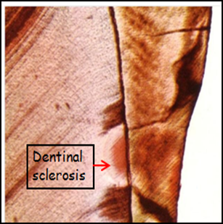
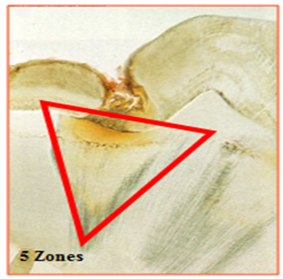
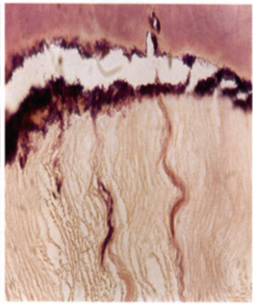
A
B
C

Slide 10
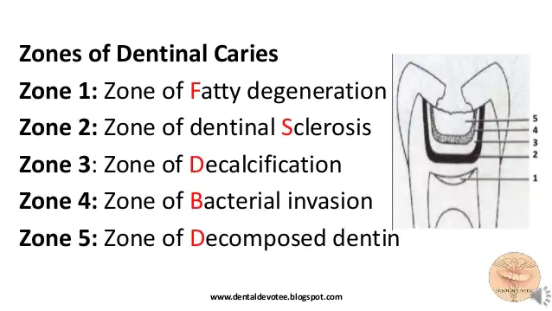

Slide 11
Advanced dentinal changes:
. After demineralization, the dentine matrix is progressively destroyed by proteolysis, the dentinal tubules form pathways open to bacteria.
. Once the bacteria extend down to the tubules, soon fill them. The tubules become distended by the expanding masses of bacteria and their products.
. Later, the intervening tubule walls are destroyed and collections of bacteria in adjacent tubules coalesce to form irregular liquefaction foci.
. In some areas bacteria also spread laterally, and, occasionally, bacteria-filled clefts form at right angles to the general direction of the tubules.

Slide 12
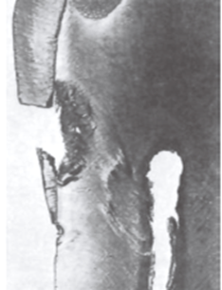
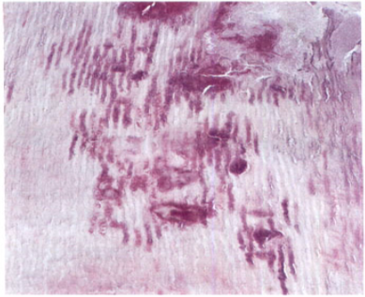
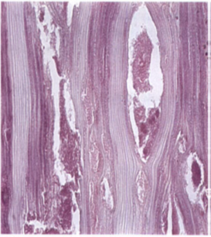



Clinically, these clefts may allow carious dentine sometimes to be excavated in flakes in a plane parallel to the surface.
. (D) Caries of enamel and dentine. (E) Caries of dentine, masses of bacteria filling the tubules. (F) Advanced dentine caries. The dentine is disintegrating with a large liquefaction foci and tubules packed with bacteria.

Slide 13
REACTIONS OF DENTINE AND PULP UNDER CARIES
These reactions are not specific to caries and may be provoked by other irritants such as attrition, erosion, abrasion and restorative procedures.
1. Tubular sclerosis: Peritubular dentine reduces the size of the dentinal tubules, preventing bacterial penetration and generating a more heavily mineralized dentine. It is a translucent zone which may be visible radiographically.
2. Regular reactionary dentine forms at the pulp dentine interface and retains the tubular structure of dentine. Forms in response to mild stimuli and may obliterate pulp horns, increasing the dentine thickness between caries and pulp.

Slide 14
3. Irregular reactionary dentine forms in response to moderate or severe insult by caries and correspondingly ranges from dentine with irregular tubules to a disorganized bone-like mineralized tissue.
4. Dead tracts formed when odontoblasts die. If peritubular dentine formation was extensive before odontoblast death, the dead tract may be sclerotic and inhibit advance of caries. If not it may allow more rapid progress.

Slide 15
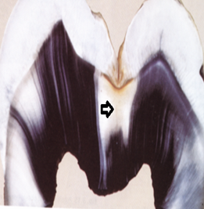
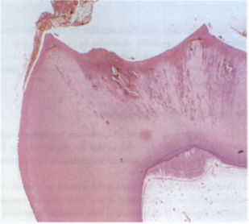
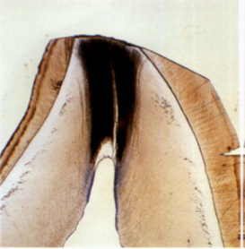

A
C
(A) translucent zone (arrow). (B) Regular reactionary dentine below occlusal caries (C) A dead tract is empty tubules below the worn incisal edge have been filled with a stain to which they are permeable from the surface, so that the whole zone appears black. At the proximal end of the tubules the dead tract has been sealed off by impermeable reactionary dentine through which the stain cannot penetrate. The pulp is thus protected from irritants penetrating along the dentinal tubules.

Slide 16
ROOT SURFACE CARIES
. When the neck of the tooth becomes exposed by recession of the gingival margin, a stagnation area may be formed and the cementum attacked .
. The cementum therefore decalcified and softens beneath the plaque producing a saucer-shaped cavity, and the underlying dentine is soon involved.
. Cementum is invaded along the direction of Sharpie's fibers and the infection spreads between the lamellae along the incremental lines.

Slide 17
RADIOGRAPHICAL ASPECTS OF DENTAL CARIES
The bitewing radiograph is especially indicated for the detection of proximal caries.
Usually the pit and fissure caries radiographically appears as a triangular shaped radiolucent area with it base towards the dentinoenamel junction.
On the other hand the smooth surface caries also appear triangular shaped radiolucent area but the base is located toward the surface of the tooth.
The root caries appear as U- shaped radiolucent area with irregular margins

Slide 18
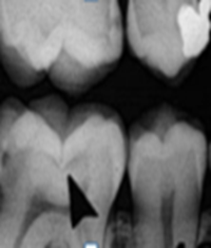
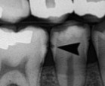
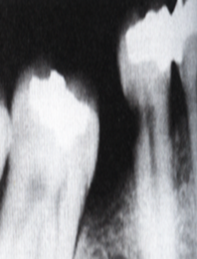
pit and fissure caries
smooth surface caries
Root caries

