Slide 1
Agarose gel Electrophoresis
Dr. Salah Tofik Balaky
Miss Amna
Course: Molecular Biotechnology
MA Code408
Summer school: Week 5
Date 25/ 8/ 2024

Slide 2
Running the PCR product on agarose gel
After PCR is performed, the result can be analysed by agarose gel electrophoresis. Gel electrophoresis is a standard technique commonly used in laboratories for the separation of charged nucleic acid molecules based on their size. Agarose gels which have a permeable matrix are used for DNA electrophoresis. In which the negatively charged nucleic acids migrate through the gel, with shorter DNA fragments moving quicker than the longer strands and these are thus separated based on their size.

Slide 3
Electrophoresis
Nucleic acids are (poly) acids and thus negatively charged, which makes them migrate to the positive pole in the electric field. The separation process depends on the voltage used, the properties of the gel, as well as the charge and shape of the molecule in question. The method used for the separation of nucleic acids is chosen according to the size of molecules to be separated and the desired resolution capacity.

Slide 4
Preparation of 1% agarose gel for electrophoresis
• Weigh 1 g of agarose and add it to 100 ml of 1X Tris-acetate (TAE) or Tris-borate (TBE) buffer and swirl to mix.
• Microwave the solution at short intervals until the agarose has completely dissolved. Allow the solution to cool.
• Pour the gel solution in the electrophoresis tank and remove any air bubbles using a disposable tip.
• Insert the gel comb into the corresponding slots on the gel casting tray.
• Allow the gel to set for 30–60 mins.

Slide 5
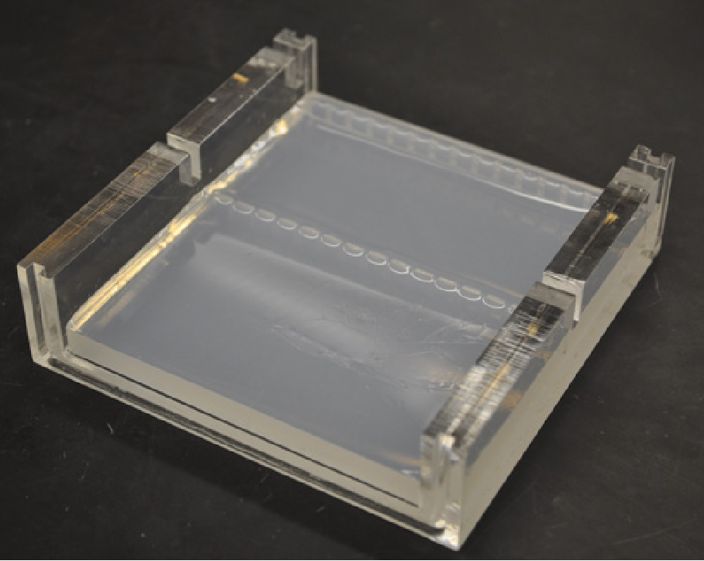

Slide 6
Loading and running PCR products
• After the gel is set, remove the comb and pour the 1X running buffer into the gel tank to submerge the gel in it.
• Thaw the DNA samples (PCR products) to be analyzed and add the loading dye to each sample so that the migration of the sample through the gel can be monitored.
• DNA marker or DNA ladder (5 µl) is added to the first well of the gel. The DNA fragments in the marker are of known bp products (sizes) which aid in determining the approximate size of the fragments in the samples.
• Pipet 5 µl the DNA samples into the empty wells of the gel making a careful note of which sample is being loaded in which position of the well.

Slide 7
Loading and running the gel
Close the gel apparatus by ensuring that the orientation of the gel and the positive and negative electrodes is right. Switch on the power source and run the gel at 50 volts.
Monitor the progress of the gel by visually monitoring the migration of the marker dye.
Stop running the gel by turning off the current when the samples have run approximately ¾ the length of the gel and carefully remove the gel from the electrophoresis tank.

Slide 8
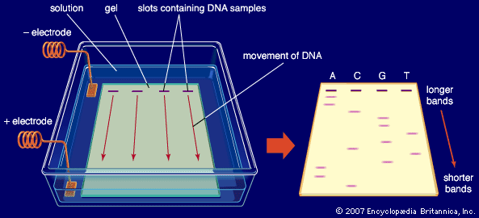

Slide 9
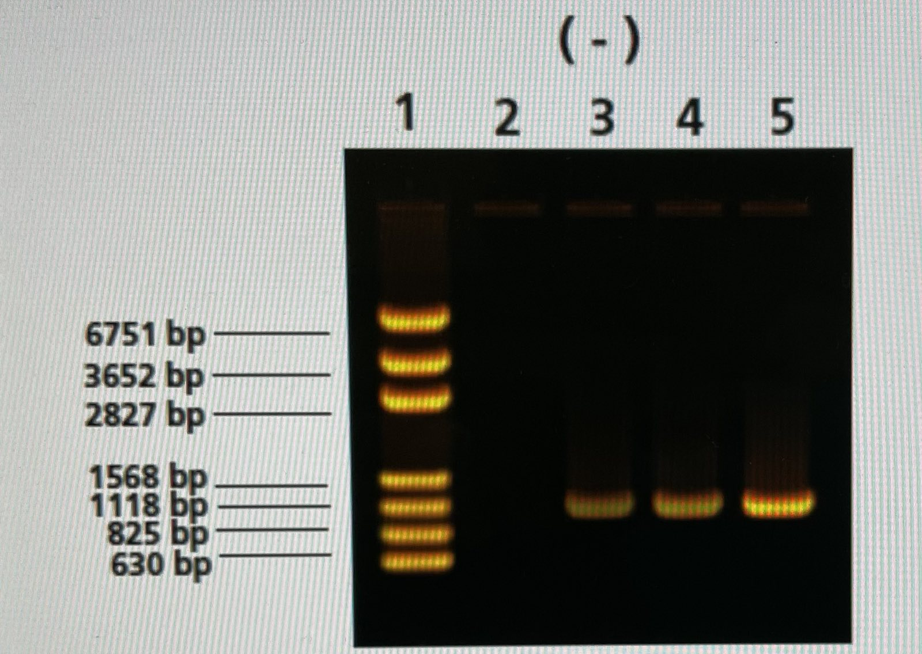

Slide 10
DNA Marker (Ladder)
This marker is composed of a mixture of DNA fragments with known sizes and can be purchased from companies. By comparing the band from the unknown PCR products with the lanes from the MW marker, we can estimate the size of our PCR product because the MW marker was “run” in the same gel as our samples

Slide 11
Sequencing the PCR products
The molecular basis of identification of bacterial species deals with the amplification and sequencing of 16S rRNA gene followed by their comparison with the existing database. Comparison of rRNA gene sequences for bacterial identification has been pioneered by Carl Woese that redefined the main lineage in the evolution of microorganisms.

Slide 12
Advantages of Sequencing
The major advantage of rRNA gene sequence comparison is the generation of increasingly expanding database available globally (Fig. 1.6). Nearly 60,000 16S rRNA gene sequences are currently available in the ribosomal database project (RDP II). The concept of

Slide 13
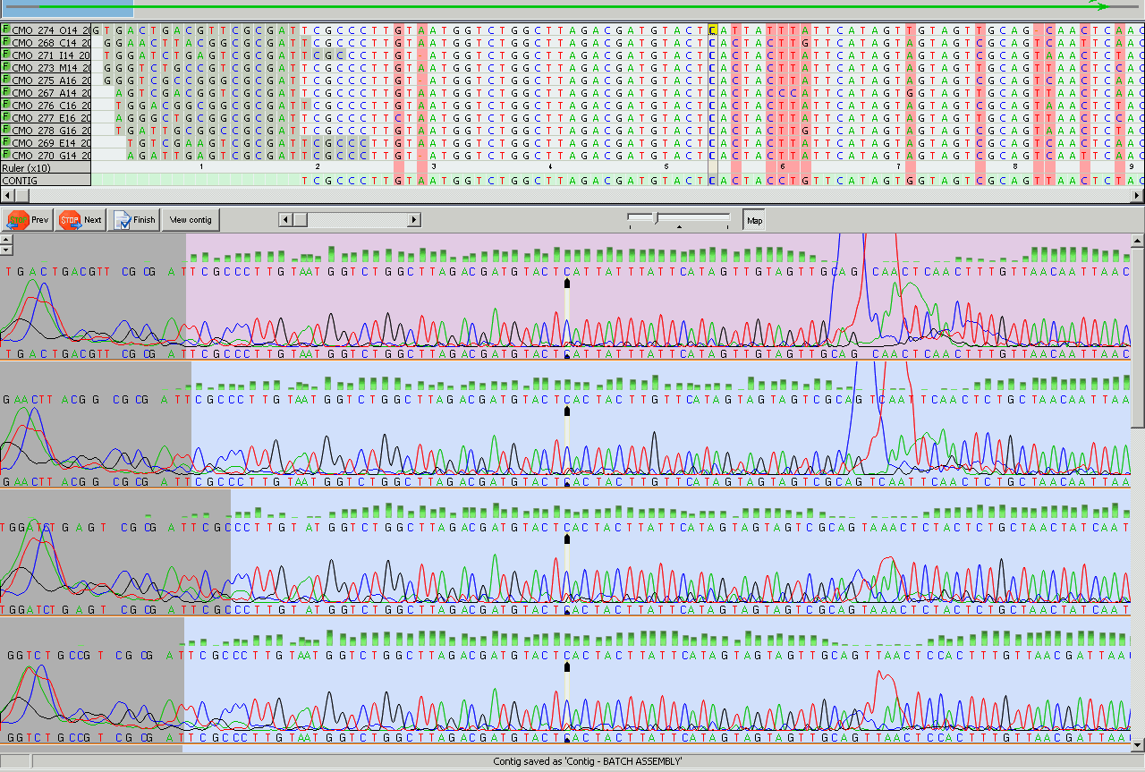
DNA sequence alignment for Identitification

Slide 14
Next lab
Recombinant DNA Technology

