Slide 1
Recombinant DNA Technology
Dr. Salah Tofik Balaky
Miss Amna
Course: Molecular Biotechnology
MA Code408
Summer school: Week 6
Date 25/ 8/ 2024

Slide 2
Recombinant DNA Technology
Recombinant DNA technology, which is also called gene cloning or molecular cloning, is a general term that consists of a number of experimental protocols leading to the transfer of genetic information (DNA) from one organism to another.

Slide 3
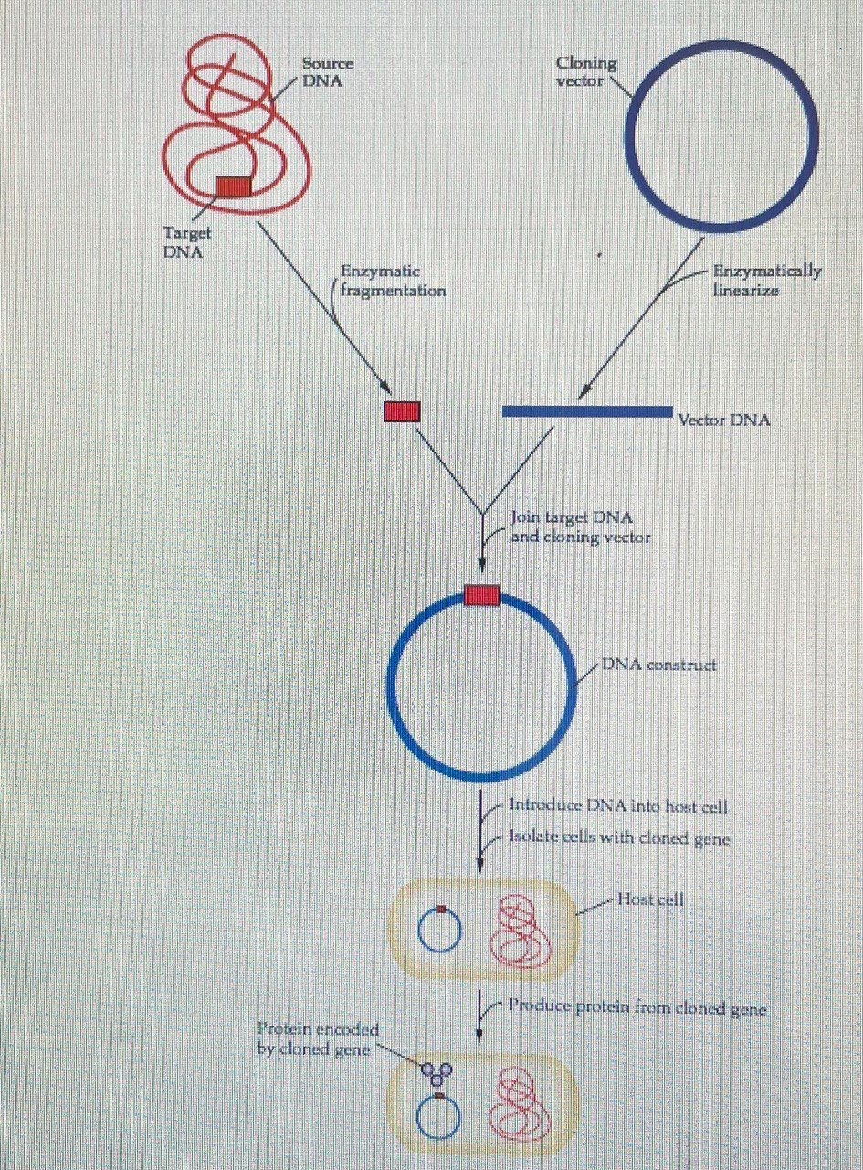
Recombinant DNA-cloning procedure.
DNA from a source organism is cleaved with a restriction endonuclease and inserted into a cloning vector. The cloning vector–insert (target) DNA construct is introduced into a host cell.

Slide 4
Main steps of Recombinant DNA experiment
The DNA (target DNA) from a donor organism is enzymatically cleaved (cut).
The target DNA joined (ligated) to another DNA entity (a cloning vector) to form a new, recombined DNA molecule.
This cloning vector–insert DNA construct is transferred into a host cell (transformation).
Transformed cells are identified and selected (separated, or isolated) from those that do not.

Slide 5
Recombinant DNA
For instance, the human insulin gene is expressed in E. coli
bacteria to make insulin used by diabetics.

Slide 6
Steps of DNA cloning
Cut open the plasmid and "paste" in the gene. This process relies on restriction enzymes (which cut DNA) and DNA ligase (which joins DNA).
Insert the plasmid into bacteria. Use antibiotic selection to identify the bacteria that took up the plasmid.
Grow up lots of plasmid-carrying bacteria and use them as "factories" to make the protein.
Harvest the protein from the bacteria and purify it.

Slide 7
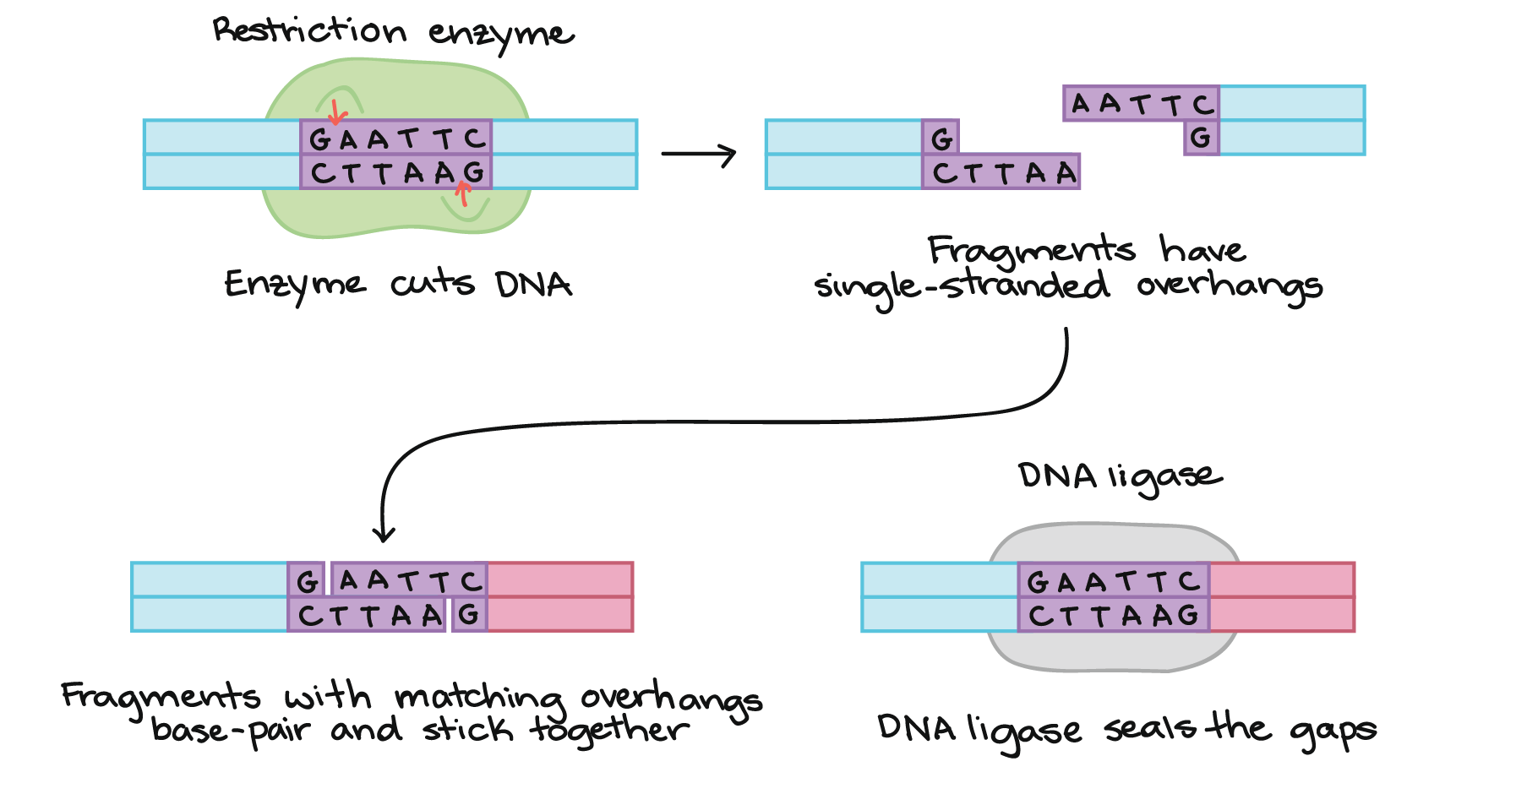
1. Cutting and pasting DNA
How can pieces of DNA from different sources be joined together?
A common method uses two types of enzymes:
A/ Restriction enzymes.
B/ DNA ligase.

Slide 8
Restriction enzyme
A restriction enzyme is a DNA-cutting enzyme that recognizes a specific target sequence and cuts DNA into two pieces at or near that site. Many restriction enzymes produce cut ends with short, single-stranded overhangs. If two molecules have matching overhangs, they can base-pair and stick together. However, they won't combine to form an unbroken DNA molecule until they are joined by DNA ligase, which seals gaps in the DNA backbone.

Slide 9
2. Bacterial transformation and selection
Plasmids and other DNA can be introduced into bacteria, such as the harmless E. coli used in labs, in a process called transformation. During transformation, specially prepared bacterial cells are given a shock (such as high temperature) that encourages them to take up foreign DNA.

Slide 10
3. Protein production
Once we have found a bacterial colony with the right plasmid, we can grow a large culture of plasmid-bearing bacteria. Then, we give the bacteria a chemical signal that instructs them to make the target protein. The bacteria serve as miniature “factories," producing large amounts of protein.

Slide 11
Next lab
Production of cloning vectors

