Slide 1
Transfer of Genetic Materials in Bacteria
Dr. Salah Tofik Balaky
Course: Molecular Biotechnology
MA Code408
Summer school: Week 3
Date 25/08/2024

Slide 2
Transfer of Genetic Materials in Bacteria
Natural genetic transformation involves the uptake of free DNA by bacterial cells, leading to the incorporation of genetic information. This process has been studied extensively and is considered a powerful mechanism of horizontal gene transfer in natural bacterial populations

Slide 3
Main types of gene transfer
Vertical gene transfer: Occurs when genes are passed from an organism to its offspring.
Horizontal (lateral) gene transfer: Occurs when genes are passed between organisms or a piece of DNA is somehow transferred from a donor into a recipient cell of the same generation.

Slide 4
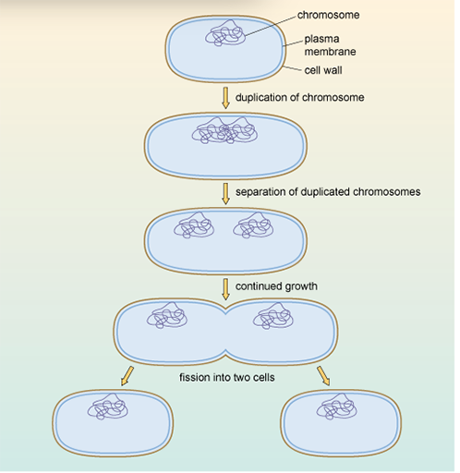
Vertical gene transfer

Slide 5
Vertical gene transfer
Vertical gene transfer refers to the process of genetic material being passed from parents to their offspring during reproduction. This process involves the inheritance of genes from one generation to the next within the same species. It is the primary mode of genetic transfer in bacteria, ensuring the continuity of genetic traits and characteristics within bacterial populations.

Slide 6
Horizontal (lateral) gene transfer
Occurs when genes are passed between organisms or a piece of DNA is somehow transferred from a donor into a recipient cell of the same generation.
Bacterial gene transfer refers to the process by which bacteria exchange genetic material, allowing for the transmission of genes within and between bacterial species. There are several mechanisms through which this transfer can occur, including natural genetic transformation, conjugation, and transduction.

Slide 7
Bacterial gene transfer
Bacteria are capable of exchanging genes.
A transferred piece of DNA recombine with the host genome by crossing over.
Gene exchange between closely related genotypes is possible by natural mechanisms of bacterial gene transfer which include: Transformation, Transduction & Conjugation.

Slide 8
Recombination and crossing over
Genetic recombination is the rearrangement of genes to form new combinations. If two chromosomes break and are rejoined in such a way that some of the genes are reshuffled between the two chromosomes, the process is called crossing over. The original chromosomes each have been recombined so that they carry a portion of genes from the other chromosome.

Slide 9
Natural mechanisms of bacterial gene transfer
1) Transformation: in which micro organisms can uptake and retention of external DNA molecules
2) Conjugation: which means direct transfer of DNA from one bacterium to another
3) Transduction: it is the transfer of DNA between bacteria by a virus.

Slide 10
Transformation
In transformation, “naked” DNA in solution is transferred from one bacterial cell to another. The process occurs naturally among very few genera of bacteria, and it usually occurs when donor and recipient are closely related and in the log phase of growth. To take up the DNA fragment, the recipient cell must be competent; that is, its cell wall must be permeable to large DNA molecules.

Slide 11
Steps involved in transformation
In nature, bacterial cells may undergo lysis releasing their DNA into the environment.
A fragment of DNA from the dead donor bacterium enter into a competent, recipient cell
Recombination occurs between donor DNA and recipient DNA
Transformation works best when the donor and recipient cells are very closely related.

Slide 12
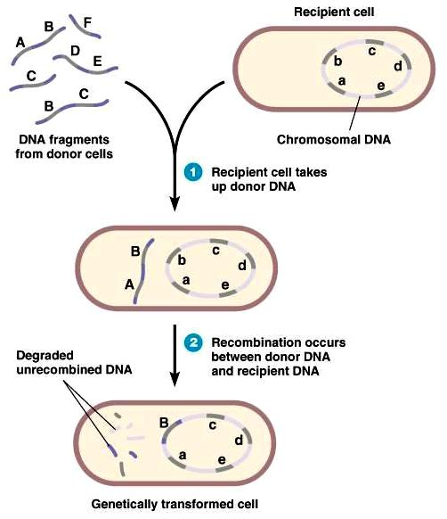
Transformation main steps
Recipient cell
DNA fragments from donor cells
Chromosomal DNA
Recipient cell takes up donor DNA
Degraded un-recombinated DNA.
Recombination occurs between donor DNA and recipient DNA.
Genetically transformed cell
Genetically transformed cell

Slide 13
Transformation and Griffith experiments
It was the first example of genetic exchange in bacteria to have been discovered. This was first demonstrated in an experiment conducted by Griffith in 1928. Certain bacteria (e.g. Bacillus, Haemophilus, Neisseria, Pneumococcus) can take up DNA from the environment and the DNA that is taken up can be incorporated into the recipient's chromosome.

Slide 14
Factors affecting transformation
Bacterial strain
Medium composition.
Growth phase.
Divalent cations.
DNA size.

Slide 15
Next lecture
Transduction and Conjugation

Slide 16
Questions and comments?

