Slide 1
Transduction
Dr. Salah Tofik Balaky
Course: Molecular Biotechnology
MA Code408
Semester 8: Week 8
Date 9/05/2024

Slide 2
Transduction
Transduction is the process by which DNA is transferred from one bacterium to another by a virus. It is a process by which a bacterial phage (virus) picks up a piece of DNA from one bacterial cell and injects it into another where it is incorporated into the chromosome. In most cases, bacterial transduction takes place between members of the same species.

Slide 3
Types of transduction in bacteria
Generalized transduction.
Specialized transduction.

Slide 4
Generalized transduction
In generalized transduction, phages can carry any part of the chromosome, the phage attaches to the bacterial cell wall and injects DNA into the bacterium. Normally this directs the synthesis of new viruses.

Slide 5
Generalized transduction
Sometimes, however, bits of bacterial chromosome are accidentally incorporated into the viral DNA. When these viruses infect a new host cell, they can incorporate this genetic information from the previous bacterial host into the new bacterial host.

Slide 6
Steps of generalized transduction
A phage infects the donor cell.
Phage DNA and proteins are made.
Pieces of bacterial DNA are packaged in a phage capsid.
Then releases phage particles containing bacterial DNA.
A phage carrying bacterial DNA infects a new host cell.
Recombination can occur.

Slide 7
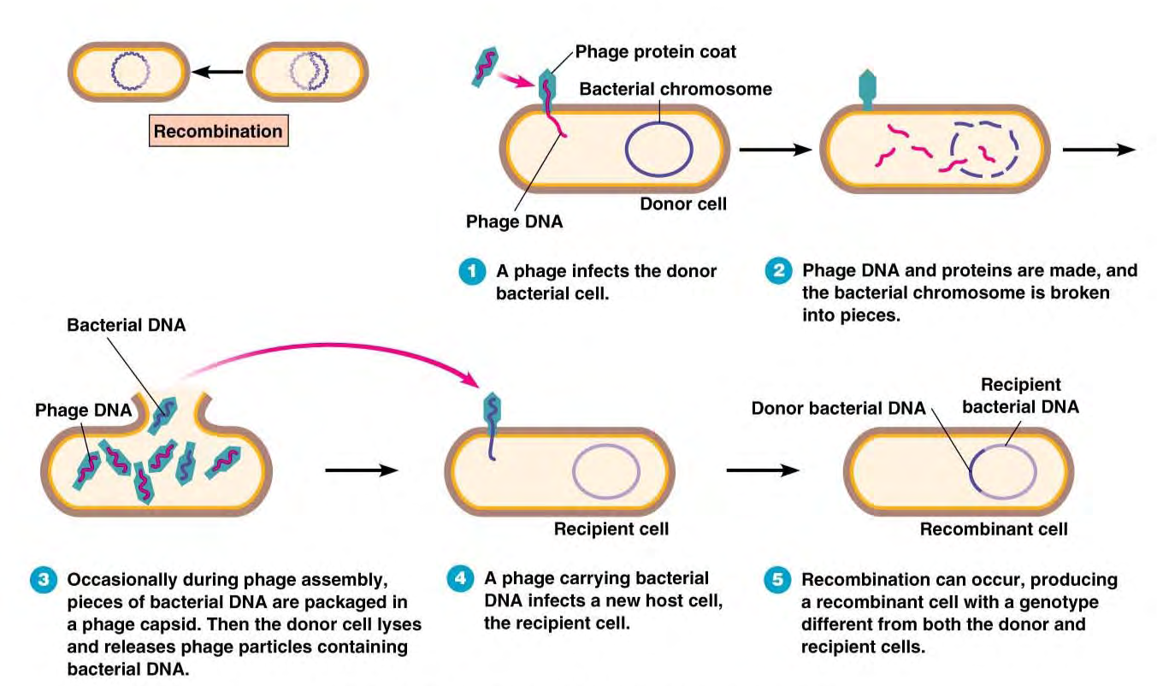
Steps of generalized transduction

Slide 8
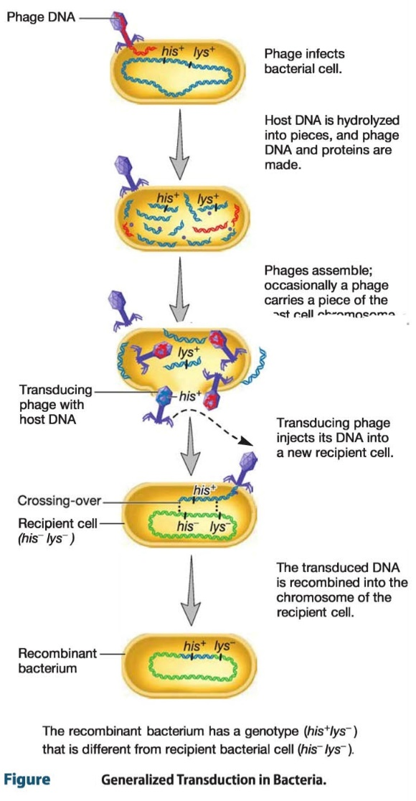
Steps of generalized
transduction

Slide 9
Specialized transduction
specialized transducing phages carry only restricted parts of the bacterial chromosome.In this case, only certain donor genes can be transferred by each viral strain. Different phages may transfer different genes. Specialized transduction is mediated by lysogenic (temperate) phages. The genes that get transferred depend on where the prophage has inserted in the chromosome.

Slide 10
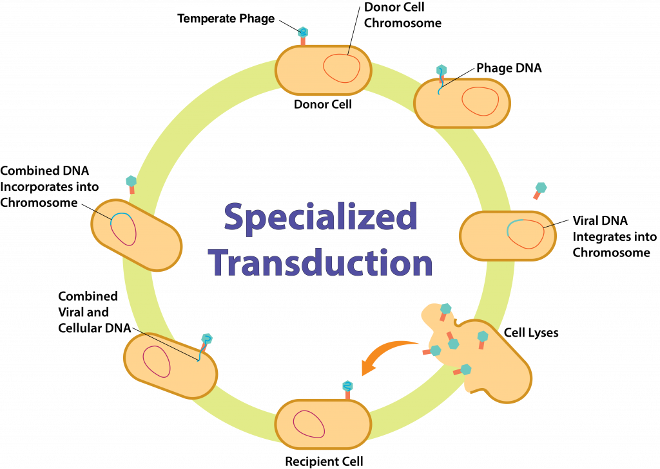
Specialized Transduction

Slide 11
Examples of specialized transduction
Lambda phage and the lac operon in E. coli.
Staphylococcus aureus and antibiotic resistance.

Slide 12
Antibiotic resistance in S. aureus
Antibiotic resistance in S. aureus, particularly MRSA, presents a significant challenge in healthcare settings. Bacteriophages that infect S. aureus can carry genes for antibiotic resistance, such as genes encoding resistance to beta-lactam antibiotics like penicillin.

Slide 13
Next lecture
Conjugation

Slide 14
Questions and comments?

