Slide 1
Conjugation
Dr. Salah Tofik Balaky
Course: Molecular Biotechnology
MA Code408
Summer school: Week 3
Date 25/08/2024

Slide 2
Conjugation
Conjugation requires contact between living cells of opposite mating types. The donor cell, called an F⁺ cell (corresponding to maleness), has extra DNA pieces called F (or fertility) factors. These are a type of plasmid, a free genetic element in the cell. When F⁺ and F– (corresponding to femaleness) cells are mixed, the F⁺ cells attach by sex pili to F– cells.

Slide 3
Conjugation main characteristics
1.Conjugation process requires cell-to-cell contact and mediated by fertility plasmids.
2. The fertile cell forms a sex pilus to connect the recipient and the plasmid DNA replicate.
3. Genes from Donor cells F⁺ move into F^{-.}
4. Fertility plasmid will be transferred from the donor cell to the recipient cell, both cells will separate.

Slide 4
Different types of bacterial conjugation
F-type conjugation.
P-type conjugation.
Type IV secretion systems (T4SSs).

Slide 5
F-type conjugation
This type of conjugation is mediated by the F plasmid and is the most well-studied. It involves the transfer of genetic material from the donor bacterium to the recipient bacterium through the formation of a conjugative pilus.

Slide 6
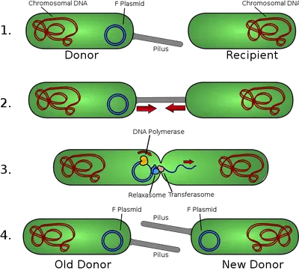
F-type conjugation

Slide 7
P-type conjugation
This type of conjugation is mediated by the P plasmid and is less well-studied compared to F-type conjugation. It also involves the transfer of genetic material from the donor bacterium to the recipient bacterium through the formation of a conjugative pilus. The P plasmid is also a self-replicating plasmid that can carry antibiotic resistance genes and other traits beneficial to the recipient bacterium.

Slide 8
Significance of conjugation
Each of these types of bacterial conjugation plays a significant role in the spread of antibiotic resistance genes and the evolution of bacterial populations. Understanding the mechanisms and regulation of these processes is essential for the development of effective strategies to combat the spread of antibiotic resistance and to prevent the emergence of new bacterial pathogens.

Slide 9
Questions and comments?

