Slide 1
DENTAL CARIES
Dental caries is progressive bacterial damage to the calcified tissues of tooth, characterized by demineralization of the inorganic portions and destruction of its organic structures. Caries is one of the most common of all diseases and still a major cause of loss of teeth.

Slide 2
In 1890, Miller WD showed that lesions similar to dental caries could be produced by incubating teeth in saliva when carbohydrates were added.
Miller concluded that caries could result from decalcification of inorganic part of the tooth caused by bacterial acid production followed by invasion and destruction of organic part of the tooth

Slide 3
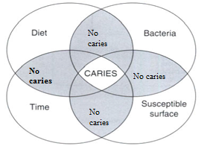
However, dental caries develops only in the presence of several interacting variables

Slide 4
Microbiology: Large number of micro organisms play role in dental caries. Substantial evidence indicates that
- streptococci are essential for development of caries.
S. mutans are strongly acidogenic, and with freely available sucrose can store an intracellular, glycogen-like reserve polysaccharide.
When the supply of substrate dries up, this reserve is metabolized to continue acid production for a time.
.

Slide 5
There is little evidence that lactobacilli are clinically important in initiating dental caries but they may contribute to tooth destruction after the process has started.
Strains of actinomyces are also found, particularly when caries is rampant, but appear capable only of causing root surface lesions.

Slide 6
Bacterial polysaccharides:
. The ability of S. mutans to initiate dental caries and form large amounts of adherent plaque depends on its ability to polymerize sucrose into high-molecular-weight extracellular polysaccharides (glucans).
. Glucans enable streptococci to adhere to one another and to the tooth surface. In this way S. mutans and its glucans may initiate their attachment to the teeth and enable critical masses of plaque to be built up.
. Fructans formed from fructose are produced in smaller amounts. They are more soluble than glucans and less important in caries.

Slide 7
Bacterial plaque:
. Plaque is adherent deposit that forms on tooth surfaces (biofilm). It consists of an organic matrix containing a dense concentration of bacteria.
. It can only be readily removed by tooth brushing. However, neither tooth brushing nor fibrous foods will remove plaque from inaccessible surfaces or pits.
. Plaque becomes visible, particularly on the labial surfaces of the incisors, when tooth brushing is stopped for 12-24 hours and appears as a translucent film.

Slide 8
Acid production in plaque:
. Sucrose diffuses rapidly into plaque
. Acid production quickly follows.
. The rapid production of high concentration of acid temporarily overcomes the local buffering.
. These changes have been measured directly in the human mouth using microelectrodes in direct contact with plaque.

Slide 9
. It has been shown that, after rinsing the mouth with a 10% glucose solution, the pH falls within 2-5 minutes, often to a level sufficient to decalcify enamel
. The pH level remains at a low level for about 15-20 minutes.
. Continued sugar production from bacterial intracellular polysaccharides contributing to maintenance of low plaque pH causing slow rate of recovery to the resting pH.
. It returns only gradually to the resting level after about an hour.

Slide 10
CONTRIBUTING FACTORS IN DENTAL CARIES
1.Tooth factors:
Composition of tooth: The highly mineralized tooth structure, the chance of caries formation becomes less.
Morphology: Presence of deep, narrow and retentive pits and fissures on the tooth surface may contribute to a higher caries incidence because they favor the colonization of plaque microorganisms.
Position: The maligned teeth in the dental arch are attacked by caries more frequently as there is more possibility of plaque accumulation in these regions.

Slide 11
Saliva factors:
Flow rate: Salivary flow is highly important in clearing cariogenic foods from the mouth. Dental caries may become rampant in humans with xerostomia.
(Average value for whole saliva to be about 0.3-0.4 ml/minute)
Viscosity: When viscosity of saliva is increased, there will be more and more deposition of plaque on the tooth surface since the thick saliva fails to produce adequate cleaning action.

Slide 12
Buffering capacity: Buffering power of saliva depends mainly on its bicarbonate content. The buffering power of the saliva affects the buffering power of dental plaque to some degree and helps to prevent the pH from falling to very low levels.
Moreover saliva also contain urea..etc. which hydrolyzed to produce ammonia which rise the salivary pH which counter the acid attacks on the tooth surface

Slide 13
Salivary antibodies: Salivary immunoglobulins (IgA and IgG) facilitating cariogenic bacteria destruction.
Remineralization of damaged tooth surface: Calcium and phosphate ions present in saliva help in partial repair of tooth damaged by caries by remineralization of tooth and this process starts when the salivary pH is above 5.5.
Direct antibacterial action: Saliva contains lysozyme, lactoferrin, and lactoperoxidase etc… antibacterial substances, which cause destruction of the cariogenic bacteria.

Slide 14
Diet factors:
Physical nature of diet: More intakes of soft and sticky foods increase the possibility of caries. Fibrous food help to keep the teeth clean.
Composition of food: Diet with adequate vitamins and minerals associated with low caries incidence.
Fluorides from drinking water and other sources are taken up by calcifying tissues during development can decrease the caries incidence.

Slide 15
CLINICAL ASPECTS OF DENTAL CARIES
A- Pit and fissure caries:
- Occurs in the developmental pits and fissures of the teeth like the occlusal surfaces of molars and premolars, buccal and lingual surfaces of molars and palatal surfaces of maxillary incisors.
- It appear brown or black and when is examined by a fine explorer tip a catch point is often felt.
- When the lesions reach the dentinoenamel junction, they spread laterally to cause undermining of the enamel.

Slide 16
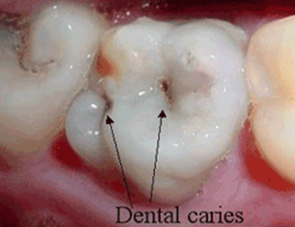
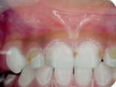
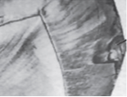
B.Smooth surface caries: Commonly occurs in the proximal surfaces or on the gingival third of the buccal and lingual surfaces of teeth.
A
B
C
(A) Pit and fissure caries (B, C) Smooth surface caries, clinical and microscopically.

Slide 17
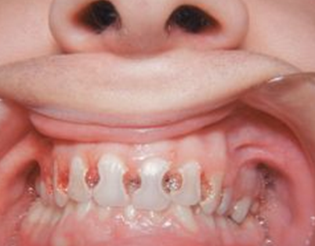
C-Acute dental caries:
1-Rampant caries
- Is acute caries involving multiple teeth, it is most often observed in the primary dentition of young children and the permanent dentition of teenagers.
- Dietary factors affecting oral substrate and oral flora and physiological factors affecting saliva are often significant in the development of rampant caries
Rampant caries .

Slide 18
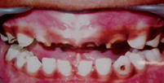
2-Nursing bottle caries:
Is another type of acute dental caries which occurs among children who take milk or fruit juices by the nursing bottle for a considerably longer duration of time
commonly occurs in the upper anterior teeth, while the lower anterior are not usually affected as they remain under the cover of the tongue.
In acute caries early pulp involvement may occur because this caries is very rapid and there is no time for forming reparative dentine.
Nursing bottle caries

Slide 19
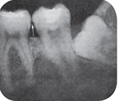
D- Chronic dental caries:
- This type of caries progresses at a slower pace and appear dark brown in color
It rarely causes pulp involvement unless the tooth is left untreated for long period.
The pulp gets sufficient time to form reparative dentine.
E.Primary caries: Attacking previously intact surface.
Primary caries of proximal surface

Slide 20
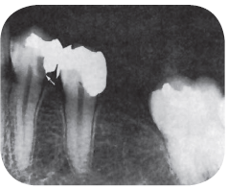
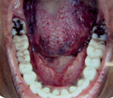
F- Recurrent caries: Carious lesion that begins around the margins or at the base of
a pre- existing defective restoration
Recurrent caries

Slide 21
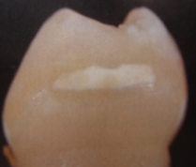
G-Incipient caries:
- Caries has just evolved the enamel of teeth and there is just demineralization to notice upon (white spot).
The caries has not created any cavity.
Also these sorts of caries are reversible by remineralisation using fluoride application
Incipient caries

Slide 22
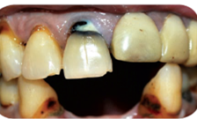
H- Root caries:
Carious lesion involve the cemental walls of exposed root surfaces of teeth due to ageing or gingival recession
Root caries

Slide 23
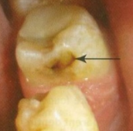
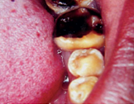

H- Arrested caries:
-The progression of lesion is ceased after the initial development.
Arrested caries in proximal surface may occur when carious process stops.
It occurs when the adjacent carious tooth from which the disease has spread to this new tooth, is extracted, so the carious lesion in the new tooth becomes easily accessible for cleaning.
The arrested caries in occlusal surface occurs when the carious cavity becomes wide open, so that it gets exposed to the cleaning measures. The arrested caries appear hard and black or brown in color
B
A

