Slide 1
DISEASES OF PERIAPICAL TISSUES L5

Slide 2
Periapical inflammation is usually due to spread of infection following death of the pulp.
Infection is the most common cause , the usual sequence of events is caries ,pulpitis, death of the pulp and periapical periodontitis .

Slide 3
Periapical inflammation is usually due to
Spread of infection following death of the pulp due to caries
Blow which damages the apical vessels.
During endodontic treatment the instruments may be pushed through the apex damaging the periodontal membrane and carrying infected debris from the pulp chamber into the wound.
Irritant antiseptics used to sterilize a root canal can escape through the apex and damage the surrounding tissues.
A root canal filling may also extend beyond the apex with similar effect.

Slide 4
A cut periapical abscess
Clinical feature
Tooth to be extruded from its socket.
Hot or cold substances do not cause pain in the tooth.
The inflammation becomes more severe and pus starts to form, pain becomes intense and throbbing in character associated with severe tenderness.
There is often a large carious cavity or filling in the affected tooth, or it may be discolored due to death of the pulp earlier.

Slide 5
5. At this stage the gingiva over the root is red and tender.
6. The regional lymph nodes are enlarged and tender associated with elevated body temperature.
7.Exudate may penetrate overlying bone and periosteum, allowing relief of the pressure, and pus discharging sinus often develops over the affected root apex and sometimes on the skin overlying the jaw bone

Slide 6
8. If exudate cannot escape, it distends the soft tissues to form a swelling, either extra orally or intra orally . It subsides when the tooth is extracted or the infection is drained.
9. Further spread of infection can cause inflammation of the surrounding bone (osteomyelitis) or infections of facial spaces which may further complicated by the development of septicemia, Ludwig’s angina and cavernous sinus thrombosis.

Slide 7
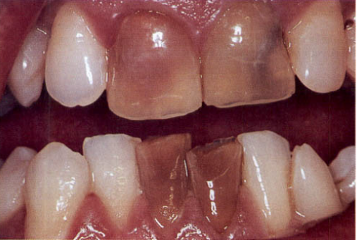
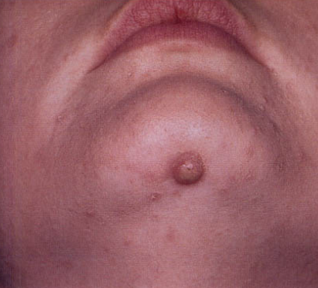
(A)
(B)
Non-vital incisor teeth as a result of trauma. Hemorrhage and products of autolysis (the destruction of cells or tissues by their own enzymes0 of the pulp discolor the dentine and darken the teeth.
(B) Skin sinus from a non-vital lower incisor.

Slide 8
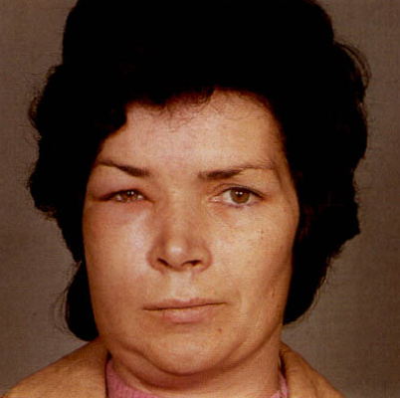
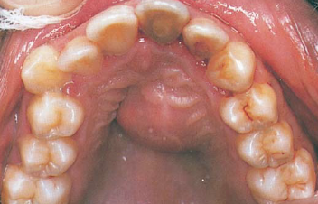
If the host resistance is high or the virulence of the organisms involved in periapical abscess is low, a chronic stage of the abscess sets.
An acute periapical infection of a canine has perforated the buccal plate of bone causing edema of the face
Palatal abscess.

Slide 9
Radiological features:
- In acute periapical abscess, radiographs give little information because bony changes had too short a time to develop
The lamina dura around the apex may appear slightly hazy and the periodontal space may be slightly widened.
When acute periapical abscess is due to exacerbation of a chronic infection, the original lesion can be seen as an area of radiolucency at the apex

Slide 10
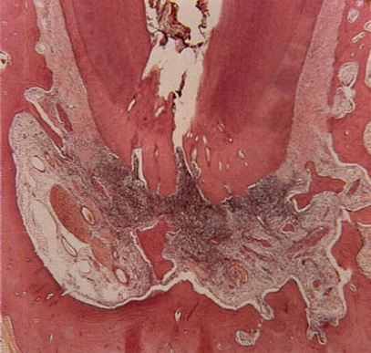
Histopathological features:
- In early acute lesion inflammatory cells, mainly neutrophil, are seen clustered around the apex of a non-vital tooth.
- The inflammatory cells are spreading around and into bone and there has not yet been time for significant bone resorption to develop
Bone trabeculae in the periapical
region may show empty lacunae
which result from death of osteocytes.

Slide 11
Chronic periapical abscess

Slide 12
Clinical features
- Mild, dull pain , intraoral or extra-oral pus discharging sinuses.
-Facial spaces infections.
- Facial spaces infections may be farther complicated by the development of septicemia, cavernous sinus thrombosis.
- Spread of periapical infection into the medullary spaces of bone may produce osteomyelitis in some patients.

Slide 13
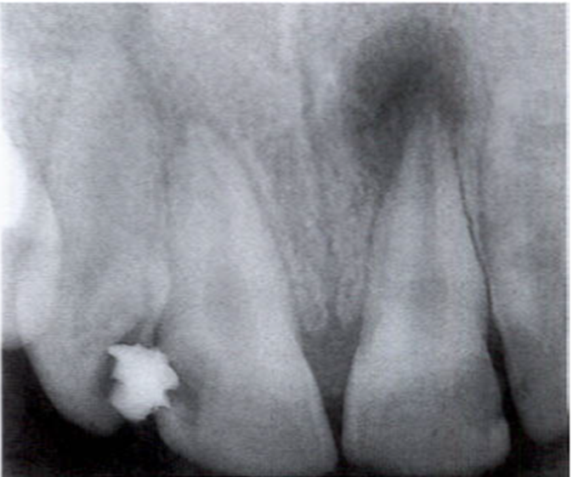
Radiological features:
In chronic periapical abscess, radiographs often reveal small poorly defined radiolucent areas at the apex of the tooth

Slide 14
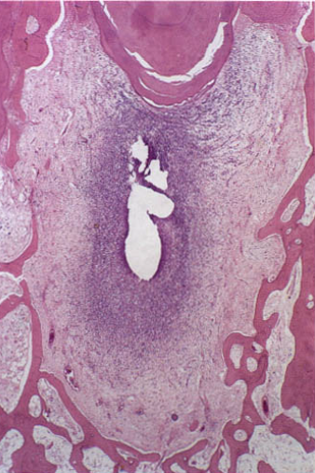
Histopathology
-Periapical bone has been resorbed and the trabeculae reorientated around the mass.
-The abscess cavity is surrounded by a thick fibrous wall.
-The periapical area is densely infiltrated by
chronic inflammatory cells, lymphocytes,
plasma cells and macrophages

Slide 15
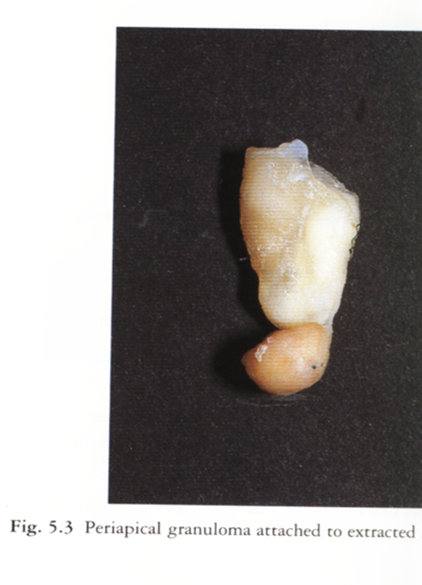
PERIAPICAL GRANULOMA
It is a localized mass of
granulation tissue around the
apex of non vital tooth which
develop in response to
infection or inflammation.

Slide 16
Clinical features
it may be asymptomatic or cause mild sensitivity to percussion or discomfort during chewing solid food.
The involved tooth may be slightly elongated from its socket.

Slide 17
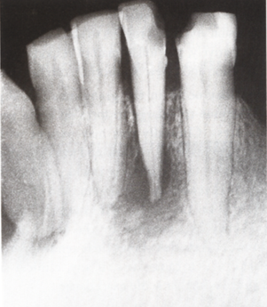
Radiological features:
Frequently, recognized as a rounded area of radiolucency at the apex of a tooth.
Sometimes the radiolucent area is well demarcated from surrounding bone by a thin sclerotic margin.
Long standing periapical granuloma
may show varying degrees of root
resorption
Periapical radiolucency and apical resorption associated with periapical granuloma.

Slide 18
Histopathological features
1.The granulation tissue grows into a rounded mass surrounded by connective tissue capsule.
2. Lymphocytes, macrophages and plasma cells are often present in the lesion, cholesterol cleft, foam cells in addition to proliferating fibroblasts and endothelial cells.
3. osteoclasts resorbed the bone to accommodate granuloma growth.
4.Variable degrees of proliferation of the epithelial rests of Malassez in a periapical granuloma at the apex of a dead tooth are common.

Slide 19
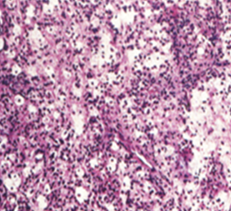
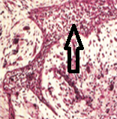
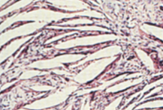
Epithelial proliferation may be sufficient to lead ultimately to cyst formation and is the most common cause of jaw cysts.
In other cases the epithelium is scanty or destroyed by the inflammation.
Treatment by extraction with apical curettage or endodontic treatment with apicoectomy.
(A)
(B)
(C)
(A) High power of an apical granuloma showing lymphocytes and foam cells in fibrous tissue.
(B) Strands of epithelial proliferation, arrow.(C) Cholesterol clefts.

Slide 20
RADICULAR CYSTS
Cyst: is defined as a pathological cavity which may (true cyst) or may not (pseudo)be lined by epithelium and is filled with solid, semisolid or gaseous material but not pus.
Radicular or periapical cyst is the most common odontogenic cystic lesion of inflammatory origin, which occurs in relation to the apex of a non-vital tooth

Slide 21
Clinical feature:
Radicular cysts are always associated with non vital tooth and are most common type of cyst of the jaws of inflammatory origin and cause:
. Slowly progressive painless swellings, with no symptoms until they become large enough to be conspicuous.
. The swelling at first is hard, later, when the bone has been reduced to eggshell thickness, a crackling sensation may be felt on pressure.
. Finally, part of the wall is resorbed entirely away, leaving a soft fluctuant swelling, bluish in color, beneath the mucous membrane

Slide 22
Radiological features:
. A radicular cyst appears as a rounded, radiolucent area with a sharply defined outline ,few millimeters to several centimeters.
. A condensed radiopaque periphery is present only if growth is unusually slow and is usually more prominent in long-standing cysts. . .The dead tooth from which the cyst has arisen can be seen and often has a large carious cavity.
. Adjacent teeth may be tilted or displaced a little or occasionally become slightly mobile

Slide 23
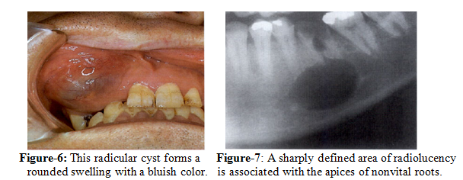

Slide 24
Pathogenesis:
The radicular cyst develops due to stimulation of epithelial rests of Malassez in the periapical area by direct inflammatory effect of necrotic pulp tissue, this stimulation leads to proliferation of the epithelial rests of Malassez in the periapical area.
The radicular cyst develop due to proliferation and subsequent cystic degeneration of the epithelial cell rests of malassez within chronic periapical granulomas but not all granulomas progress to cysts

Slide 25
The mechanism of formation of an epithelial-lined cyst cavity within the granuloma is unclear .two main mechanisms have been proposed
1- Once a large bulk of the cell rest of Malassez is produced, the central cells are often deprived of proper nutritional supply and undergo ischemic liquefaction necrosis while the peripheral area survive, this give rise to formation of a lumen inside the mass of the proliferating cells(cystification) and peripheral lining of epithelial cells is present.

Slide 26
2- Cyst fluid is largely inflammatory exudate and contains high concentrations of proteins, some of high molecular weight which can exert osmotic pressure.
Higher osmotic tension of cystic fluid causes progressive increase in the amount of fluid inside the lumen and this causes increased internal hydrostatic tension within the cyst which results in cyst enlargement

Slide 27
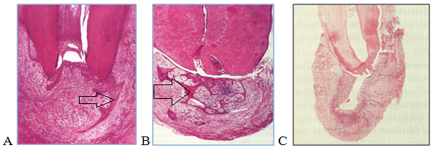
The enlargement may also occur due to release of the bone resorbing factors like prostaglandins and collagenase from the cystic tissue which destroy the bone and facilitate expansion of the cyst.
(A, B) Epithelial proliferation (arrows) and (C) formation of periapical cyst.

Slide 28
Histopathological features :
-The epithelial lining consists of nonkeratinized stratified squamous epithelium of variable thickness.
Early, active epithelial proliferation is associated with obvious chronic inflammation and may then be thick, irregular and hyperplastic or appear net-like, forming rings and arcades.
Rushton bodies within the lining epithelium may also seen. These are peculiar linear, often curved, hyaline bodies which are of uncertain origin; the structures are probably of hematogenous origin.

Slide 29
Mucous cells are often present as a result of metaplasia.
Respiratory epithelium may be also present in radicular cyst near the maxillary sinus.
The cyst wall or capsule consists of collagenous fibrous connective tissue.
During active growth the capsule is vascular and infiltrated by chronic inflammatory cells.

Slide 30
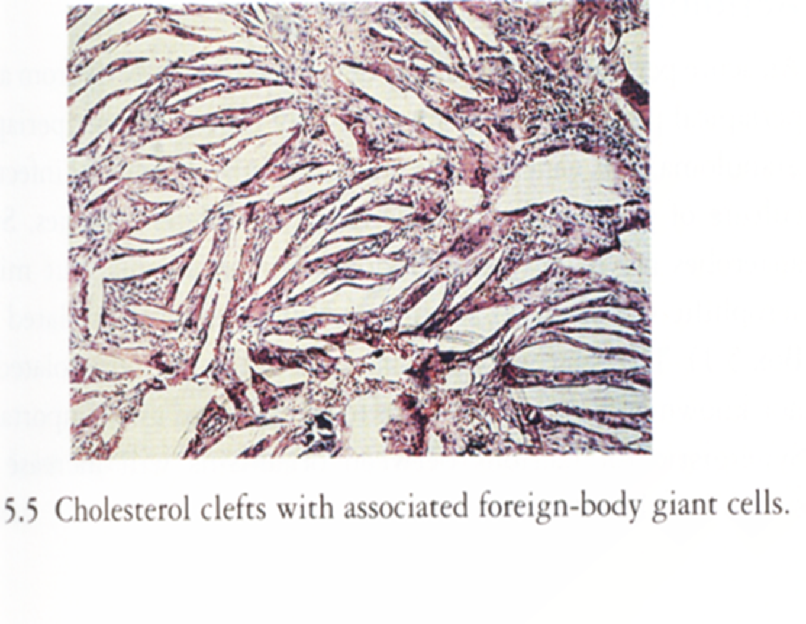
Within the cyst capsule there are fine needle-shaped clefts. These are left by cholesterol dissolved-out during preparation for sectioning.
-Clefts may also be seen extending into the cyst contents but are formed in the cyst wall.
The cystic fluid is usually watery
and opalescent but sometimes more
viscid and yellowish.

Slide 31
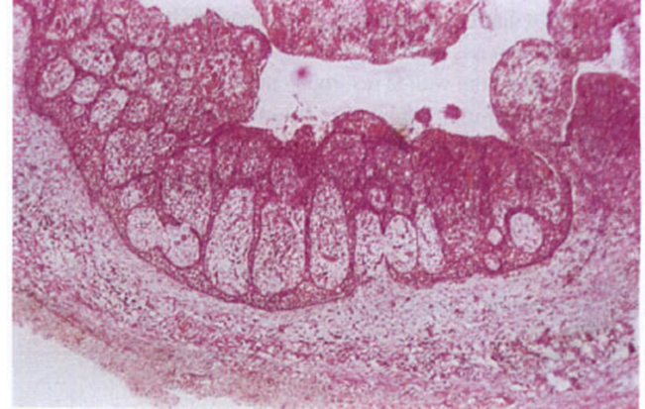
Proliferating cystic epithelium may some times grow in a peculiar fashion ,by enclosing or encircling a mass of connective tissue capsule from all sides , This pattern is called arcading pattern.
Small cysts are treated by apicoectomy with apical curettage, while the large cysts are treated by enucleation or marsupialization.

Slide 32
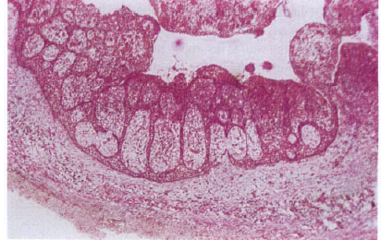
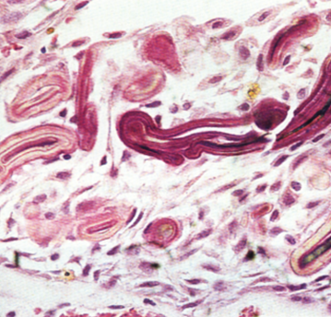
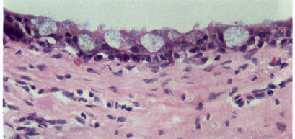
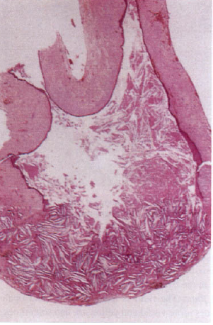
B
D
A) Radicular cyst. The epithelial lining often assumes this arcaded pattern with numerous inflammatory cells beneath its surface.(B) Hyaline bodies in cyst epithelium.(C) Mucous metaplasia in a radicular cyst, the numerous goblet cells can be seen.(D) Cholesterol clefts in a cyst wall. The squamous epithelium overlying this focus has broken down and the cholesterol leaks into the cyst contents.

Slide 33
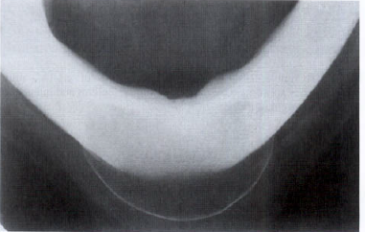
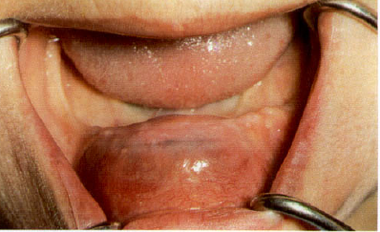
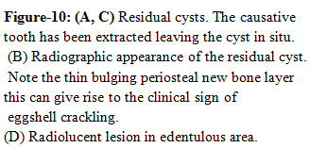
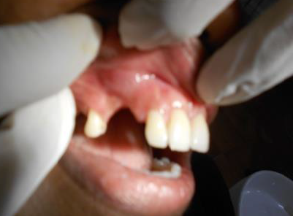
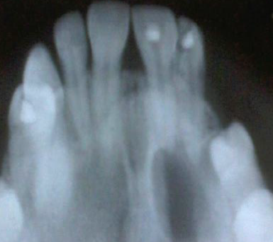
RESIDUAL CYST
Residual cysts are a common cause of swelling of the edentulous jaw in older persons. It is periapical cyst which remains after extraction of the non vital tooth

