Slide 1

Determination of serum electrolytes (Sodium)
Dr. Jaafaru Sani Mohammed/ Mr. Tolaz Khadhm
Advanced Clinical Biochemistry I
Fall Semester
Week Two
08/10-2024

Slide 2
Objectives
At …The students should understand/practice:
The importance and principle behind the laboratory test for electrolytes accordingly.
The step-by-step procedure of Sodium determination in serum
The interpretation of laboratory results and their correlation with clinical
conditions in real-life situations.

Slide 3
Introduction
Sodium is involved in most major metabolic functions in the body, and it is amongst the most important physiological ions and the most often assayed electrolytes.
Sodium is supplied primarily through the diet, absorbed in the GIT, and excreted via the kidneys.
Na⁺ is the major extracellular cation and functions to maintain fluid distribution and osmotic pressure.
Some causes of decreased levels of sodium include prolonged vomiting or diarrhea, diminished reabsorption in the kidney, and excessive fluid retention.
Common causes of increased sodium include excessive fluid loss, high salt intake, and increased kidney reabsorption.

Slide 4
Clinical Significance
Na⁺ measurements are used in the diagnosis and treatment of various forms of disease conditions.
Aldosteronism, diabetes insipidus, adrenal hypertension, dehydration, inappropriate ADH secretion, or diseases involving electrolyte imbalance.
The urine Na⁺ and K⁺ are used as nutritional indicators in healthy persons. Urine sodium data is an important biomarker of dietary sodium intake.

Slide 5
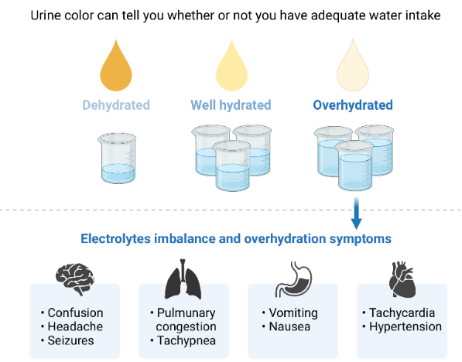

Slide 6
Principle of the experiment
Sodium precipitates with Magnesium acetate and Uranyl-acetate.
The Uranyl ions remaining in the solution are forming a yellow-brown color complex together with thioglycolic acid.
The difference between the reagent blank. The analysis is proportional to the sodium concentration.
Na⁺+ 3UO₂(OAc)₂ + AcO⁻ + MgOAc₂ + 9H₂O MgNa(UO₂)OAc₉ + 9H₂O

Slide 7
Reagents
Reagent 1
Uranylacetate
Magnesium acetate
Reagent 2
Ammonium Thioglycolate
Ammoniak
Standard

Slide 8
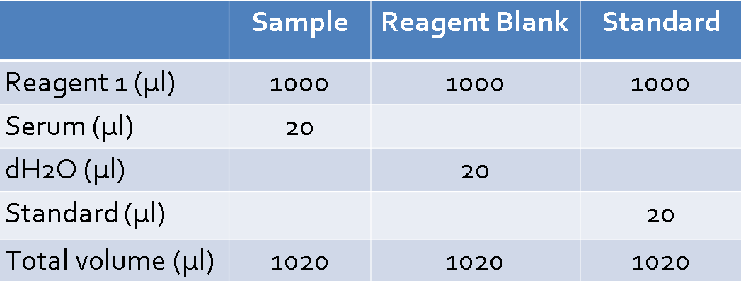
Procedure
The experiment is to be carried out in two steps as follows:
Table 1: Step 1 of the procedure.
Shake the tube gently and keep for five minutes.
Shake vigorously for 3 sec and keep the tubes in the dark for 30 min.
Centrifuge at high speed for 5 – 10 min.

Slide 9
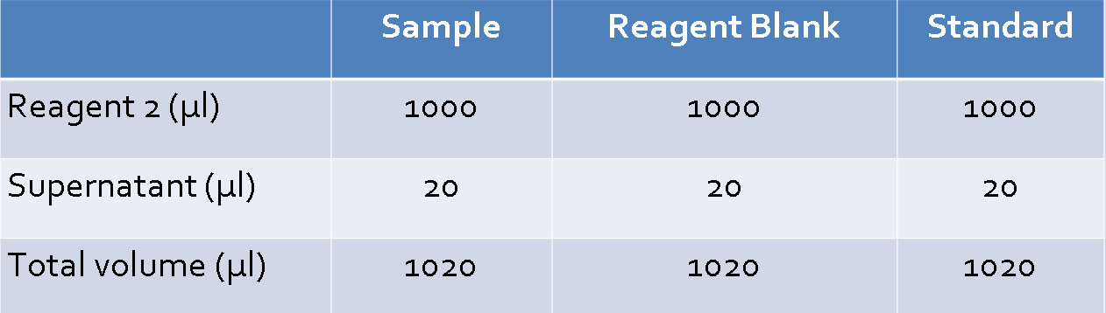
Procedure
The experiment is to be carried out in two steps as follows:
Table 2: Step 2 of the procedure.
Shake the tubes and keep at room temperature for five minutes.
Take absorbance at 365/406 nm using reagent only as blank.
Record your result and calculate the Na⁺ concentration as follows:

Slide 10
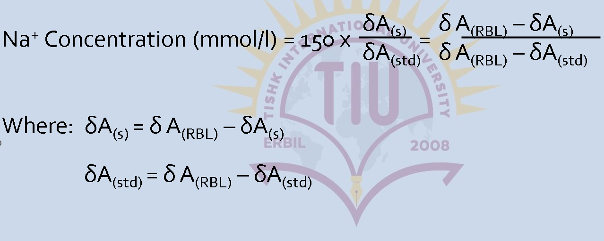

Slide 11

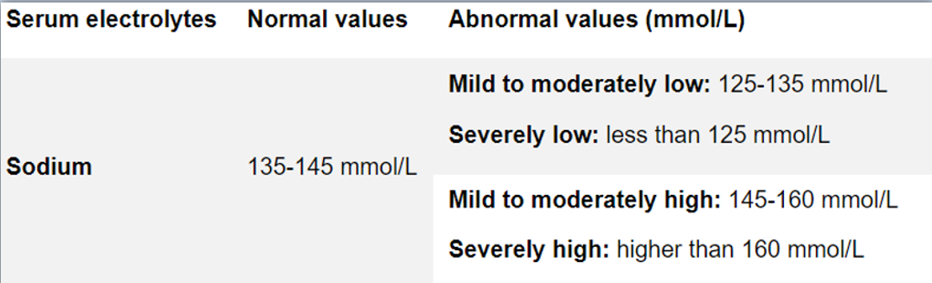
Ranges for Sodium conc.

Slide 12
Practical Report
Refer to practical note 1 and write a step-by-step practical report for today’s experiment.
The report should comprise all the components outlined in the standard report format and should not be more than five (5) pages.
The submission date is Tuesday 15th October 2024 during practical session

Slide 13


