Slide 1
Writing A Cover Letter

Slide 2
What is a Cover Letter?
Definition: A cover letter is a one-page document that applicants submit along with their resume that summarizes professional experience and background.
Purpose: The goal of a cover letter is to illustrate the applicant's interest in a given position along with their qualifications.
Importance: a well written cover letter will get an employer’s attention and encourage them to read the resume and schedule an interview.

Slide 3
How Do We Write a Resume that Will Get Us Noticed?
Major Considerations: AIDA
Attention
Action
Interest
Desire

Slide 4
Attention
The goal of the first paragraph in your cover letter is to grab your potential employer's attention. To do this, consider including the following information:
Who you are
What position you're applying for
How you learned about that position
Why you are interested

Slide 5
Attention Grabber Examples
I am writing in application for the _____ position I learned about through (Ziprecruiter/Indeed/Monster/etc.)
I am following up on the _____ position we discussed at the Bartow County job fair.
I am interested in learning more about the ______ career opportunity I heard about through my friend Jane Doe.
I am inquiring about the available positions I saw advertised while shopping in your store.

Slide 6
Interest & Desire
The second and third paragraphs of your letter should peak the employer's interest and also create a desire for the hiring manager to meet with you by telling them what makes you a unique applicant. This can be accomplished through explaining solid accomplishments. Consider including the following:
Education
Specialized Skills
Related Experience
Degrees
Workshops
Certifications
Years of experience
Specific projects
Familiar with x computer program
Skilled in social media content creation

Slide 7

Action
The cover letter should end with a call to action.
Express interest in an interview
Provide your contact information
Thank the hiring manager for considering your application

Slide 8
Cover Letter Tips!
Always write a new cover letter for each job you are applying for
Include key words from the job posting
Check out their mission statement and goals, include that as well
Proofread!
  A cover letter is your first writing sample for the job you are applying for. It it's riddled with errors, that reflects poorly on you

Slide 9
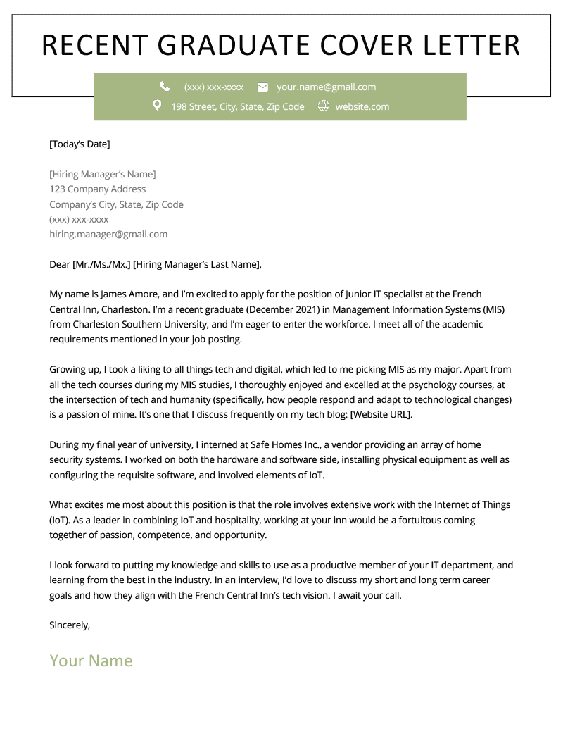
Example
Attention
Education
Skills
Related Experience
Passion
Call to Action

Slide 10
Create Your Own!
If you have a cover letter...
If you do not...
Get in groups of two or three
Trade cover letters
Read to see if the it has all the elements of AIDA
Give your partners constructive feedback.
Trade back and revise!
Using the provided templates, write a draft of your cover letter
When you are finished, get in groups, provide feedback, and revise.

Slide 11
Work Cited
Benz, Conrad, et al. “Recent Graduate Cover Letter Sample & Writing Tips.” Resume Genius, Resume Genius, 10 Feb. 2022, https://resumegenius.com/cover-letter-examples/recent-graduate-cover-letter.
Dahlstrom, Harry S. “Let AIDA Help You Write a Better Cover Letter.” The Job Hunting Handbook, Dahlstrom & Company, Inc, Holliston, MA, 2019, pp. 24–25.

