Slide 1
Peripheral IV Cannulation
Presented by:
Hilal Farouq Hussein
Clinical supervisor and Instructor at Tishk International University – Faculty of nursing

Slide 2
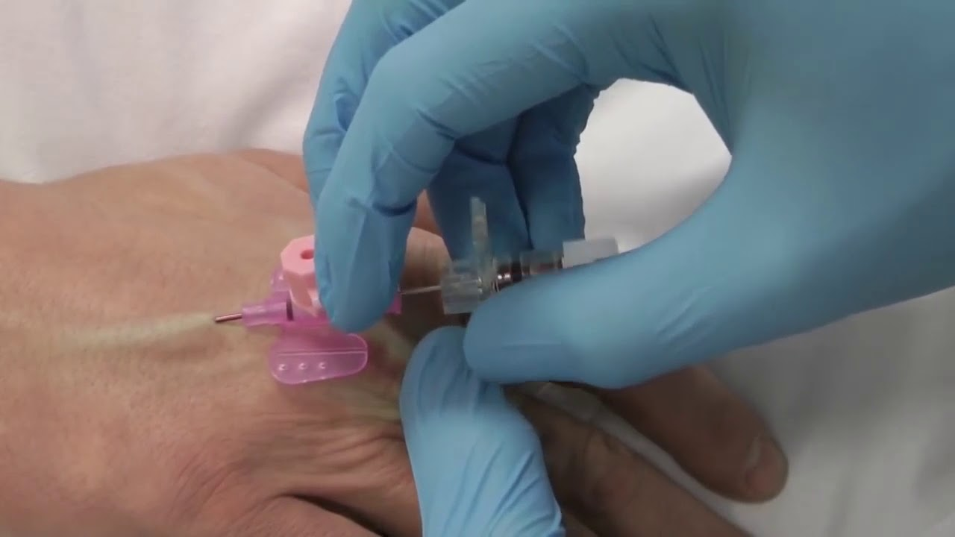
Cannulation
Intravenous (IV) cannulation is a technique in which a cannula is placed inside a vein to provide venous access.

Slide 3
Anatomy of Cannula

Slide 4
Common sites of peripheral IV Cannulation

Slide 8
Complication
Other complications include
Extravasation of infused fluids into surrounding tissues
Hematoma or bleeding
Damage to the vein
Nerve damage
Local infection
Air embolism

Slide 9
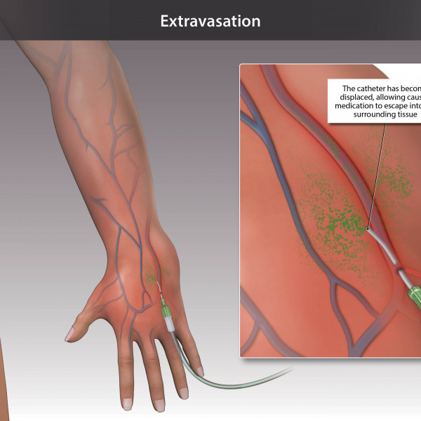
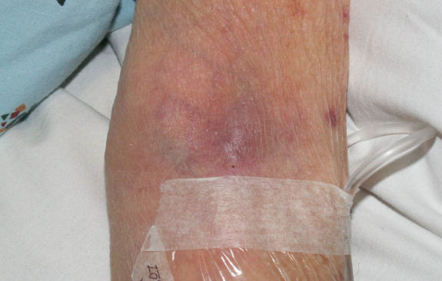
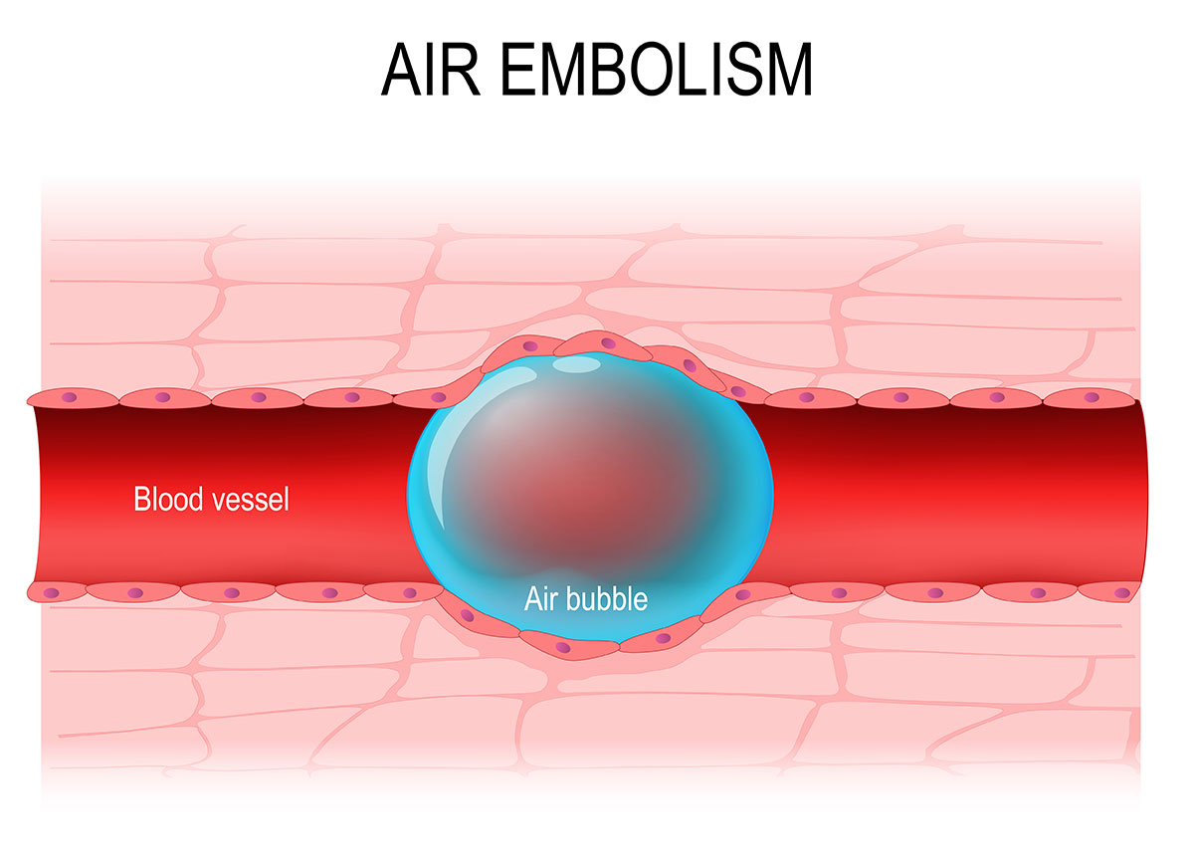
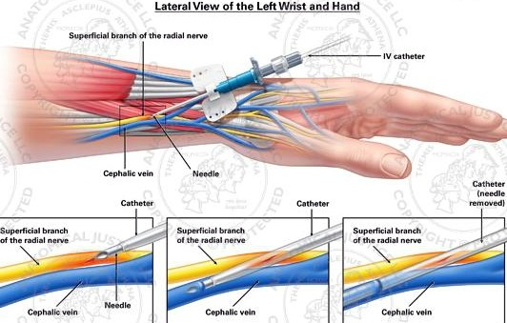

Slide 10
Warnings and Common Errors
Use only mild tension when applying the tourniquet; it is a venous, not an arterial, tourniquet.
If the vein is not entered, do not try to reposition the needle by moving the tip to one side or another.
Never withdraw the catheter back over the needle or reinsert the needle into the catheter. Doing so could shear off the catheter tip within the patient.

Slide 11
Tips and Tricks
Nitroglycerin ointment or warm compresses may help dilate veins.
Consider using double tourniquets (a second tourniquet is placed distal to the anticipated catheter-insertion site after placement of the first tourniquet) to engorge the veins for large body habitus or edematous limbs.
You can use vein scanner for very complicated vein.

Slide 13
How to do Cannulation

