Slide 1
BUSINESS COMMUNICATION & REPORT WRITING
Dr. Abdullah Nabeel
  LECTURE 2

Slide 2
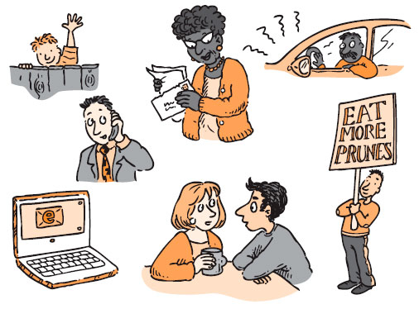
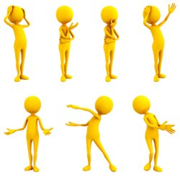
Verbal and Nonverbal Communication
Verbal Communication
Non Verbal Communication

Slide 3
Two Essential Tools
Verbal Communication – How you use words and language
Nonverbal Communication – Message components other than words that generate meaning

Slide 4
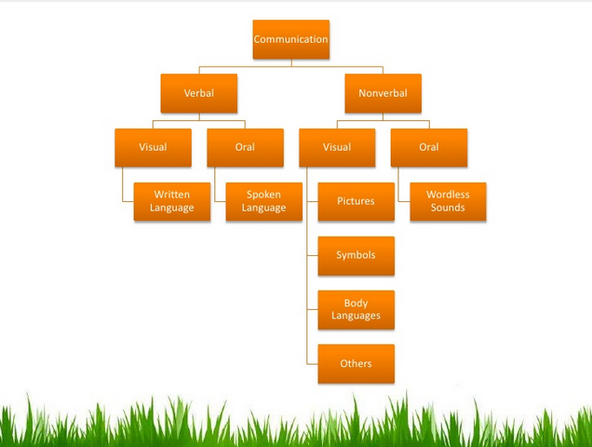

Slide 5
Verbal Communication
The basis of communication is the interaction between people. Verbal communication is one way for people to communicate face-to-face. Some of the key components of verbal communication are sound, words, speaking, and language.
Verbal communication is communication that uses words, either written or spoken. This is in contrast to non-verbal communication, such as body language.
"Verbal" is sometimes used colloquially in the sense of "spoken", but it is better to use "oral" in that context, to avoid ambiguity

Slide 6
1. Verbal Communication
Verbal communication is an act of conveying messages, information, ideas or feelings through the use of words spoken or written
It consists of
    Speaking
    Listening
    Writing
    Reading

Slide 7
Forms of Verbal Communication
It may be Oral or Written
Oral: Meetings, Discussions, Seminars, Workshops, Video Conferencing, Oral Presentations, Lectures, Conversations and Interviews
Written: Letters, Memo, Reports, Applications and Drafting

Slide 8
Characteristics of Effective Verbal Communication
Consider the objective
Be sincere
Use simple language, familiar words
Be brief and precise
Assume nothing
Use polite words and tone
Say something interesting and pleasing

Slide 9
Merits of Verbal (Oral) Communication
More personal and informal
Makes immediate impact
Provides opportunity for interaction and feedback
Help us correct ourselves (our messages according to the feedback and non-verbal cues from the listener)
It is fastest and less expensive

Slide 10
Demerits of Verbal Communication
It can be quickly forgotten
A word once uttered cannot be taken back
There is no legal evidence of oral communication
Impact may be short lived
Very difficult to be conscious of our body language

Slide 11
2. Nonverbal Communication
Nonverbal communication is the process of communication through sending and receiving wordless (mostly visual) cues between people
Transmission of messages by a medium other than speech or writing

Slide 12
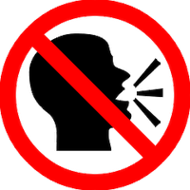
“Actions speak louder than words.”

Slide 13
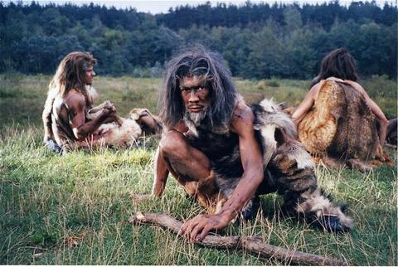
Cave –men and Non verbal communication
Humans communication has existed for about 30,000 BC .
In the beginning There was non verbal communication not verbal.
Notes:
Human communication was revolutionized with speech approximately 200,000 years ago
hThe oldest known symbols created with the purpose of communication through time are the cave paintinge oldest known cave painting is that of the Chauvet Cave 30,000 BC. The oldest known symbols created with the purpose of communication through time are the cave painting

Slide 14
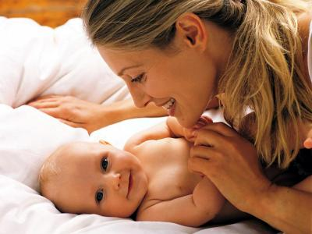
Child looks and recognizes before it speaks

Slide 15
2. Nonverbal Communication
Nonverbal communication involves those nonverbal stimuli in a communication setting that are generated by both the source [speaker] and his or her use of the environment and that have potential message value for the source or receiver [listener]
Basically it is sending and receiving message in a variety of ways without the use of verbal codes (words). It is both intentional and unintentional. Most speakers / listeners are not conscious of this.

Slide 16
Example
A very good example is: A man comes home late, hears from the kitchen the slamming of pots and pans and cupboard doors. He enters the kitchen, asks his wife "What's wrong, honey?" She answers, "Nothing!" as she slams another cupboard door and rolls her eyes toward the ceiling.
She has spoken the word "Nothing", but it is her unspoken communication that tells him that "nothing" is not the real answer. It is clearly communicated by her actions.
A truly effective communicator will train him or herself in nonverbal communication as well as verbal and oral.

Slide 17
Merits of Nonverbal Communication
You can communicate with someone who is hard of hearing of deaf
You can communicate at place where you are supposed to maintain silence
You can communicate something which you don't want others to hear or listen to
You can communicate if you are far away from a person. The person can see but not hear you
Non-verbal communication makes conversation short and brief
You can save on time and use it as a tool to communicate with people who don't understand your language

Slide 18
Demerits of Nonverbal Communication
You can not have long conversation
Can not discuss the particulars of your message
Difficult to understand and requires a lot of repetitions.
Less influential and can not be used everywhere.
Not everybody prefers to communicate through non-verbal communication.
Can not create an impression upon people/listeners

Slide 19
Importance of Nonverbal Communication
Sometimes nonverbal messages contradict verbal; Often express feelings more accurately than the words spoken or written
Studies suggest that from 60-90% of a message’s effect comes from nonverbal cues

Slide 20
Components of Nonverbal Communication
Nonverbal Communication consists the following three components
  Appearance
  Body Language
  Silence, Time and Space

Slide 21
1. Appearance
Appearance conveys nonverbal impressions that affect receiver's attitudes towards the verbal messages
Appearance as a Nonverbal Communication concept effects in following two ways
    Effect on Written Messages
    Effect on Oral Messages

Slide 22
1. Appearance
Effect on Written Messages:
    An envelope's appearance (Size, color, weight, postage) may impress the receiver as important, routine or junk mail
    Mailgrams, Express mail and Pvt. Courier mail also have distinctive envelopes that shows urgency and importance
    Letter, Report or Title Page communicates nonverbally by the kind of paper used, its length, format and paper used before its contents are read by the reader
    Language itself communicates nonverbally and it must be carefully worded and generally correct in mechanics as spelling, grammar and punctuations

Slide 23
1. Appearance
Effect on Oral Messages:
    When you communicate face to face or to a group in a meeting personal appearance and appearance of your surroundings convey nonverbal stimuli that affects attitude towards your spoken words
    It consists of the following two appearances
        Personal Appearance
        Appearance by Surroundings

Slide 24
1. Appearance
        Personal Appearance
    Clothing, hairstyles, neatness, jewelry, cosmetics, posture, stature are part of personal appearance
    They convey impressions regarding occupation, age, nationality, social and economic level, job status and good or poor judgment, depending on circumstances

Slide 25
1. Appearance
        Appearance by Surroundings
    Aspects of surroundings including room size, location, furnishings, machines, architecture, wall decorations, floor, lightening, windows, views and other related features wherever people communicate orally
    Surroundings will vary according to status and according to country and culture

Slide 26
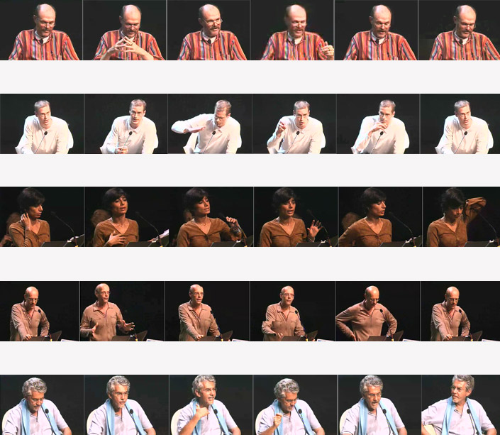
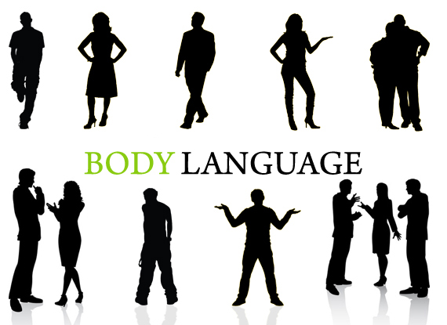
2. Body Language

Slide 27
2. Body Language
Definition:
“The conscious and unconscious movements and postures by which attitudes and feelings are communicated, is called body language”.
Body language can also vary depending on the culture. There are a set of universally recognized gestures but many are influenced by our social settings
Body language may provide clues as to the attitude or state of mind of a person. For example, it may indicate aggression, attentiveness, boredom, a relaxed state, pleasure, amusement, and intoxication

Slide 28
2. Body Language
Body Language consists of the following four components
        i. Facial Expressions
        ii. Gestures, Postures and Movement
        iii. Smell and Touch
        iv. Voice and Sounds

Slide 29
2. Body Language
Facial Expressions:
    It is said that face is the index of mind
    Eyes and face are especially means of communicating nonverbally and they can reveal hidden emotions including anger, confusion, fear, joy, surprise, uncertainty and others
    Conventions of eye contact are specific to each culture (e.g. In USA direct eye contact is encouraged and eye drop or shift away from listener is thought to be either shy, dishonest and untrustworthy)

Slide 30
2. Body Language
Gestures, Body Postures and Movement:
    Gesture and Body Movements: A movement of part of the body, especially a hand or the head, to express an idea or meaning, is called Gestures
    Gestures and body movements of a person reflects his state of mind
    One can be easily judged from the gestures and movements either he is confident or nervous
    Handshakes reveal attitude
    Gestures may be warm or cold

Slide 31
2. Body Language
Postures:
    Posture is the position of a body while standing or sitting
    The way a person stands, sits, leans or shift expresses his interest in the matter under discussion
    The posture of a person expresses his personality
    An unbecoming and bad posture sends a bad signal
    An interested listener may lean towards the speaker, and one who is bored may lean away, slump or glances towards the clock

Slide 32
2. Body Language
Smell and Touch:
    If receiver is sensitive to scents then various odors and fragrances convey the emotions of the sender and affect the reactions of receiver
    Touching people can communicate friendship, love, approval, hatred, anger or other feelings
    A mother’s kiss on cheek of her son, pat on a shoulder or slap on the back is prompted by various actions

Slide 33
2. Body Language
Voice and Sounds:
    Paralanguage: While speaking the extra sounds you make and voice quality also a part of nonverbal communication
    Paralanguage includes voice, volume, rate, articulation, pitch and other sounds you make such as clearing and sighing
    Examples: A loud voice shows urgency and soft one is something calming
    Lack of pitch variation becomes monotone and too much variation becomes artificial and dramatic
    Throat clearing may distract from the words spoken
    Emphasis on certain words in a sentence indicate the importance of message

Slide 34
3. Time, Silence and Space
Silence:
      How silence communicates?
      Consider how do you feel when you make an oral request that is met with silence
      Think about the confusion you feel when your written message generates no response
      Example:
      Please see the book (Page No. 26)

Slide 35
3. Time, Silence and Space
Time:
        In the preceding example should you ask again?
        How do you feel when you are kept waiting two hours after the scheduled time for an interview?
        In US culture being on time is to be considered communicating nonverbally favorable
        Concept of time varies across cultures
        For Example: Americans and Germans are quite punctual
        Middle eastern people think little to be on time in office on agreed time, which shows that tasks will be completed regardless of time
        In Portugal, if you reach on time for a meeting then your host will be wondered that why you came so early

Slide 36
3. Time, Silence and Space
Space:
        If you step into an empty elevator, where do you stand?
        If elevator fills up with the people, where do you move?
        Where do you stand when you communicate with your boss, teacher, parents and friends?
        The need for personal space decreases as the number of people increases
        In the USA, the need for the personal space between two people is about 18 inches
        The need for space is less in many middle eastern countries and more in most Scandinavian countries
          Example: See Book-Page No 26

