Slide 1
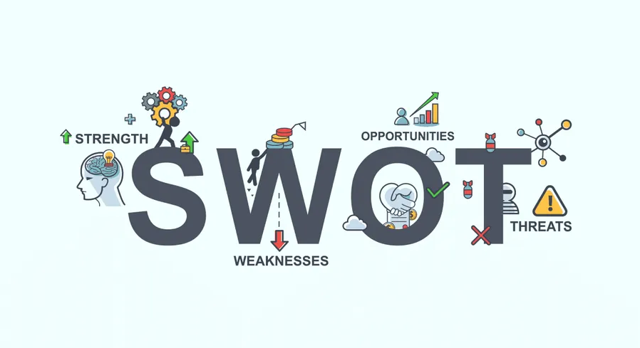
Marketing (BUS: 221) SWOT Analysis
Tishk International University – Erbil
College of Engineering
Aviation Engineering Department
Instructor : Ahmed A. Mohammed MSc in Air Transport Management Email:ahmed.abdulkareem@tiu.edu.iq Academic Year 2024-2025 2nd Grade (Fall Semester)
Lecture 4

Slide 2
Outline
What is SWOT Analysis…..………………………………………………………………………………….. 2
SWOT Analysis and the Two Environmental Factors ………………………………………….. 3
The four parts of SWOT Analysis ……………………………………………………………………….. 4
SWOT Analysis – Internal Factors ………………………………………................................. 5
SWOT Analysis – External Factors ……………………………………………………………………… 8
SWOT Analysis – Example ………………………………………………………………………………... 11
Assignment ………………………………………………………………………………………………………. 12
References ……………………………………………………………………………………………………….. 13

Slide 3
Learning Outcomes
After studying this course, you should be able to:
Understand the SWOT framework
Use the SWOT framework to analyse a business case study or a workplace situation
Use appropriate language and structuring to organise and write a SWOT analysis report for a business context.
To make a summary analysis of external and internal factors.

Slide 4
What is SWOT Analysis
SWOT Analysis is an analysis tool used to evaluate the Strengths, Weaknesses, Opportunities and Threats involved in an organization, a project, plan, program, or any kind of business activities (Kumar C.R et al., 2023)
SWOT Analytical tool is used for strategic planning and strategic management in organizations (Božić V 2023)

Slide 5
SWOT Analysis and the Two Environmental Factors
SWOT analysis focuses on two organizational environmental factors
First: internal environmental Factors, in which the organization itself and can control it (Strength and Weakness)
Second: external environmental factors. Factors that are existed outside the organization and can not control it (Opportunity and Threats).

Slide 6
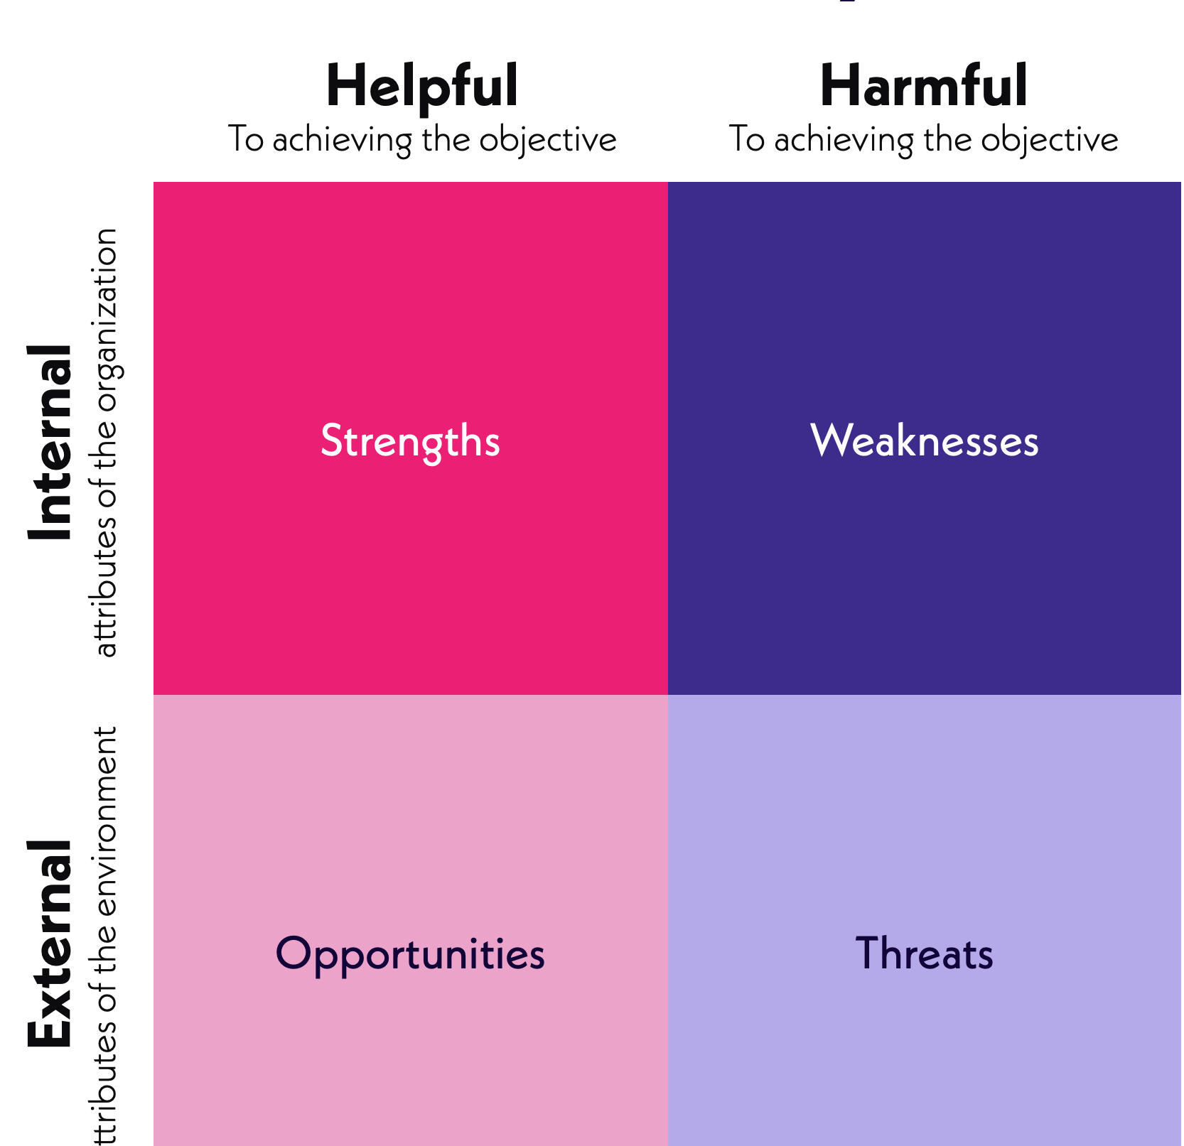
The Four Parts of SWOT Analysis
SWOT is an acronym for:-
S Strength
W Weakness
O Opportunities
T Threats

Slide 7
SWOT Analysis – Internal Factors (Strength & Weakness)
The elements of an organization internal environment are Strength and Weakness
Strength refers to characteristics that enhance the value of an organization, giving it a competitive advantage.
At the organizational level, strengths encompass unique properties and abilities that lead to greater effectiveness and efficiency compared to competitors.

Slide 8
SWOT Analysis – Internal Factors (Strength & Weakness)
Weakness refers to a lack of necessary form and competency, making an organization less advantageous compared to others.
It is a negative characteristic that highlights areas where an organization's capabilities are inferior to competitors, leading to reduced effectiveness and efficiency.

Slide 9
Common internal factors - Example
Financial resources (funding, sources of income and investment opportunities)
Human resources (employees, volunteers and target audiences)
Physical resources (location, facilities and equipment)

Slide 10
SWOT Analysis – External Factors (Opportunities & Threats)
External forces influence and affect every company, organization and individual.
Opportunity: Opportunities refer to favorable external factors that could give an organization a competitive advantage

Slide 11
SWOT Analysis – External Factors (Opportunities & Threats)
Threats: Threats are considered external elements in the environment that may cause problems for the company and major unfavorable situations in the environment. Threats are out of the organization control.

Slide 12
SWOT Analysis – External Factor- Example
External factors are typically things a company do not control, such as the following:
Economic trends (local, national and international financial trends)
Funding (donations, legislature and other sources)
Political, environmental and economic regulations

Slide 13
SWOT Analysis - Example
Strengths A Company current available resources (Staff, budlings, website, and finance) Strong Brand Image (Qatar Airways, Lufthansa, Apple) Strong Customer Services Strong Financial Support (Support from government) | Weakness lacking resources (Staff shortages, sources of funds) Poor Customer Services (Long wait times, Ignoring customer feedback) Lack of research and information.
Opportunities New emerging technologies (Artificial intelligence) New customer segmentation (Targeting young customers) New targeted markets (Targeting markets internationally & regionally) | Threats Political Conflicts (Russia & Ukraine war) Economic Trends (Inflation) (Rapid change in currency exchange rate – Iraqi dinar against US$) Diseases (Coronavirus) Earthquakes

Slide 14
Assignment
Title: SWOT Analysis of a Brand
Instructions:
Prepare a short presentation (3-5 slides) that includes:
Choose a Brand: Select a well-known brand (e.g., Apple, Nike, Starbucks).
SWOT Analysis:
Strengths: List 2-3 key strengths of the brand.
Weaknesses: List 2-3 key weaknesses.
Opportunities: List 2-3 potential opportunities for growth.
Threats: List 2-3 external threats the brand faces.
Conclusion: Summarize how the brand can leverage its strengths and opportunities.
Due Date: 22nd Oct 2024
Evaluation Criteria:
Clarity and conciseness
Key points covered
Overall presentation quality

Slide 15
References
Božić, Velibor. (2023). Objectifying SWOT and PESTLE Analysis in Hospital. 10.13140/RG.2.2.18907.34086.
Kumar C.R, S. and K.B, P. (2023) ‘SWOT analysis’, International Journal of Advanced Research, 11(09), pp. 744–748. doi:10.21474/ijar01/17584.
Panteleiev, V. (2023) ‘Application of SWOT analysis to justify the strategy of Hotel Business Enterprises’, Technology audit and production reserves, 1(4(69)), pp. 14–19. doi:10.15587/2706-5448.2023.274918.

Slide 16
Thank you

