Slide 1
Tishk International University faculty of Nursing
Introduction to Nursing
Dr. Sahar Ismail Abdulla
2024

Slide 2
Outline
Definition of nursing
History and development of nursing
Nursing in ancient civilization
Nursing in the middle ages
The development of modern nursing
History of nursing iraq

Slide 3
Objectives
At the end of session students should Identify
definition of nursing
History back ground of nursing
Development of nursing
Nursing history in Iraq

Slide 4
Introduction
The word nursing is originated from latin word “Nutrix” to nourish”.
Nursing is a profession or practice of providing care for the sick and infirm (unwell).

Slide 5
Definition of nursing
Different people have defined nursing differently. the common definitions of nursing:
Nursing is as a profession that helps people maintain health, recover from illness, and attain optimal health in chronic conditions.
Nursing is directed to ward meeting both the health and illness need and man who is viewed holistically as having physical, emotional, psychological intellectual, social and spiritual.

Slide 6
According to ICN 2002 definition of nursing are
1- the promotion of health
2- Prevention of health and the care
3- the care of ill, disabled and dying people
4- advocacy, promotion of a safe environments and environment, research, participation in shaping health policy and inpatient and health systems management, and education are also key nursing role.

Slide 7
Nursing is an art and science where the careful and compassionate application of scientific knowledge is blended into high quality nursing care.
“Nursing is not simply a collection of specific skills…Nursing is a profession”
The American Nurses Association (ANA, 20210) nursing is the treatment and diagnosis of human response to actual and potential health problems.

Slide 8
The practice of nursing is defined as diagnosing and treating human response to actual or potential health problems through such services as case finding, health teaching, health counseling; and provision of support to or restoration of life and well-being.
As a practice discipline nursing's scientific body of knowledge is used to provide an essential service to people, that is to promote ability to affect health positively.

Slide 9
History and development of nursing
Nursing in ancient civilization
The early record of ancient civilization offers little information about those who care for the sick. During this time beliefs, about the cause of disease were embedded in superstition and magic and thus treatment often involved magical cures.

Slide 10
Ancient Egyptians developed community planning and strict hygienic rules to control communicable diseases. The first recorded Nurses were seen.
In the Babylonian civilization, there were references to tasks and practices traditionally provided by nurses. Nurses are mentioned occasionally in old Testament as women who provide care for infant, for the sick and dying and as midwives who assisted during pregnancy and delivery

Slide 11
In ancient Rome, care of the sick and injuries was advanced in Mythology and reality. Although medicine as a science was developed there was little evidence of establishing a foundation for nursing.
The ancient Greeks gods were believed to have special healing power. In 460 BC Hippocrates born and credited with being the Father of medicine. He proved that illness had natural cause and not to be of a religious or magical cause.
Hippocrates first proposed such concepts as physical assessment, medical Ethics, patient – centered care and observation and reporting.

Slide 12
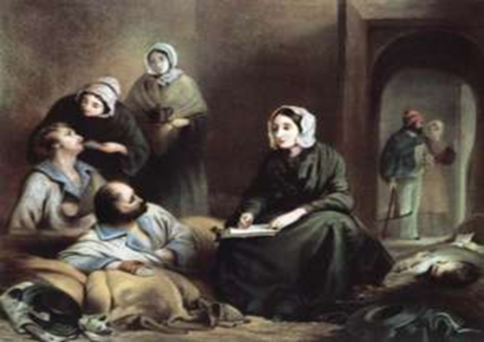
In ancient India, male nurses staffed early Hospitals and women served as midwives and nursed ill family members
Nursing in the middle ages
Nursing today is far different from nursing as it was practiced years ago, and it is expected to continue changing during the 21st century.
Nursing has undergone dramatic change in response to societal needs and influences.
Nursing has evolved as society and health care needs and policies change over many hundreds of years.

Slide 13
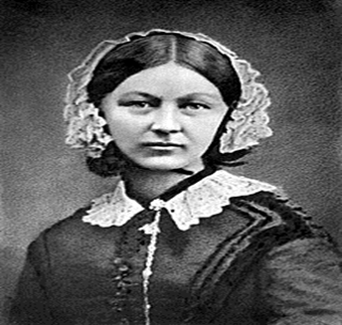
Modern nursing
In the early nineteenth century, hospitals were dirty and overcrowded. The hospital was a place to contact disease rather than be cured of them. Florance Nightingale a strong-minded and intelligent woman determined to lead a group of nurses to care for wounded, by appling scientific principles.
Florence Nightingale began her illustrious nursing career as a nurse within the Crimean War that took place in the mid in the Mar 30, 1856

Slide 14
She played a significant role in changing the nature of the nursing profession in the 19th century.
During this time, deaths from injuries were commonplace, due to the lack of general hygiene and the huge number of fatal infections that resulted from these wounds.
She developed and implemented action plans to improve sanitary conditions and made hand washing, bathing, and other principles of asepsis and infection control mandatory. During the Crimean War, she and her team applied these techniques and reduced their hospital's death rate by two-thirds

Slide 15
According to Florence nightingales definition
Nursing is the act of utilizing the environment to client to assist her/him or his recovery.

Slide 16
Since the founding of the World Health Organization (WHO) in 1948, nursing and midwifery development has maintained a distinguished status within the human resources for health programmed of the Organization.
Women’s Roles Traditional female roles of wife, mother, daughter, and sister have always included the care and nurturing of other family members. From the beginning of time, women have cared for infants and children; thus, nursing could be said to have its roots in “the home.”

Slide 17

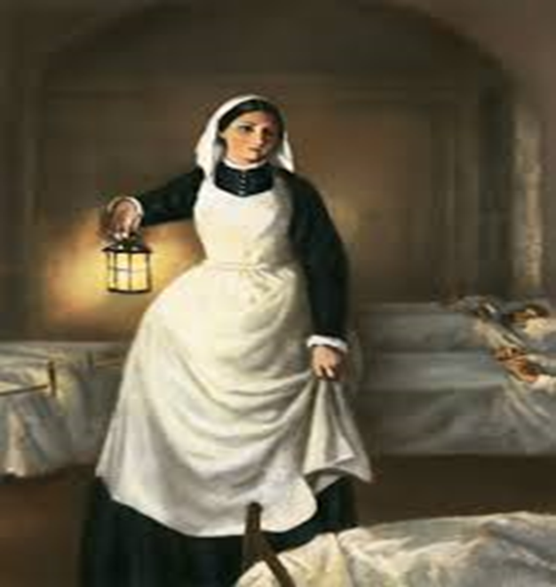

Slide 18
Fundamental of nursing:
Fundamental to nursing practice is the therapeutic relationship between the nurse and the patient that is based on :
Open communication, trust, understanding, compassion and kindness, and serves to empower the patient to make life choices.

Slide 19
HISTORY OF NURSING IRAQ
In ancient Iraq illness was considered to be punishment from sins or magic. Most tribes and people had a medicine man or women called "Hakims" or “Tabeebs" who performed rituals, using various plants and herbs to heal the sick.
The religious people were also providing care for the sick or injured in the religious centers. Nursing training courses of six months duration were performed before 1950s. Intermediate nursing schools had been established since 1950s. Secondary nursing schools established in 1970s.

Slide 20
The first college of nursing had been established in Baghdad University in 1962. Later on, colleges of nursing in other cities had been established. In Kurdistan Region, the first college had been established in Erbil firstly then in Suleimaniyah and Duhok respectively. In 2018, two private colleges had been enrolled students in.

Slide 21
Nursing education in Iraq
Practical Nursing Education: Hospital based practical nursing has been in existence for many years due to shortage of nurses after the World War II. In the past the practical nurse was the family, friends or community members who was called to the home during emergencies.
These were lay people who gained the experience through self-taught. It started by requirement of 6th grade and lasted 3 months of training for male and females.

Slide 22
Male students were awarded the title of Dresser derived from “wound dressing”, while females were awarded the title of Assistant Nurses. Then the duration of the training course changed to 6 months.
2. Assistant (Auxiliary nurses): This program required 6th grade and lasted for 3 years as intermediate nursing schools for only females. They were belonged to the hospitals. The duration of the program was three years after primary school.

Slide 23
3. Nursing and Midwifery Secondary Nursing Schools: This program graduates skilled nurses. It is existed in few of governorates. It was under the umbrella of the General Foundation of Health Education and Training-Baghdad. Lately, it belonged to the Health Directorates in each governorate. The duration of study is 3 years after intermediate school (9th grade).

Slide 24
4.Technical Diploma: Duration of study is two years after secondary (High) school (12th grade). This program is run by the Technical Institutes of the Polytechnic or Technical Universities. The graduates had been employed under the title “Institute Nurses”. Nowadays, this program is run by the Health Directorate in Baghdad as well.

Slide 25
5. University Nurses: They study 4 academic years after secondary school (12th grade) at the Faculties (Colleges) of Nursing. The graduates of this program are awarded the title of University Nurses. The first College of Nursing had been established in Baghdad University in 1962. It started by enrolment of female students, while the first group of male student nurses was graduated from this college in 1981. Later on the program continued in the other governorates.

Slide 26
Internationally, the following programs had been provided:
6. Registered nursing: In the United States, most basic education for registered nurses is provided in three types of programs, Diploma, Associate degree, and baccalaureate programs in Canada, the 2-years, 3-years or more diploma and baccalaureate programs prepare registered nurses after passing a specific examination.

Slide 27
4. Diploma: today’s diploma nursing program has changed markedly from the original nightingale model, becoming hospital-based education programs that provide a rich clinical experience for nursing students. These programs may last two or more years and are often associated with colleges or universities.
Associate degree: In 1980 as a solution to the acute shortage of nurses that came about because of World War II. Associated degree programs are offered in the United States in junior colleges as well as in college and universities. An associate's degree in nursing is a two-year degree that is obtained from a

Slide 28
community college or vocational school. An associate's degree is the minimum requirement to become a registered nurse; however, be advised that many employers are requiring a bachelor's degree for many RN nursing roles.
6. Baccalaureate degree: Although baccalaureate nursing education programs were established in universities in both United States and Canada in the early 1900s. In 1960s the number of the students enrolled in these programs increased markedly. A bachelor of science in nursing (BSN) is required for many, but not all, nursing careers. A BSN, like most bachelor's degrees, is typically a four-year degree from a university or college.

Slide 29
Like most other nursing degrees, a bachelor of science in nursing combines classroom learning with hands-on training called clinical which allow students to obtain first-hand experience working with patients in a clinical setting. A BSN should be obtained from an accredited nursing program.

Slide 30
7. Masters programs: Requires a bachelor's degree in nursing or related field in order to obtain MSN unless the student opt for one of the combined bachelor's/master's programs. A master's degree in nursing is required to become an advanced practice nurse (APN or APRN). Advanced practice nurses have more clinical authority and autonomy, and typically earn more than "regular" registered nurses. Some master's nursing programs may have a special focus or "track" for certain medical specialties or types of nursing

Slide 31
such as a focus on forensic nursing or a clinical nurse specialist track. A specialized master's degree is also required to become a mid-level provider, such as a nurse practitioner (NP) or certified registered nurse anesthetist (CRNA). Master's degrees are typically one to two years of additional coursework that you can obtain while employed as a nurse. Sometimes the employer will help pay for the master's degree in nursing if the student commit to working for a number of years into the future. An MSN must also be completed from an accredited nursing program.

Slide 32
8. Doctorate Degrees in Nursing: The highest degree one can earn in nursing is a doctorate level degree. You must first have a bachelor's and then a master's degree before completing the doctorate degree in nursing and becoming what some refers to as Doctor Nurse. There are two types of doctorates in nursing: a Doctor of Nursing Practice (DNP) which focuses on the clinical aspects of nursing and a Doctor of Nursing Science (DNSc, also a DSN or DNS). The latter is the more common choice for those who wish to be professors at nursing programs or researchers.

Slide 33
9. Continuing education: To formalize experiences designed to enlarge the knowledge or skills of practitioners.
10. In service education: Program is administered by an employer; it is designed to update the knowledge or skills of employees.

Slide 34
References

