Slide 1
Antenatal Care

Slide 2
Definition of Antenatal care
it is planned examination, observation and guidance given to the pregnant woman from conception till the time of labor.

Slide 3
Goals
1. The main goal is the safety and welfare of the mother and her fetus.
2. The preparation of mother for labor, and lactation.
3. The early detection and appropriate treatment of high risk conditions.
4. The reduction of maternal and infant mortality, and prematurity.

Slide 4
Schedule for Antenatal Visits:
The first visit or initial visit should be made as early is pregnancy as possible.
Return Visits:
Once every month till 28 w.
Once every 2 weeks till the 36 w
Once every week, till labor.

Slide 5
Assessment
History
Examination
Investigation

Slide 6
History
Personal history
Family history
Medical and surgical history
Menstrual history
Obstetrical history
History of present pregnancy

Slide 10
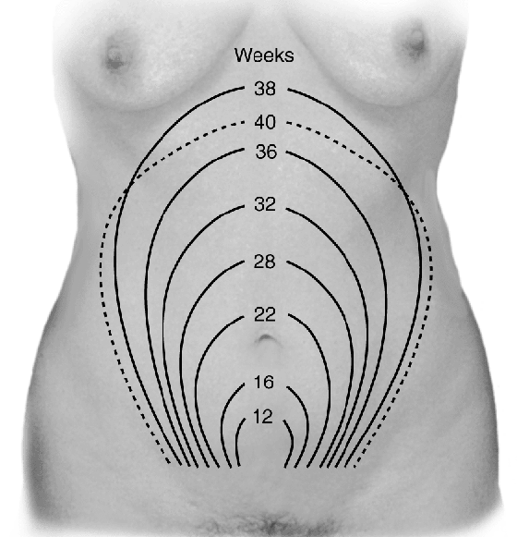
Symphysis–fundal height should be measured and recorded at each antenatal.

Slide 17
Fetal heart sound is heard by sonicaid as early as 10th weeks of pregnancy.
Fetal heart sound is heard by Pinard' s fetal stethoscope after the 20th weeks of pregnancy.

Slide 18
Minor discomfort during pregnancy
Nausea and vomiting
RELIEF MEASURES:
Avoid food or smells that exacerbate condition.
Eat small, frequent meals.
Avoid sudden movements. Get out of bed slowly
Breath fresh air to help relieve nausea.

Slide 19
Heartburn
RELIEF MEASURES:
Eat small, more frequent meals.
Use antacids.
Avoid overeating and spicy foods.

Slide 20
Edema
Avoid standing for long periods.
Elevate legs when laying or sitting.
Avoid tight stockings.

Slide 21
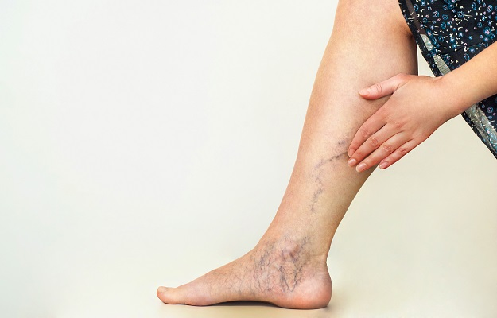
Varicosities
Rest in sims' position.
Elevate legs regularly.
Avoid crossing legs.
Avoid long periods of standing

Slide 22
Hemorrhoids
RELIEF MEASURES:
Maintain regular bowel habits.
Use prescribed stool softeners.
Apply topical or anesthetic ointments to area.

Slide 23
Some daily activity
Exercise:
Exercise is avoided in women with twin pregnancies, pregnancy induced hypertension,
Coitus:
Coitus should only be avoided in threatened abortion, PROM, threatened preterm delivery or if there is a placenta previa

Slide 24
Clothing
should be practical and non-restricting.
High heels are avoided to prevent loss of balance and prevent increased backache.
Traveling.
Care of teeth.

Slide 25
Nutritional Supplements

Slide 26
Folic Acid
Start before conception and throughout the first 12th weeks.
reduces the risk of having a baby with a neural tube defect (for example, anencephaly or spina bifida).
The recommended dose is 400 micrograms per day.

Slide 27
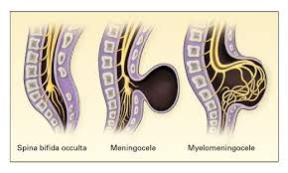

Slide 29
Vitamin D
women who have limited exposure to sunlight, such as women who are predominantly housebound, or usually remain covered when outdoors
women who eat a diet particularly low in vitamin D, such as women who consume no oily fish, eggs, meat, vitamin D-fortified soulde be taking.

Slide 30
Screening
Women should be offered testing for blood group
To give anti-D at 28 weeks and post delivery within 72 hrs

Slide 31
Blood group and RH incompitability
GUE
GSE
RFT
LFT
CBC
U/S

