Slide 1
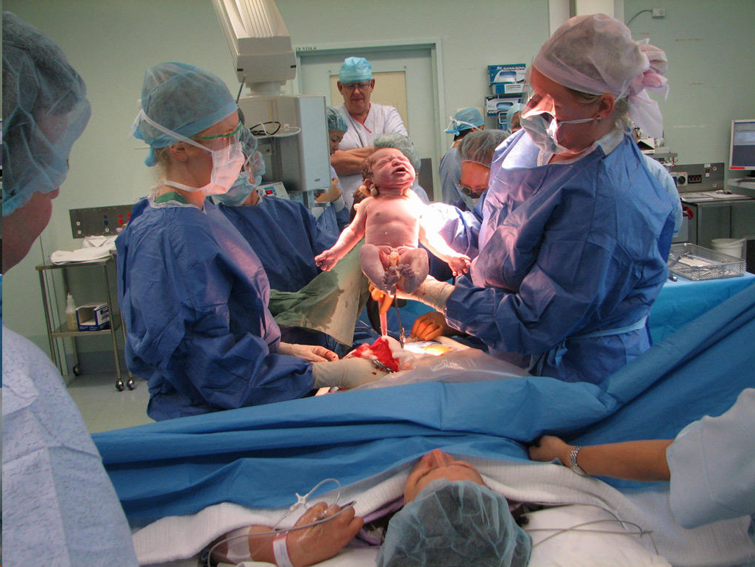
Cesarean Section
Presented by :
Shaimaa Shahab

Slide 2
OBJECTIVE
Introduction
Definition
Types
Indications
Complication
Technique
Management

Slide 3
INTRODUCTION
- Caesarean section, also known as C-section, or caesarean delivery, is the use of surgery to deliver babies.
- A caesarean section is often necessary when a vaginal delivery would put the baby or mother at risk.

Slide 4
DEFINITION:
A surgical procedure involving incision of the walls of the abdomen and uterus for delivery of baby.

Slide 5
TYPE:
1. ACCORDING TO TIMING:
(A) ELECTIVE : Is an operation where a doctor makes a cut in the abdomen and womb and lifts baby out through it. If the lady know will need a C-section before go into labour, this is called a elective planned C- section.
(B) EMERGENCY: If labour has already begun, and a complications begin, then an emergency C- section is performed

Slide 6
2. ACCORDING TO UTERINE INCISION
(A) Lower segment Caesarean section.
(B) Upper segment Caesarean section .

Slide 7
LSCS
USCS
1. Incision make 3 cm above the symphysis pubis.
2. Less amount blood loss.
3. Less chances to hernia.
4. High cosmetic value.
5. Better healing process Occur
1.Incision make is above umbilicus & below fundus part.
2. High amount blood loss.
3.High chances to herni recommended
4. Less cosmetic value.
5. Healing process delay.

Slide 8
INDICATION:-
Breech presentation or other malpresentations e.g. unstable lie transverse lie or oblique lie.
Twin pregnancy - when the first twin is not a cephalic presentation.
Placenta praevia - Low-lying placenta where the placenta covers, or reaches the internal os of the cervix

Slide 9
Maternal diabetes-with a baby estimated to have a fetal weight >4.5 kg.
Where labour would be dangerous for the mother.

Slide 11
Nursing Management
A. Pre-operative management:
Patient should be physically prepared
i.e.abdomen,back,private parts and upper part or thigh are shaved and cleaned.
Prepare mother psychologically by providing assurance and explanning the indication,procedure and need of C/S

Slide 12
Administration of IV infusion of 50% saline or dextrose to avoid hypotension following spinal anaesthesia.

Slide 13
Blood grouped and cross matched for emergency requirement.

Slide 14
Bladder should be empty by inserting foleys catheter.
Mother should be in NPO for about 8 hours.
Patient should be in clean gown,valuable ornament should be taken off and all make up should be removed.
If elective caesarean section then Ranitidine 150mg should be given orally in the night before to prevent gastric PH.

Slide 15
B. Post operative care:
Immediate care (4-6 hours):
In the immediate recovery period, the blood pressure is recorded in every 2 hourly.
The wound must be inspected half hourly to detect any blood loss.
Analgesic is given as prescribed.
The lochia are inspected and drainage should be small
initially.

Slide 16
Lochia
Is the vaginal discharge that occurs after childbirth, consisting of blood, mucus, and uterine tissue that shed as the uterus heals.

Slide 17
Postpartum Lochia
Lochia Rubra | Lochia Serosa | Lochia Alba
Lasts until postpartum day 3- 4 Dark red in color Flows like a heavy period, Can see clots | Begins on postpartum day 4- week 2 Brownish-pink discharge Flows like the end of the period | Last from 2-4 weeks Creamy white/yellowish discharge

Slide 19
2. First 24 hours:
IV fluids are continued, blood transfusion is helpful in anemia mothers.
• Parental antibiotic is usually given for 1st 48 hours,analgesics is the form of pethidine 75mg are given as needed.

Slide 20
Ambulation is encouraged following day of surgery and baby is given to mother.

Slide 21
3. After 24 hours:
Vital signs checked every 4 hourly.
Orally feeding is started with clear liquid and then advanced to normal diet.
Catheter may be removed on following day when the women is able to get up to the toilet.
The mother must be encouraged to take rest and provide care to the baby and should breast feed the baby

Slide 22
Complication:
partum hemorrhage related to uterine atony and rarely blood coagulation disorders.
Shocks related to blood loss.
Anesthesia hazards.
Thrombosis
Lung infection post.

