Slide 1
INTRODUCTION, history and career in COSMETICS
Dr. Mohammad Aslam
Phytocosmetics, PHAR 535
Final Semester
Week -1
Pharmacy Department
Date 08/10/2024

Slide 2
Outline
Introduction of cosmetics
History of cosmetics
Structure of skin

Slide 3
Objectives
Understanding the Concept of Cosmetics.
Understanding the structure of skin and various structures in it.

Slide 4
Introduction
The cosmetics term is derived from the Greek word “COSMETIKOS” which mean skills to decorate.
Thus cosmetics is the art and science of decoration to look beautiful.
Cosmetics are articles intended to be rubbed, poured, sprinkled, or sprayed on, introduced into, or otherwise applied to the human body or any part thereof for cleansing, beautifying, promoting attractiveness, or altering the appearance without affecting structure or function
It is involved with developing, formulating, and producing cosmetics and personal care products.
These skin care products are categorized into three functional groups:
Drugs: To prevent diseases by altering the structure and function of the body.
Cosmetics: To beautify and improve the skin.
Cosmeceuticals: An intermediate classification for cosmetic products that may enhance the function of the skin.

Slide 5
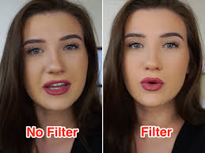
Cosmetology is the study and application of beauty treatments, including hair styling, skin care, cosmetics, manicures/pedicures, and permanent or non-permanent hair removal.
Beauty lies on the EYE OF THE BEHOLDER
Technology has put the power to define beauty in the hands of the people. Mobile phones allow people greater control of their image, and include apps that come with filters used for fun, appearance, and entertainment.

Slide 6
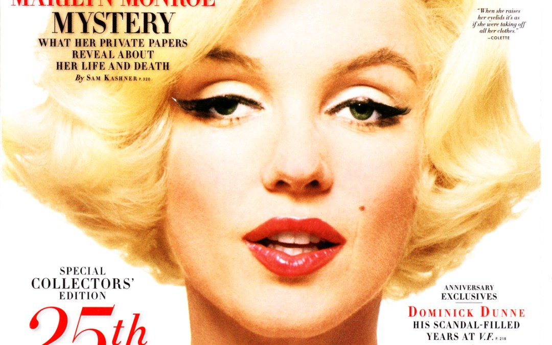
For generations, beauty required a slender build but with a generous bosom and a narrow waist. The jaw line was to be defined, the cheekbones high and sharp. The nose angular. The lips full but not distractingly so. The eyes, ideally blue or green, large and bright. Hair was to be long, thick, and flowing—and preferably golden. Symmetry was desired. Youthfulness, that went without saying.
This was the standard from the earliest days of women’s magazines, when beauty was codified and commercialized.

Slide 7
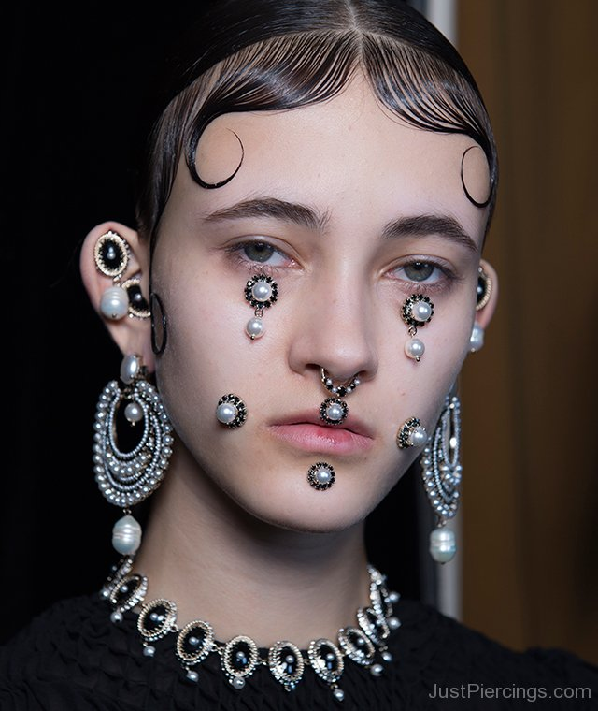
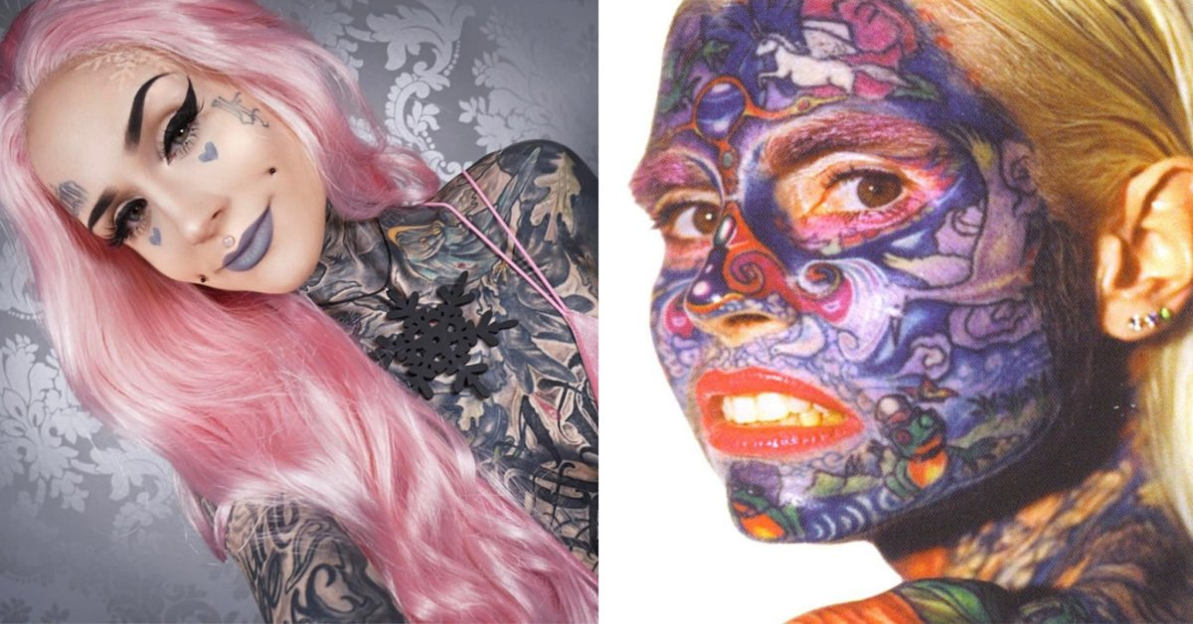
Beauty depends on culture
Beauty is, of course, cultural. What one community admires may leave another group of people cold or even repulsed. What one individual finds irresistible elicits a shrug from another. Beauty is personal. But it’s also universal. There are international beauties—those people who have come to represent the standard.
Body piercing
Beauty enhancement by tattoos

Slide 8
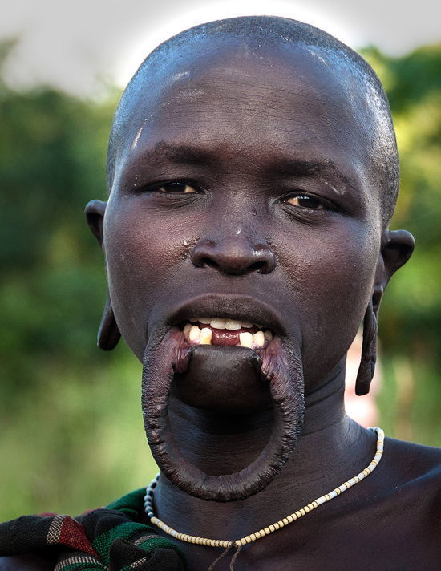
Lip stretching in Mursi people in Ethiopia

Slide 9
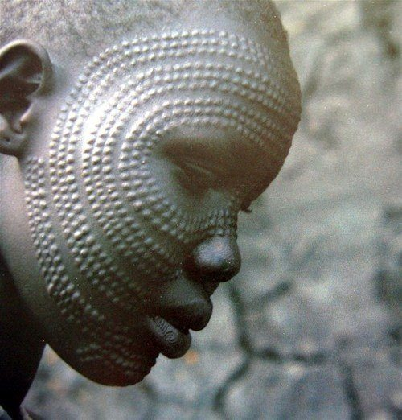
Ear lobe stretching in Afro-american woman
Scarification in karo tribe of Ethiopia

Slide 10
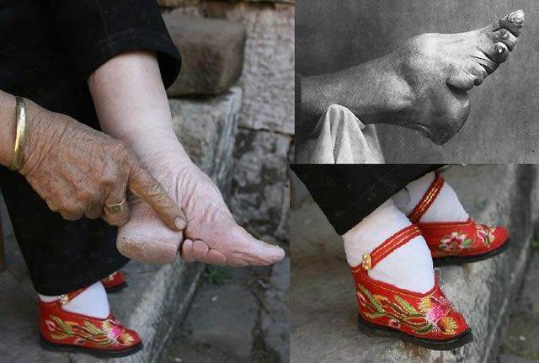
Lotus feet in china
Neck elongation in Myanmar

Slide 11
What Does a Cosmetologist Do?
Cosmetologists provide personal care services that include caring for people's hair, skin, and nails. Beauty professionals employed in the cosmetology industry include hair stylists, barbers, and estheticians, also called skin care specialists.

Slide 12
What is a cosmetics?
European Regulations specify 6 functions for cosmetic products, namely:-
To Perfume
To clean
To change the appearance
To protect
To keep in good condition
To correct body odors

Slide 13
To clean
These products should not penetrate the skin but they do affect the skin surface (Stratum corneum – SC), they can remove skin lipids, affect skin barrier properties, increase cell turn- over, change pH & cause loss of moisture
Soap
Syndet bars
Bath additives
Shower gels
Cleansing emulsions
Scrubs
Cleansing masks
Shampoos

Slide 14
To change the appearance
These products should not penetrate the skin. *These products need to penetrate the S.C.
Decorative cosmetics Foundation creams Blushers Lipsticks & eye shadows Fake tans
Cover fine lines & wrinkles
Plump out fine lines & wrinkles
Freeze facial muscles
dihydroxyacetone (DHA) tanning
Skin lightening

Slide 15
To protect
These products should not penetrate the skin.
These products need to penetrate the S.C
Examples
Sun protection or Sunscreen
Antiseptic washes
Anti-oxidants
Protect immune system

Slide 16
To keep in good condition
*Generally these products need to penetrate the S.C.
Moisturizer
Occlusive film
Humectants
NMF* Natural Moisturizing Factor
NMF = Urea, cholesterol, sodium lactate, lactic acid, amino acids, phospholipids, water Anti-oxidants*
Support immune system
Plump out fine lines & wrinkles

Slide 17
To correct body odors
These products should not penetrate the skin. *These products may affect the S.C.
Deodorants
Antiperspirants
Cleansing*
Washing

Slide 18
Field of application
The field of application of cosmetics is to one or more of the following:
The epidermis
The hair system
The nails
The lips
The teeth
The mucous membranes of the oral cavity

Slide 19
History
The Egyptians: As early 3000 BC, Egyptians used minerals, insects, and berries to create makeup for their eyes, lips and skin. Ancient Egyptians are created with kohl make up.
The Chinese aristocrats rubbed a tinted mixture of gum Arabic, gelatin, bees wax and egg whites on to their nails to color them crimson(red) or ebony(black).
Nail tinting was so closely tied to social status that commoners caught wearing a royal nail color faced a punishment of death.
The Greeks: During the golden age, hairstyling was a highly developed art. They used perfumes and cosmetics in religious rites, grooming and for medicinal purposes.
The middle ages: Beauty culture included towering headdresses, intricate hairstyle, and the use of cosmetics on skin and hair.

Slide 20
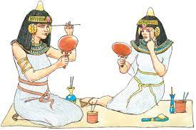
Egypt

Slide 21
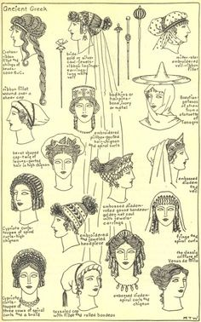
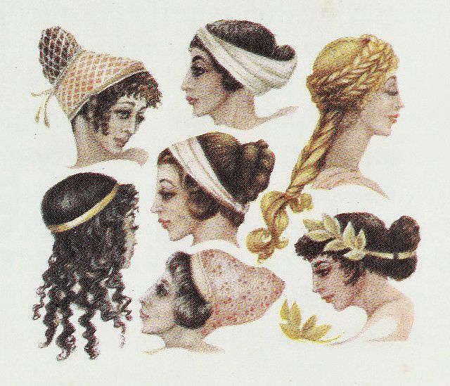
The Greeks

Slide 22
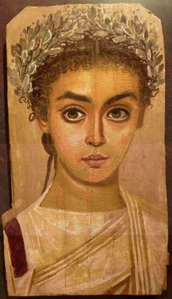
Roman
The Romans: Facials made of milk and bread or fine wine were popular..

Slide 23
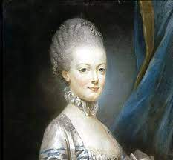
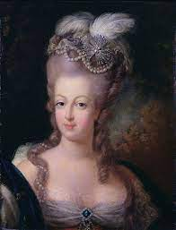
The middle ages:
The middle ages: Beauty culture included towering headdresses, intricate hairstyle, and the use of cosmetics on skin and hair.

Slide 24
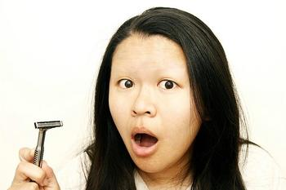
The Renaissance
The renaissance : Western civilization made the transition from medieval to modern history.
Eyebrows and hairline were shaved to show greater expanse of forehead.
(The Renaissance is a term used to describe a period in European history marking the transition from the Middle Ages to modernity and covering the 15th and 16th centuries. It occurred after the Crisis of the Late Middle Ages and was associated with great social change.)

Slide 25
The Victorian age
The Victorian age: fashion in dress and personal grooming were drastically influenced by the social mores of this austere and restrictive period in history.
(In the history of the United Kingdom, the Victorian era was the period of Queen Victoria's reign, from 20 June 1837 until her death on 22 January 1901. The era followed the Georgian period and preceded the Edwardian period, and its later half overlaps with the first part of the Belle Époque era of Continental Europe)

Slide 26
Modern Age
1901-1910: Max factor began making and selling makeup.
After world war 1, when women cut their hair into the short bobbed style, the croquignole( kroh-ken- yohl) wrapping technique was introduced.
Sarah Breedlove, known as madam C. J Walker, became a pioneer in the modern African- American hair care and cosmetics industry.
1920- cosmetics industry grew rapidly.
1930- preheat perm method was introduced in 1931, first nail polish marketed in 1932.
1940- cold waves replaced virtually all predecessors and competitors. In fact the terms cold waving became practically synonymous.
1951-2000: tube mascara, improved hair care, and nail products induced.
Vidal sassoons geometric cuts of the late 1960s
In 1998, creative nail design introduced the first spa pedicure system.

Slide 27
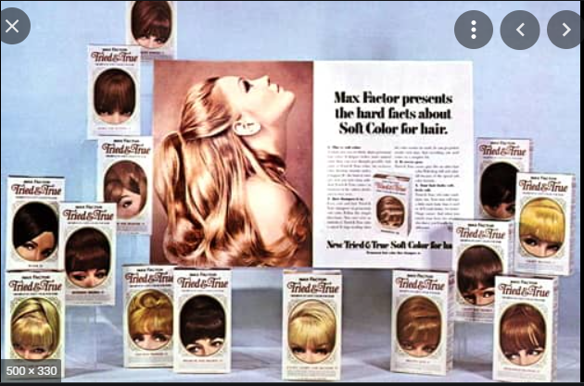

Slide 28
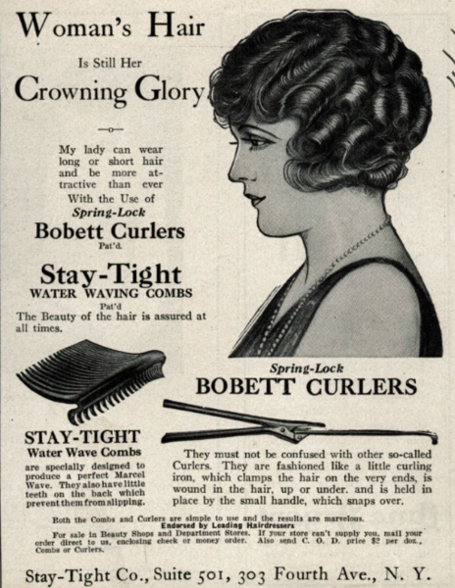
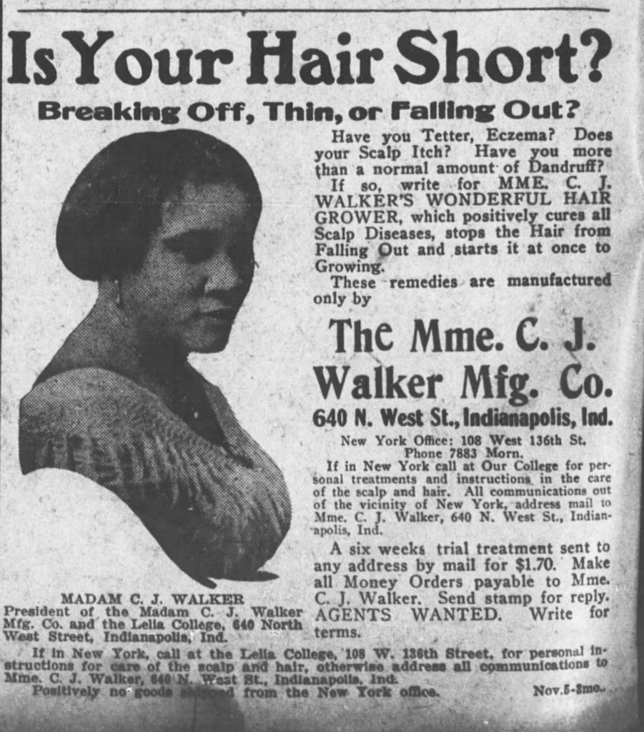

Slide 29
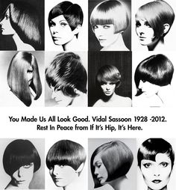
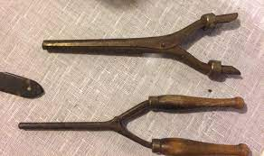

Slide 30
Brief history of cosmetology : the twenty - first century
The salon industry has evolved to include day spas, a name coined by beauty legend noel de caprio.
Men – only specially spas and barber spas have also grown in popularity.

Slide 31
Career path for cosmetologists
Texture specialist: Subspecialty focuses on maintaining natural curl.
Cutting specialist: Requires a dedicated interest in learning various cutting styles and techniques.
Hair color specialist: May work for a product manufacturer training professionals to perform color services according to company guidelines and products instructions.
Salon trainer: Technical training to management and interpersonal relationship training.
Help develops the beauty industry’s most valuable resource- salon staff and personnel.
Distributor sales consultants(DSCs)
Provide information about new products, trends and technique
The salon and it’s staff link with the rest of the industry
Manufacturer educator: Hired by manufacturer to train stylists and salon staff to understand and use the company’s hair care, hair color and chemical-service products.

Slide 32
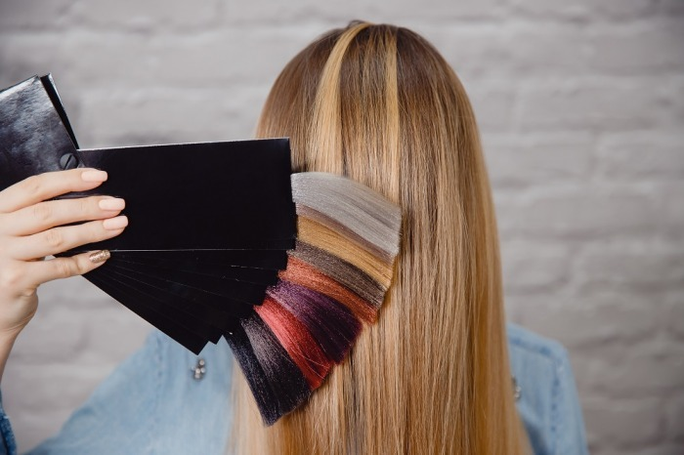
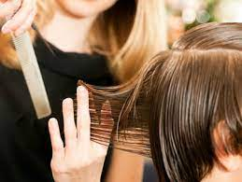
Hair color specialist
Cutting specialist

Slide 33
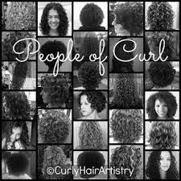
Texture

Slide 34
Cosmetology instructor:
Career teaching new professionals then tricks of the trade.
Many instructors have fantastic careers in salon
Film or theatrical hairstylist and editorial stylist
Work behind the scenes at magazine and internet photo shoots or backstage on movies and TV sets.
Require persistence networking skills, reliability, team spirit, and attention details.
Requires constant continuing education, particularly in working with wigs, hairpieces and make ups.
Diverse opportunities include being an inventory manager, department head, educator, special events manager and general manager.
With experience. you can add salon owner to this list of career possibilities
Managers must have an aptitude for math and accounting and should understand marketing.
Work as a beautician and opening clinics

Slide 35
SALONS
Beyond choosing a specialty, there are different types of facilities:
Specialty salons
Full service salons (offerings hair, skin and nail services.)
Photo, video, or film sets (preparing models, and actors for camera appearances.)

Slide 36
References
Baki, G. (2022). Introduction to cosmetic formulation and technology. John Wiley & Sons.
Bennett, M. L., & Henderson Jr, R. L. (2003). Introduction to cosmetic dermatology. Current Problems in Dermatology, 15(2), 43-83.
Yamaguchi, M. (2018). Cosmetics. In Electrical Phenomena at Interfaces (pp. 415-427). Routledge.

Slide 37
Beauty isn’t about having a pretty face, it is about having a pretty mind, a pretty heart, and most importantly a beautiful soul.

