Slide 1
SKIN AND ITS APPENDAGES
Dr. Mohammad Aslam
Phytocosmetics, PHAR 535
Final Semester
Week -2
Pharmacy Department
Date 15/10/2024

Slide 2
Outline
Introduction of Skin
Structure of skin
Function of Skin

Slide 3
Objectives
Describe the skin and structure of the human skin
Understand functions of skin and skin layers
Know the types of skin according to gender, hydration state and sensitivity to UV light
Understanding the structure of skin and various structures in it.

Slide 4
Skin Structure and Function
The human body’s largest sensory and touch organ is the skin.
Adults have a surface area of roughly 1.5 to 2 m²
The epidermis and dermis are the two primary layers of the human skin.
The hypodermis is a layer that lies beneath the dermis and is primarily made up of fat cells.

Slide 5
Skin Types in general
Hairy skin (non-glabrous)
Hairless skin (glabrous): Mostly in palms and sole

Slide 6
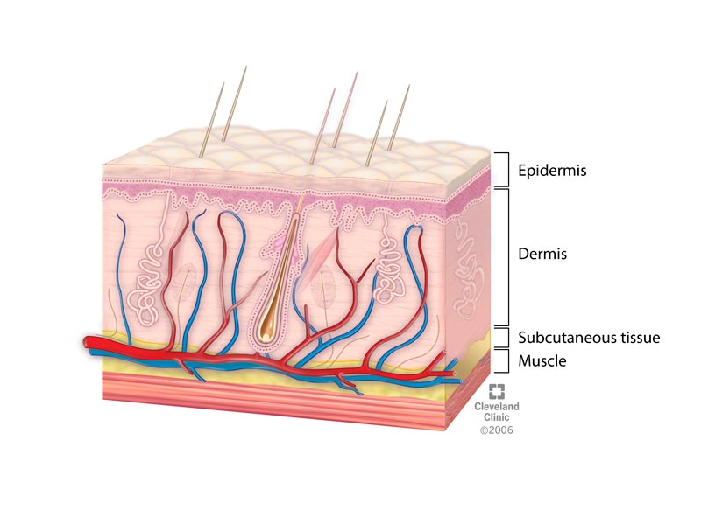
Skin Structure
Dead cells, epithelium, connective tissue, muscles, nerves, blood vessels, as well as the so-called appendages, such as the nails, hair, and glands, such as sebaceous and sweat glands, make up the complex organ known as the skin.

Slide 7
O
Un

Slide 8
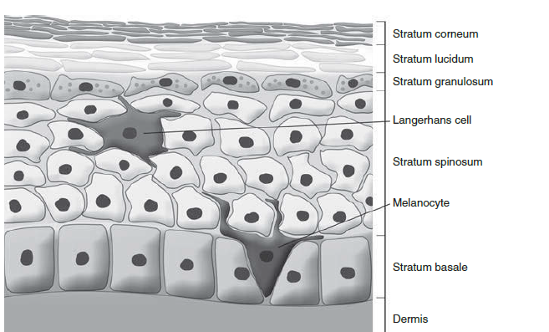
Skin Layers 1- Epidermis
The epidermis differs in thickness in thin and thick skin.
Thick skin is found on the palms of the hands and soles of the feet and has all five layers. Thin skin, which covers the rest of the body, does not have a stratum lucidum and has a thinner SC than thick skin.

Slide 9
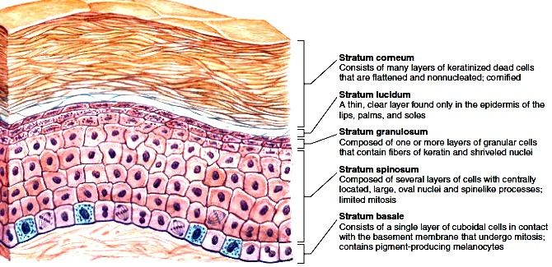
O
Un

Slide 10
Functions of the epidermis include the following
Maintaining water content for the skin.
Limiting water loss through the skin.
Sustaining optimal lipid content.
Providing immune protection;
Acting as an antioxidant barrier against reactive oxygen species.
Synthesizing vitamin D.
Providing photoprotection.
Providing skin color.

Slide 11
2. Dermis
Is located under the epidermis, and it functions as a supporting frame to the epidermis, supplying it with nutrients and oxygen via the blood capillaries.
It is composed of fibrous and cellular connective tissue elements and contains nerve and vascular networks, skin appendages and many cell types.
It is arranged into two regions: The upper papillary dermis and The deeper reticular dermis.
The papillary dermis takes the contour of epidermis, and is usually no more that twice its thickness.
The reticular dermis forms the bulk of the dermal tissue

Slide 12
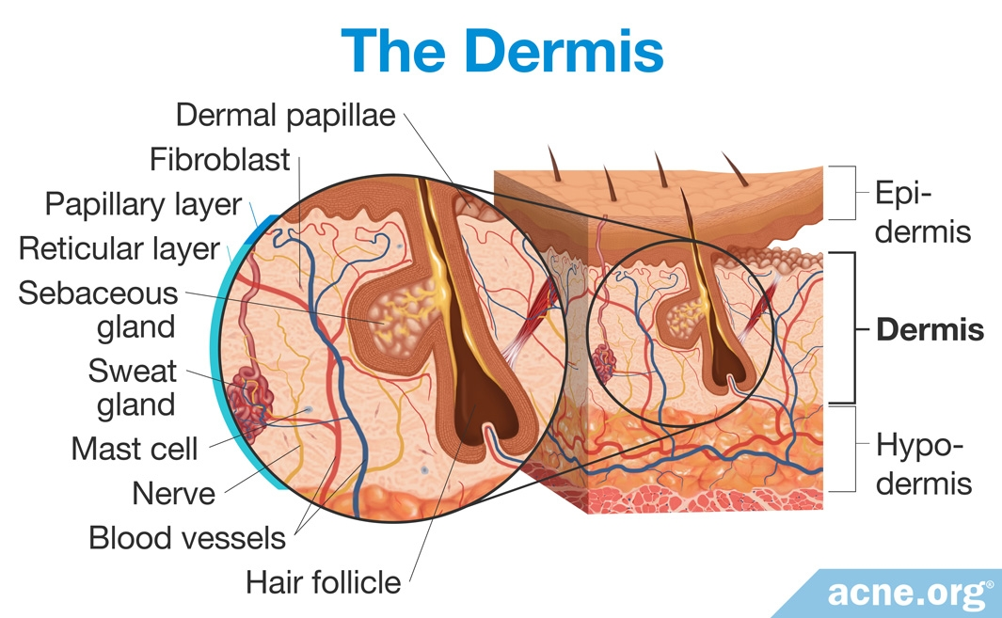
O
Un

Slide 13
3. Hypodermis
Consists mainly of adipose tissue. The body is protected by it, and it also acts as a reserve energy source.
It shields the skin.
It permits the skin's movement over the supporting structures.
It improves the appearance of the body's contours.

Slide 14
O
Un

Slide 15
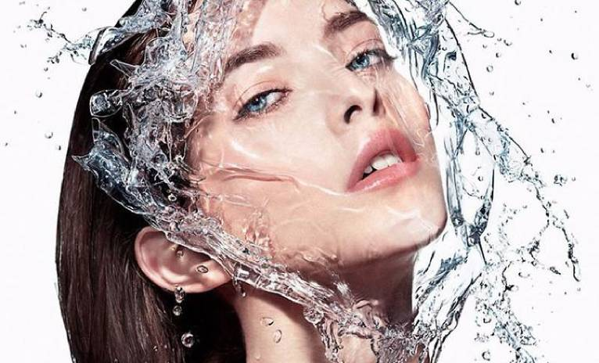
Moisture Content of Normal Skin
The water content of the skin, including the epidermis and dermis, is approximately 80%.
When the water content of the skin is normal, it appears smooth, soft, and glowing.
When its water content is lower than normal, lines are more visible, the skin feels tight and dry, and itching and redness can be experienced

Slide 16
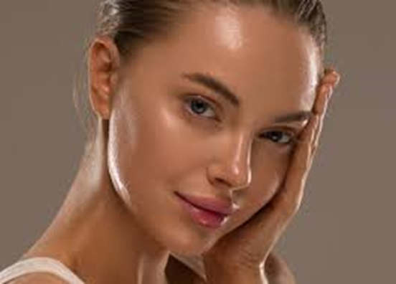
Moisture Content of Normal Skin
In normal skin, there is a continuous movement of water from the deeper layers toward the superficial layer where water eventually evaporates.
Water is necessary for the skin to maintain its flexibility. When the skin is overly dry, it loses its ability to stretch, causing it to crack and peel more easily.

Slide 17
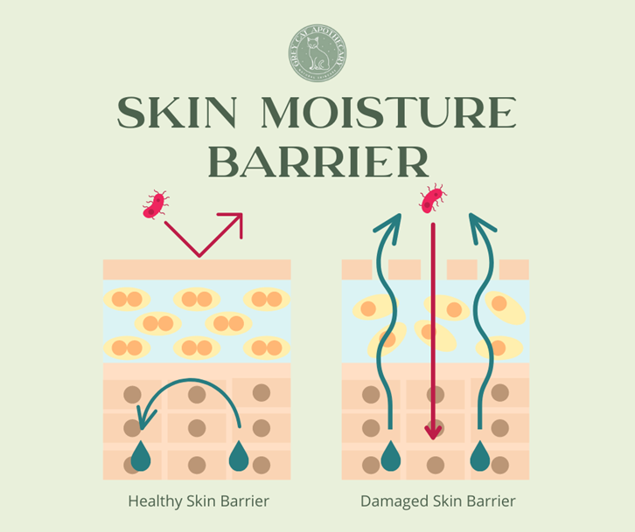
However, water alone will not increase the skin’s moisture level. A protective lipid layer is necessary to prevent water from evaporating off the skin.

Slide 18
Skin Flora and Skin pH
Human skin is continuously inhabited by many different bacteria and fungi, which under normal circumstances in a healthy individual are harmless and are even beneficial.
Normally, the skin surface is slightly acidic and ranges between pH 4.5 and 5.5,

Slide 19
Functions of Skin

Slide 20
Skin Types
Human skin can be categorized based on
Gender,
Its color,
UV sensitivity,
Oiliness,

Slide 21
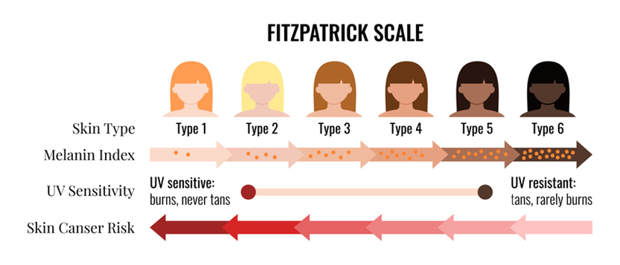
Skin Types Based on Sensitivity to Ultraviolet Light

Slide 22
Skin Types Based on Hydration State and Lipid Content
Normal skin
Dry skin
Oily skin
Combination skin
Sensitive skin

Slide 23
Skin Types Based on Hydration State and Lipid Content
Normal skin
it is usually compared to other skin types as a reference.
It is generally described as not too oily and not too dry.
normal skin is structurally and functionally balanced,
And it has fine pores; it is smooth and well supplied with blood.
In addition, it has no or only a few imperfections, no severe sensitivity.

Slide 24
Skin Types Based on Hydration State and Lipid Content
Dry skin
is relatively common; most people experience it from time to time due to various factors.
It can be characterized as scaly, rough, and dull, which can lead to itchiness.
In addition, it generally has red patches and can be characterized with less elasticity and a rough complexion.
Enviromental factors such as
low relative humidity,
cold weather, and
sunlight,
in addition to repeated contact with water, surfactants, and solvents,
skin diseases and dietary deficiencies, can produce dry skin.

Slide 25
Oily skin
Has enlarged pores; therefore, it is very shiny as a result of over activity of the sebaceous glands.
Oiliness is most visible on the forehead, nose, and chin, and these parts are oily to the touch.
Oily skin usually develops with the onset of puberty and affects a large percentage of young people.
Factors that can cause and/or contribute to oily or greasy skin including:
Genetic inheritance,
Hormonal changes,
Diet, stress, and
External agents (such as cosmetics, chemicals, UV light).
Individuals with this skin type often tend to suffer from acne and dandruff as adolescents.

Slide 26
Combination skin
as its name implies, is the combination of normal and oily skin, or of oily and dry skin.
This type of skin has a tendency to be greasy in the central T-zone of the forehead, nose, and chin. The skin on the other areas (cheeks and hairline) is normal or dry.

Slide 27
Sensitive skin
is a complex dermatological condition, defined by abnormal sensory
symptoms, for example, tingling, burning, and possibly pain by various chemicals (e.g., cosmetics, soaps, water, pollution), physical factors (e.g., UV light, heat, cold and wind), microorganisms, psychological factors (e.g., stress), and hormones (e.g., menstrual cycles).

Slide 28
Skin Types Based on Gender
Androgen stimulation causes an increase in the thickness of the skin; male skin is reported to be approximately 25% thicker than that of women
it has also been shown that male skin gradually thins with advancing age, whereas female skin stays more constant until menopause. Upon entering menopause, female skin progressively thins
it has been shown that the sebum content is higher in men than in women at all body locations
Male skin appears to be more sensitive to UV radiation.

Slide 29
Important points related to Skin
How many layers are present in Skin?
Answer=3
Write the name of layers present in Epidermis.
Answer= 1. Stratum basale 2. Stratum spinosum 3. Stratum germinativum, 4. Stratum lucidium 5. Stratum corneum. (Bashi girl choni )
Write the name of main appendages present in Dermis
Answer= Connective tissues, Hair follicles, Sweat glands, Sebum glands
Write the name of proteins present in Dermis.
Answer= Collagen and Elastin
What are the three parts in which hair is divided?
Answer= Hair follicle, Hair root and Hair Shaft.
What is the name of the part of hair which comes out?
Answer= Hair Shaft

Slide 30
From where, hair follicles get blood supply for its nutrition.
Answer= Hair papilla
Which protein is present in hair?
Answer= Keratin.
Name of the muscle which is related with hair
Answer= Arrector pilli muscle.
The muscle present in hair, is related with which physiology of the body.
Answer= Thermoregulation
Which cell gives color to hair and skin?
Answer= Melanocyte.
Which pigment is present in skin and hair?
Answer= Melanin
Which vitamin is produced by skin, in the presence of sunlight?
Answer= Vitamin D

Slide 31
Name the constituent present in skin, which converts in cholecalciferol (Vit. D3) and cholecalciferol later converts in Vitamin D in Liver and Kidney.
Answer= 7- Dehydrocholesterol
Name of the gland present in Hair, which secrets oil for the nourishment of Hair.
Answer= Sebum
Which types of sweat gland is present in sole of the legs and palm of the Hands.
Answer= Eccrine glands
Which types of sweat glands is present in the hairy region, such as arm pit.
Answer= Apocrine glands
Write the two physiology of skin.
Answer= 1. Barrier to microrganisms, 2. Vitamin D synthesis 3. Thermoregulation, 4. Sensation. 5. Secretion
Which cells are related, with sensation of skin.
Merkel cell or Merkel Ranvier cells
Skin, Hair and Nails are part of which system in the body.
Answer= Integumentary system

Slide 32
References
Peter Elsner, (2000). Cosmeceuticals , Drugs vs Cosmetics, Marcel Dekker, Inc. New York • Basel TM
Costa, I. M. (2015). Phytocosmetics–where nature meets well-being. Journal of Phytocosmetics and Natural Ingredients.

Slide 33
THANK YOU

