Slide 1
Natural vs. Synthetic Skincare
Dr. Mohammad Aslam
Phytocosmetics, PHAR 535
Final Semester
Week -3
Pharmacy Department
Date 21/10/2024

Slide 2
Outline
Phytocosmetic Product Categories
Skin products
Hair Products
Others

Slide 3
Objectives
Understanding the difference between natural and synthetics product lists
Know the types of products used
Differentiate uses of products for skin parts (Lips, face, body), hair, nail..

Slide 4
Natural vs. Synthetic Skincare - What’s The Difference?
As more individuals gain a more health-conscious approach to what they consume, it’s becoming more common (and even customary) to wonder about the ingredients in our makeup and skincare.
And as natural skincare has grown increasingly in demand, many consumers have raised concerns about its parallel: synthetic skincare.
While natural skincare can be a beneficial choice, it’s sparked a bit of a debate in the community: what’s better, natural skincare or synthetic skincare?
Right off the bat, this answer has a bit of nuance, and requires a little deep-diving.
So our journey to demystify natural and synthetic skincare–starting out with some basic definitions.

Slide 5
Natural Skincare & Synthetic Skincare, Defined
So what, exactly, is “natural skincare?”
Before we begin, it’s important to note that the term “natural” is not regulated by the FDA, which means that there is no standard definition or criteria for natural skincare.
In other words, “natural skincare” can mean whatever a brand wants it to mean, and as such will align it with their own marketing strategy.
But in this context, we can define “natural skincare” as products that use ingredients derived straight from nature, such as seed oils, fruit extracts, and grains like oats and rice. Generally, natural skincare does not contain any synthetically created ingredients.

Slide 6
So what, then, is “synthetic skincare?”
Synthetic skincare, or “artificial skincare” is, in essence, skincare that’s made with synthetic ingredients which have been made in a lab–often from natural ingredients.
With the skyrocketing popularity of natural skincare, synthetic skincare has developed a bit of a bad rap. And while it’s true that synthetic skincare can include a few undesirables like paraben, silicones, and phthalates, it also includes some ingredients that we know and love, like hyaluronic acid and retinol.
Many beauty brands will even look to synthetic versions of certain ingredients for their formulations, since they’re often identical to natural versions on a molecular level while holding more consistency and a longer shelf life.

Slide 7
Is Synthetic Skincare More Effective Than Natural Skincare?
With the growing popularity of natural skincare, there’s been some discourse in the beauty industry declaring that synthetic skincare should be avoided altogether.
However, it’s actually not that simple. There are downsides to both synthetic and natural skincare, but there are benefits to both, as well.
With natural skincare, for instance, many ingredients can offer the skin some immense benefits.
And as we’ll quickly find, there’s a wealth of natural ingredients that have been backed by scientific evidence, like green tea, colloidal oatmeal, and rosehip oil.
However, just because an ingredient comes from nature doesn’t make it inherently safe, or even effective.
In fact, there are plenty of “natural” ingredients that we wouldn’t want in our skincare–cyanide, for instance, is one of the most deadly chemicals out there, and can find small traces of it in peach pits and apple cores!
Plus, “natural” minerals are often known for having contaminants; talc, for instance, comes from deep within the earth, and must be treated for formaldehyde in order to ensure its safety.

Slide 8
And in that vein, natural skincare is almost always processed in a lab at some point, which further blurs the definition of “natural,” but can create some wonderful products. Hyaluronic acid, for instance, is often extracted from sweet potatoes in a lab, while salicylic acid, one of the best ingredients for acne, is lab-extracted from willow bark.
While it’s true that synthetic skincare can include harmful ingredients, there are some ingredients that we, as a cruelty-free community, love.
For instance, Glycereth-26 is a water-binding emollient and thickener, and it helps products feel smooth and luxurious, and there are no documented side effects. Another example is Hydrogenated polydecene, which has been known in clinical studies to help improve the spreadability and even application of skincare products, while smoothing out the skin.
Does this mean that synthetic skincare is better than natural skincare?
Not necessarily.
Both natural skincare and synthetic skincare have their pros and cons, and as a consumer, it helps to understand how we can benefit from either one.

Slide 9
Pros and Cons of Synthetic Skincare
Pro: Better Consistency in Batches While many natural ingredients can go straight from the source and into the product, synthetic ingredients are manufactured by experts in a professional lab, which offers far more consistency and uniformity in batch quality.
Con: Some synthetics may clog pores Though typically safe and effective, there are some ingredients in synthetic skincare that may cause irritation or clog pores. That’s why we tend to steer away from PEGs, silicones, and synthetic dyes.
Pro: Creates Kinder Alternatives Lab-extracted ingredients in synthetic skincare can allow us to choose more sustainable, cruelty-free options. Squalene, for example, is a hydrating ingredient that’s traditionally harvested from shark livers–a great example of not-so-great natural skincare.
Squalane, however, is extracted in a lab from rice bran, sugarcane, and olives.

Slide 10
100% PURE: Natural Skincare & Beyond
At 100% PURE, we’re committed to producing the purest, healthiest products on the market, while educating everyone on the importance of being kind to themselves, their neighbors, and the planet.
The Standards We Set:
All 100% PURE™ formulas follow strict purity standards with sensitive skin types in mind, and will never contain sulfates, parabens, silicones, or phthalates.
We source our pigments from fruit, vegetables, tea, and cocoa instead of synthetic FD&C colorants and heavy metal dyes
Commitment to protecting animals, and as a cruelty-free brand, will never, EVER test on animals.

Slide 11
List of Cosmetic Products ILLUSTRATIVE LIST BY CATEGORY OF COSMETIC PRODUCTS
Creams, emulsions, lotions, gels and oils for the skin (hands, face, feet, etc.).
Face masks (with the exception of chemical peeling products).
Tinted bases (liquids, pastes, powders).
Make-up powders, after-bath powders, hygienic powders etc.
Toilet soaps, deodorant soaps, etc.
Perfumes, toilet waters and eau de Cologne.
Bath and shower preparations (salts, foams, oils, gels, etc.).

Slide 12
Continue……..
Depilatories.
Deodorants and anti-perspirants.
Hair care products:
hair tints and bleaches,
products for waving, straightening and fixing, setting products, o cleansing products (lotions, powders, shampoos),
conditioning products (lotions, creams, oils),
hairdressing products (lotions, lacquers, brilliantines)

Slide 13
Continue……..
Shaving products (creams, foams, lotions, etc.).
Products for making-up and removing make-up from the face and the eyes
Products intended for application to the lips.
Products for care of the teeth and the mouth.
Products for nail care and make-up.
Products for external intimate hygiene.

Slide 14
Continue……..
Sunbathing products.
Products for tanning without sun.
Skin-whitening products.
Anti-wrinkle products

Slide 15
Hair styling Phytocosmetic Products & Shampoo
Urtica dioica = Urtica dioica, often known as common nettle, burn nettle, stinging nettle (although not all plants of this species sting) or nettle leaf, or just a nettle or stinger, is a herbaceous perennial flowering plant in the family Urticaceae. Originally native to Europe, much of temperate Asia and western North Africa
Matricaria chamomilla =Matricaria chamomilla (synonym: Matricaria recutita), commonly known as chamomile (also spelled camomile), German chamomile, Hungarian chamomile (kamilla), wild chamomile, blue chamomile, or scented mayweed, is an annual plant of the composite family Asteraceae.
Achillea millefolium =Achillea millefolium, commonly known as yarrow (/ˈjæroʊ/) or common yarrow, is a flowering plant in the family Asteraceae. Growing to 1 metre (3+1⁄2 feet) tall, it is characterized by small whitish flowers, a tall stem of fernlike leaves, and a pungent odor.
Shampoo Product:
Triticum vulgare =Common wheat (Triticum aestivum), also known as bread wheat, is a cultivated wheat species. About 95% of wheat produced worldwide is common wheat; it is the most widely grown of all crops and the cereal with the highest monetary yield.
Urtica dioica

Slide 16
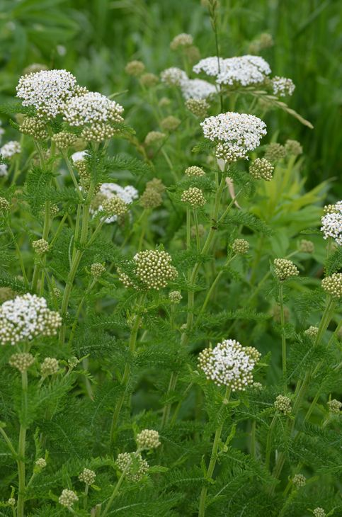
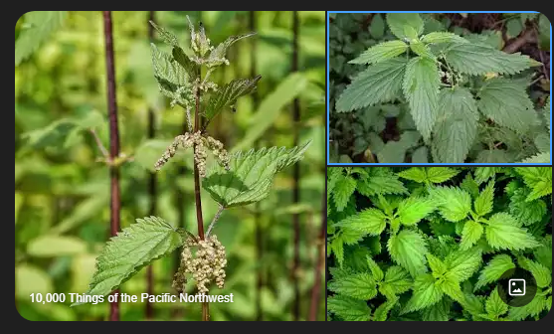
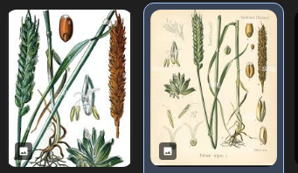
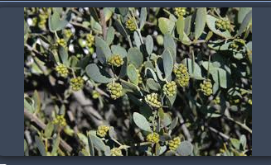
Achillea-millefolium
Utrica dioica
Matricaria chamomilla

Slide 17
Hair bleaching phytocosmetic product:
Matricaria chamomilla
Hair Conditioner and care products
Triticum vulgare ,
Urtica dioica ,
Simmondsia chinensis
Cream:
Butyospermum parkii
Vitis vinifera
Lotion and serum:
Helianthus annuus ,
Glycine max

Slide 18
Tonic and skin cleansing agents:
Rosa damascena
Skin depigmantation and ant blemish products:
Achillea millefolium
Camellia sinensis
Glycyrrhiza glabra
Melissa officinalis
Sun protection and tanning products:
Vitis vinifera
Camellia sinensis
Soap
Olea europaea
Laurus nobilis

Slide 19
Mask, peeling and gels:
Vitis vinifera
Butyrospermum parkii
Aromatherapy and caring oils:
Helianthus annuus
Olea europaea

Slide 20
Eye contour care products:
Camellia sinensis
Butyrospermum parkii
Bath and hand care products:
Aloe barbadensis
Olea europaea
Mouth and lip care products:
Helianthus annuus
Glycine max
Butyrospermum parkii

Slide 21
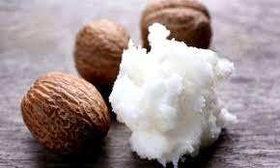
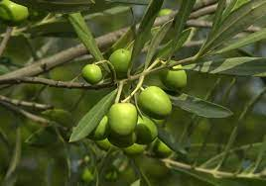
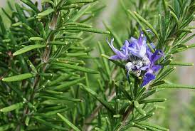
Most10 natural products that are found in dermal products:
Butyrospermum parkii (Shea butter) ,
Vitis vinifera ,
Helianthus annuus ,
Olea europaea ,
Glycine max ,
Rosmarinus officinalis ,
Simmondsia chinensis (Jojoba),
Citrus aurantium var. dulcis (Citrus sinensis),
Aloe barbadensis
Citrus medica var. limonum

Slide 22
References
Peter Elsner, (2000). Cosmeceuticals , Drugs vs Cosmetics, Marcel Dekker, Inc. New York • Basel TM
Costa, I. M. (2015). Phytocosmetics–where nature meets well-being. Journal of Phytocosmetics and Natural Ingredients

Slide 23
THANK YOU

