Slide 1
Phytochemical groups of plants
Dr. Mohammad Aslam
Phytocosmetics, PHAR 535
Final Semester
Week -4
Pharmacy Department
Date 29/10/2024

Slide 2
Outline
Phytochemical groups of plants
Functions of plant extracts used in cosmetic products
Antioxidants
Herbal cosmetics formulations
Carriers

Slide 3
Objectives
Understanding the different group of products used in cosmetic preparations
Understanding the Use of Phytoconstituents for different purposes

Slide 4
Phytochemical groups of plants
Carbohydrates
Volatile oils
Fixed Oils
Mucilage
Polphenols (Flavonoid, Tanin,..)
Amino acid and Peptide
Organic acids
Coloring agents
Saponosides
Vitamin and minerals

Slide 5
Functions of plant extracts used in cosmetic products
Antibacterial effect
Astringent
Antioxidant
Antiperisperant
Sebum regulation
Tonic
Calming effect for skin
Emolient
Anticelullite
Coloring

Slide 6
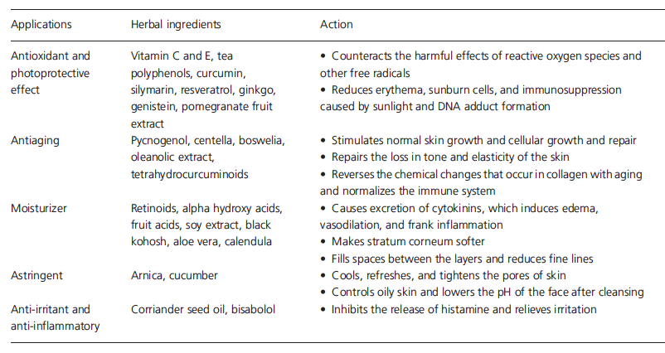
Application of Herbal Extracts with actions
Understanding the different group of products used in cosmetic preparations

Slide 7
Chemical classification of phytoconstituents

Slide 8
Antioxidants
What is Antioxidant?
Why it is important?
Homework…

Slide 9
Antioxidants
Are a range of chemicals and enzymes that can neutralize free radicals; compounds with single, unpaired electrons.
Free radicals can cause real havoc in our cells; altering DNA, damaging the proteins our cells needs to function and messing with the sophisticated membranes holding everything together,
And these free radicals can come from anywhere food, air we breathe and even sunlight can produce free radicals.
Oxidative distress; long time cause serious health consequences.
Vitamin c, Vitamin E, Blueberries, Black tea, Lycopene.
Homework…

Slide 10
Herbal cosmetic Formulations
Some ingredients are essential in cosmetic formulations such as:
Carriers, Surfactants, Thickening agents, Penetration enhancers, Preservatives.
Homework:
What is the function of each ingredient in phytocosmetic products?
Give 2 example for each

Slide 11
Carriers
Efficacy of cosmeceutical products are affected by the carrier type and active ingredient content.
In general when the active ingredient penetrate the dermal layer, the effect start .
Choosing the right carrier will affect penetration of the product into skin.
Carrier systems refer to carrier vesicles such as liposomes, nano/microparticles, emulsions, etc., that are coupled with active agents and applied to products to achieve the promoted effects of the active ingredients.

Slide 12
Thickeners
Major Applications of Thickeners
Thickeners improve the consistency, texture, and performance of the final product. They find their way in a variety of cosmetic applications. They help to achieve the desired viscosity and stability within a formula. Along with these features, thickeners provide added sensory benefits to the consumer. Discussed below are some cosmetic products where thickeners are suitably used.
Creams and lotions: Thickening agents find use in skin care category. They offer a range of sensory experiences to the consumer. Some popular products include facial moisturizers, body lotions, and sunscreens.
Gels and serums: Used in lightweight formulas like facial gels, eye gels, and hair serums. They provide hydration, anti-aging, or acne treatment to consumers. For example:
Natural thickeners — Aloe vera
Synthetic thickeners — Acrylates/C10-30 alkyl acrylate crosspolymer
Associative thickeners — Hydroxypropyl methylcellulose
Shampoos and conditioners: Thickeners provide viscosity and foam stability to hair care formulations. Popular examples include volumizing shampoos, moisturizing conditioners, and clarifying shampoos. For example:
Natural thickeners — Guar gum
Synthetic thickeners — Sodium polyacrylate
Associative thickeners — Cetyl hydroxyethylcellulose.

Slide 13
Penetration Enhancers
Penetration enhancers (also called chemical penetration enhancers, absorption enhancers or sorption promotors) are chemical compounds that can facilitate the penetration of active pharmaceutical ingredients (API) into or through the poorly permeable biological membranes. These compounds are used in some pharmaceutical formulations to enhance the penetration of APIs in transdermal drug delivery and transmucosal drug delivery (for example, ocular, nasal, oral and buccal). They typically penetrate into the biological membranes and reversibly decrease their barrier properties.
In addition, they may solubilize or plasticize skin–tissue components. Examples of commonly investigated chemical permeation enhancers include phospholipids, surfactants, dimethylsulfoxide (DMSO), and 1-odecylazacycloheptan-2-one (azone).

Slide 14
Carriers
Oleic acid—a monounsaturated fatty acid that increases the partitioning of drugs into the stratum corneum by disrupting the barrier function of the skin. It increases the solubility of lipophilic drugs by forming lipophilic complexes. It enhances the delivery of both lipophilic and hydrophilic drugs.
Azone (laurocapram) [10]—disrupts the lipid bilayers and increases the fluidity and permeation in the lipid regions of the skin. Also fluidizes the hydrophobic regions of the lamellate structure. It enhances penetration of both lipophilic and hydrophilic drugs.
Dendrimers—repetitively branched molecules, typically symmetric around the core, often adopt a spherical three-dimensional morphology. They have been used to encapsulate hydrophobic drugs. They interact with lipids and keratin in the stratum corneum and increase drug partitioning.
Monoolein—a monoglyceride with a structure similar to oleic acid. A polar lipid that is insoluble in water. Forms a bicontinuous cubic liquid crystalline phase that aids drug delivery. It disrupts the lamellar structure of the bilayers in the stratum corneum, thereby increasing lipid fluidity. It also solubilizes lipophilic compounds in the skin.
Oxazolidinones—high-molecular-weight compounds with structural features closely related to the sphingosine and ceramide lipids found in the upper skin layers. They fluidize the bilayers in the stratum corneum.

Slide 15
SEPA (2-n-nonyl-1,3-dioxolane)—fluidizes lipids and alters the structure of the stratum corneum
Phospholipids—formulated into microemulsions, vesicles, and micellar systems. They disrupt the ordered bilayer structure in the stratum corneum and enhance the partitioning of encapsulated drugs.
Surfactants—surface-active agents that alter the barrier function of the stratum corneum by removing water-soluble components and emulsifying sebum. This degreasing effect can cause irritation, especially with cationics. Examples are:
Sodium lauryl sulfate (anionic)
Cetyltrimethyl ammonium bromide (cationic)
Polyoxyethylene sorbitan monopalmitate (nonionic)
Lauryl betaine (amphoteric/zwitterionic).

Slide 16
References
Peter Elsner, (2000). Cosmeceuticals , Drugs vs Cosmetics, Marcel Dekker, Inc. New York • Basel TM
Costa, I. M. (2015). Phytocosmetics–where nature meets well-being. Journal of Phytocosmetics and Natural Ingredients

Slide 17
THANK YOU

