Slide 1
Phytoconstituents used as category in cosmetics ingredients
Dr. Mohammad Aslam
Phytocosmetics, PHAR 535
Final Semester
Week -4
Pharmacy Department
Date 29/10/2024

Slide 2
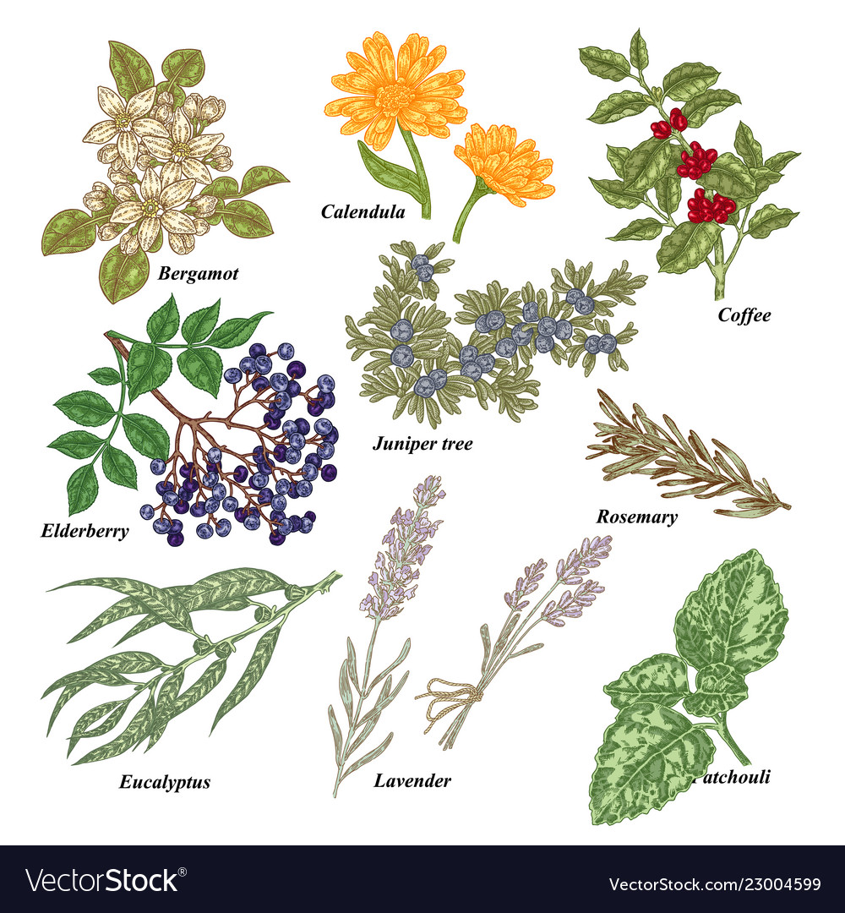
Outline
Surfactants (Surface active agents)
Thickening/Suspending Agents
Functions of Thickenners
Penetration enhancers
Preservatives

Slide 3
Objectives
Understanding the different group of products used in cosmetic preparations
Understanding the Use of Phytoconstituents for different cosmetic purposes

Slide 4
Surfactants in Phytochemical groups of plants
Surfactants/ Surface Active Agents are the ingredients used to formulate several suspensions, and emulsions in cosmetic technology.
They are added to aqueous solutions to increase solubility of lipophilic substances and hence they have ability to increase lipid absorption through the SC.
Because akylglycosides or fatty alcohol glycosides are biodegradable, non-toxic and non-irritant surfactants, they are widely used in industry of cosmetics and detergents.

Slide 5
Surfactants in Phytochemical groups of plants
Alkylglycosides have been isolated from the fruit of acerola (Malphigia glabra), the essential oil of the dried leaves of oregano (Origanum vulgare), the methanolic extract of cumin fruit (Cuminum cyminum), the fruit of bupleurum (Bupleurum falcatum), and the aerial parts of the sage plant Phlomis lunariifolia.
Other natural surfactants of great interest are fatty acid (FA) amides, such as ceramides, anandamide, oleamide, N-arachidonoyldopamine, and N-acylethanolamine.
These compounds generally have high biological properties. For example, N-palmitoylethanolamine is an anti-inflammatory contained in soybean and peanut oil.
FA amide glycosides, such as gangliosides, aminoglycosides, and their derivatives, also show biological activities.

Slide 6
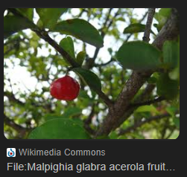
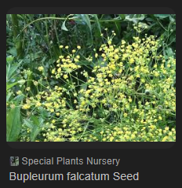
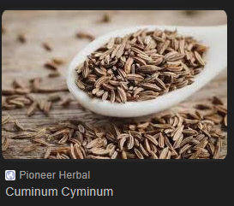
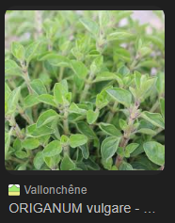
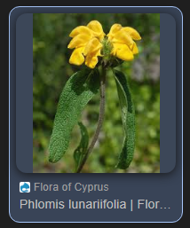

Slide 7
Surfactants in Phytochemical groups of plants
Other surfactants include carotenoid glycosides, isoprenoid glycolipids, and terpenoids.
Saponins are glycosides of triterpenes, steroids, or steroid alkaloids with high surfactant properties.
These compounds derive their name from the soapwort plant (Saponaria officinalis), the roots of which have been traditionally used as a soap.
Other well-known botanical sources of saponins include ginseng (Panax ginseng), the roots of licorice (Glycyrrhiza glabra) and butcher’s broom (Ruscus aculeatus), and the seeds of horse chestnut (Aesculus hippocastanum).

Slide 8
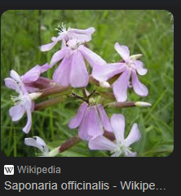
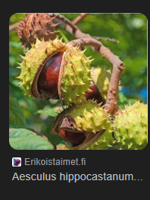
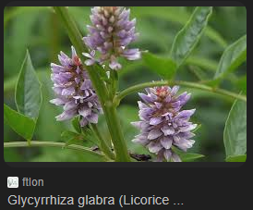
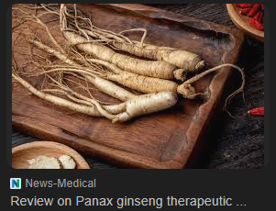
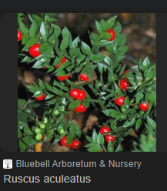

Slide 9
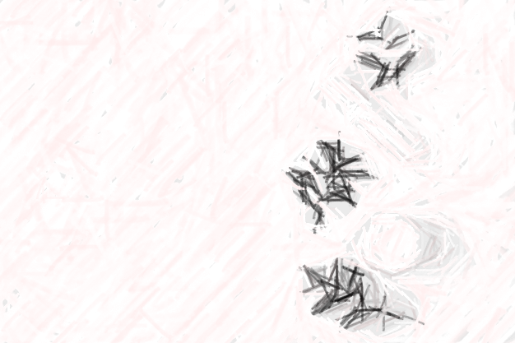
Thickening Agents
Viscosity-increasing, thickening agents are frequently used in topical formulations.
These materials serve the purpose of producing solid cosmetics or rendering suspensions, emulsions, or ointments more easily spreadable and appealable, and improving skin moisturizing, emolliency, and absorption characteristics.
According to the type of formulation, aqueous or oily thickening agents, or a mixture thereof, have to be used.

Slide 10
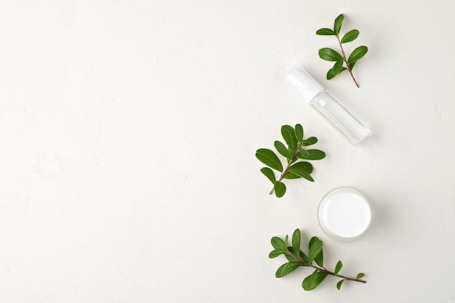
Thickening Agents
Most common natural aqueous thickening agents include polysaccharides such as carrageenan; a sulfated polysaccharide extracted from red seaweeds, glucomannan, which is present in aloe gel and is particularly abundant in the corm of the konjac plant (Amorphophallus konjac); xanthan gum, a bacterial product obtained from fermentation processes operated by Xanthomonas campestris; guar gum, a galactomannan obtained from guar (Cyamopsis tetragonoloba) beans; and carob gum, a galactomannan extracted from the seeds of the carob tree (Ceratonia siliqua)

Slide 11
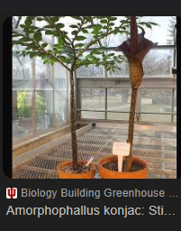
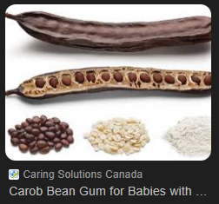
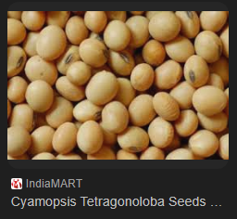
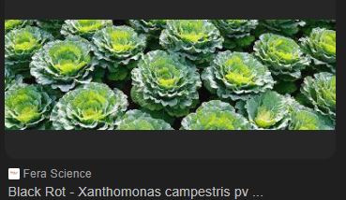
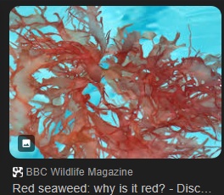

Slide 12
Thickening Agents
Components of plant cell walls are also commonly used as viscosity enhancers, such as pectin, a main source of which are citrus fruits, and cellulose, mostly employed in the form of its derivatives, like methylcellulose and hydroxyethylcellulose, which do not occur naturally but are synthesized starting from plant material.
Proteins are also used as aqueous viscosity enhancers, usually gelatin, which is obtained from the collagen contained in by-products of the meat and leather industry.
Examples of natural oily thickening agents include waxes, such as carnauba wax, derived from the leaves of the carnauba palm (Copernicia prunifera), and beeswax produced by honey bees (Apis mellifera).

Slide 13
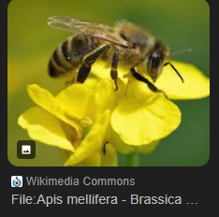

Slide 14
Penetration Enhancers
Penetration enhancers generally act on the stratum corneum, and their possible mechanisms of action include the reduction of the skin permeability barrier via the disruption of the tightly packed lipid regions,
They induce modification in the skin texture, especially in the stratum corneum, which can lead to irritation or other injurious effects to the skin, and should always be used after careful testing.
Water exerts a very poor penetration-enhancing activity as an external agent, while there is more efficient approach consists in the use of occlusive materials or patches, which increase the amount of water in the stratum corneum by preventing transepidermal water loss: Ethanol, Urea..

Slide 15
Penetration Enhancers
Ethanol and Urea as penetration enhancers
Ethanol is commonly used to increase the solubility of a drug in the vehicle and in transdermal formulations, and is often the solvent of choice for use in patches.
Urea is acting by increasing the water content of the stratum corneum and exerting keratolytic activity.

Slide 16
Penetration Enhancers
The essential oils of:
Eucalyptus (Eucalyptus globulus),
Wormseed (Chenopodium ambrosioides), and
Ylang ylang (Cananga odorata) have been tested as penetration enhancers in vivo.
As Volatile oil: Such a kind of activity in volatile oils is mainly due to the presence of various terpenes and terpenoids.
These compounds operate by modifying the solvent nature of the stratum corneum, improving drug partitioning into the tissue.

Slide 17
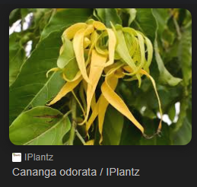
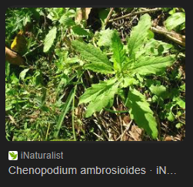
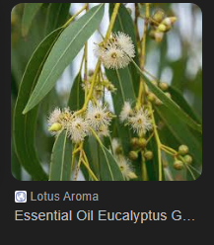

Slide 18
Preservatives
Various methods of preservation are available to the formulators of cosmetic preparations, in order to prevent alteration and degradation of their products.
Due to the toxicity properties of many preservatives, their application and selection are strictly defined by legal rules in many countries.
Methods of preservation, botanical materials and natural molecules offer different possibilities of use.

Slide 19
Preservatives
Plant natural preservatives, also known as phytoalexins, frequently possess other biological effects besides their antimicrobial properties.
Components of natural preservatives:
Terpenoids, organic acids, oxygenated fatty acids, aliphatic alcohols, polyols, and polyphenols.
Examples for natural preservative compounds:
Essential oils
Glyceryl monoesters, such as glyceryl caprylate
Benzoic acid/ Benzyl alcohol
Alkyl esters of p-hydroxybenzoic acid (parabens)
Vitamin A, retinoic acid, β-carotene,Vitamin C, and E

Slide 20
Preservatives
Among natural antioxidants, phenolic compounds are in the forefront since they have the structural requirements of free radical scavengers. Various phenolic classes can be used for this purpose, including phenolic acids, anthocyanins, cathechins, hydroxycinnamic acid derivatives, and flavonoids

Slide 21
References
Peter Elsner, (2000). Cosmeceuticals , Drugs vs Cosmetics, Marcel Dekker, Inc. New York • Basel TM
Bruno Burlando, Luisella Verotta, Laura Cornara, Elisa Bottini-Massa, Herbal Principles in Cosmetics: Properties and Mechanisms of Action, 2010, CRC Press.

Slide 22
THANK YOU

