Slide 1
Herbals in skin care
Dr. Mohammad Aslam
Phytocosmetics, PHAR 535
Final Semester
Week -5 -6
Pharmacy Department
Date: 19/11/2024

Slide 2
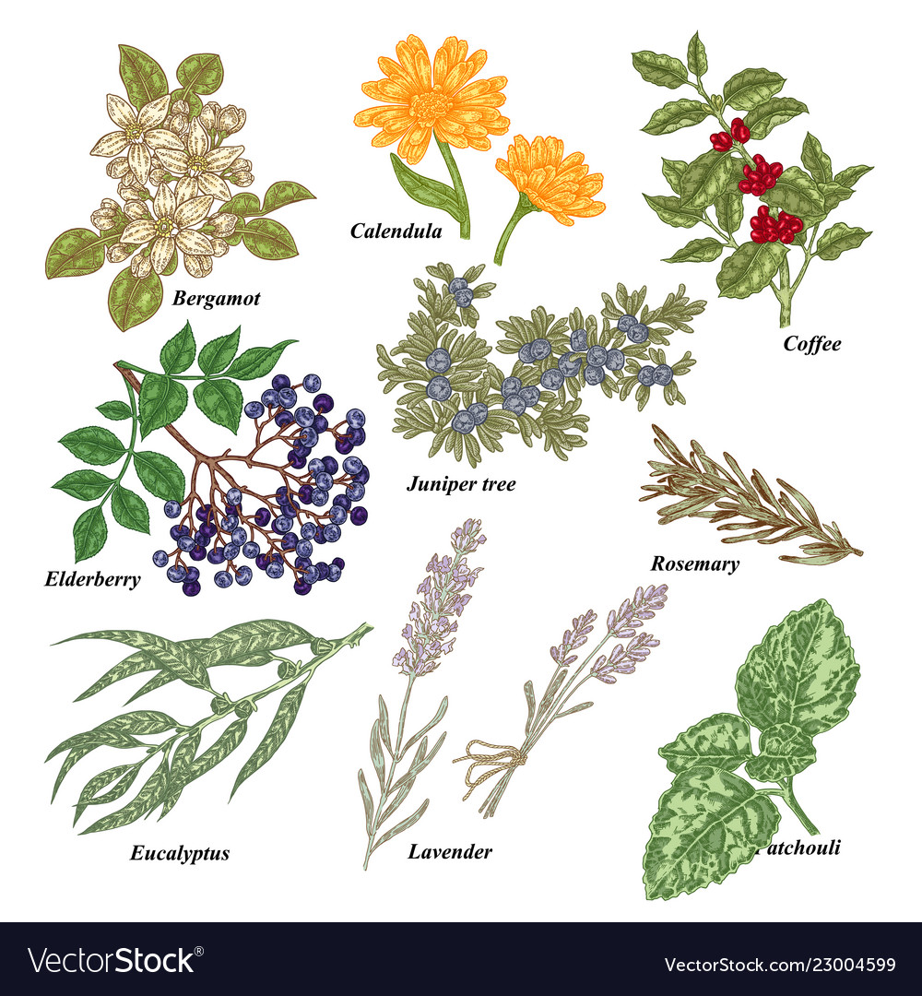
Outline
Herbals in skin care
Coconut Palm
Green Tea
Aloe
Argan Tree
Chamomile
Ginkgo
Mango
Rosemary

Slide 3
Objectives
Understanding the different plants used in cosmetic preparations
Understanding the source of Phytoconstituents for different plants used in cosmetic purposes

Slide 4
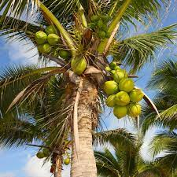
Herbal Skin Care Products
Coconut Palm
Scientific name: Cocos nucifera L.
Family: Arecaceae
Parts used: Fruit, seeds
Coconut water contains sugars (4%), mainly glucose, fructose, and sucrose, while other components include malic and citric acids; proteins (0.1%); fats (0.1%); amino acids; vitamins, particularly vitamin E; and mineral salts (0.4%), of which the most abundant is potassium, followed by calcium and phosphorus, while iron is also relatively abundant.
The fresh pulp of the seed is composed of lipids (about 35%) and sugars (about 10%), while in the dried copra the content of lipids is higher (about 70%).

Slide 5
Herbal Skin Care Product
Coconut Palm Uses in Cosmetics
The coconut oil is widely used in cosmetics and soaps due to its high content in lauric acid.
The oil has a strengthening effect on hairs, mainly due to the presence of lauric acid glyceride
The oil has emollient, rehydrating, and elasticizing properties, thus preventing wrinkle formation and other skin aging processes
Products obtained from coconut water through a freeze-drying process stimulate tissue growth and are employed in rejuvenation treatments on the skin and scalp

Slide 6
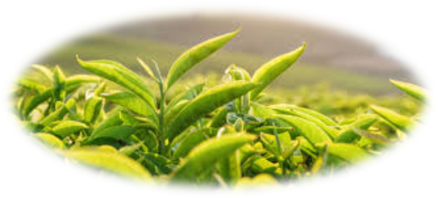
Herbal Skin Care Product
Green Tea
Scientific name: Camellia sinensis (L.) Kuntze
Family: Theaceae
Parts used: Leaves
It has been shown that the therapeutic properties of the plant are mainly due to catechins, and are primarily attributable to EGCG (pigallocatechin-3-gallate)
Gallocatechins prevent UV ray injury on the skin and are therefore potentially useful against the development of skin tumors EGCG has been shown to protect keratinocytes from UV-B rays, preventing the activation o the AP-1 transcription factor. Moreover, EGCG also protects these cells from UV-A rays.

Slide 7
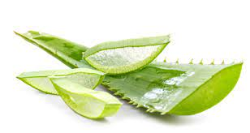
Herbal Skin Care Product
Aloe
Scientific name: Aloe vera (L.) Burm. f. (syn. A. barbadensis Mill., A. vulgaris Lam.)
Family: Asphodelaceae
Parts used: Leaves
The plant gel and exudate have been used since ancient times as medicaments.
In the procedure for gel extraction, the mechanical separation of the pulp from the leaf skin is not always complete
The plant has been used to heal skin disorders for more than 2,000 years. The gel is present in a great variety of cosmetic and dermatologic products.

Slide 8
Herbal Skin Care Product
Aloe
Its main application is for skin hydration in the treatment of dry skin.
Skin hydration properties have been proved by transepidermal water loss (TEWL) measurements Performed on volunteers.
Even though the gel does not act as a UV screen, it can prevent the arising of sun erithema.
The gel also reduces the production of interleukins that induce immunosuppression in keratinocytes
Besides protection from sun rays, the anti-inflammatory action of the gel makes it useful for eczematous conditions, while a clinical test has also shown beneficial effects on psoriasis.
Aloe compounds must be avoided during pregnancy, lactation, and in newborns.
The plant or the gel can cause allergy or contact and photodermatitis in sensitive subjects

Slide 9
Diagrammatic representation

Slide 10
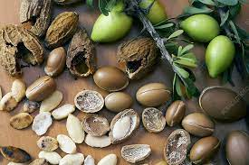
Herbal Skin Care Product
Argan Tree
Scientific name: Argania spinosa (L.) Skeels
Family: Sapotaceae
Parts used: Seeds
The seeds contain a large amount of oil, which can reach a value of more than 50%.
The oil is composed of triglycerides (95%), mostly consisting of unsaturated fatty acids (30% linoleic).
The unsaponifiable fraction consists of carotenes (37%), Vitamin E (8%), triterpenic alcohols (20%), sterols (20%), and xanthophylls (5%). The phenolic component contains benzoic, hydroxybenzoic, phenylacetic, and caffeic acids, while oleuropein, flavonoids, and their glycosides are also present.

Slide 11
Herbal Skin Care Product
Argan Tree
Argan oil has been used for centuries in the traditional medicine of Morocco to heal skin disease and as a vehicle for massage.
Its properties make it a useful remedy for psoriasis, dermatitis, eczema, furuncles, acne, and chickenpox blisters. It is also recommended as an unguent for rheumatic diseases.
The oil is indicated to contrast skin dehydration and for the treatment of wrinkles. It can also protect the skin against UV-B radiations.

Slide 12
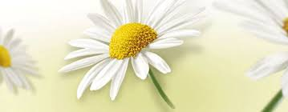
Herbal Skin Care Product
Chamomile
Scientific name: Matricaria recutita L.
Family: Compositae
Parts used: Heads
The essential oil contains lipophilic compounds, including terpenes, coumarins, and azulenes
Chief components of the volatile oil are α-bisabolol and derivatives, β-trans-farnesene, and chamazulene
The antiseptic and anti-inflammatory properties allow neutralization of skin irritations, and therefore, the plant is particularly indicated for sensitive skin
The plant is moreover used for lightening treatments on head hairs

Slide 13
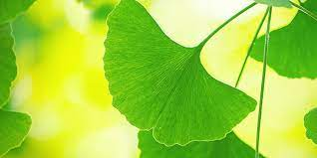
Herbal Skin Care Product
Ginkgo
Scientific name: Ginkgo biloba L.
Family: Ginkgoaceae
Parts used: Leaves
Chief bioactive compounds are flavonoids, including flavonol glycosides, dimeric flavones, and amentoflavone, polyphenols (ginkgolic acids,cathechins, gallocatechins); and anthocyanosides.
Cosmetic formulations based on extracts of the plant exert stimulating, tonifying, antibacterial, and antioxidant effects, and can be used to prevent or amend skin aging and cellulite

Slide 14
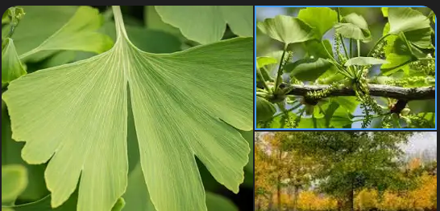
Herbal Skin Care Product
Ginkgo
The plant is also used in products that stimulate hair growth. Also in this case, the promotion of microcirculation seems to play a determinant role, by acting favorably on piliferous bulbs, and moreover inducing anti-inflammatory, antioxidant, and antibacteric effects.
Due to its antioxidant properties, the plant can also be used to protect the skin from damage due to sun irradiation

Slide 15
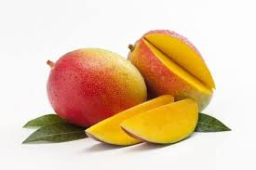
Herbal Skin Care Product
Mango
Scientific name: Mangifera indica L.
Family: Anacardiaceae
Parts used: Fruit, seeds, leaves, bark
The fruit contains protein, fat, carbohydrate, and minerals. Chief simple sugars are saccharose, fructose, and glucose.

Slide 16
Herbal Skin Care Product
Mango
The butter from seed kernel has soothing properties and heals a wide variety of skin eruptions, sores, and boils.
The high percentage of tocopherol, phytosterols, and triterpenes suggests its supplemental use in cosmetics as a source for skin active ingredients.
It is excellent as an ointment base, and has been observed to release salicylic acid at a remarkably greater rate than a standard paraffin-based ointment formulation.

Slide 17
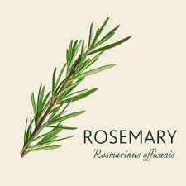
Herbal Skin Care Product
Rosemary
Scientific name: Rosmarinus officinalis L.
Family: Lamiaceae
Parts used: Leaves, twigs, flowering apices
The plant contains various antioxidant polyphenols, mainly phenolic diterpenoids, caffeol derivatives like rosmarinic acid and flavones
Rosmarinic acid is an ingredient of various cosmetic formulations and perfumes

Slide 18
Herbal Skin Care Product
Rosemary
It has been shown that the plant’s extract protects hairs from external injurious agents also due to its antioxidant properties
The plant is therefore useful against various hair and scalp disorders, such as early baldness or dandruff, and is frequently used as a component of shampoos and lotions.
The essential oil should not be used during pregnancy or by people affected by epilepsy or hypertension. It is known that various essential oils contain neurotoxins that can induce convulsions.
The plant can be the cause of contact dermatitis.

Slide 19
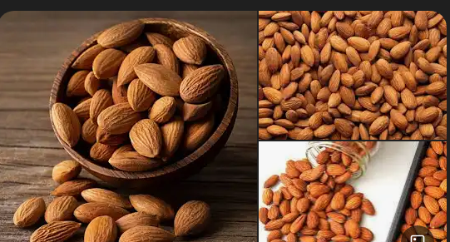
Herbal Skin Care Product
Almond
Scientific name: Prunus dulcis (Mill.) D. A. Webb var. dulcis
P. dulcis (Mill.) D. A. Webb var. amara (DC) H. Moore
Family: Rosaceae
Parts used: Seeds
The seed is composed of triglycerides (45–50%), proteins (20–25%), mineral salts (2–3%), cellulose fiber (4–5%), mono- and disaccharides (5–6%), and vitamins (A, B1, B2, B3, B6). The seed also contains an enzymatic complex, including emulsin (β-glucosidase), amylase, and oxynitrilase.

Slide 20
Herbal Skin Care Product
Dermatologic and Cosmetic Use
About 95% of the oil is represented by ω-3 fatty acids (mostly oleic and linoleic).
The oil is therefore widely used in cosmetics for its emollient, lenitive, and nourishing properties.
It is indicated for the skin of adults and kids, and even for the particularly delicate skin of newborns. It is used as a lubricant, sebum restitutive, and reepithelialization agent, and is recommended for dry skins and to alleviate itching caused by dermatitis, eczema, measles, and chickenpox. The oil can also be used against stretch marks caused by birth or slimming diets and to soften and moisturize dry or frizzy hair, or hair bleached by sun and saltiness. It can be mixed with essential oils for massage for joint pain or after physicalexercise

Slide 21
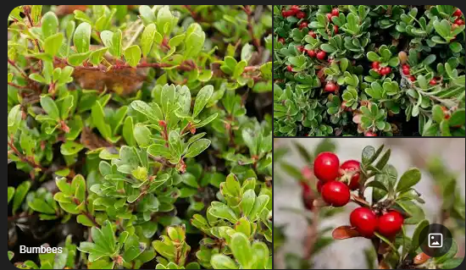
Herbal Skin Care Product
Bearberry
Scientific name: Arctostaphylos uva-ursi (L.) Spreng.
Family: Ericaceae
Parts used: Leaves
The plant is used in skin care products mostly for its depigmenting action. Hydroquinones are well-known inhibitors of tyrosinase, the enzyme responsible for L-tyrosine oxidation in the biosynthetic pathway of melanin. An in vitro experimental study has shown that arbutin inhibits the synthesis of melanin in human melanoma cells and in a three-dimensional human skin model.
Ursolic acid exerts an anti-inflammatory action on the skin, and moreover, it inhibits elastase, hence being an interesting compound for antiaging products. Allantoin is used as an active principle in creams against herpes and vaginal infections

Slide 22
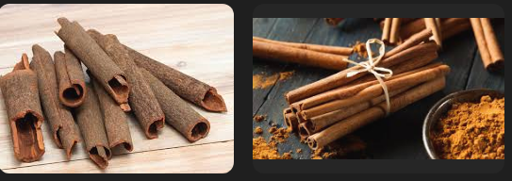
Herbal Skin Care Product
Cinnamon
Scientific name: Cinnamomum verum J. Presl (syn. Cinnamomum zeylanicum Bl.)
Family: Lauraceae
Parts used: Bark and leaves
The essential oil obtained from the bark and leaves (0.5–1.0% and 1.6–1.8%, respectively) is very aromatic and spicy

Slide 23
Herbal Skin Care Product
Dermatologic and Cosmetic Use
The essential oil is used in perfume and cosmetic industries, but the dosage must be carefully controlled due to the oil’s capability of inducing irritation and sensitization on the skin and mucosae. Noxious effects are mainly due to the presence of cinnamaldehyde.
In aromatherapy it is preferable to use the oil extracted from leaves, owing to a lower content in cinnamaldehyde. Cinnamon oil is used for tonifying massage, since it exerts a vasodilatory effect caused by cinnamaldehyde.
Such a property is responsible for the emmenagogue effect of the plant, while it can also be exploited for aesthetic purposes, such as lip volumizers, or in the treatment of cellulite

Slide 24
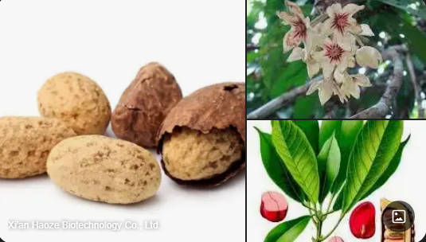
Herbal Skin Care Product
Cola
Scientific name: Cola acuminata (P. Beauv.) Schott & Endl. C.nitida (Vent.) Schott & Endl.
Family: Malvaceae
Parts used: Seeds

Slide 25
Herbal Skin Care Product
Dermatologic and Cosmetic Use
Plant extracts based on cola nut induce an increase of lipolysis (similar to those of Coffea arabica, the coffee plant, and of Camellia sinensis, the tea plant), also involving a reduction of adipocytes in peripheral body areas. These preparations are therefore helpful in treatments against cellulite.
It has been shown that caffeine reduces the occurrence of skin tumors in hairless mice exposed to intense UV irradiation through a prevention of p53 gene mutation.

Slide 26
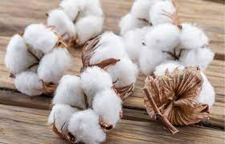
Herbal Skin Care Product
Cotton
Scientific name: Gossypium hirsutum L.
Family: Malvaceae
Parts used: Seeds
Cottonseed oil is commonly used in soaps and cosmetic products, while cotton fiber can also be used in the cosmetic field. The importance of the oil is linked to the high content in linoleic acid.
This fatty acid is essential for the structure of cellular membranes and ensures the integrity of the skin water barrier. Linoleic acid reduces skin dehydration, but it also has protective effects against external irritating agents

Slide 27
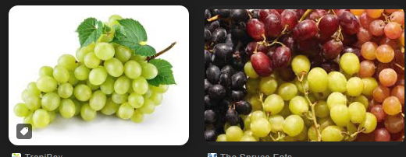
Herbal Skin Care Product
Grape
Scientific name: Vitis vinifera L.
Family: Vitaceae
Parts used: Fruits, seeds, leaves

Slide 28
Herbal Skin Care Product
Red grape extracts and active principles are widely used in cosmetic products.
The importance of grape in skin care is evidenced by wine therapy, which originally developed in the region of Bordeaux, France, and then diffused to other countries.
Wine therapy basically consists of baths or applications of wine and grape extracts rich in polyphenols in order to stimulate microcirculation and strengthen blood vessels.
The stabilizing action of proanthocyanidins on capillary vessels gives a contribution to the maintenance of skin elasticity and improves disorders linked to skin circulation, such as couperose, or to an insufficient draining of subdermal tissue, like cellulite.

Slide 29
Herbal Skin Care Product
The antioxidant power of flavonoids and polyphenols contrasts aging processes induced by UV radiations and free radicals.
A main change involved in skin aging is the degradation of glycosaminoglycans and collagen, with a consequent reduction in skin thickness.
Resveratrol has a tightening and firming action on the skin and favors tissue renewal, thus acting similarly to retinol.
A grapeseed extract has promoted the expression of vascular endothelial growth factor (VEGF) in keratinocytes, thus favoring skin angiogenesis and wound healing
Grapeseed oil is easily absorbed by the skin, on which it exerts emollient, mildly astringent, and hydrating effects.
It is particularly suitable for stress-induced skin damage, particularly in the periocular region, because of its high regenerative properties.
The oil forms a thin film on the skin and is therefore used as a vehicle of
essential oils in aromatherapy. It is also useful in the treatment of acne

Slide 30
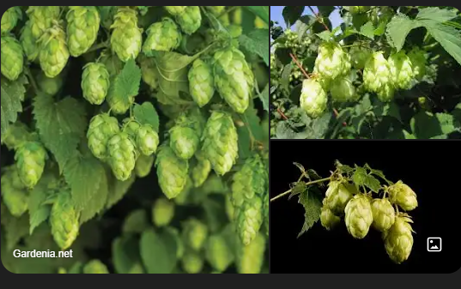
Herbal Skin Care Product
Hops
Scientific name: Humulus lupulus L.
Family: Cannabaceae
Parts used: Female flowers
The active principles of hops can stimulate the cells of the connective tissue. Herbal preparations of the plant are used in wound healing and in the manufacturing of creams and lotions having emollient, hydrating, and regenerative effects

Slide 31
Herbal Skin Care Product
Hop extracts are also useful in the prevention of skin aging and in the treatment of loose skin, stretch marks, and sagging.
They are also used in breast tightening, for the presence of the phytoestrogen 8-prenylnaringenin, even though clinical trials do not allow a reliable evaluation of this treatment and cannot exclude the insurgence of noxious effects.
A hexan extract containing humulones and lupulones, mixed to an oily or creamy vehicle, has been patented as a solar screen due to its ability to absorb UV light. This product has also been claimed to prevent erythema and sunburning by the stimulation of cutaneous melanization.

Slide 32
Marks in Phytocosmetics
Participation = 5
Quiz =15
Project or Assignment = 10
Midterm = 30
Final = 40
TOPICS FOR ASSIGNMENT= PREPARE THE MONOGRAPH OF 10 HERBAL DRUGS USED IN COSMETICS AND WRITE ABOUT THEIR FORMULATIONS ALSO.

Slide 33
References
Peter Elsner, (2000). Cosmeceuticals , Drugs vs Cosmetics, Marcel Dekker, Inc. New York • Basel TM
Bruno Burlando, Luisella Verotta, Laura Cornara, Elisa Bottini-Massa, Herbal Principles in Cosmetics: Properties and Mechanisms of Action, 2010, CRC Press.

Slide 34
THANK YOU

