Slide 1


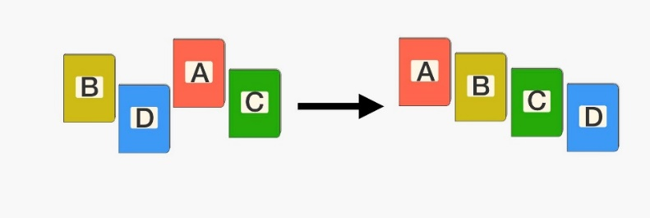
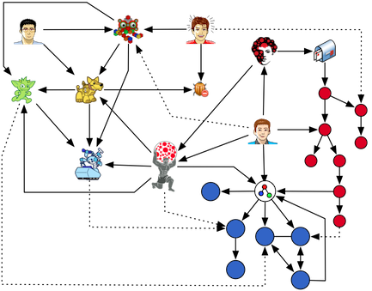
Introduction to Discrete Mathematics
Ms. Togzhan Nurtayeva
Course Code: IT 235/A
Semester 3
Week 1
Date: 04.10.2023

Slide 2

Basic Information
Instructor: Ms. Togzhan
Lectures: 3 hours a week
Homework:
  Will be posted on the SIS system
Lecture Notes:
  Will be posted on the Lecture Notes web page
Office Hours: will be announced soon
Contact: via email togzhan.nurtayeva@tiu.edu.iq

Slide 3


Course Materials
Discrete Mathematics and its Applications, 8th edition by Kenneth H. Rosen
Discrete Mathematics and its Applications, 8th edition by Richard Johnsonbaugh
Discrete Mathematics with Applications, 5th edition by Susanna S. Epp
Study links and references for specific topics will be given within Lecture Notes.

Slide 4

Class Regulations
Students have an obligation to arrive on time and remain in the classroom for the duration of scheduled classes and activities.
Students have an obligation to write, homework, quizzes and final examinations at the times scheduled by the teacher and university.
Students have an obligation to show respectful behavior and appropriate classroom deportment. Should a student be disruptive and/or disrespectful, the teacher has the right to exclude the disruptive student from learning activities (classes) and may refer the case to the Director of Student Services under the Student Code of Conduct.
Mobile Phones are not allowed in the classroom.
Should a student have an emergency case during lecture hours, he/she must raise his hand, and only after lecturer’s permission can leave the class.
If students miss more than 10 minutes of any class period or leave before the instructor dismisses the class, they will be marked absent for the whole hour.

Slide 5


A Grading Scheme
Participation/Discussion: 5% (not attendance)
Homework: 10%
Quizzes: 20% (25% - for exempted students)
Midterm: 25%
Final Exam 40%

Slide 6

Course Content
01.10.2023-19.10.2023 | Intro to Algorithms and Pseudo Code Searching Sorting Optimization Recursive Big-O Notation
22.10.2023-26.10.2023 | Time and Space Complexity of Algorithms
29.10.2023 – 02.11.2023 | - Cartesian Products and Ordered Pairs - Relations
05.11.2023 – 09.11.2023 | Revision Week (if topics above are covered fully)
11.11.2023 – 18.11.2023 | MIDTERM
19.11.2023 – 23.11.2023 | Proofs (direct, by case, induction, contradiction)
26.11.2023 – 30.11.2023 | Proofs (direct, by case, induction, contradiction)
03.12.2023 – 07.12.2023 | Intro to Graph Theory Types Applications
10.12.2023 – 21.12.2023 | Trees / Dijkstra’s, Kruskal’s and Prim’s Algorithms
24.12.2023 – 28.12.2023 | Cryptography or Logic Laws (if topics above are covered fully)
31.01.2024 – 04.01.2024 | Revision Week
06.01.2024 – 18.01.2024 | FINALS

Slide 7
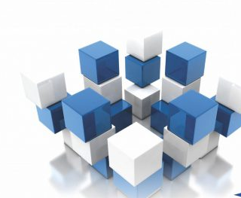
What is discrete math?
Discrete math is the study of countable, distinct elements rather than continuous ones.
So instead of smooth-running real numbers, you’ll study:
✅ integers
✅ graphs
✅ statements
Discrete math principles are commonly used in building algorithms for computer science and data science.

Slide 8

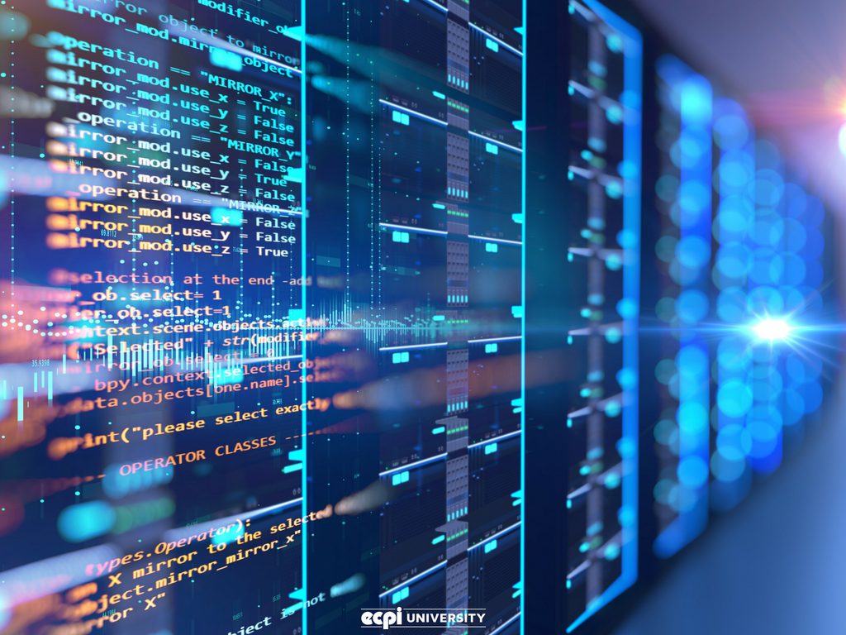
Why Discrete Mathematics?
Design efficient computer systems.
How did Google manage to build a fast search engine?
What is the foundation of internet security?
algorithms, data structures, database,
parallel computing, distributed systems,
cryptography, computer networks…
Logic, number theory, counting, graph theory…

Slide 9
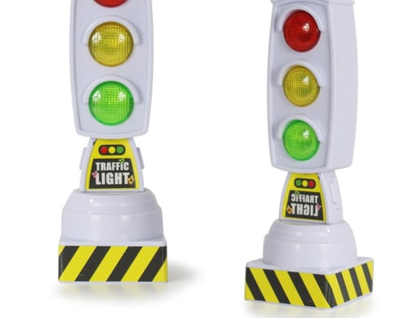



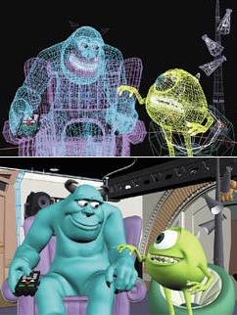
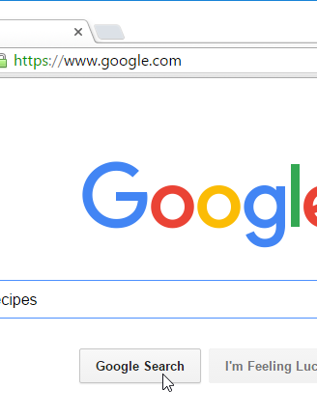
Applications

Slide 10



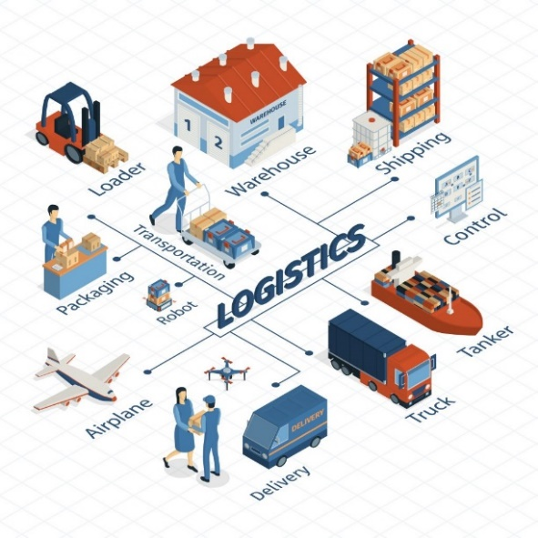

Computer Graphics (e.g., video games)
Cryptography (security)
Networks (“following” on Twitter, “friending” on Facebook, etc.)
Voting systems
Logistics
A programmer uses DM to design efficient algorithms.
Web Search
Database
Scheduling
Cell phone Communications
Web Designing

Slide 11
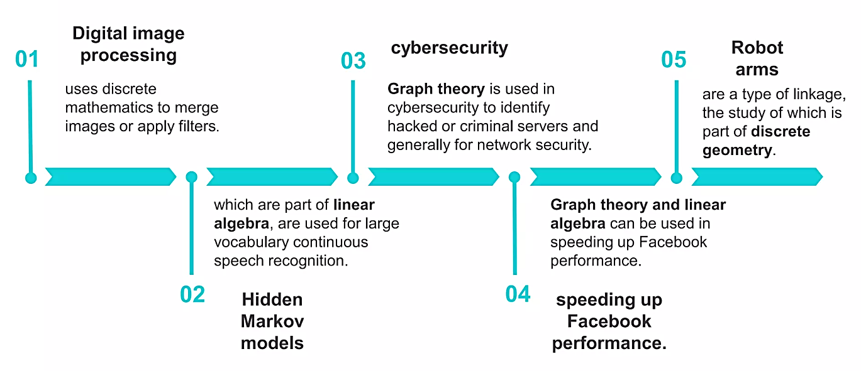

Slide 12
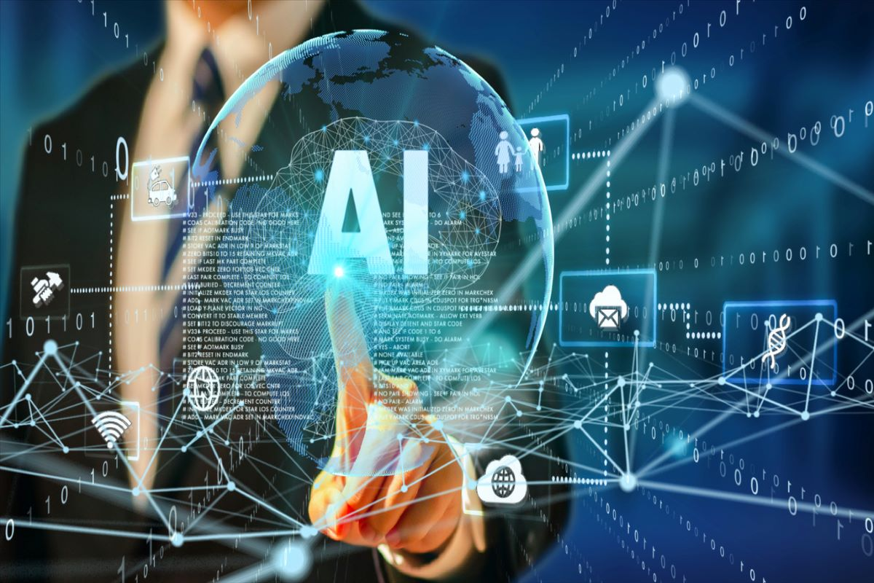


Slide 13
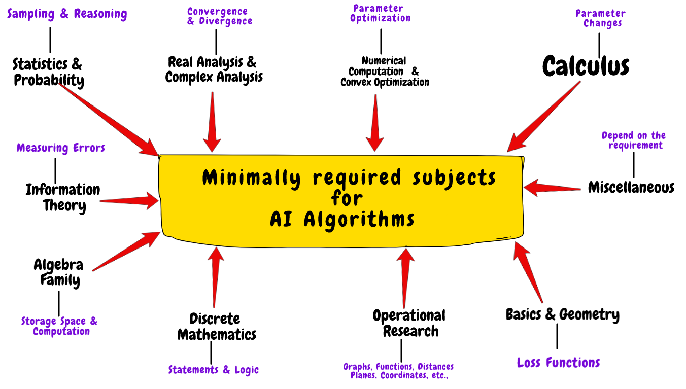

Slide 14
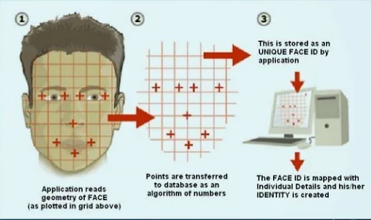
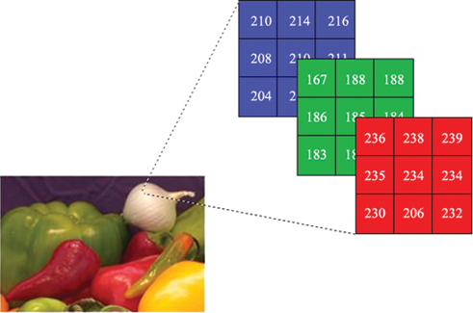
Digital Image Processing
In computer science, digital image processing is the use of computer
algorithms to perform image processing on digital images to get an enhanced image or to extract some useful information from it.
It allows a much wider range of algorithms to be applied to the input
data and can avoid problems such as the build-up of noise and signal
distortion during processing.

Slide 15
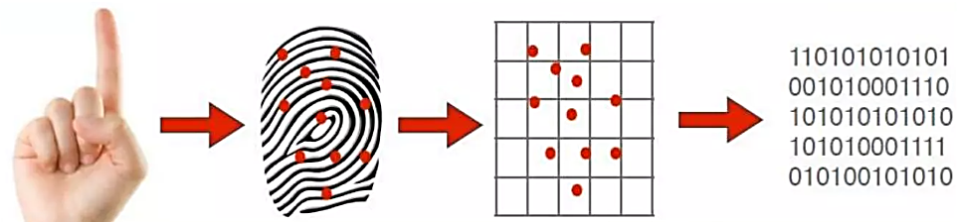
Fingerprint Optical Scanner
Fingerprint Optical Scanner measures your finger electrically.
Only specific characteristics, which are unique to every fingerprint, are filtered and saved as an encrypted biometric key or mathematical representation. No image of a fingerprint is ever saved, only a series of numbers (a binary code), which is used for verification. The algorithm cannot be reconverted to an image, so no one can duplicate your fingerprints.

Slide 16
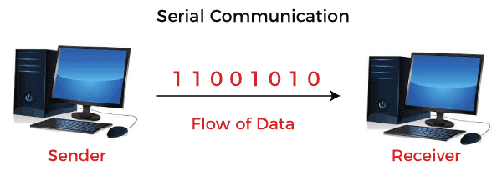
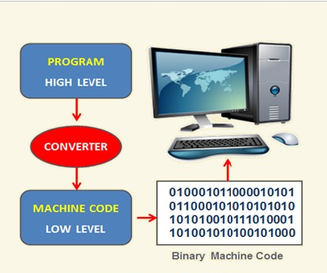
Computers
Run software and store files. The software and files are both stored as huge strings of 1s and 0s. Binary math is discrete mathematics.

Slide 17
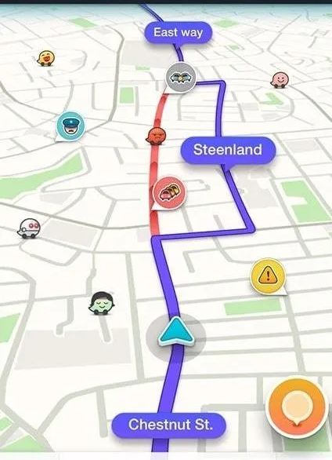

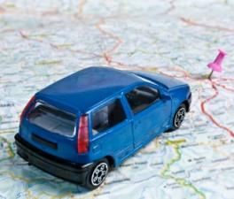
Google Maps
Uses discrete mathematics to determine fastest driving routes and times.
Google Maps knows your position via the Global Positioning System.
Edsger W. Dijkstra’s Algorithm is used to calculate shortest route.
Co-ordinate geometry is used.

Slide 18
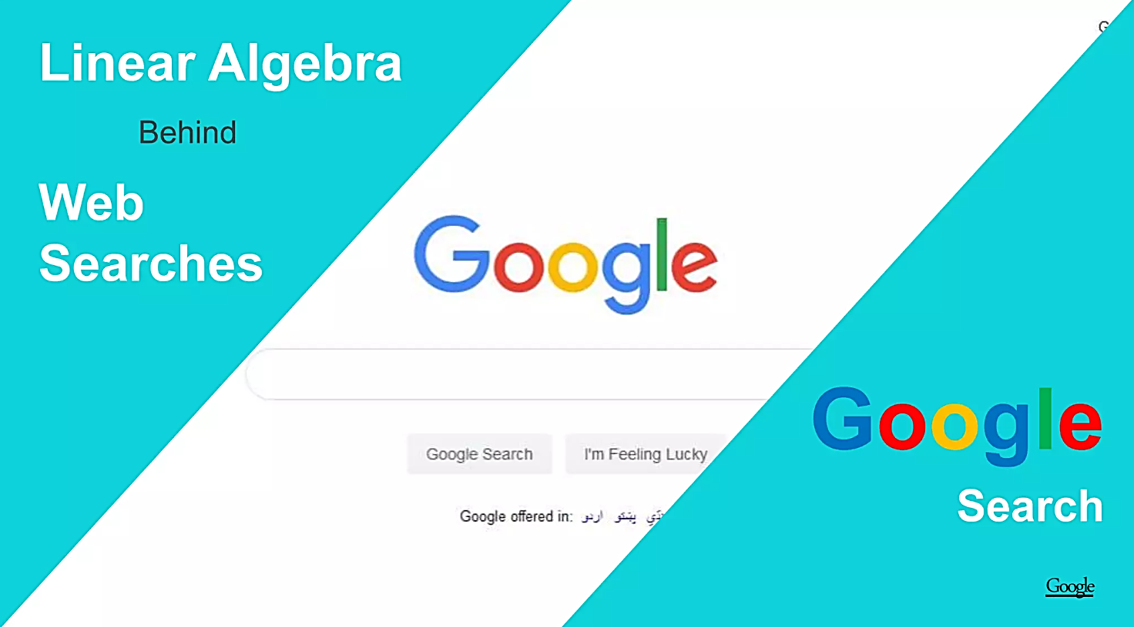

Slide 19
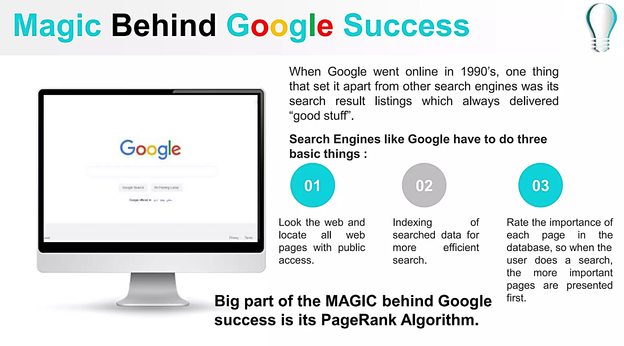

Slide 20
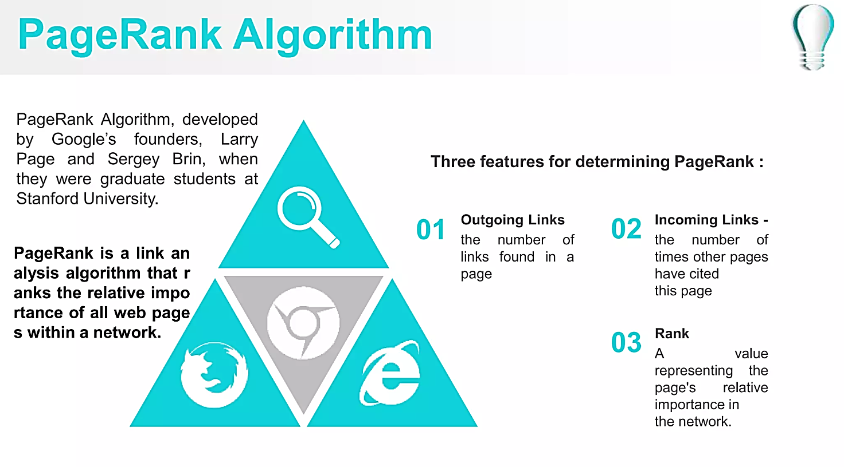

Slide 21
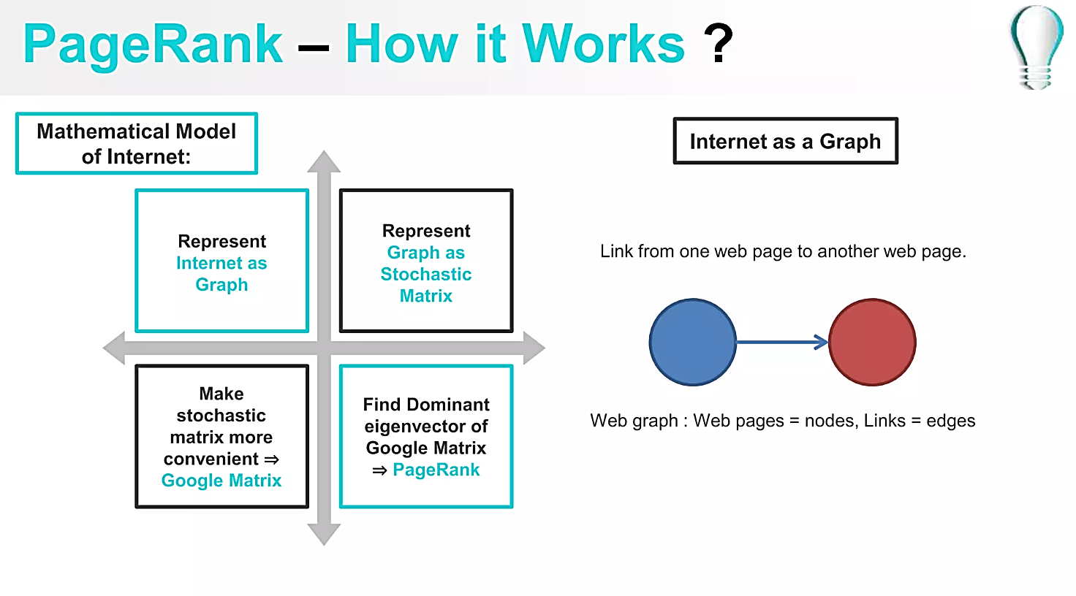

Slide 22
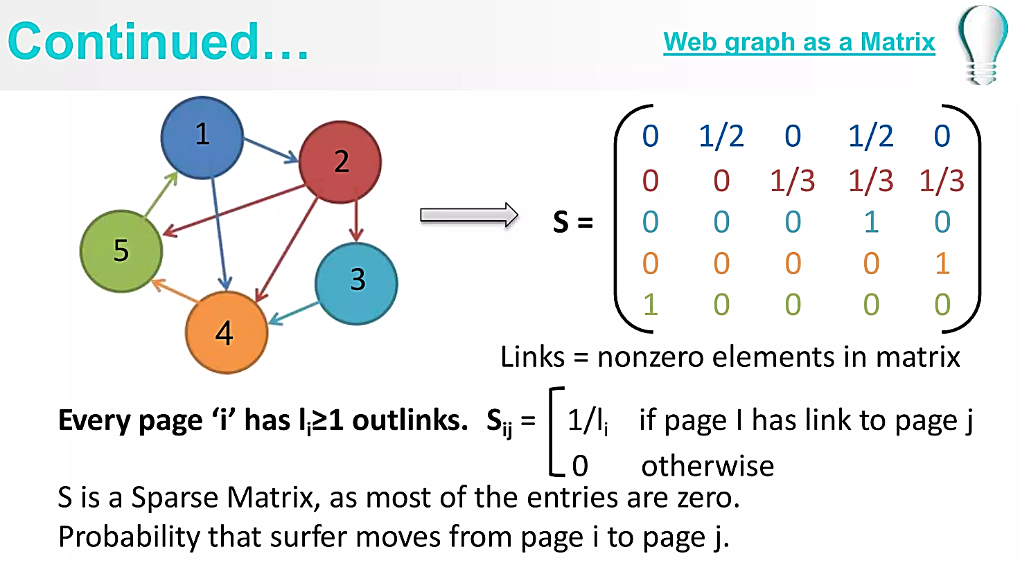

Slide 23
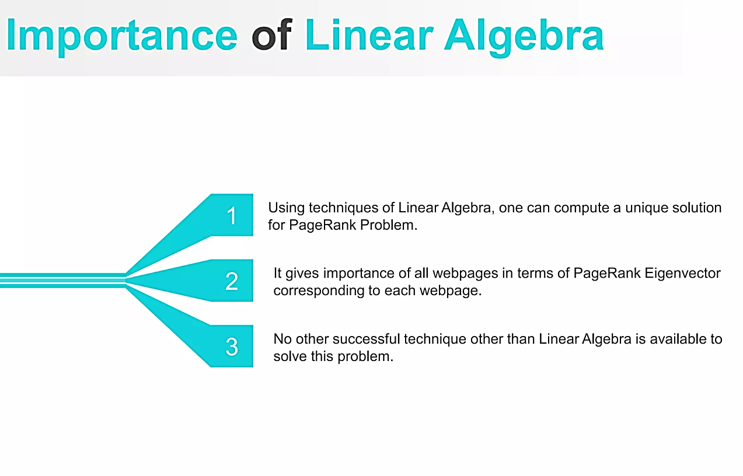

Slide 24
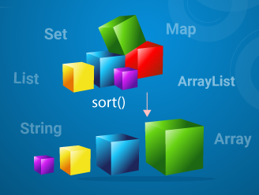
Topic 1: Algorithms
Introduction to Algorithms and Pseudo Code
Searching Algorithms
Sorting Algorithms
Optimization Algorithms
Recursive Algorithms
Big-O Notation
Algorithms, coding theory, data structures

Slide 25
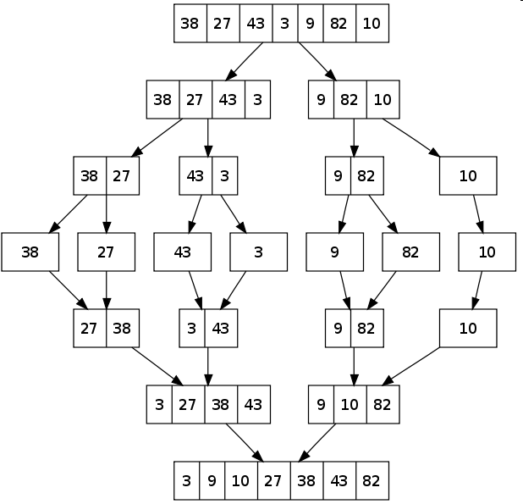
How many steps are needed to sort n numbers?
Algorithm 1 (Bubble Sort):
Every iteration moves the i-th smallest number to the i-th position
Algorithm 2 (Merge Sort):
Which algorithm runs faster?

Slide 26

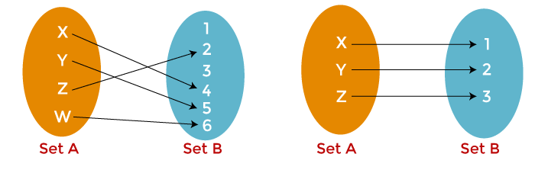
Topic 2: Number Theory
Cartesian Products and Ordered Pairs
Relations
Database, algorithms, data structures

Slide 27
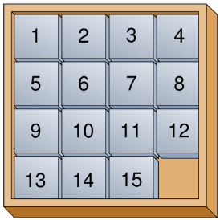
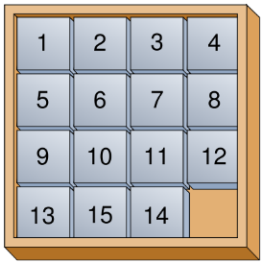
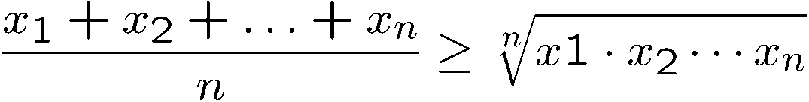
Topic 3: Logic and Proofs
How do computers think?
Logic: propositional logic
Truth Tables
Conditionals and Negation
Proofs: direct, by case, induction, contradiction
Artificial intelligence, database, circuit, algorithms

Slide 28
Topic 4: Graph Theory
Graphs
Applications of Graphs
Trees
Dijkstra’s Algorithm
Computer networks, circuit design, data structures

Slide 29
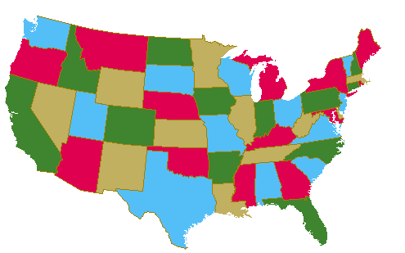
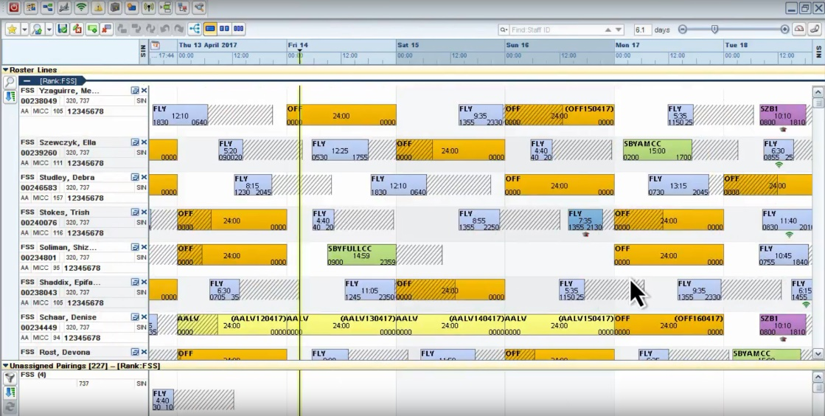
Topic 4: Graph Theory
How to color a map?
How to send data efficiently?
Crew Scheduling

Slide 30

Objectives of This Course
To learn mathematical concepts that are related to Computer Science
To be familiar with formal mathematical reasoning, e.g. logic, proofs
To improve problem solving skills
To see the connections between discrete mathematics and computer science

Slide 31

Thank you for your attention.

Slide 32
Course Books’ Links
chrome-extension://efaidnbmnnnibpcajpcglclefindmkaj/http://www.toomey.org/tutor/text_books/Digital_Logic/Discrete%20Mathematics%20with%20Applications%20-%20Susanna%20S.%20Epp%20(2019).pdf
chrome-extension://efaidnbmnnnibpcajpcglclefindmkaj/https://readyforai.com/download/discrete-mathematics-and-its-applications-8th-edition-pdf/?wpdmdl=1676&_wpdmkey=651a85506a31c
chrome-extension://efaidnbmnnnibpcajpcglclefindmkaj/https://faculty.ksu.edu.sa/sites/default/files/rosen_discrete_mathematics_and_its_applications_7th_edition.pdf

