Slide 1
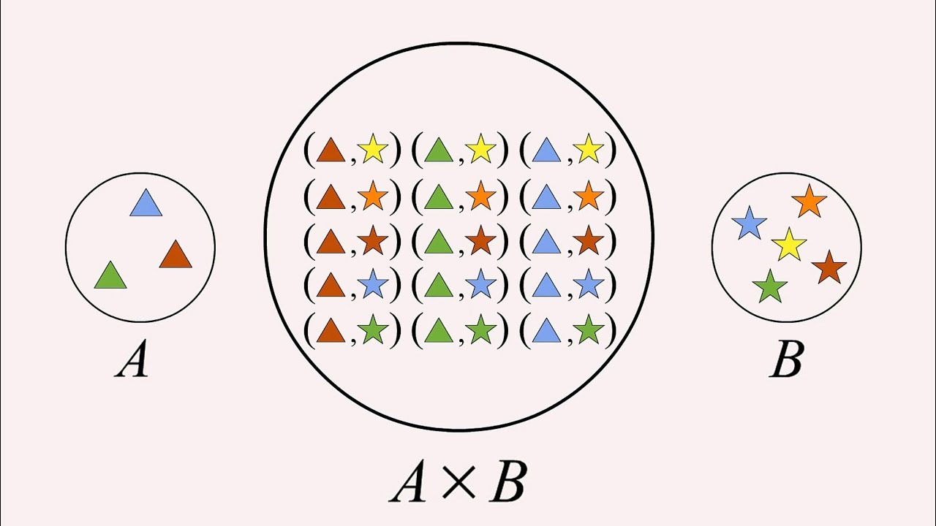
Lecture 3: Cartesian Products

Slide 2
Objectives:
Ordered Pairs
Cartesian Products/Cross Products
Cardinality
Quantifiers
Truth Sets

Slide 3
An ordered pair is a set of two numbers that identifies the location of a point on a coordinate plane.
An ordered pair $(a, b)$is a set:
$$\{\left\{a\right\}, \{a, b\}\}$$
You’ve seen ordered pairs before as graph coordinates:
$$\left(1, 2\right)=\{\left\{1\right\}, \{1, 2\}\}$$
$$≠$$
$$=$$
$$\left(2, 1\right)=\{\left\{2\right\},\{2, 1\}\}$$
$$∙$$
$$(1, 2)$$
$$(−2, 0)$$
$$∙$$
$$(2, 1)$$
$$\left(−2, 0\right)=\{\left\{−2\right\}, \{−2, 0\}\}$$
$$∙$$
not the same ordered pairs
Notes:
Given two points are different on the coordinate system, that is why their set notation should be different as well.

Slide 4
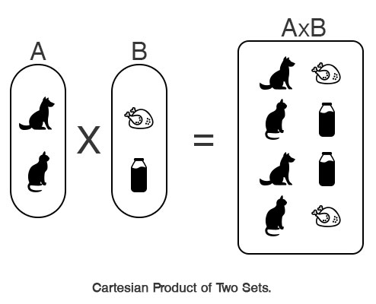
The Cartesian Product, $A×B,$is the set:
$$\left\{\left(a, b\right) \right| a∈A and b ∈B\}$$
Given $X=\{0,1,2\}$ and $Y=\{0,1\}$:
Also, it can be called Cross Product
$x$ | $y$
0 | 0
1 | 1
2
$$X×Y=\{\left(0, 0\right), \left(0,1\right), \left(1, 0\right), \left(1, 1\right), \left(2,0\right), (2,1)\}$$
$y$ | $x$
0 | 0
1 | 1
 | 2
$$Y×X=\{\left(0,0\right),\left(0,1\right),\left(0,2\right),\left(1,0\right),\left(1,1\right),\left(1,2\right)\}$$
Notes:
Cartesian Product/Cross Product

Slide 5
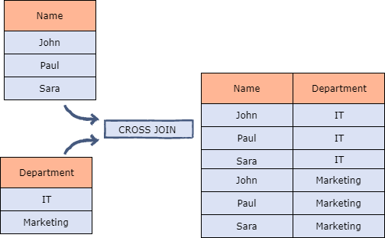
Cross join or Cartesian Join

Slide 6
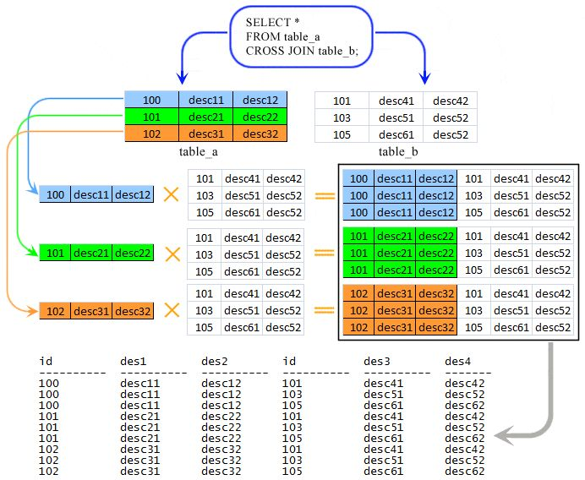
Usage in Database

Slide 9
What is the cardinality of $A×B?$
If $\left|A\right|=m$ and $\left|B\right|=n$ then
Cardinality – the number of elements in a set.
$$\left|A×B\right|=m∙n$$
$$\left|X\right|=3$$
$$A =$$
$$\left|Y\right|=2$$
$$\left|X×Y\right|=3∙2=6$$
$$T =$$
$$Cardinality=4 ∙5=20$$

Slide 10
Cartesian Products can generalize to n-tuples
3-tuple
$$A×B×C=\left\{\left(a, b, c\right)\right| a∈A, b∈B, c∈C\}$$
n-tuple
$$A_{1}×A_{2}×A_{3}×…×A_{n}=\left\{\left(a_{1}, a_{2}, a_{3}, …,a_{n}\right)\right| a_{1}∈A_{1}, a_{2}∈A_{2}, a_{3}∈A_{3}, …, a_{n}∈A_{n}\}$$

Slide 11
What is the Cartesian Product, $A×B×C,$where $A=\left\{0, 1\right\}, B=\left\{1, 2\right\},$ and $C=\{0, 1, 2\}$?
$$A$$ | $$B$$ | $$C$$
$$0$$ | $$1$$ | $$0$$
$$1$$ | $$2$$ | $$1$$
 |  | $$2$$
$$A×B×C=\left\{0, 1, 0\right\},\left\{0, 1, 1\right\},\left\{0, 1, 2\right\},\left\{0, 2, 0\right\},\left\{0, 2, 1\right\},\left\{0, 2, 2\right\},$$
$\left\{1, 1, 0\right\},\left\{1, 1, 1\right\},\left\{1, 1, 2\right\},\left\{1, 2, 0\right\},\left\{1, 2, 1\right\},\left\{1, 2, 2\right\}$
Find the Cartesian product of $C×A×B,$ $A^{2}$ and $A^{3}$.

Slide 12
Truth Sets
A truth set of P is the set of elements $x$ in D such that $P(x)$ is true.
a mathematical or logical set containing all the elements that make a given statement of relationships true when substituted in it the equation.
Notation: $\left\{x∈D\right|P(x)\}$
the equation x + 7 = 10 has as its truth set the single number 3
$$D=ℤ$$
$$P\left(x\right):\left|x\right|=3$$
$$\{−3, 3\}$$
absolute value

Slide 13
Quantifiers
Besides “for all” and “for every,” universal quantification can be expressed in many other ways, including “all of,” “for each,” “given any,” “for arbitrary,” “for each,” and “for any.”
universal
$∀xP\left(x\right):$ “For all $x$, $x$ is P”
for all $x$, P(x).
Besides the phrase “there exists,” we can also express existential quantification in many other ways, such as by using the words “for some,” “for at least one,” or “there is.”
existential
$∃xP\left(x\right):$ “For some $x$, $x$ is P”
there exists an $x$ for which P(x).
Quantifier Negation
$$¬∃xP\left(x\right)⟺∀x¬P\left(x\right);$$
$$¬∀xP(x))⟺∃x¬P(x).$$
All students in my class have not taken a course in programming.
There is a student in my class who hasn’t taken a course in programming.

Slide 14
We use this notation everywhere in mathematics
For every real number $n$, there is a real number $m$ such that $m^{2}=n$ .
$$∀n∈ℝ$$
$$∃m∈ℝ$$
$$:m^{2}=n$$
A conjunction implies that both statements are true, while disjunction implies that at least one statement is true. With a conjunction, statements are connected by the word "and" while with disjunction statements are connected by the word "or." The symbol for conjunction is ∧. The symbol for disjunction is ∨.
Given two rationales $x$ and $y$, $\sqrt{xy}$ will also be a rational.
$$\sqrt{xy}∈ℚ$$
$∀x, y∈ℚ$,
$$∀x∈ℚ, ∀y∈ℚ$$

Slide 15
Truth Sets
Notes:
Recall:
R – real numbers
Z – integers
N – natural numbers
W – whole numbers
Q – rational numbers

Slide 16
4) Let P(x) be the statement “$x =$ $x^{2}$.” If the domain consists of the integers, what are these truth values?
P(0)
P(1)
P(−1)
∃xP(x)
P(2)
∀xP(x)
1) Let P(x) denote the statement “x ≤ 4.” What are these truth values?
a) P(0)
b) P(4)
c) P(6)
2) Let P(x) be the statement “x spends more than five hours every weekday in class,” where the domain for x consists of all students. Express each of these quantifications in English.
∃xP(x)
∀xP(x)
5) Let N(x) be the statement “x has visited North Dakota,” where the domain consists of the students in your school. Express each of these quantifications in English.
∃xN(x)
∀xN(x)
3) Suppose the domain of the propositional function P(x, y) consists of pairs x and y, where x is 1, 2, or 3 and y is 1, 2, or 3. Write out these propositions using disjunctions and conjunctions.
a) ∃x P(x, 3)
b) ∀y P(1, y)
c) ∃y￢P(2, y)
d) ∀x ￢P(x, 2)
6) Let Q(x) be the statement “$x + 1 > 2x$.” If the domain consists of all integers, what are these truth values?
Q(0)
∃xQ(x)
Q(−1)
∀xQ(x)
Q(1)
Notes:
Answer Q3:
a) There exists an x such that $P(x,y)$holds when $y = 3.$
$P\left(1,3\right)∨P\left(2,3\right)∨P\left(3,3\right)$
b) For any value of y, $P(x,y)$ holds when $x = 1.$
$P(1, 1)∧P(1, 2)∧P(1, 3)$
c) $¬P\left(2, 1\right)∨¬P\left(2,2\right)∨¬P\left(2,3\right)$
d)$¬P(1, 2)∧¬P(2, 2)∧¬P(3, 2)$

Slide 17
Cartesian Products

Slide 18
Exercise
Let $A=\{a, b\}$ and $B=\{c, d\}$
$$A×B=$$
$$B^{2}=$$
$$∅×A=$$

Slide 19
Exercise
Let $A=\{a, b\}$ and $B=\{c, d\}$
$$A×B=\{\left(a, c\right),\left(a, d\right),\left(b, c\right),\left(b, d\right)\}$$
$$B^{2}=B×B=\{\left(c, c\right),\left(c, d\right),\left(d, c\right),\left(d, d\right)\}$$
$$∅×A= ∅$$
$$\left|∅×A\right|=|∅|∙\left|A\right|=0∙2=0$$

Slide 20
Exercise
If $\left|B\right|=m$ and $\left|A\right|=n$ then find:
$$\left|A×B\right|=$$
$|A^{2}|=$
$$\left|B^{32}×A^{19}\right|=$$

Slide 21
Answers
If $\left|B\right|=m$ and $\left|A\right|=n$ then find:
$$\left|A×B\right|=m∙n$$
$\left|A^{2}\right|=n∙n=n^{2}$
$$\left|B^{32}×A^{19}\right|=m^{32}n^{19}$$

Slide 22
Where do we use Cartesian Products in real life?

Slide 23
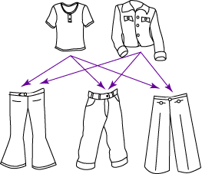
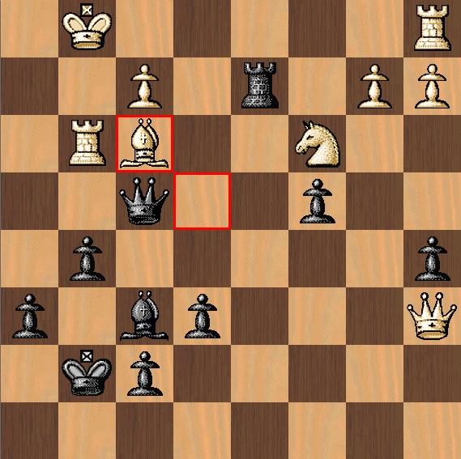
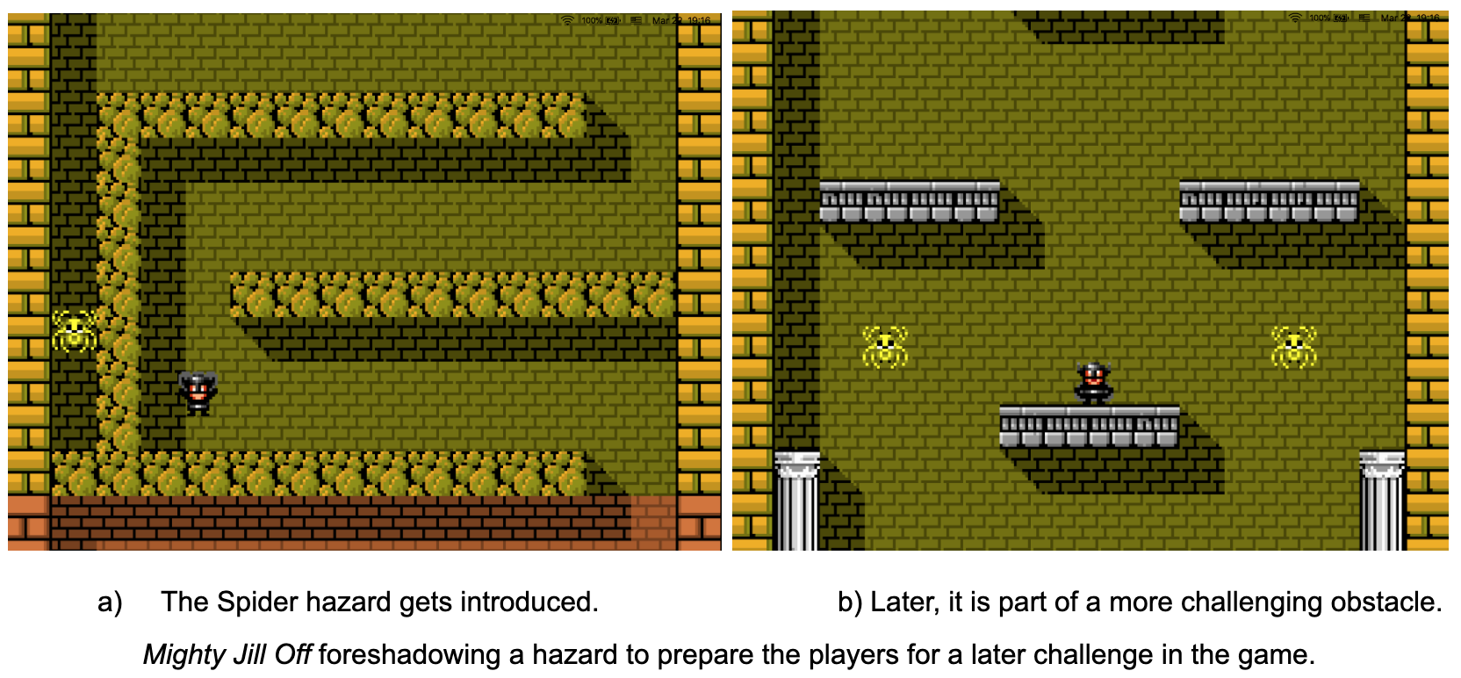
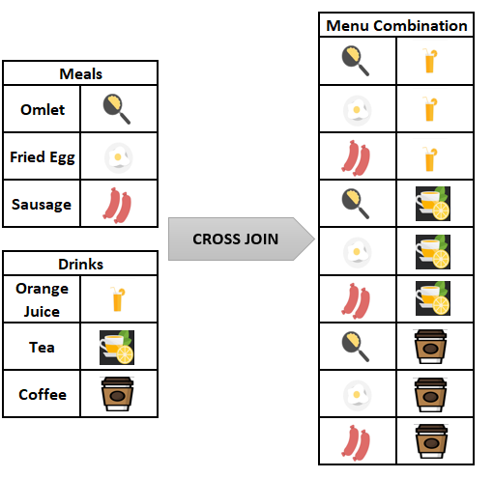

Slide 24
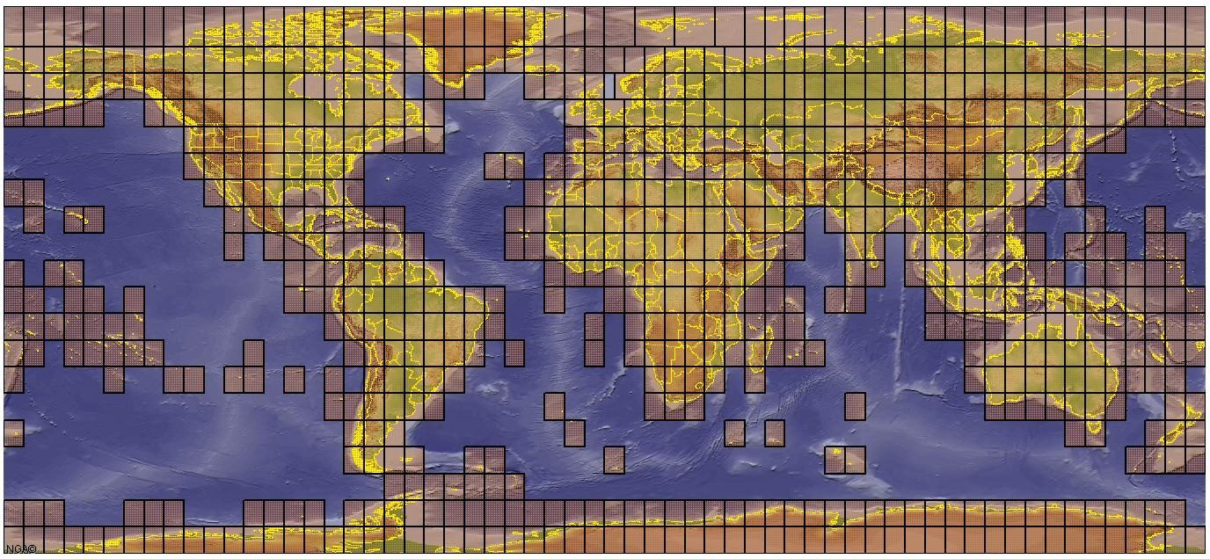
Notes:
Most computers display images as a raster of points called pixels that can be addressed by their coordinates.
These coordinates are ordered pairs and hence elements of a Cartesian Product.

Slide 25
Use Cartesian Product to create combinations from given sets for selling
Make & Model : Toyota Corolla, Honda CRV, Chevy Cruze
Colors : White, Grey, Red
Engine Capacities : 1.4L, 1.6L, 1.8L

