Slide 1
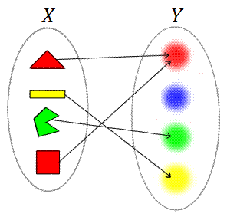
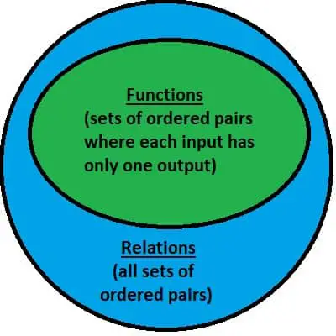
Lecture 4: Relations

Slide 2
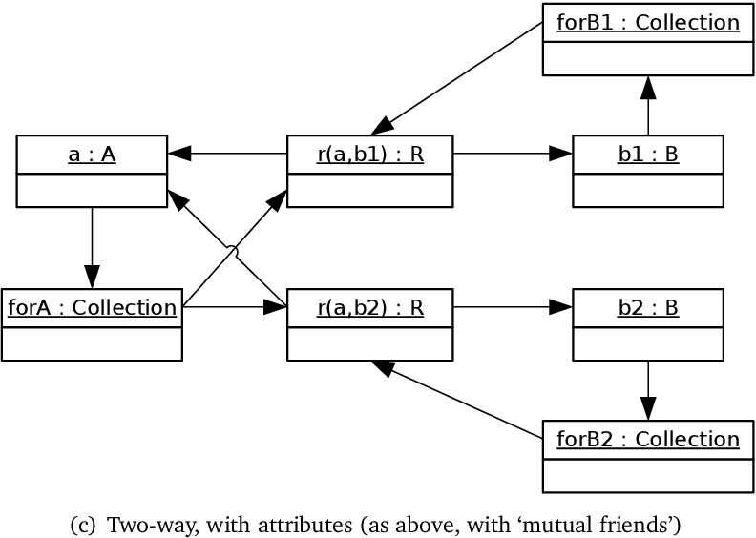
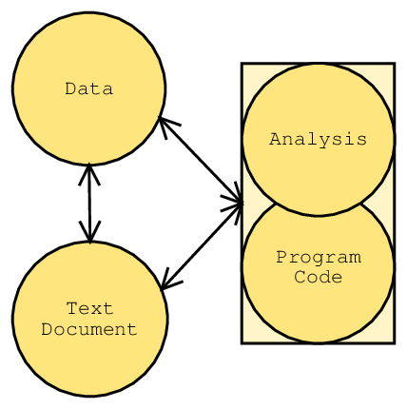
A relation is a mathematical tool for describing associations between elements of sets. Relations are widely used in computer science, especially in databases and scheduling applications. A relation can be defined across many items in many sets, but in this text, we will focus on binary relations, which represent an association between two items in one or two sets.

Slide 4
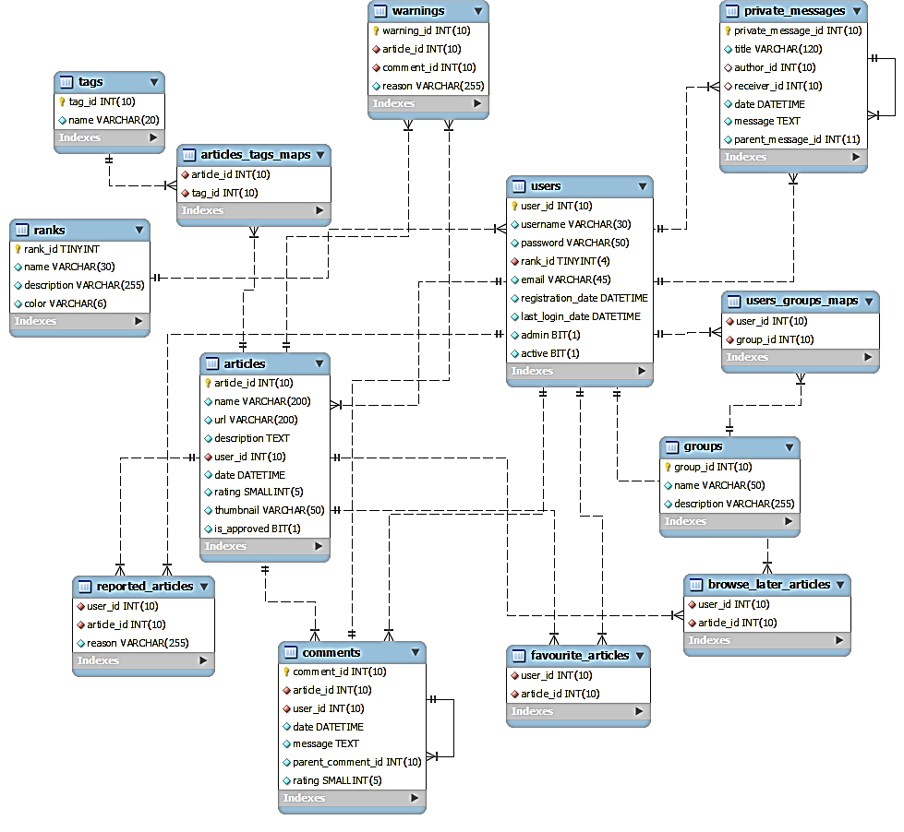
An Entity Relationship (ER) Diagram is a type of flowchart that illustrates how “entities” such as people, objects or concepts relate to each other within a system. ER Diagrams are most often used to design or debug relational databases in the fields of software engineering, business information systems, education and research.
Notes:
ER diagram: https://vertabelo.com/blog/how-to-use-er-diagram/

Slide 5
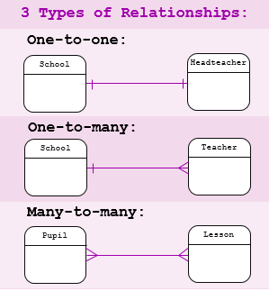
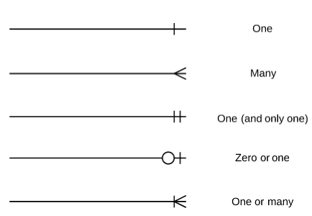
https://www.lucidchart.com/pages/er-diagrams

Slide 6
Definition 1:
Let A and B be sets. A binary relation from A to B is a subset of A × B.
When (a, b) belongs to R, a is said to be related to b by R.
a R b
(a, b) ∈ R
When a is not related to b:
a R b
(a, b) $∉$ R
Binary relations represent relationships between the elements of two sets.

Slide 7
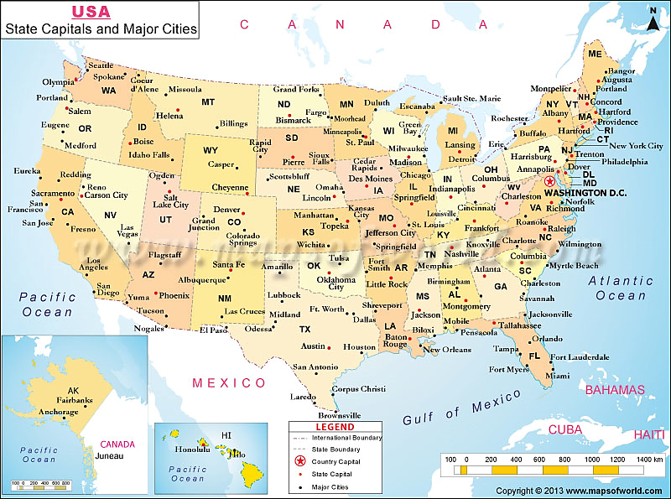
EXAMPLE 1
Let A be the set of cities in the U.S.A., and let B be the set of the 50 states in the U.S.A.
Define the relation R by specifying that (a, b) belongs to R if a city with name a is in the state b.
Boulder, Colorado
Bangor, Maine
Ann Arbor, Michigan
Middletown, New Jersey
Cupertino, California
Red Bank, New Jersey
are in R.

Slide 8
A relation can be used to express a one-to-many relationship between the elements of the sets A and B (as in Example 1), where an element of A may be related to more than one element of B. A function represents a relation where exactly one element of B is related to each element of A.
Notes:
Give examples also for one-to-one, many-to-many relationships from world map.
Ex.: country-capital, state-capital, ocean-states, ocean-cities, …

Slide 9
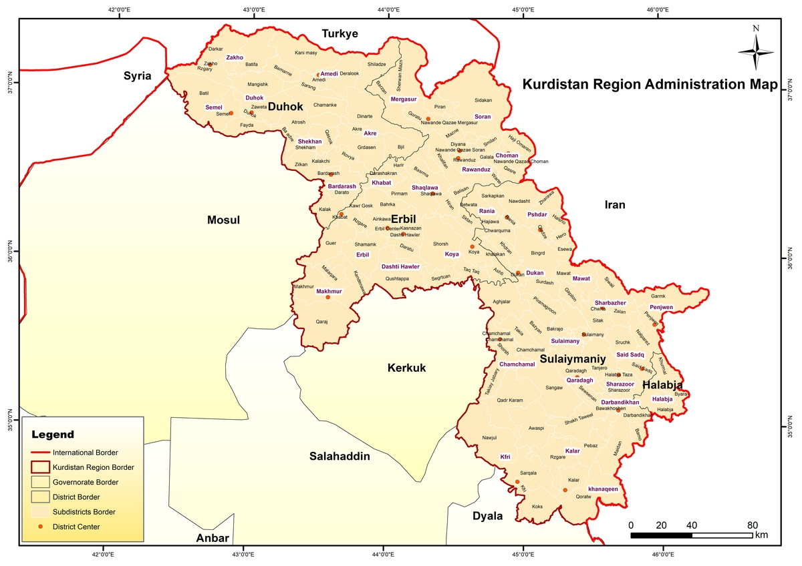
Define the relation R by specifying that (a, b) belongs to R if a city with name a is in the region b (Kurdistan).

Slide 10
EXAMPLE 2
Let A = {0, 1, 2} and B = {a, b}. Then {(0, a), (0, b), (1, a), (2, b)} is a relation from A to B.
Mapping representation
Tabular representation

Slide 11
EXAMPLE 3
Let A be the set of students in your university, and let B be the set of courses. Let R be the relation that consists of those pairs (a, b), where a is a student enrolled in course b.
Ahmed and Sara are enrolled in Programming 1 course. Then the pairs (Ahmed, Programming 1) and (Sara, Programming 1) belong to R.
If Ahmed is also enrolled in Physics 1, then the pair (Ahmed, Physics 1) is also in R. However, if Sara is not enrolled in Biology, then the pair (Sara, Biology) is not in R.

Slide 12
Relations
A relation $R$ on a set $X$ is a subset of $X×X$.
If $(a,b)∈R$, we write $xRy.$
“$x$ is related to $y$”.
$$R(x,y)$$
$$Rxy$$
(Predicate Logic)

Slide 13
$xGy:$ $x$ is greater than $y$. $(x,y)∈ℤ$
$(7, 5)$
$(6, 2)$
$(1, 9)$
$(4.3, 2)$

Slide 14
$xGy:$ $x$ is greater than $y$. $(x,y)∈ℤ$
$(7, 5)$
$$7G5$$
or
$$G(7, 5)$$
$(6, 2)$
$$6G2$$
$(1, 9)$
$$1G9$$
$(4.3, 2)$
$$G(4.3, 2)$$
Don’t make claim
not an $ℤ$

Slide 15
Given the relation:
$$\{\left(2, −6\right),\left(1, 4\right), \left(2, 4\right), \left(0, 0\right), \left(1, −6\right), (3, 0)\}$$
domain
$$:\{0, 1, 2, 3\}$$
$$\{\left(−4, 3\right),\left(−1, 2\right), \left(0, −4\right), \left(2, 3\right), \left(3, −3\right)\}$$
range
$$:\{−6, 0, 4\}$$
domain
$$:\{−4, −1, 0, 2, 3\}$$
range
$$:\{−4, −3, −2, 3\}$$

Slide 16
In Summary:
A relation is a set of pairs of input and output values.
There are four ways to represent relations:

Slide 17
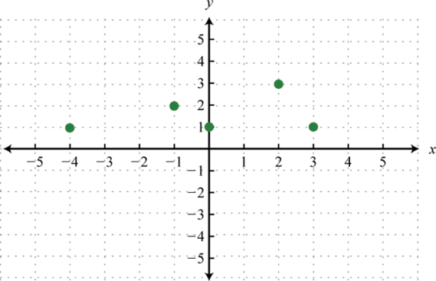
Given the relation:
$$\{\left(2, −3\right),\left(4, 6\right), \left(3, −1\right), \left(6, 6\right), \left(2, 3\right)\}$$
domain
$$:\{2, 3, 4, 6\}$$
domain
$$:\{−4, −1, 0, 2, 3\}$$
range
$$:\{−3, −1, 3, 6\}$$
range
$$:\{1, 2, 3\}$$

Slide 18
EXAMPLE 4
Let A be the set {1, 2, 3, 4}. Which ordered pairs are in the relation R = {(a, b) | a divides b}?
Solution: Because (a, b) is in R if and only if a and b are positive integers not exceeding 4 such that a divides b, we see that
R = {(1, 1), (1, 2), (1, 3), (1, 4), (2, 2), (2, 4), (3, 3), (4, 4)}.
$a$ divides $b$ $= a|b =a∙k=b$
Notes:
a divides b = a|b = a$∙$k = b

Slide 19
EXAMPLE 5
Consider these relations on the set of integers:
R1 = {(a, b) | a ≤ b},
R2 = {(a, b) | a > b},
R3 = {(a, b) | a = b or a = −b},
R4 = {(a, b) | a = b},
R5 = {(a, b) | a = b + 1},
R6 = {(a, b) | a + b ≤ 3}.
Which of these relations contain each of the pairs (1, 1), (1, 2), (2, 1), (1,−1), and (2, 2)?
Solution: The pair (1, 1) is in R1, R3, R4, and R6; (1, 2) is in R1 and R6; (2, 1) is in R2, R5,
and R6; (1,−1) is in R2, R3, and R6; and finally, (2, 2) is in R1, R3, and R4.

Slide 20
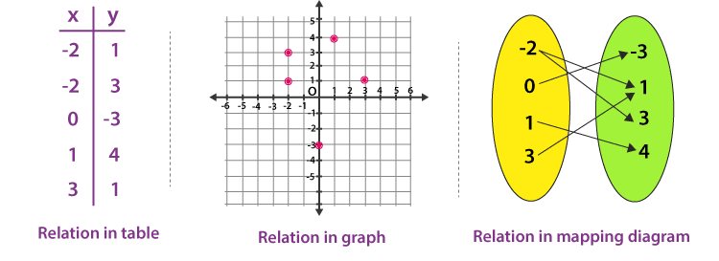
Relations as Functions
Relations are a generalization of graphs of functions;
The function f from A to B is the set of ordered pairs (a, f (a)) for a ∈ A

Slide 21
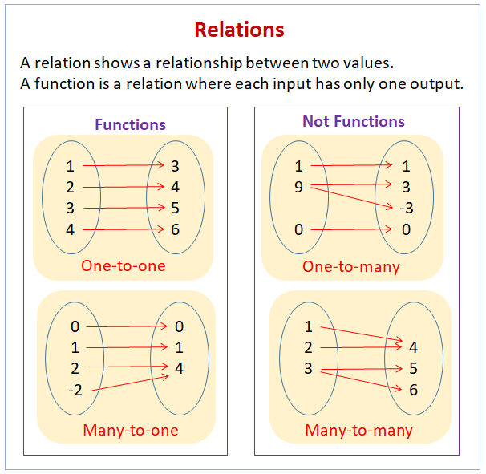

Slide 23
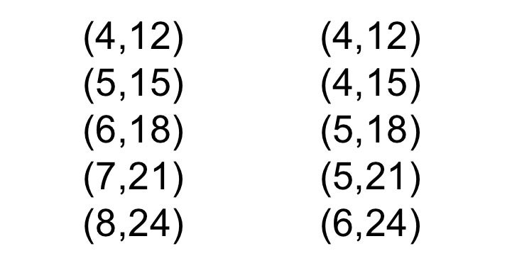
Define “Function” and “Not Function”:
Function
Not Function

Slide 24
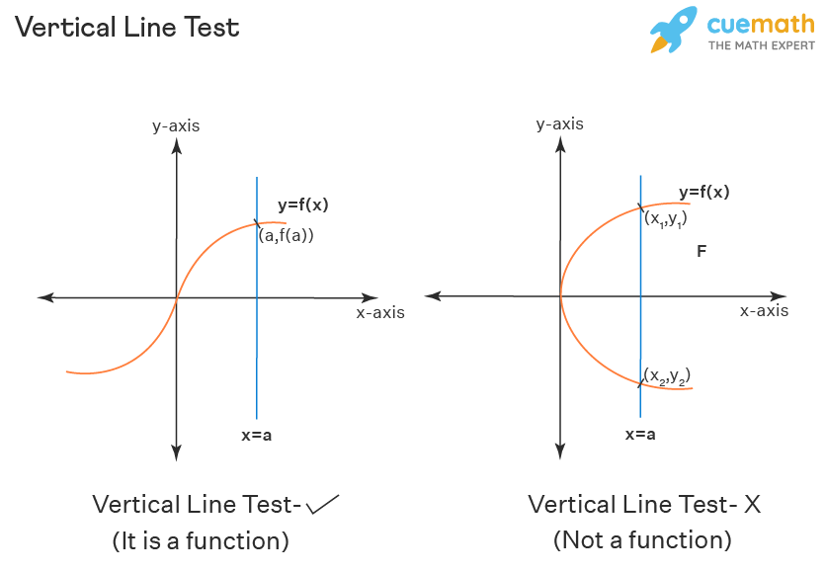
Use the vertical line test to determine whether or not a graph represents a function. If a vertical line is moved across the graph and, at any time, touches the graph at only one point, then the graph is a function. If the vertical line touches the graph at more than one point, then the graph is not a function.

Slide 26
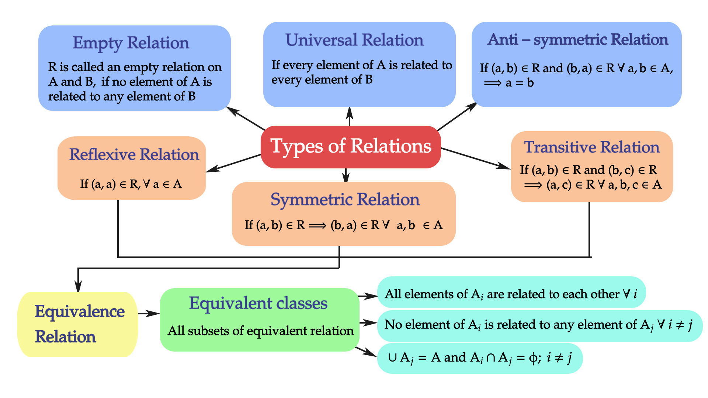

Slide 27
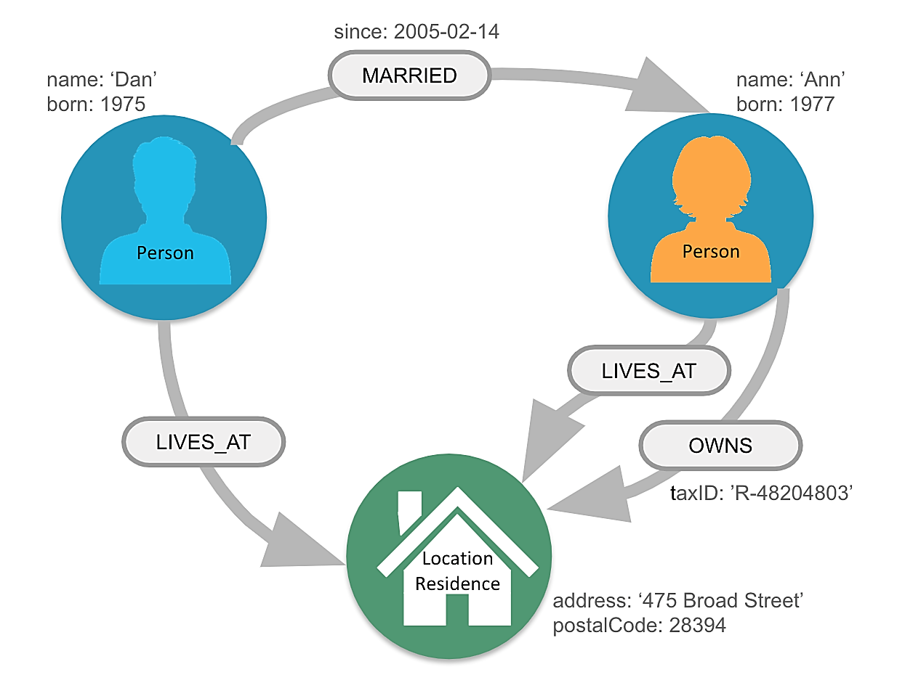
Properties of Relations
Reflexive
Symmetric
Antisymmetric
Transitive

Slide 28
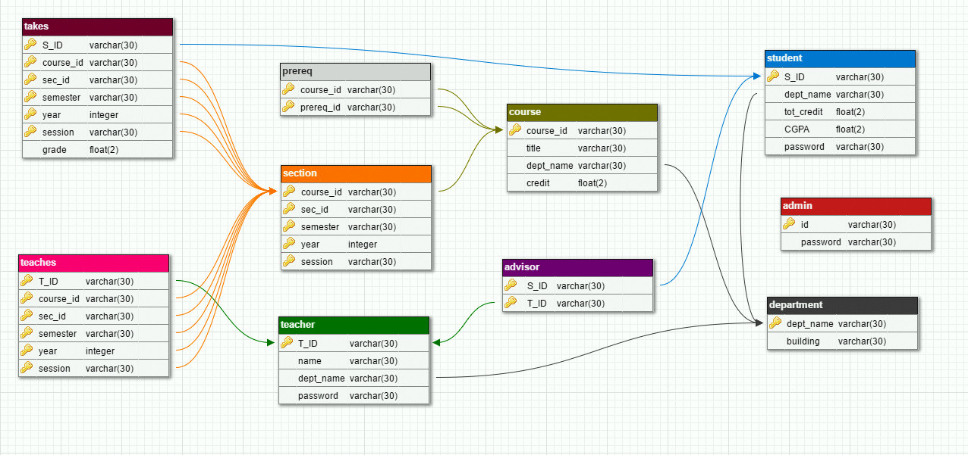
Advantages of relational databases:
Simple Model
Data Accuracy
Easy to access Data
Security
Collaborate
A system used to maintain relational databases is a relational database management system (RDBMS). Many relational database systems are equipped with the option of using the SQL (Structured Query Language) for querying and maintaining the database.

Slide 29
Properties of Relations: Reflexive

Slide 30
Properties of Relations
Reflexive
A relation R on a set A is called reflexive if (a, a) ∈ R for every element a ∈ A.
We see that a relation on A is reflexive if every element of A is related to itself.

Slide 31
A relation $R$ on a set $A$ is said to be reflexive if $∀ a∈A, \left(a, a\right)∈R.$
$$A=\{a, b, c\}$$
$$A×A$$
❌
$∅$
 | $$a$$ | $$b$$ | $$c$$
$$a$$ | $$aa$$ | $$ab$$ | $$ac$$
$$b$$ | $$ba$$ | $$bb$$ | $$bc$$
$$c$$ | $$ca$$ | $$cb$$ | $$cc$$
✔
$A×A$
✔
$\{\left(a, a\right), \left(b, b\right), (c, c)\}$
❌
$\{\left(a, b\right), \left(b, a\right), \left(a, a\right), (b,b)\}$
because there is no $(c, c)$
✔
$\{\left(a, a\right), \left(b, b\right), \left(c, c\right), \left(a, b\right), (b, c)\}$
❌
$\{\left(a, b\right), \left(b, c\right),(a, c)\}$

Slide 32
EXAMPLE 6
Answer:
Consider the following relations on {1, 2, 3, 4}: R1 = {(1, 1), (1, 2), (2, 1), (2, 2), (3, 4), (4, 1), (4, 4)}, R2 = {(1, 1), (1, 2), (2, 1)}, R3 = {(1, 1), (1, 2), (1, 4), (2, 1), (2, 2), (3, 3), (4, 1), (4, 4)}, R4 = {(2, 1), (3, 1), (3, 2), (4, 1), (4, 2), (4, 3)}, R5 = {(1, 1), (1, 2), (1, 3), (1, 4), (2, 2), (2, 3), (2, 4), (3, 3), (3, 4), (4, 4)}, R6 = {(3, 4)}.
Which of these relations are reflexive?
In reflexive relations there should be all pairs of the form (a, a), namely, (1, 1), (2, 2), (3, 3), and (4, 4).
Therefore, only the relations R3 and R5 are reflexive.

Slide 33
Back to EXAMPLE 5
Consider these relations on the set of integers:
R1 = {(a, b) | a ≤ b},
R2 = {(a, b) | a > b},
R3 = {(a, b) | a = b or a = −b},
R4 = {(a, b) | a = b},
R5 = {(a, b) | a = b + 1},
R6 = {(a, b) | a + b ≤ 3}.
Which of the relations are reflexive?
Answer: R1 (because a ≤ a for every integer a), R3, and R4.

Slide 34
Properties of Relations: Symmetric

Slide 35
A relation $R$ on a set $A$ is said to be symmetric if $∀ a, b∈A, \left(a, b\right)∈R, \left(b, a\right)∈R.$
$$∀a∀b((a, b) ∈ R → (b, a) ∈ R)$$
$$A=\{1, 2, 3\}$$
✔
$$A×A$$
$∅$
It is a possible subset of the cartesian product;
As there is no condition for $∅$, then it is symmetric.
✔
$A×A$
 | $$1$$ | $$2$$ | $$3$$
$$1$$ | $$11$$ | $$12$$ | $$13$$
$$2$$ | $$21$$ | $$22$$ | $$23$$
$$3$$ | $$31$$ | $$32$$ | $$33$$
✔
$\{\left(1, 1\right), \left(2, 2\right), (3, 3)\}$
✔
$\{\left(2, 1\right), \left(1, 2\right), (1, 1)\}$
❌
$\{\left(3, 1\right), \left(1, 3\right), \left(2, 3\right)\}$
❌
$\{\left(1, 2\right), \left(2, 3\right),(1, 3)\}$

Slide 36
Properties of Relations: Antisymmetric

Slide 37
Given a relation $R$ on a set $A$ we say that $R$ is antisymmetric if and only if:
$∀(a, b) ∈ R$where $a≠b$we must have $(b, a) ∉ R$.
(3, 1)
(7, 3)
(1, 7)
$∉$ $R_{1}$
$$R_{1}=\{\left(1, 3\right),\left(3, 7\right),(7, 1)\}$$
✔ antisymmetric
(7, 1)
(3, 7)
$∉$ $R_{1}$
✔ antisymmetric
$$R_{2}=\{\left(1, 7\right),\left(3, 3\right),(7, 3)\}$$
(1, 3)
(3, 1)
(7, 1)
$$R_{3}=\{\left(3, 1\right),\left(1, 3\right),(1, 7)\}$$
❌ not antisymmetric
Notes:
In $R_{2}$ we skip (3, 3) because according to the definition we are only interested in a$≠$b.

Slide 38
A relation $R$ on a set $A$ is said to be antisymmetric $∀ a, b∈A, \left(a, b\right)∈R, \left(b, a\right)∈R a=b.$
If you have $(a, b)$then you can never have $(b, a),$but $a=b$.
$$A=\{1, 2, 3\}$$
✔
It is a possible subset of the cartesian product;
As there is no condition for $∅$, then it is both
symmetric and antisymmetric.
 | $$1$$ | $$2$$ | $$3$$
$$1$$ | $$11$$ | $$12$$ | $$13$$
$$2$$ | $$21$$ | $$22$$ | $$23$$
$$3$$ | $$31$$ | $$32$$ | $$33$$
$∅$
❌
In antisymmetric, if you have (1, 3) then
you cannot have (3, 1).
$$A×A$$
$A×A$
✔
$\{\left(1, 1\right), \left(2, 2\right), (3, 3)\}$
✔
$\{\left(2, 1\right), \left(2, 3\right), (1, 1)\}$
Antisymmetric – means we cannot accept the values of the one side symmetric pair but diagonal.
❌
$\{\left(2, 3\right), \left(3, 2\right), \left(2, 2\right), (3, 3)\}$
✔
$\{\left(1, 1\right), \left(2, 2\right), \left(2, 3\right), (1, 3)\}$

Slide 39
Back to EXAMPLE 5
Answer:
Consider these relations on the set of integers:
R1 = {(a, b) | a ≤ b},
R2 = {(a, b) | a > b},
R3 = {(a, b) | a = b or a = −b},
R4 = {(a, b) | a = b},
R5 = {(a, b) | a = b + 1},
R6 = {(a, b) | a + b ≤ 3}.
The relations R3, R4, and R6 are symmetric.
R3 is symmetric, for if a = b or a = -b, then b = a or b = -a.
R4 is symmetric because a = b implies that b = a.
R6 is symmetric because a + b ≤ 3 implies that b + a ≤ 3.
The relations R1, R2, R4, and R5 are antisymmetric.
R1 is antisymmetric because the inequalities a ≤ b and b ≤ a imply that a = b.
Which of the relations are symmetric and
which are antisymmetric?
R2 is antisymmetric because it is impossible that a > b and b > a.
R4 is antisymmetric, because two elements are related with respect to R4 if and only if they are equal.
R5 is antisymmetric because it is impossible that a = b + 1
and b = a + 1.
Notes:
The relation “is less than or equal to”, denoted “≤”, is NOT an equivalence relation on the set of real numbers.
For any x, y, z ∈ R, “≤” is reflexive and transitive but NOT necessarily symmetric.
(Reflexivity) Of course x ≤ x is true since x = x.
(Symmetry) If x ≤ y then it is not necessarily true that y ≤ x. For example, 5 ≤ 7, but 7 ≰ 5.
(Transitivity) If x ≤ y and y ≤ z then x ≤ z since x ≤ y ≤ z.

Slide 40
Back to EXAMPLE 6
Answer:
Consider the following relations on {1, 2, 3, 4}: R1 = {(1, 1), (1, 2), (2, 1), (2, 2), (3, 4), (4, 1), (4, 4)}, R2 = {(1, 1), (1, 2), (2, 1)}, R3 = {(1, 1), (1, 2), (1, 4), (2, 1), (2, 2), (3, 3), (4, 1), (4, 4)}, R4 = {(2, 1), (3, 1), (3, 2), (4, 1), (4, 2), (4, 3)}, R5 = {(1, 1), (1, 2), (1, 3), (1, 4), (2, 2), (2, 3), (2, 4), (3, 3), (3, 4), (4, 4)}, R6 = {(3, 4)}.
Which of the relations are symmetric and which are antisymmetric?
The relations R2 and R3 are symmetric.
R4, R5, and R6 are all antisymmetric.

Slide 41
Properties of Relations: Transitive

Slide 42
A relation $R$ on a set $A$ is said to be transitive if $∀ a, b∈A, \left(a, b\right)∈R, \left(b, c\right)∈R then (a, c)∈R.$
$$A=\{1, 2, 3\}$$
✔
It is a possible subset of the cartesian product;
As there is no condition for $∅$, then it is
symmetric, antisymmetric, and transitive.
$∅$
$$A×A$$
✔
$A×A$
 | 1 | 2 | 3
1 | 11 | 12 | 13
2 | 21 | 22 | 23
3 | 31 | 32 | 33
✔
$\{\left(1, 1\right), \left(2, 2\right), (3, 3)\}$
✔
$\{\left(2, 3\right), \left(1, 2\right), (1, 3)\}$
✔
$\{\left(1, 2\right), \left(1, 3\right)\}$
there is no requirement to check transitivity,
so, the set automatically considered transitive.
✔
$\{\left(2, 3\right)\}$
❌
$\{\left(1, 2\right), \left(2, 1\right)\}$
$\left(1,1\right)and \left(2,2\right)$ also should belong to R.

Slide 43
Detailed information about TRANSITIVE RELATION, when there are more than 3 pairs:

Slide 44
Another Method to check for Transitivity

Slide 45
Conclusion
$∅$ - not reflexive, but symmetric, antisymmetric, transitive
A relation R on a set A is called reflexive if (a, a) ∈ R for every element a ∈ A.
= is reflexive (2=2)
That is, a relation is symmetric if and only if a is related to b implies that b is related to a.
A relation is antisymmetric if and only if there are no pairs of distinct elements a and b with a related to b and b related to a.
= is symmetric (x=2 implies 2=x)
≤ is antisymmetric (x≤y and y≤x implies x=y)
A relation $R$ on a set $A$ is said to be transitive if $∀ a, b∈A, \left(a, b\right)∈R, \left(b, c\right)∈R then (a, c)∈R.$
< is transitive (2<3 and 3<5 implies 2<5)

Slide 46
X = {a, b, c, d} and R = {(a, a),(a, b),(a, c),(d, b),(b, b),(c, d)}
Only antisymmetric
List Properties.
Let A = {0, 1, 2, 3} and R a relation over A:
R = {(0, 0),(0, 1),(0, 3),(1, 1),(1, 0),(2, 3),(3, 3)}
Only transitive
If R and S are reflexive, then R ∩ S is so. Explain why.
Prove.
If R and S are symmetric, then R ∩ S is so. Explain why.
$$R=\{\left(1,1\right), \left(1,2\right),\left(2,1\right),\left(2,2\right),\left(3,4\right),\left(4,1\right),(4,4)\}$$
❌
Transitive?
$$R=\{\left(2,1\right), \left(3,1\right),\left(3,2\right),\left(4,1\right),\left(4,2\right),\left(4,3\right)\}$$
Notes:
X: (not refl. since (c, c) $∉$ R, not symm. not trans. (a, c),(c, d) ∈ R but (a, d) $∉$ R.
Proof: R ∩ S is reflexive means that (a,a) ∈ R∩S for every element a of set A.
Since R and S are reflexive, then (a,a) ∈ R and (a,a) ∈S for every element of A.
Therefore (a,a) must be in their intersection.

Slide 47
For each of these relations on the set {1, 2, 3, 4}, decide whether it is reflexive, whether it is symmetric, whether it is antisymmetric, and whether it is transitive.
a) {(2, 2), (2, 3), (2, 4), (3, 2), (3, 3), (3, 4)} b) {(1, 1), (1, 2), (2, 1), (2, 2), (3, 3), (4, 4)} c) {(2, 4), (4, 2)} d) {(1, 2), (2, 3), (3, 4)} e) {(1, 1), (2, 2), (3, 3), (4, 4)} f ) {(1, 3), (1, 4), (2, 3), (2, 4), (3, 1), (3, 4)}
Notes:
Answers:
a) Transitive b) Reflexive, symmetric, transitive c) Symmetric d) Antisymmetric e) Reflexive, symmetric, antisymmetric, transitive f) None of these properties

Slide 48
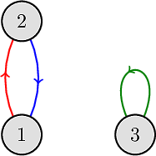
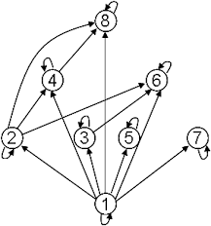
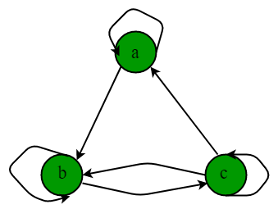
Directed Graphs or Digraphs

Slide 49
Reflexive
For any given item in the relation is going to be related to itself
$$x$$
$$∀x xRx$$
$$= 5∈X$$
$$R$$
$$\left(5, 5\right)∈R⟹5=5$$
Symmetric
$$R$$
$$x$$
$$y$$
$$≠$$
$$10≠11→11≠10$$
$$∀x∀y$$
$$xRy→yRx$$
$$R$$
$$xRy→yRx$$
Transitive
$$x$$
$$z$$
$$∀x∀y∀z$$
$$xRy ∧yRz →xRz$$
$$y$$
$$3<5 , 5<7 ⇒3<7$$
Notes:
These relations do not hold for everything. These are properties used to describe certain relationships.
They don’t enforce relationships. They simply describe them.

Slide 50
Equivalence Relation
A binary relation R on a set A is an equivalence relation if and only if (1) R is reflexive (2) R is symmetric, and (3) R is transitive.
$$→$$
$$a, aRa$$
$$→$$
$$a, b aRb→bRa$$
$$→$$
$$aRb∧bRc→aRc$$
Answer the Question:
Notes:
Definition(equivalence relation): A binary relation R on a set A is an equivalence relation if and only if (1) R is reflexive (2) R is symmetric, and (3) R is transitive.

Slide 51
The directed graph with vertices a, b, c, and d, and edges:
R = {(a, b), (a, d), (b, b), (b, d), (c, a), (c, b), (d, b)}

Slide 52
The directed graph of the relation on the set {1, 2, 3, 4}:
R =
{(1, 1),
(1, 3),
(2, 1),
(2, 3),
(2, 4),
(3, 1),
(3, 2),
(4, 1)}

Slide 53
What are the ordered pairs in the relation R represented by the directed graph below?
R = {(1, 3), (1, 4), (2, 1), (2, 2), (2, 3), (3, 1), (3, 3), (4, 1), (4, 3)}.

Slide 54
Determine whether the relations for the directed graphs shown below are reflexive, symmetric, antisymmetric, and/or transitive.
R is reflexive, neither symmetric nor antisymmetric and not transitive.
S is not reflexive, symmetric and not antisymmetric, not transitive.

Slide 55
Draw the directed graph that represents the relation {(a, a), (a, b), (b, c), (c, b), (c, d), (d, a), (d, b)}.
List the ordered pairs in the relations represented by the directed graphs.
Determine their types.

Slide 56
Combining Relations
Because relations from A to B are subsets of A × B, two relations from A to B can be combined in any way two sets can be combined.
EXAMPLE 17
Let A = {1, 2, 3} and B = {1, 2, 3, 4}. The relations R1 = {(1, 1), (2, 2), (3, 3)} and R2 = {(1, 1), (1, 2), (1, 3), (1, 4)} can be combined to obtain:
$R1 ∪ R2 = \{(1, 1), (1, 2), (1, 3), (1, 4), (2, 2), (3, 3)\},$
$R1 ∩ R2 = \left\{\left(1, 1\right)\right\},$
$R1 − R2 = \{(2, 2), (3, 3)\},$
$R2 − R1 = \{(1, 2), (1, 3), (1, 4)\}.$

Slide 57
Let R1 = {(1, 2), (2, 3), (3, 4)} and R2 = {(1, 1), (1, 2), (2, 1), (2, 2), (2, 3), (3, 1), (3, 2), (3, 3), (3, 4)} be relations from {1, 2, 3} to {1, 2, 3, 4}. Find:
a) R1 ∪ R2. b) R1 ∩ R2. c) R1 - R2. d) R2 - R1.

Slide 58
Databases and n-ary Relations

Slide 59
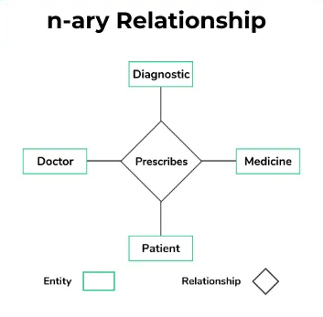
in DBMS
Let $A_{1}$,$A_{2}$, . . . , $A_{n}$ be sets. An n-ary relation on these sets is a subset of $A_{1}$ × $A_{2}$ × · · · × $A_{n}$ The sets $A_{1}$, $A_{2}$, . . . , $A_{n}$ are called the domains of the relation, and $n$ is called its degree.
Let R be the relation on N × N × N (set of natural numbers) consisting of triples (a, b, c), where a, b, and c are integers with a < b < c. Then (1, 2, 3), (0, 2, 3), (3, 4, 5), … ∈ R, but (2, 4, 3) $∉$ R.
The relation has degree 3
The domains of the relation are the set of natural numbers
Let R be the relation consisting of 5-tuples (A, N, S, D, T ) representing airplane flights, where A is the airline, N is the flight number, S is the starting point, D is the destination, and T is the departure time.

Slide 60
Student records are represented as 4-tuples of the form (Student_name, ID_number, Major, GPA).
A sample database of six such records is: (Ackermann, 231455, Computer Science, 3.88) (Adams, 888323, Physics, 3.45) (Chou, 102147, Computer Science, 3.49) (Goodfriend, 453876, Mathematics, 3.45) (Rao, 678543, Mathematics, 3.90) (Stevens, 786576, Psychology, 2.99)

Slide 61
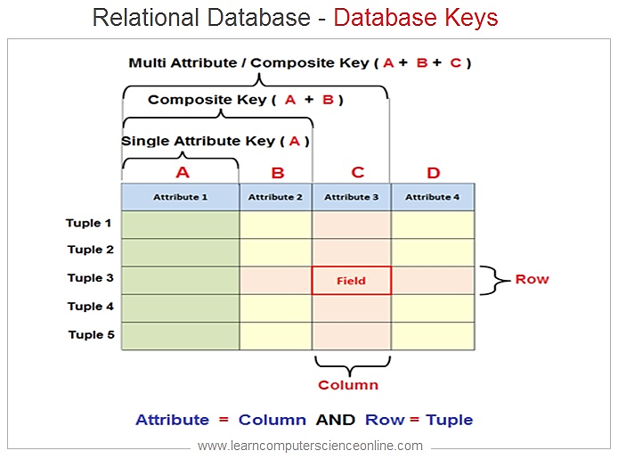
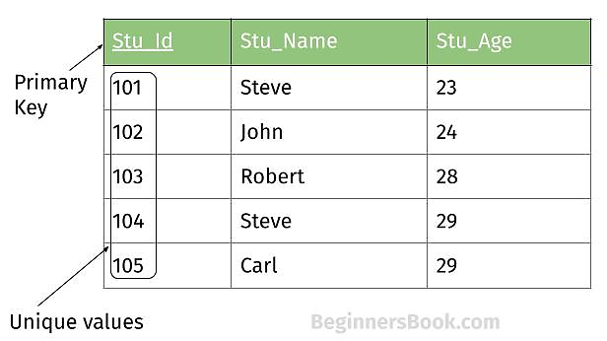
A database consists of records, which are n-tuples, made up of fields.
Relations used to represent databases are also called tables, because these relations are often displayed as tables.
Each column of the table corresponds to an attribute of the database. In Table 1, the attributes of this database are Student Name, ID Number, Major, and GPA.
A domain of an n-ary relation is called a primary key.
In Table 1, there is only one 4-tuple in this table for each student name, the domain of student names is a primary key. Similarly, the ID numbers in this table are unique, so the domain of ID numbers is also a primary key. However, the domain of major fields of study is not a primary key, because more than one 4-tuple contains the same major field of study. The domain of grade point averages is also not a primary key, because there are two 4-tuples containing the same GPA.
The Cartesian product of these domains is called a composite key.
Notes:
https://www.learncomputerscienceonline.com/database-keys/

Slide 62
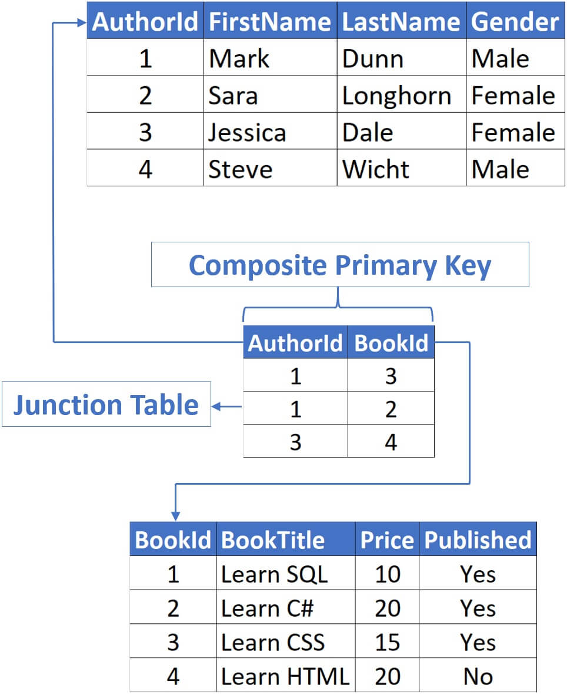
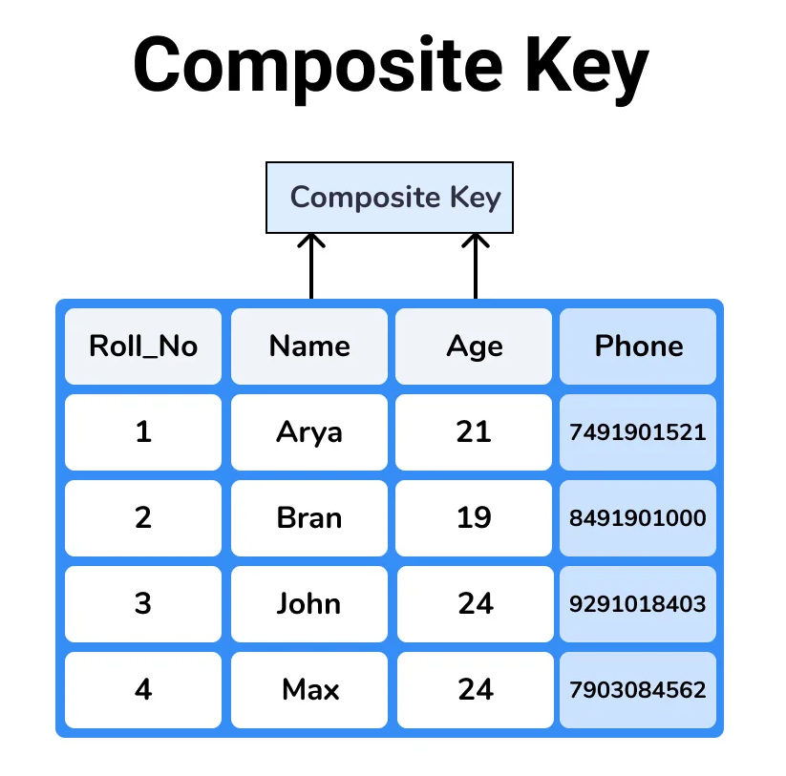
A composite key in SQL can be defined as a combination of multiple columns, and these columns are used to identify all the rows that are involved uniquely.
Note: Any key such as super key, primary key, candidate key, etc. can be called composite key if it has more than one attributes.
Notes:
If a single column alone fails to be served as a primary key, then combination columns would help to uniquely access a record from table such type of keys or nothing but composite keys.

Slide 63
The 3-tuples in a 3-ary relation represent the following attributes of a student database: student ID number, name, phone number.
a) Is student ID number likely to be a primary key? b) Is name likely to be a primary key? c) Is phone number likely to be a primary key?

Slide 64
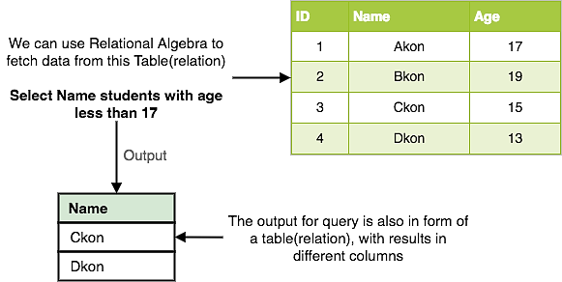
Let R be an n-ary relation and C a condition that elements in R may satisfy. Then the selection operator ($S_{c}$) maps the n-ary relation R to the n-ary relation of all n-tuples from R that satisfy the condition C.
To find the records of computer science majors in the n-ary relation R shown in Table 1, we use the operator $S_{C_{1}}$, where C1 is the condition Major = “Computer Science.”
Similarly, to find the records of students who have a grade point average above 3.5 in this database, we use the operator $S_{C_{2}}$, where C2 is the condition GPA > 3.5.
Finally, to find the records of computer science majors who have a GPA above 3.5, we use the operator $S_{C_{3}}$, where C3 is the condition (Major= “Computer Science” ∧ GPA > 3.5).
The result is the two 4-tuples (Ackermann, 231455, Computer Science, 3.88) and (Chou, 102147, Computer Science, 3.49).
The result is the two 4-tuples (Ackermann, 231455, Computer Science, 3.88) and (Rao, 678543, Mathematics, 3.90).
The result consists of the single 4-tuple (Ackermann, 231455, Computer Science, 3.88).

Slide 65
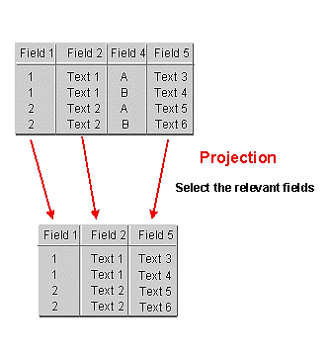
Projections are used to form new n-ary relations by deleting the same fields in every record of the relation.
The projection $P_{i_{1}i_{2}…,i_{m}}$where $i_{1}<i_{2}<…<i_{m}$, maps the n-tuple ($a_{1}, a_{2}, …,a_{n}$) to the m-tuple ($a_{i_{1}},a_{i_{2}}, …,a_{i_{m}}$), where $m ≤ n$.
In other words, the projection Pi1,i2,...,im deletes n - m of the components of an n-tuple, leaving the i1th, i2th, . . . , and imth components.
For instance:
What results when the projection P1,3 is applied to the 4-tuples (2, 3, 0, 4), (Jane Doe, 234111001, Geography, 3.14), and (a1, a2, a3, a4)?
The projection P1,3 sends these 4-tuples to (2, 0), (Jane Doe, Geography), and (a1, a3), respectively.

Slide 66
What relation results when the projection P1,4 is applied to the relation in Table 1?
When the projection P1,4 is used, the second and third columns of the table are deleted.

Slide 67
What is the table obtained when the projection P1,2 is applied to the relation in Table 3?

Slide 68
The join operation is used to combine two tables into one when these tables share some identical fields.
What relation results when the join operator J2 is used to combine the relation displayed in Tables 5 and 6?
Notes:
In other words, the join operator Jp produces a new relation from two relations by combining all
m-tuples of the first relation with all n-tuples of the second relation, where the last p components
of the m-tuples agree with the first p components of the n-tuples.
There are other operators besides projections and joins that produce new relations from existing relations. A description of these operations can be found in books on database theory.

Slide 69
SQL
SELECT Departure_time FROM Flights WHERE Destination=’Detroit’
Output: 08:10, 08:47, 09:44
SELECT Professor, Time FROM Teaching_assignments, Class_schedule WHERE Department=’Mathematics’
Output: Rosen, 3:00 p.m.

Slide 70
What do you obtain when you apply the selection operator sC, where C is the condition (Project = 2) ∧ (Quantity ≥ 50), to the database in Table 10?
What are the operations that correspond to the query expressed using this SQL statement?
a) SELECT Supplier FROM Part_needs WHERE 1000 ≤ Part_number ≤ 5000 b) SELECT Supplier, Project FROM Part_needs, Parts_inventory WHERE Quantity ≤ 10
Construct the table obtained by applying the join operator J2 to the relations in Tables 9 and 10.
Notes:
b) $J_{2}$ followed by $P_{1, 3}$

Slide 71
Representing Relations Using Matrices

Slide 72
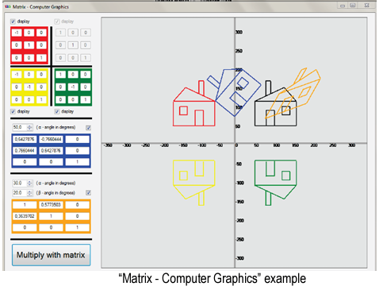
$$1 if \left(a_{i}, b_{j}\right)∈R,$$
$$m_{ij}=$$
$$0 if \left(a_{i}, b_{j}\right)∉R.$$
Suppose that A = {1, 2, 3} and B = {1, 2}. Let R be the relation from A to B containing (a, b) if a ∈ A, b ∈ B, and a > b. What is the matrix representing R if a1 = 1, a2 = 2, and a3 = 3, and b1 = 1 and b2 = 2?
Because R = {(2, 1), (3, 1), (3, 2)}, the matrix for R is
$$M_{R}=\left[\begin{matrix}0 & 0 \\ 1 & 0 \\ 1 & 1\end{matrix}\right]$$

Slide 73
Let A = {a1, a2, a3} and B = {b1, b2, b3, b4, b5}. Which ordered pairs are in the relation R represented by the matrix
$M_{R}=\left[\begin{matrix}0 & 1 & 0 & 0 & 0 \\ 1 & 0 & 1 & 1 & 0 \\ 1 & 0 & 1 & 0 & 1\end{matrix}\right]$?
R = {(a1, b2), (a2, b1), (a2, b3), (a2, b4), (a3, b1), (a3, b3), (a3, b5)}.

Slide 74
List the ordered pairs in the relations on {1, 2, 3} corresponding to these matrices (where the rows and columns correspond to the integers listed in increasing order).
Determine their types.

Slide 75
Examples for matrices:
In true matrix style, we call the existence of a road link 1 and lack of a road link, a 0: Is there a link from Pink city to Blue city? yes. Pink to Pink? nonsensical, so 0. Pink to Green? 0. Green to Blue? 1. Giving us a matrix:

Slide 76
We could also imagine that there are more than one roads going from one town to the other. For instance, see if you can write a matrix for this network:
The arrow from P to B means you can go to from P to B, but not from B to P. Two arrows on the same line mean the road is two-way:

Slide 77
The next important use is that combining matrices can provide more information about the problem, than using each matrix alone. For instance, if we consider our first town routes representing train lines, (the golden-yellow matrix), and the city decided to add new bus lines (the sky-blue matrix) then combining these two we will have more information about how to move around these towns. Representing this new, more complex network as a matrix is as simple as multiplying the orange matrix to the blue one.

Slide 78
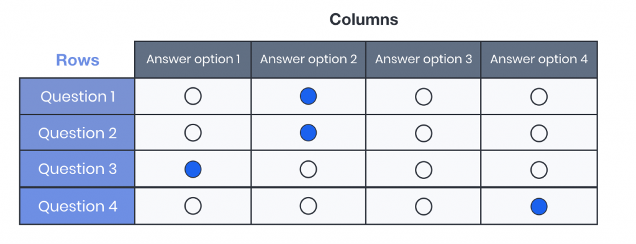
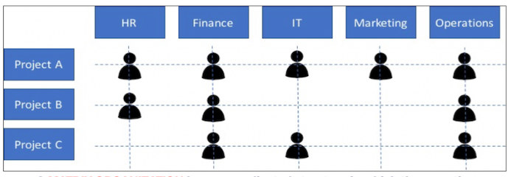
Another example of matrices for calculating scores of millions of students at once.
Matrix management structures in organizations
Notes:
Computer can easily calculate total score of millions of students at once.

Slide 79
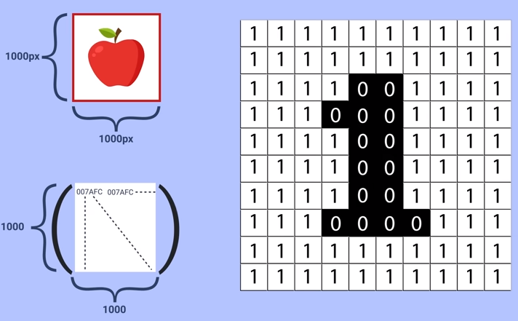

Slide 80
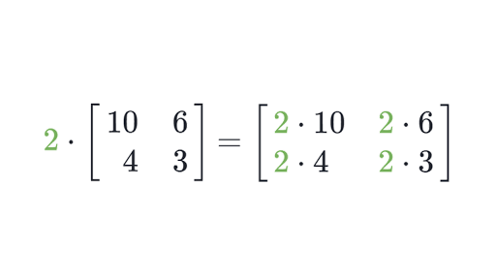
Scalar multiplication
Matrix Multiplication

Slide 81
Reference
Discrete Mathematics and Its Applications, 7th edition by Kenneth H. Rosen
Chapter 9: Relations, pages 573-597

Slide 82
What is the binary relation type of a set: {(1,1), (2,1), (2,2), (2,3), (2,4), (3,1), (3,2)}?
Let R1 be a relation from A = {1, 3, 5, 7} to B = {2, 4, 6, 8} and R2 be another relation from B to C = {1, 2, 3, 4} as defined below:
a) An element x in A is related to an element y in B (under R1) if x + y is divisible by 3.
b) An element x in B is related to an element y in C (under R2) if x + y is even but not divisible by 3.
List ordered pairs of R1 and R2, find their types of relations.
Let $R_{1}$, $R_{2}$ are relation defined on Z such that $aR_{1}b⇔(a−b)$ is divisible by $3$ and $aR_{2}b⇔(a−b)$ is divisible by $4$. Then what are: $(R_{1}∪R_{2})$, $\left(R_{1}∩R_{2}\right)$ and $(R_{2}−R_{1})$?
What is the Cartesian product of A = {1, 2} and B = {a, b}?

Slide 83
What is the Cardinality of the set {0, 1, 2}?
The Cartesian Product B x A is equal to the Cartesian product A x B.
True
False
Which of the following two sets are equal?
A = {1, 2} and B = {1}
A = {1, 2} and B = {1, 2, 3}
A = {1, 2, 3} and B = {2, 1, 3}
A = {1, 2, 4} and B = {1, 2, 3}
The members of the set S = {x | x is the square of an integer and x < 100} is ________________
{0, 2, 4, 5, 9, 58, 49, 56, 99, 12}
{0, 1, 4, 9, 16, 25, 36, 49, 64, 81}
{1, 4, 9, 16, 25, 36, 64, 81, 85, 99}
{0, 1, 4, 9, 16, 25, 36, 49, 64, 121}

Slide 84
$N=\{0, 1, 2, 3, …\}$ and $Z=\{…, −2, −1, 0, 1, 2, …\}$
Let R be the relation on $N×Z×N×Z$ consisting of 4-tuples $(a, b, c, d)$ such that $(a+b≠c+d)⋀(a+b+c+d=0)$. Give examples for this relation and find its degree.
The relation has degree 4
$$\left(5 −11, 3, 3\right)∈R$$
$$\left(0, −1, 1, 0\right)∈R$$
$$\left(6, 6, 3, 9\right)∉R$$
Let A={1,4,5} and R be given by the digraph shown below. Find the relation determined by the following digraph:
Let A={1,2,3,4} and R={(1,1), (1,2),(2,1),(2,2),(2,3), (2,4),(3,4),(4,1)} is a relation on A. Draw the digraph of R.
Determine types of all these relations.

Slide 85
Determine their types.

Slide 86
State whether each set of ordered pairs represents a function.
State whether each set of ordered pairs on the graph represents a function.

