Slide 1
Lecture 5: Proofs

Slide 2
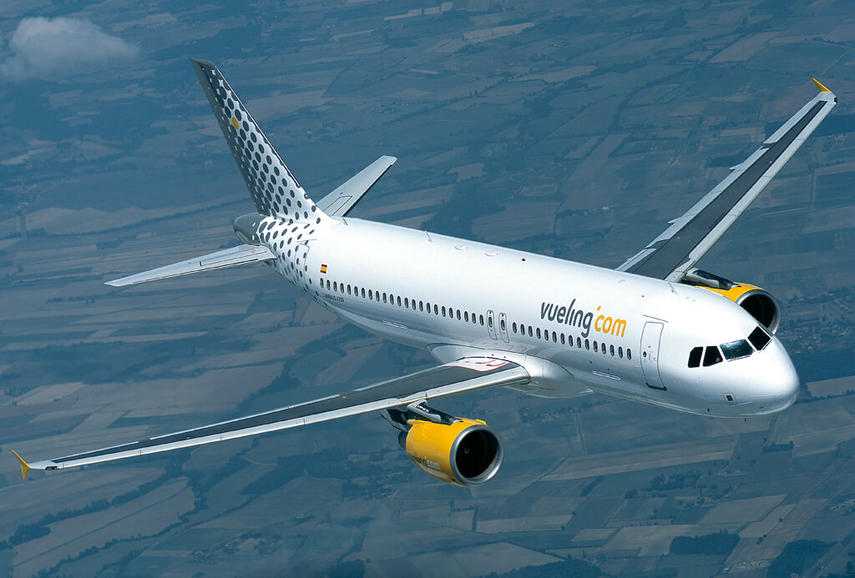
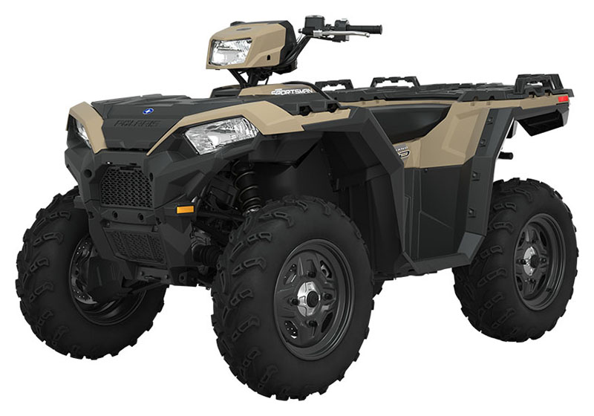
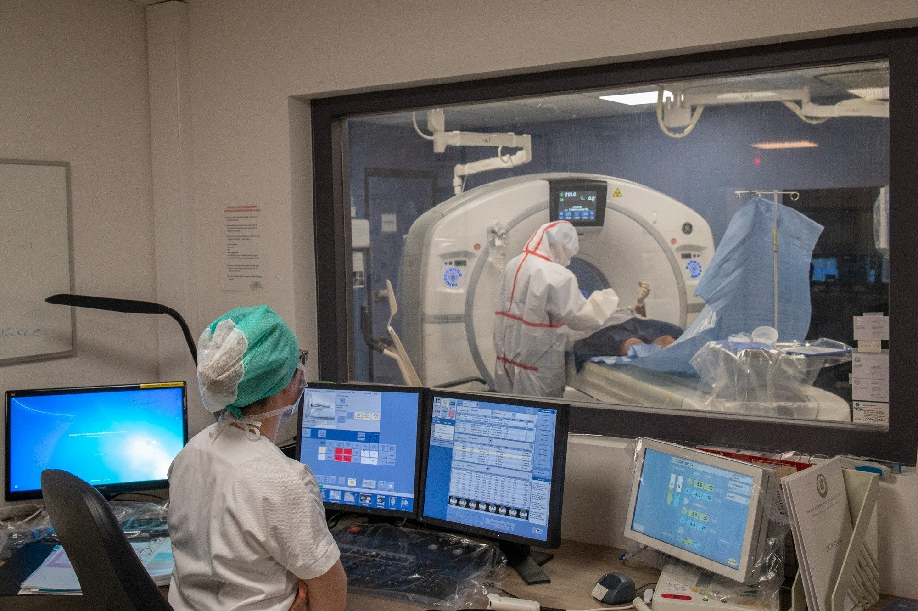
Why Study Proofs?
Computing systems are doing so much:
How can we guarantee they work?
Many advanced topics in computer science, such as cryptography, artificial intelligence, and formal verification, heavily rely on proofs. Understanding proofs lays a solid foundation for comprehending and working with these complex topics.
Notes:
A bunch of programming classes on edX and Coursera, especially algorithms & automata (robot) focus very heavily on going through proofs.
The proofs explain why the algorithms work. If you need to modify these algorithms, you'd better know how they work.
Such an understanding is very useful even just for coding algorithms, and certainly for debugging them.

Slide 3
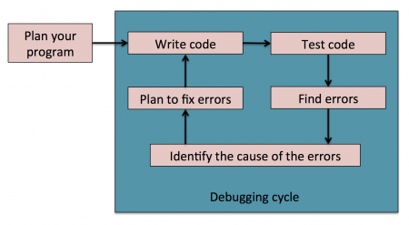
Why Study Proofs?
Why not just testing?
Integrates well with programming
No new languages, tools required
Conclusive evidence for bugs
Because…
Difficult to assess coverage
Cannot demonstrate absence of bugs
No guarantees for safety-critical systems
Formal Verification
1. SOFTWARE
If you want to debug a program beyond a doubt, prove that it’s bug-free! Deduction and proof provides universal guarantees.
2. HARDWARE
Proof-theory has recently also been shown to be useful in discovering bugs in pre-production hardware.
https://cse.buffalo.edu/~erdem/cse331/support/proofs/index.html
Notes:
Formal verification is the process of mathematically checking that the behavior of a system,
described using a formal model, satisfies a given property.
Formal verification helps confirm that your embedded system software models and code behave correctly.
In the context of hardware and software systems, formal verification is the act of proving or disproving
the correctness of intended algorithms underlying a system with respect to a certain formal specification or property,
using formal methods of mathematics.

Slide 4
With the ever-increasing complexity of software and the layers of abstraction, we have reached a time when writing secure, efficient and resilient code requires some level of formal verification to be done, if not for the whole software at least for the important sub-systems involved. In recent times we have seen more widespread adoption of formal verification by the industry leaders like Intel, Amazon or Microsoft, in products where we have enormous complexity and multiple systems interacting with one another.
https://www.moritz.systems/blog/an-introduction-to-formal-verification/

Slide 5
Objectives
Direct Proof
Proof by Case
Proof by Induction
Proof by Contradiction

Slide 6
Terminology
Definition: Something given (no proof)
E.g. Let $M=\left[\begin{matrix}1 & 2 \\ 3 & 4\end{matrix}\right]$
Theorem: Something to be proved
Results corollary (sub-proofs): any number divisible by 2 is even.

Slide 7
Direct Proof.
If $φ$, then $φ$.
Assume $φ.$
Show that $φ.$
Prove:
If $x$ is odd, then $x^{2}$is odd.
Assume $x$ is odd.
Odd number: $x=2n+1$
$$x^{2}=(2n+1)^{2}$$
$$=4n^{2}+4n+1$$
$$=2(2n^{2}+2n)+1$$
$$k$$

Slide 8
Direct Proof.
Prove:
If $x,y$ are odd, then $xy$is odd.
$$x=2k+1$$
$$y=2j+1$$
$$xy=(2k+1)(2j+1)$$
$$=4kj+2k+2j+1$$
odd
$$=2(2kj+k+j)+1$$

Slide 9
Direct Proof.
Prove:
If $5|2a$ for $a∈ℤ$, then $5|a$.
Assume $5|2a$ , $⩝a∈ℤ$.
$5j=2a$ some $j∈ℤ\text{.}$
odd
even
$$5(2k)=2a$$
even $j=2k$ for some $k∈ℤ$
$$5k=a$$
$$5|a$$
Notes:
x (an integer) divides y (an integer) means that there exists a positive integer, say q such that y=q $∙$ x (e.g. 4 divides 12 with q=3).

Slide 10
Direct Proof.
Prove:
If $7|4a$ for $a∈ℤ$, then $7|a$.
Every odd integer is a difference of two squares. $(13=7^{2}−6^{2})$

Slide 11
Direct Proof.
Every odd integer is a difference of two squares. $(13=7^{2}−6^{2})$
$$1=1^{2}−0^{2}$$
$$2\left(0\right)+1=1^{2}−0^{2}$$
trial-and-error method
$$3=2^{2}−1^{2}$$
$$2\left(1\right)+1=2^{2}−1^{2}$$
Trial and error is a fundamental method of problem-solving. It is characterized by repeated, varied attempts which are continued until success, or until the practicer stops trying.
$$5=3^{2}−2^{2}$$
$$2\left(2\right)+1=3^{2}−2^{2}$$
$$2k+1=(k+1)^{2}−k^{2}$$
E.g. $2\left(69\right)+1=139={70}^{2}−{69}^{2}$
$$=k^{2}+2k+1−k^{2}$$
$$=2k+1$$
Notes:
Solve by trial-and-error method

Slide 12
Direct Proof.
if $m$ and $n$ are both perfect squares, then nm is also a perfect square.
An integer that can be expressed as the square of another integer is called a perfect square.
$m=s^{2}$
$$n=t^{2}$$
$$m∙n=s^{2}∙t^{2}=s∙s∙t∙t=s∙t∙s∙t=(st)^{2}$$

Slide 13
Direct Proof.
$$\frac{x+y}{2}≥\sqrt{xy}$$
This is called the Arithmetic-Geometric Mean Inequality.
Prove that if $x$ and $y$ are nonnegative real numbers, then:
$$\frac{x+y}{2}≥\sqrt{xy}$$
$${\left(\frac{x+y}{2}\right)}^{2}≥{\left(\sqrt{xy}\right)}^{2}$$
$$\frac{x^{2}+2xy+y^{2}}{4}≥xy$$
$$x^{2}+2xy+y^{2}≥4xy$$
$$x^{2}+2xy+y^{2}−4xy≥0$$
$$x^{2}−2xy+y^{2}≥0$$
$${(x−y)}^{2}≥0$$

Slide 14
Direct Proof.
Use a direct proof to show that the sum of two odd integers is even.
Prove that if n and m are positive, even integers, then nm is divisible by 4.
A perfect number is a positive integer n such that the sum of the factors of n is equal to 2n (1 and n are considered factors of n). So, 6 is a perfect number since 1 +2+3+6 = 12 = 2∗6. Prove that a prime number cannot be a perfect number.
For any prime number P, its divisors are P and 1. The sum of these divisors is (P+1), which is always less than 2P.
If $x$ and $y$ are integers and $x^{2}+y^{2}$ is even, prove that $x+y$ is even.
Notes:
1. $(2n+1)+(2n+1)=4n+2=2(2n+1) ⇒ even$
2. (Another definition for perfect numbers) In number theory, a perfect number is a positive integer that is equal to the sum of its positive divisors, excluding the number itself.
For instance, 6 has divisors 1, 2 and 3, and 1 + 2 + 3 = 6, so 6 is a perfect number.
Prime number is a number that is divisible only by itself and 1. (Remember: 1 is not a prime number)
3. Restructure $x^{2}+y^{2}$ to ${(x+y)}^{2}−2xy$. If a number is even, then its square also even.

Slide 15
Proof by Case
Prove:
If $n∈ℤ$, $n^{2}+3n+4$ is even
Prove: $φ∨ψ→x$
Case 1: $n$ is odd
Assume $φ$
$$(2k+1)^{2}+3\left(2k+1\right)+4$$
Show $x$
Assume $ψ$
$$=4k^{2}+4k+1+6k+3+4$$
Show $x$
$$=4k^{2}+10k+8$$
Case 2: $n$ is even
(If either 𝜑 (phi) or 𝜓(psi) is true, then 𝑥 is true)
$$(2{k)}^{2}+3\left(2k\right)+4$$
$$=4k^{2}+6k+4$$

Slide 16
Proof by Case
Prove: If $m+n$ and $n+p$ are even, where $m, n, p∈ℤ,$ then $m+p$ is even.
Prove: If $x,y∈ℝ,$ then $\max\left(x,y\right)+\min\left(x,y\right)=x+y.$

Slide 17
Proof by Case
Prove: If $m+n$ and $n+p$ are even, where $m, n, p∈ℤ,$ then $m+p$ is even.
Case 1:
$m + n =$even so, there are 2 possibilities:
$m$ and $n$ are both even
$m$ and $n$ are both odd
Case 2:
$n + p =$even so, there are 2 possibilities:
$n$ and $p$ are both even
$n$ and $p$ are both odd
If $n$ is even, then from the first case, $m$ has to be even and from the second case, $p$ has to be even - hence, $m + p =$even
If $n$ is odd, then from the first case, $m$ has to be odd and from the second case, $p$ has to be odd - hence, $m + p =$even
So, $m + p$ is always even

Slide 18
Proof by Case
Prove: If $x,y∈ℝ,$ then $\max\left(x,y\right)+\min\left(x,y\right)=x+y.$
How many cases are there?
Case 1: $x≥y$
Case 2: $x<y$
$$\min\left(x, y\right)=y$$
$$\min\left(x, y\right)=x$$
$$+$$
$$+$$
$$\max\left(x, y\right)=x$$
$$\max\left(x, y\right)=y$$
$$x+y$$
$$x+y$$

Slide 19
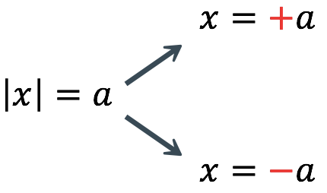
Proof by Case
Prove that for all $x∈ℝ$,
$$−5≤\left|x+2\right|−\left|x−3\right|≤5$$
$$−2$$
$$3$$
Case 1:
$x≤−2$:
$$−5≤−\left(x+2\right)+(x−3) ≤5$$
Case 2:
$−2<x≤3$:
$$−5≤\left(x+2\right)+(x−3) ≤5$$
Case 3:
$$x>3:$$
$$−5≤\left(x+2\right)−(x−3) ≤5$$
For any real number $x$, prove $\left|x−6\right|+x>3$
Notes:
x+2>0
x+2$≤$0
and $⇒$ $x≤−2, −2<x≤3, and x>3$ So, we have 3 cases.
x-3>0
x-3$≤$0
Practice: Case 1: $x≥6$, Case 2: $x<6$.

Slide 20
By Cases and Direct Proof.
If $x or y$ are odd, check if $xy$is odd.
Case 1:
$$x=2k+1$$
$$y=2j+1$$
Case 2:
$$x=2k$$
$$y=2j+1$$
Case 3:
$$x=2k+1$$
$$y=2j$$
Notes:
Case 1 holds the case; and Case 2 and Case 3 do not hold the case.

Slide 21
Tips for proof by Cases

Slide 22
Proof by Case
If $n$ is an integer, prove that $n^{3}−n$ is even.
If $n$ is an integer, prove $n≤n^{2}$.
If $n∈ℤ$, prove $n^{2}+3n+2$ is even.
Show that if an integer $n$ is not divisible by $3$, then $n^{2}=3k+1$ for some integer $k$.
If $n∈ℤ$, prove $n^{2}+3n+5$ is an odd integer.
If $x$ is a real number such that $\frac{x^{2}−1}{x+2}>0$, then either $x>1$ or $−2<x<−1$.
Notes:
Solution for the 2nd question: 3 cases: $Case 1: n≤−1, Case 2: n=0, Case 3: n≥1$
Solution for the 4th question: not divisible by 3, has 2 cases: $Case 1: 3n+1, Case 2: 3n+2$
Solution for the last question: There are 4 cases: (create a number line) for
these combination of $x + 1; x−1$, and $x + 2$.

Slide 23
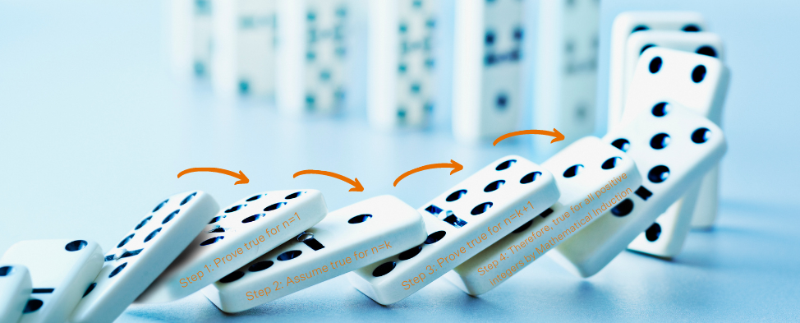
Proof by Induction
Base Case: 1st thing is true.
Inductive Hypothesis: Assume is true $n≤k$.
Show: $k+1$ is true.
Conclusion: Every $n$ is true.

Slide 24
How Mathematical Induction Works
Consider an infinite sequence of dominoes, labeled $1,2,3, …,$where each domino is standing.
Let $P(n)$ be the proposition that the $nth$ domino is knocked over. Know that the first domino is knocked down, i.e., $P(1)$ is true. We also know that if whenever the $kth$ domino is knocked over, it knocks over the $\left(k + 1\right)th$domino, i.e, $P(k) → P(k + 1)$ is true for all positive integers $k$.
Hence, all dominos are knocked over. $P(n)$ is true for all positive integers n.
Climbing an Infinite Ladder
BASIS STEP: we can reach rung 1.
INDUCTIVE STEP: Assume the inductive hypothesis that we can reach rung $k$. Then we can reach rung $k + 1$.
Hence, $P(k) → P(k + 1)$is true for all positive integers $k$. We can reach every rung on the ladder.

Slide 25
Why Base Case?
Recursive functions are functions that calls itself. It is always made up of 2 portions, the base case and the recursive case. The base case is the condition to stop the recursion. The recursive case is the part where the function calls on itself.
The base case is a way to return without making a recursive call. In other words, it is the mechanism that stops this process of ever more recursive calls and an ever-growing stack of function calls waiting on the return of other function calls.
If a recursion never reaches a base case, it will go on making recursive calls forever and the program will never terminate. This is known as infinite recursion, and it is generally not considered a good idea. In most programming environments, a program with an infinite recursion will not really run forever.

Slide 26
Proof by Induction
$$1+2+…+k+(k+1)=\frac{(k+1)(k+2)}{2}$$
Show $1+2+…+n=\frac{n(n+1)}{2}$
$$\frac{k(k+1)}{2}+\left(k+1\right)=\frac{(k+1)(k+2)}{2}$$
Base Case: Assume n = 1.
$$1=\frac{1(1+1)}{2}$$
$$\frac{k\left(k+1\right)+2(k+1)}{2}=\frac{k^{2}+3k+2}{2}$$
Inductive Hypothesis: Assume $n≤k$ is true.
$$1+2+…+k=\frac{k(k+1)}{2}$$
$$\frac{k^{2}+k+2k+2}{2}=\frac{k^{2}+3k+2}{2}$$
Show $k+1$ is true.
$$\frac{k^{2}+3k+2}{2}=\frac{k^{2}+3k+2}{2}$$
$k⟹k+1$ is true, inductively proved.

Slide 27
Proof by Induction
Prove that $n^{3}+2n$ is divisible by $3$ $∀n∈ℤ^{+}$
Base: Assume n = 1.
$${(k+1)}^{3}+2\left(k+1\right)=k^{3}+3k^{2}+3k+1+2k+2$$
$$1^{3}+2×1=3$$
$$\frac{3}{3}$$
$$=k^{3}+3k^{2}+5k+3$$
I.H: Assume n = k is true.
$$=k^{3}+2k+3k^{2}+3k+3$$
$$divisible by 3$$
$$=$$
$$3|{(k}^{3}+2k)$$
$$=3m+3(k^{2}+k+1)$$
$$3m=k^{3}+2k, m∈ℤ^{+}$$
$$=3(m+k^{2}+k+1)$$
Show $n=k+1$ is true.
$$∈ℤ$$
$$3|n^{3}+2n, ∀n∈ℤ$$
$$3|{(k+1)}^{3}+2(k+1)$$

Slide 28
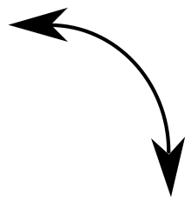
Proof by Induction
Prove that $2^{n}<n!$ for $n∈ℤ^{+}$ and $n>3$.
Base: Assume n = 4.
$$n≥4$$
$$2<4$$
$$k+1>2$$
$$(2^{4}=16)<(4!=24)$$
$$k+1≥4$$
I.H: Assume n = k is true.
$$2^{k+1}=2^{k}∙2<k!\left(k+1\right)$$
$$=\left(k+1\right)!$$
$$2^{k}<k!$$
Show $n=k+1$ is true.
$k⟹k+1$ is true, inductively proved.
$2^{n}<n!$ for $n∈ℤ^{+}$ and $n>3$

Slide 29
Proof by Induction with Derivatives
Show that $f\left(x\right)=x^{n}$ implies $f^{′}\left(x\right)=nx^{n−1}$ for all $n≥1$.
Base: Assume n = 1.
$$f\left(x\right)=x$$
$$f^{′}\left(x\right)=1x^{0}=1$$
$$f\left(x\right)=x^{k+1}=x^{k}x$$
I.H: Assume n = k is true.
$$f^{′}(x)=kx^{k−1}x+x^{k}⋅1$$
$$f\left(x\right)=x^{k}$$
$$f^{′}\left(x\right)=kx^{k−1}$$
$$=kx^{k}+x^{k}$$
Show $n=k+1$ is true.
$$=x^{k}(k+1)$$
Notes:
Derivative’s product rule used to prove

Slide 30
Proof by Induction with Matrices
Show that $A=\left[\begin{matrix}a & 0 \\ 0 & b\end{matrix}\right]$ implies $A^{n}=\left[\begin{matrix}a^{n} & 0 \\ 0 & b^{n}\end{matrix}\right]$ for all $n≥1$.
Base: Assume n = 1.
$$A^{k+1}=A^{k}A=\left[\begin{matrix}a^{k} & 0 \\ 0 & b^{k}\end{matrix}\right]\left[\begin{matrix}a & 0 \\ 0 & b\end{matrix}\right]$$
$$A^{1}=\left[\begin{matrix}a & 0 \\ 0 & b\end{matrix}\right]=\left[\begin{matrix}a^{1} & 0 \\ 0 & b^{1}\end{matrix}\right]$$
I.H: Assume n = k is true.
$$=\left[\begin{matrix}a^{k}a+0⋅0 & a^{k}⋅0+0⋅b^{k} \\ 0⋅a+b^{k}⋅0 & 0⋅0+b^{k}b\end{matrix}\right]$$
$$A^{k}=\left[\begin{matrix}a^{k} & 0 \\ 0 & b^{k}\end{matrix}\right]$$
$$=\left[\begin{matrix}a^{k+1} & 0 \\ 0 & b^{k+1}\end{matrix}\right]$$
Show $n=k+1$ is true.

Slide 31
Proof by Induction
Prove that $\sum_{i=0}^{n}{2i=n\left(n+1\right).}$
Prove that $n^{3}−n$ is divisible by 3 for any integer n ≥ 0.
Prove ${\left[\begin{matrix}a & 1 \\ 0 & a\end{matrix}\right]}^{n}=\left[\begin{matrix}a^{n} & na^{n−1} \\ 0 & a^{n}\end{matrix}\right]$ for every natural number $n.$
Notes:
$(a+b)^{3}=a^{3}+3a^{2}b+3ab^{2}+b^{3}$
I.H. $3m = k^{3}−k$
I.S. ${(k+1)}^{3}−\left(k+1\right)=k^{3}+3k^{2}+3k+1−k−1=k^{3}+{3k}^{2}+2k→\left(k^{3}−k\right)+3(k^{2}+k)$

Slide 32
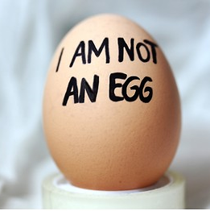
Proof by Contradiction
We want to prove $φ$
Assume $¬φ$
Find some contradiction $ψ∧¬ψ$
Claim $¬¬φ$
$$=φ$$

Slide 33
Proof by Contradiction
$$φ$$
Show that $\sqrt{2}$ is irrational.
Assume $\sqrt{2}$ is rational.
$$\frac{a(even)}{b(even)}$$
$$\sqrt{2}=\frac{a}{b}, where a, b in lowest terms$$
$$not in lowest terms$$
$$2=\frac{a^{2}}{b^{2}}$$
$by contradiction \sqrt{2}$ not rational
$$2b^{2}=a^{2}→a^{2} is even→\left(a∙a\right)even →a is even$$
$$2b^{2}={(2k)}^{2}$$
$$2b^{2}={4k}^{2}$$
$$b^{2}={2k}^{2}→b^{2} is even→b is even$$

Slide 34
Proof by Contradiction
Prove that $\left(A−B\right)∩\left(B−A\right)=∅$.
$$\left(A∩\overline{B}\right)∩\left(B∩\overline{A}\right)=∅$$
Assume $\left(A∩\overline{B}\right)∩\left(B∩\overline{A}\right)≠∅$
$$∃x∈U | x∈((A∩\overline{B})∩(B∩\overline{A}))$$
$x∈A∩\overline{B}$ and $x∈B∩\overline{A}$
$x∈A$and $x∈\overline{B}$ and $x∈B$ and $x∈\overline{A}$
$by contradiction$set is empty $∅$

Slide 35
Proof by Contradiction
Show that at least four of any 22 days must fall on the same day of the week.
$$p=\{at least four of 22 chosen days fall on the same day of the week\}$$
$$¬p is true (not 4, 3 days)$$
if we distribute 3 days to each of the 7 days of the week, that totals to $3×7=21$ days.
This distribution makes sure that no day has more than 3 days assigned to it, ensuring that no four days fall on the same day.
$Total we have 21 days but this contradicts the premise that we have 22 days under consideration.$

Slide 36
Proof by Contradiction
Give a proof by contradiction of the theorem “If 3n + 2 is odd, then n is odd.”
Show that at least ten of any 64 days chosen must fall on the same day of the week.
Show that if you pick three socks from a drawer containing just blue socks and black socks, you must get either a pair of blue socks or a pair of black socks.
Prove that if n is a perfect square, then n + 2 is not a perfect square.
Use a proof by contradiction to prove that the sum of an irrational number and a rational
number is irrational.
Notes:
4. Solution
a) $1, 4, 16, 25, 36, 49…$
$a^{2}+2=b^{2}$
$b^{2}−a^{2}=2$
$b=(a+1)$ only consecutive numbers’ squares have less difference
$(a+1)^{2}−a^{2}=2a+1$ => minimum 3
b) $b^{2}−a^{2}=2$
$\left(b−a\right)\left(b+a\right)=2$
b-a=2, it is impossible to have b+a=1

Slide 38
Practice time

Slide 39
Direct proof
Prove that if m and n are integers and mn is even, then m is even or n is even.
Prove that if x is irrational, then 1/x is irrational.
Prove that if x is rational and x $≠$ 0, then 1/x is rational.
Use a direct proof to show that the product of two rational numbers is rational.
Prove that if n is a positive integer, then n is even if and only if 7n + 4 is even.
Prove that if n is a positive integer, then n is odd if and only if 5n + 6 is odd.

Slide 40
Proof by Cases
Prove that if n is an integer, then $3n^{2}+n+14$ is even
Prove that if n is an integer, then $2n^{2}+n+1$ is not divisible by 3
$∀x∈ℝ prove if \left|x−3\right|>3 then x^{2}>6x$
Prove that the equation $2x^{2}+y^{2}=14$ has no positive integer solutions.
If $x$ and $y$ are integers and both $x∙y$ and $x+y$ are even, then both $x$ and $y$ are even.
Prove that if $m$ and $n$ are consecutive integers, then the sum $m+n$ is odd.
Let $x, y∈ℤ$, prove that $x$ and $y$ are of the same parity if and only if $x+y$ is even.
Notes:
When n is divided by 3, the possible remainders are 0, 1, 3. So, 3 cases in Q2:
n = 3a+0
n = 3a +1
n = 3a+2
In Q4, check one by one by giving values to $x$and $y$, as $14$is a small number to get easily or check with Modulo 4:
$2x^{2}≡0 (mod 4)$ for any integer $x$
$y^{2}≡0, 1 (mod 4)$ for any integer $y$
The sum ${2x}^{2}+y^{2}≡0, 1 (mod 4)$ for all $x, y$.
Since, $14≡2 (mod 4)$, it is impossible for the sum ${2x}^{2}+y^{2}=14 \left(mod 4\right). This implies that there are no positive integer solutions to 2x^{2}+y^{2}=14$.
Parity - the fact of being even or odd.

Slide 41
Proof by Induction
Prove that:
$$1+3+5+…+\left(2n−1\right)=n^{2}$$
Prove that:
$$1+4+9+…+n^{2}=\frac{n(n+1)(2n+1)}{6}$$
Prove that $9^{n}+3$ is divisible by $4$.
Suppose $a_{0}=1$, $a_{1}=2$ and for every $n>1$, $a_{n}=3a_{n−1}−2a_{n−2}$. Find a simple formula for the value of $a_{n}$and prove that it is correct.
Prove that any $n≥8$ can be expressed as $3x+5y$where $x≥0$ and $0≤y<3$.
Notes:
Q4:
a[0]=1, a[1]=2, -> a[2]=4, a[3]=8, a[4]=16, a[5]=32, …
Simple formula: a[n]=2$∙$a[n-1]
B.C: n=1: a[1]=2$∙$1=2
I.H: n=k: a[k] = 2$∙$a[k-1]
I.S: n = k+1: a[k+1]=$2∙a[k+1−1]$
a[k+1]=2$∙$a[k] => 2$∙$(2$∙$a[k-1])

Slide 42
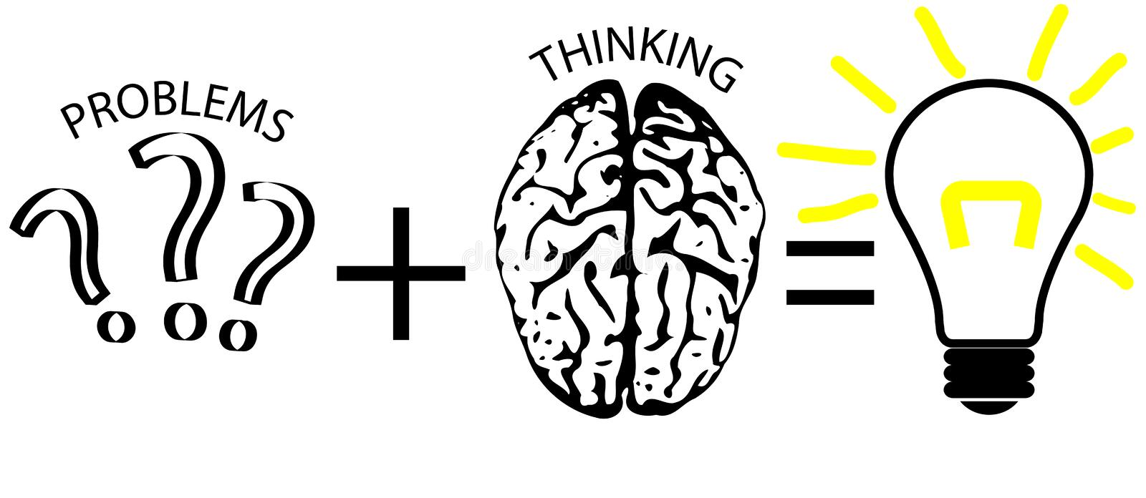
Proof by Contradiction
Suppose $n ∈ Z.$If $n^{2}$ is odd, then n is odd.
If $a,b ∈ Z,$then $a^{2}−4b−2≠0$
If $a,b ∈ Z,$then $a^{2}−4b−3≠0$
If A and B are sets, then $A ∩(B − A) = ∅ .$
There exist no integers a and b for which $21a+30b = 1.$
There exist no integers a and b for which $18a+6b = 1.$
For every $n ∈ Z,$4$∤(n^{2}+2)$
Show that if n is an integer and $n^{3}+ 5$ is odd, then n is even.
Notes:
Solution
If $a,b ∈ Z,$then $a^{2}−4b−2≠0$
$a^{2}−4b−2=0$
$a^{2}=4b+2$
$a^{2}=2(2b+1)$
$(2m)^{2}=2(2b+1)$
$2m^{2}=2b+1$
By contradiction, an even number cannot equal an odd number.
5. Solution
Suppose, for proof by contradiction, that there do exist integers a and b for which 21a + 30b = 1. This is 3(7a+10b) = 1, which, since 7a+10b ∈ Z, shows 1 is divisible by 3 (by the definition of divides). But 3|1, implies 1 ≥ 3 which contradicts 1 < 3 and completes the proof.
7. Solution
For every $n ∈ Z,$4$∤(n^{2}+2)$: solution
$n^{2}+2=4k$ $→ n^{2}=4k−2$
Case 1: n is even
$(2m)^{2}=4k−2$
${4m}^{2}=4k−2$ $(÷2)$
$2m^{2}=2k−1$
By contradiction, an even number cannot equal an odd number.
Case 2: n is odd
$(2m+1)^{2}=4k−2$
${4m}^{2}+4m+1=4k−2$
$4m^{2}+4m=4k−3$ $(+1−1)$
$2\left(2m^{2}+2m\right)=2\left(2k−2\right)+1$
By contradiction, an even number cannot equal an odd number.
As both cases have a contradiction, the original supposition is false, and $n^{2}+2$ is not divisible by $4$.

Slide 43
Study Tip

